Slide 1
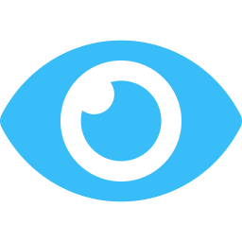
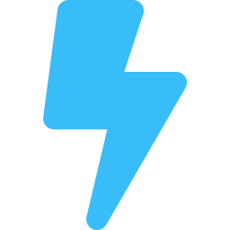

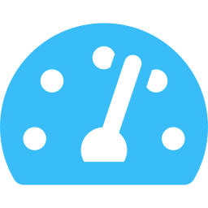
MULESOFT AGENT FABRIC • THE CONTROL PLANE
Agent Fabric as the control plane for every agent
Discover, connect, govern and optimize agents, APIs and MCP tools across the enterprise, regardless of which platform built them.
See
Act
Govern
Optimize
Agent Registry
MCP Bridge
Unified LLM & MCP gateway
AI cost controls
One source of truth for agents, APIs and MCP tools
Existing APIs become agent-ready MCP tools
One policy point across agents, models and tools
Token-based rate limits and spend attribution
Scanners
Agent Broker
Trusted Agent Identity
Intelligent model routing
Auto-discover agents and MCP servers on AWS, Google, Microsoft, Claude, Databricks, Kong
Routes multi-step work across agents and tools, with guided determinism
Acts on a user’s behalf, authorized and auditable
The right model for each task’s needs
LLM Governance
A2A support
Agent Kill Switch
Agent Visualizer
Token usage, cost and data flows for third-party models
Pre-built connectors make agents A2A-compliant
Stops agent activity quickly when needed
See confidence, bottlenecks and risk across the agent network
WORKS ACROSS
Agentforce
Amazon Bedrock & AgentCore
Google Gemini Enterprise Agent Platform
Microsoft Copilot Studio & Foundry
Claude
Databricks
Sources: endnote 21.
23
Notes:
How Agent Fabric covers the control-plane requirements:
Breadth: it governs agents regardless of where they were built. Scanners discover and register agents, MCP servers and APIs from ecosystems including Amazon (Bedrock and AgentCore), Google (Gemini Enterprise Agent Platform, formerly Vertex AI), Microsoft (Copilot Studio, Microsoft Foundry), Claude, Databricks and Kong [21].
Depth: it is built on MuleSoft's integration and API management foundation, so agents can take action in the systems where work happens as well as answer questions.
Enforcement at runtime: policy, identity, rate limits and the kill switch are applied in the gateway path [21].
Economics: token visibility, spend attribution and intelligent routing connect AI spend to business value [21].
Be precise: governance is applied to agent traffic that flows through MuleSoft [21]. The architecture principle is therefore to route every agent-to-model and agent-to-tool call through the fabric. Shadow agents running on endpoints still need endpoint and identity controls. Decoys help find what inventories miss: honeytoken credentials, canary documents and decoy MCP tools that no sanctioned agent should ever touch, so any use flags an agent working outside the governed path. A custom Omni Gateway policy family can plant and watch them [78].
Relationship to Agentforce: Agentforce is an agent platform for building and running agents in Salesforce. Agent Fabric is the control plane that registers, governs, orchestrates and observes all agents and MCP endpoints, including Agentforce. Both use the same engine for defining how agents reason, plan and act [21].
Credit: John Fisher, The AI Control Plane: Executive Briefing (2026), slide 23, licensed under CC BY-NC-ND 4.0: https://creativecommons.org/licenses/by-nc-nd/4.0/. The full deck, with its speaker notes and notices: https://johnfisher-ai.github.io/ai-control-plane-handbook/deck/.
Bracketed numbers in these notes, and endnote numbers on the slide, refer to the endnotes in Appendix B of The AI Control Plane Handbook: https://johnfisher-ai.github.io/ai-control-plane-handbook/handbook/appendix-b.html.

