Slide 1
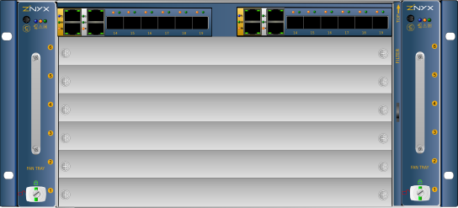
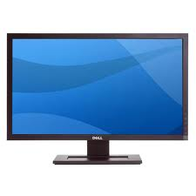
Hardware Layout
Private net
Thermopolis SBC OAControl
Public net
Browser

Slide 2

Data Flow
Browser
SNMP & etc
access to Shelf manager,
switches and SBCs
WebApp
Zenoss
MySQL persistent
configXML
ZenPackPortlet
Apache
chassisXML
snmp
ZenPackDevices
zxchassisdaemon
webserver

