Slide 1
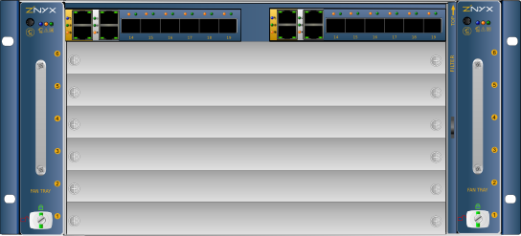
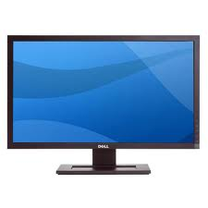
Hardware Layout
Thermopolis SBC
Browser

Slide 2
Software Layout
Browser
WebApp
ZenossZope
zen...
ZenPackDevices
zen...
zen...
zen...py
ZenPackPortlet
chManDaemon

Slide 3
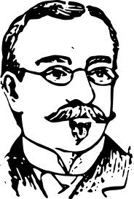
Data Flow
Reality:
SNMP etc
events
dataXML
WebApp
chManDaemon
deviceXML
chassisXML
Zenoss
MySQL persistent
Backup

Slide 4
Temporary Data Flow
Reality:
SNMP etc
Apache
WebApp
chManDaemon
chassisXML
Zenoss
MySQL persistent
Backup

