Slide 1
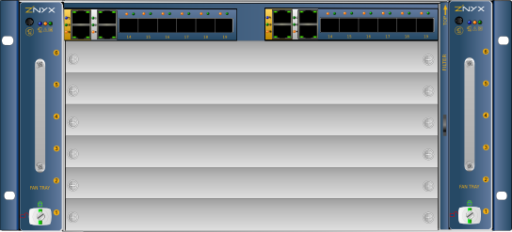
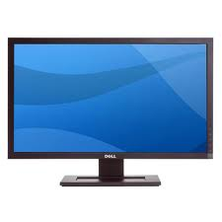
Hardware Layout
Private net
Thermopolis SBC OAControl
Public net
Browser

Slide 2
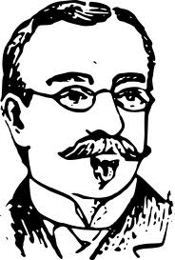
Data Flow
Browser
Reality:
SNMP & etc
WebApp
Zenoss
MySQL persistent
configXML
ZenPackPortlet
Apache
chassisXML
snmp
ZenPackDevices
ZXchassisdaemon
webserver

Slide 3
Temporary Data Flow
Browser
Reality:
SNMP & etc
WebApp
Zenoss
MySQL persistent
configXML
ZenPackPortlet
Apache
chassisXML
snmp
backend.php
ZenPackDevices
ZXchassisdaemon
webserver

