Slide 1
OAControl Demo5
New in Demo5
  Zenoss functionality ( ”back end”)
  Menus connect to Zenoss
  Mstate functionality
  7300 LEDs active
  No more demo menus
  Shelf Manager menu functional
  Prototype logo
  More realistic CLK blink

Slide 2
OAControl Demo5
Not done yet:
  Rear view of chassis
  Popup clickable port view
  Replace FTM with new drawing of RJ45s
  Determine if RMCP/IPMI is needed
  Menu for current error conditions

Slide 3
OAControl Demo5
To be done for Show:
  Make rebooting robust on slot4 SBC
  Add traffic cabling and scripts
  Primitive error checking added
  Add popup port view
  Add error conditions menu/view
  Package demo for reinstallation
  Make duplicate on slot5 SBC or laptop
  Add page refresh to avoid memory leaks

Slide 4
OAControl Demo5
Questions ( for the show demo):
  Zenoss integration adequate?
  Is it robust enough to get through the show?
  What to make active on rear view?
  What about logo?
  Comments, tasks?

Slide 5
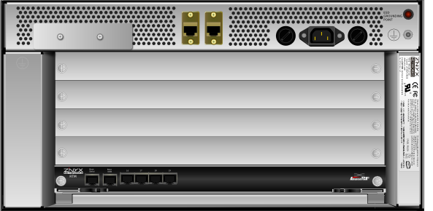
OAControl Demo5
What about rear view?

Slide 6
OAControl Demo5
Need ( for the show demo):
  Svg- ZX1900FTM ( ZX1900B) with RJ45s
  Organize users, shipping etc
  Which chassis goes to show?
  Some help figuring out cabling/networking
  SBO duties vs Fremont for demo?

Slide 7
OAControl Demo5
After the show:
  Change from PHP/Apache to Python/Zope
  Robust error checking for javascript
  New features
  Packaging for release ( make a Beta )
  Documentation

