Slide 1
Multi-Output Physics-Informed Neural Networks for Forward and Inverse PDE Problems with Uncertainties
Mingyuan Yang John T. Foster

Slide 2
Physics Informed Neural Networks
PINNs
Introduced in (Raissi, Perdikaris, and Karniadakis 2019) as a general method for solving partial differential equations.
Already recieved >5900 citations since posting on arXiv in 2018!

Slide 3
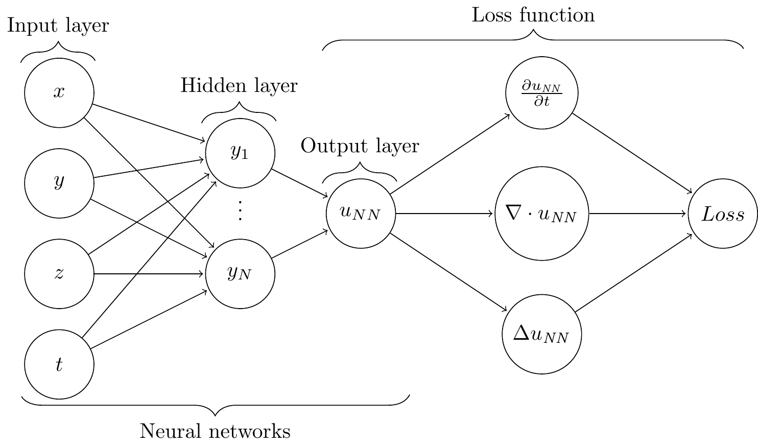
Generic PINN architecture

Slide 4
Loss function for generic PINN system
$$\begin{matrix}r_{d}\left(u_{NN},f_{NN}\right) & =Lu_{NN}−f_{NN}, x∈Ω \\ r_{e}\left(u_{NN}\right) & =u_{NN}−h, x∈∂Ω_{h} \\ r_{n}\left(u_{NN}\right) & =\frac{∂u_{NN}}{∂x}−g, x∈∂Ω_{g} \\ r_{u}\left(u_{NN}\right) & =u_{NN}\left(x_{i}^{u}\right)−u_{m}\left(x_{i}^{u}\right), i=1,2,...,n \\ r_{f}\left(f_{NN}\right) & =f_{NN}\left(x_{i}^{f}\right)−f_{m}\left(x_{i}^{f}\right), i=1,2,...,m\end{matrix}$$
$$\begin{matrix}L_{MSE}=\frac{1}{N}\sum_{i}^{N}{r_{d}^{2}}+\frac{1}{N_{e}}\sum_{i=1}^{N_{e}}{r_{e}^{2}}+\frac{1}{N_{n}}\sum_{i=1}^{N_{n}}{r_{n}^{2}}+\frac{1}{n}\sum_{i=1}^{n}{r_{u}^{2}}+\frac{1}{m}\sum_{i=1}^{m}{r_{f}^{2}}\end{matrix}$$

Slide 5
Extensions of PINNs for UQ
B-PINNs (L. Yang, Meng, and Karniadakis 2021)
E-PINN (Jiang et al. 2022)

Slide 6
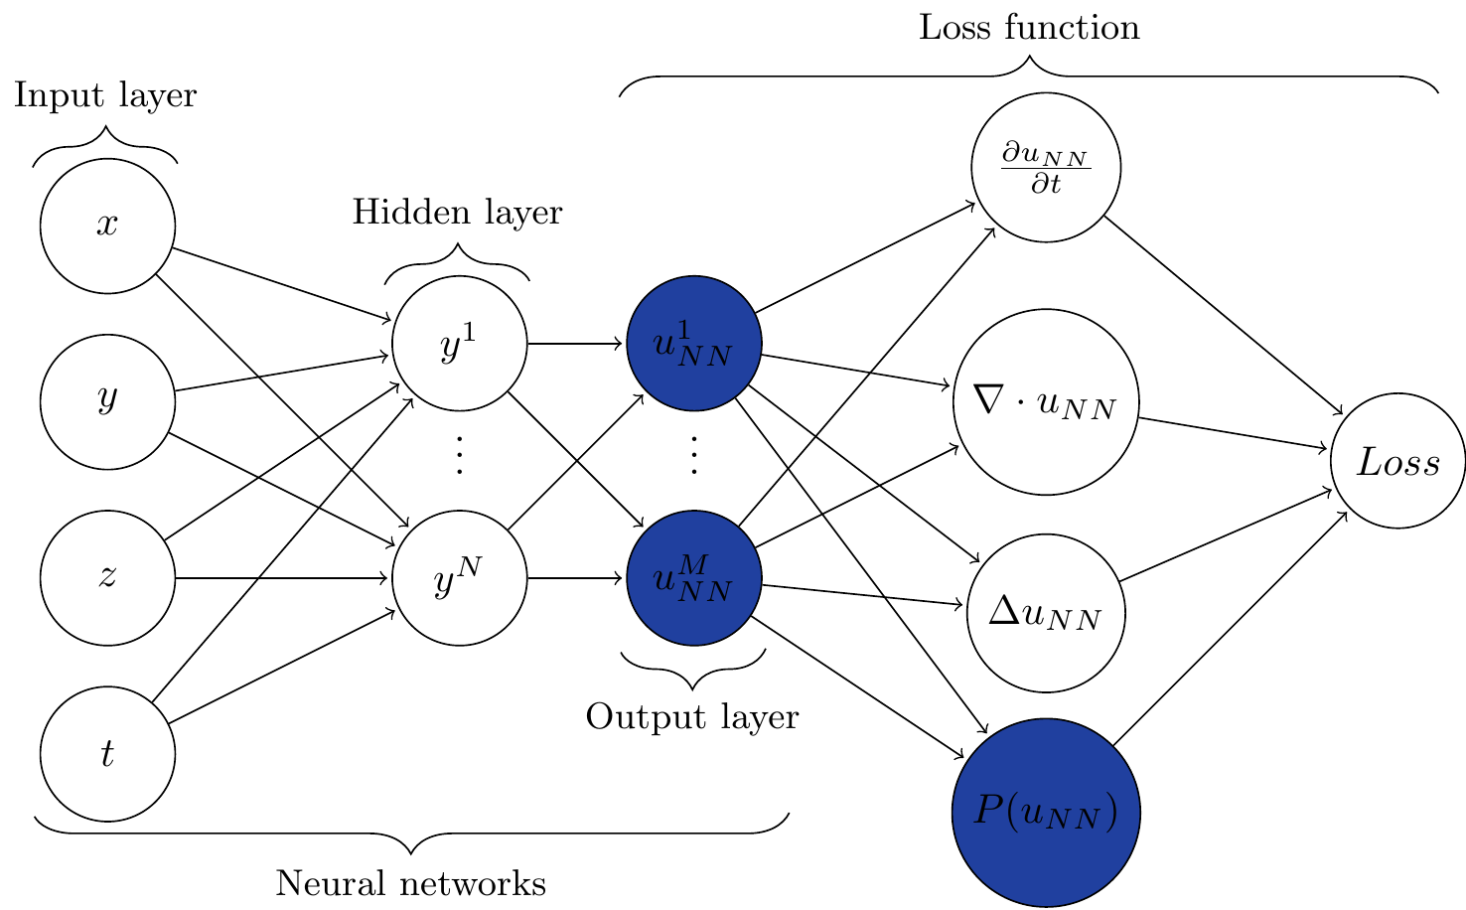
Multi-Output PINN
MO-PINN (M. Yang and Foster 2022)

Slide 7
Loss function for generic MO-PINN system
$$\begin{matrix}r_{d}\left(u_{NN}^{j},f_{NN}^{j}\right) & =Lu_{NN}^{j}−f_{NN}^{j}, x∈Ω \\ r_{e}\left(u_{NN}^{j}\right) & =u_{NN}^{j}−h, x∈∂Ω_{h} \\ r_{n}\left(u_{NN}^{j}\right) & =\frac{∂u_{NN}^{j}}{∂x}−g, x∈∂Ω_{g} \\ r_{um}\left(u_{NN}^{j}\right) & =u_{NN}^{j}\left(x_{i}^{u}\right)−\left(u_{m}\left(x_{i}^{u}\right)+σ_{u}^{j}\right), i=1,2,...,n \\ r_{fm}\left(f_{NN}^{j}\right) & =f_{NN}^{j}\left(x_{i}^{f}\right)−\left(f_{m}\left(x_{i}^{f}\right)+σ_{f}^{j}\right), i=1,2,...,m \end{matrix}$$
$$\begin{matrix}L_{MSE}=\frac{1}{M}\sum_{j=1}^{M}{\left(\frac{1}{N}\sum_{i}^{N}{r_{d}^{2}}+\frac{1}{N_{e}}\sum_{i=1}^{N_{e}}{r_{e}^{2}}+\frac{1}{N_{n}}\sum_{i=1}^{N_{n}}{r_{n}^{2}}+\frac{1}{n}\sum_{i=1}^{n}{r_{um}^{2}}+\frac{1}{m}\sum_{i=1}^{m}{r_{fm}^{2}}\right)}\end{matrix}$$

Slide 8
Forward PDE problems

Slide 9
One-dimensional linear Poisson equation
$$\begin{matrix}λ\frac{∂^{2}u}{∂x^{2}}=f, x∈\left[−0.7,0.7\right]\end{matrix}$$
where $λ=0.01$ and $u=\sin^{3}\left(6x\right)$

Slide 10
Network architecture and hyperparameters
2 neural networks: $u_{NN}$ and $f_{NN}$
2 hidden layers with 20 and 40 neurons each
$tanh$ activation function
ADAM optimizer
${10}^{−3}$ learning rate
Xavier normalization
10000 epochs
500 outputs

Slide 11
Predictions w/ $σ=0.01$ noise on measurements

Slide 12
Predictions w/ $σ=0.1$ noise on measurements

Slide 13
Sensitivity to random network parameter initialization
$σ=0.1$ noise

Slide 14
Sensitivity to measurement sampling
$σ=0.1$ noise

Slide 15
One-dimensional nonlinear Poisson equation
$$\begin{matrix}λ\frac{∂^{2}u}{∂x^{2}}+ktanh\left(u\right)=f, x∈\left[−0.7,0.7\right]\end{matrix}$$
where $λ=0.01,k=0.7$ and $u=\sin^{3}\left(6x\right)$

Slide 16
Predictions w/ $σ=0.01$ noise on measurements

Slide 17
Predictions w/ $σ=0.1$ noise on measurements

Slide 18
Two-dimensional nonlinear Allen-Cahn equation
$$\begin{matrix}λ\left(\frac{∂^{2}u}{∂x^{2}}+\frac{∂^{2}u}{∂y^{2}}\right)+u\left(u^{2}−1\right)=f, x,y∈\left[−1,1\right]\end{matrix}$$
where $λ=0.01$ and $u=sin\left(πx\right)sin\left(πy\right)$

Slide 19
Network architecture and hyperparameters
2 neural networks: $u_{NN}$ and $f_{NN}$
3 hidden layers with 200 neurons each
$tanh$ activation function
ADAM optimizer
${10}^{−3}$ learning rate
Xavier normalization
50000 epochs
2000 outputs

Slide 20
Predictions w/ $σ=0.01$ noise on measurements

Slide 21
Predictions w/ $σ=0.1$ noise on measurements

Slide 22
Inverse Problems

Slide 23
One-dimensional nonlinear Poisson equation
$$\begin{matrix}λ\frac{∂^{2}u}{∂x^{2}}+ktanh\left(u\right)=f, x∈\left[−0.7,0.7\right]\end{matrix}$$
where $λ=0.01$.
$k=\left[???,???,???,…,???\right]$ with $N$ entries corresponding to $N$ outputs of the MO-PINN

Slide 24
Predictions
$u$ and $f$

Slide 25
Inverse Estimates
$k_{exact}=0.7$

Slide 26
Sensitivity of $k_{avg}$ w.r.t number of outputs
$σ=0.1$ noise

Slide 27
Two-dimensional Allen-Cahn Equation
$$\begin{matrix}λ\left(\frac{∂^{2}u}{∂x^{2}}+\frac{∂^{2}u}{∂y^{2}}\right)+u\left(u^{2}−1\right)=f, x,y∈\left[−1,1\right]\end{matrix}$$
where $λ=0.01$ and $u=sin\left(πx\right)sin\left(πy\right)$
$k=\left[???,???,???,…,???\right]$ with $N$ entries corresponding to $N$ outputs of the MO-PINN

Slide 28
Inverse Estimates
$k_{exact}=1.0$

Slide 29
Incorporating prior statistical knowledge

Slide 30
Comparison to Monte Carlo FEM
One-dimensional linear Poisson equation

Slide 31
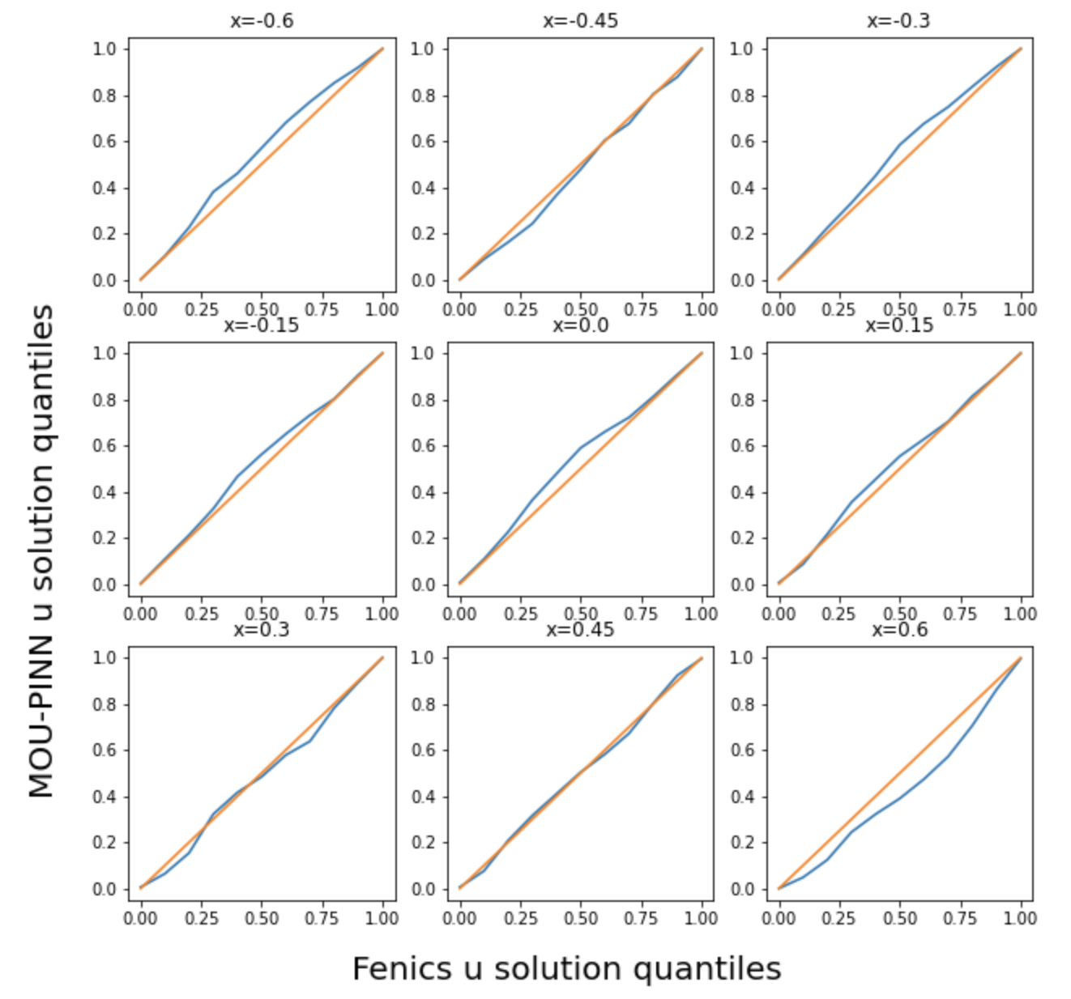
Comparison of distributions
MO-PINN vs. FEA Monte Carlo
Quantile-quantile plot of $u$ at 9 locations

Slide 32
$u$ predictions with only 5 measurements
Using mean and std to enhance learning

Slide 33
$f$ predictions with only 5 measurements
Using mean and std to enhance learning

Slide 34
Conclusions
MO-PINNs appear promising for UQ
MO-PINNs can learn solution, source terms, and parameters simultaneously
MO-PINNs are faster than Monte Carlo forward solutions for the problem studied
Only need to train a single network

Slide 35
References
Jiang, Xinchao, Xin Wanga, Ziming Wena, Enying Li, and Hu Wang. 2022. “An e-PINN Assisted Practical Uncertainty Quantification for Inverse Problems.” arXiv Preprint arXiv:2209.10195.
Raissi, Maziar, Paris Perdikaris, and George E Karniadakis. 2019. “Physics-Informed Neural Networks: A Deep Learning Framework for Solving Forward and Inverse Problems Involving Nonlinear Partial Differential Equations.” Journal of Computational Physics 378: 686–707.
Yang, Liu, Xuhui Meng, and George Em Karniadakis. 2021. “B-PINNs: Bayesian Physics-Informed Neural Networks for Forward and Inverse PDE Problems with Noisy Data.” Journal of Computational Physics 425: 109913.
Yang, M., and J. T. Foster. 2022. “Multi-Output Physics-Informed Neural Networks for Forward and Inverse PDE Problems with Uncertainties.” Computer Methods in Applied Mechanics and Engineering, 115041. https://doi.org/10.1016/j.cma.2022.115041.

