Slide 1

CalendarTAP
The easiest way to add an event.
MARCO GIONFRIDDO
Technologies for Advanced Programming

Slide 2
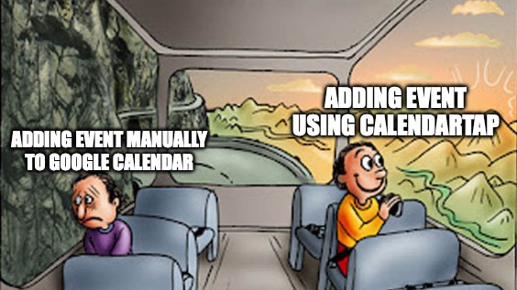

Slide 3
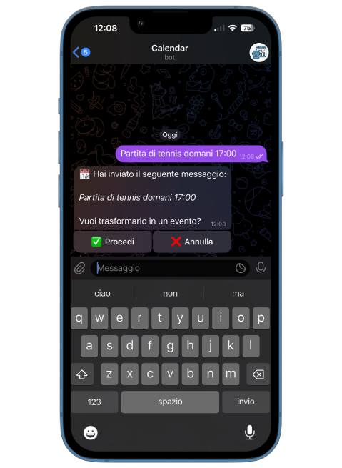
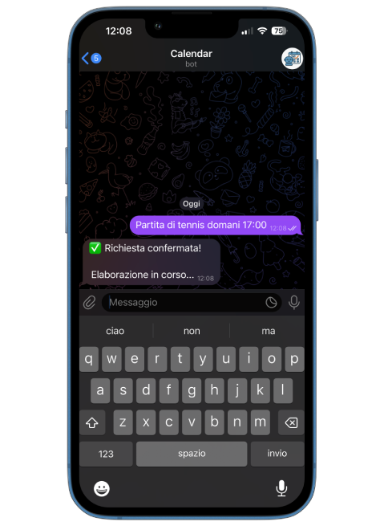

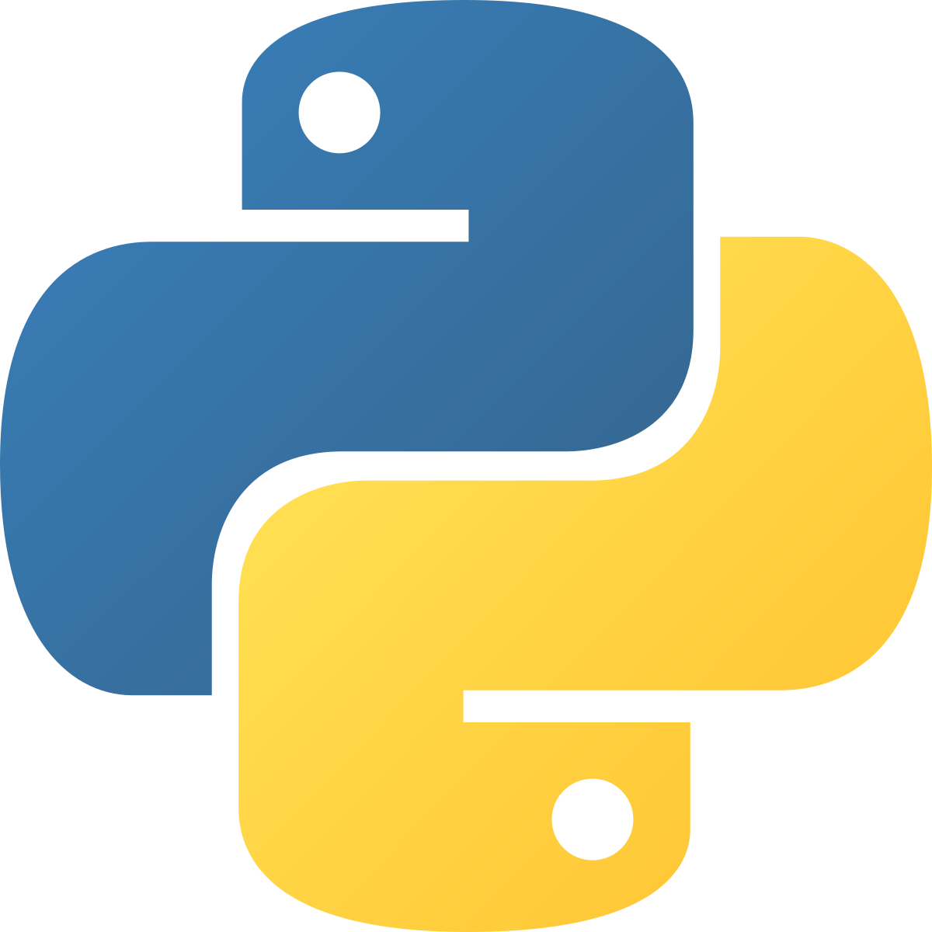
Exploring the Pipeline
2

Slide 4


Exploring the Pipeline
telegram_messages
2

Slide 5
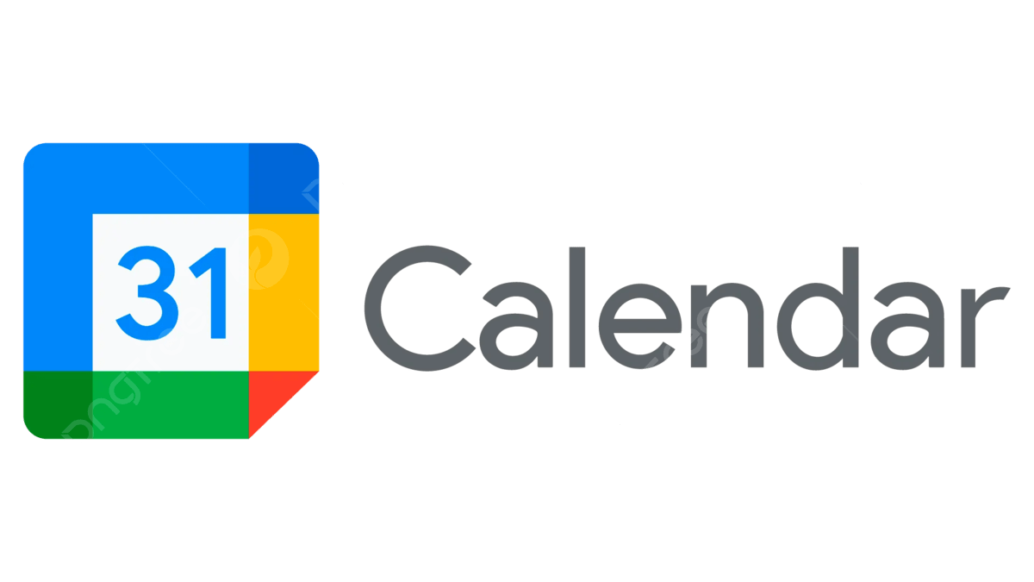

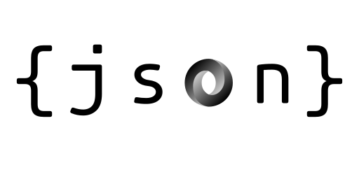
Exploring the Pipeline
2

Slide 6

How to write on Google Calendar
To write on the Google Calendar:
Google Cloud account
New Project
Enable Google Calendar API
Create Service Account
Generate JSON key and download it
Which Calendar to write:
Calendar Sharing
Invite the Assistant
Assign Permissions
2

Slide 7
Exploring the Pipeline
events_for_indexing
telegram_notifications
2

Slide 8



Exploring the Pipeline
events_for_indexing
2

Slide 9
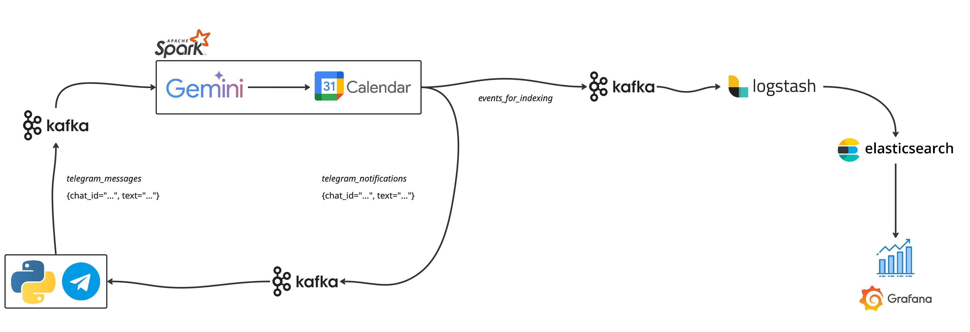
Pipeline
2

Slide 10


Demo
2

Slide 11
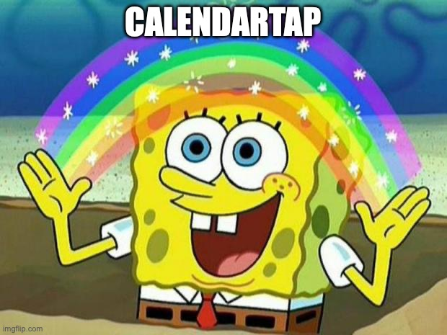
Thanks
MARCO GIONFRIDDO
Technologies for Advanced Programming

