Slide 1
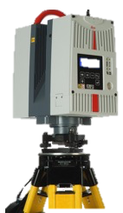


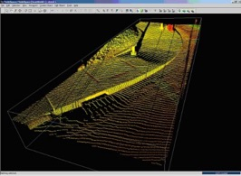
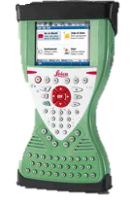

Field data
Point cloud registration
Voxelisation and noise reduction
Foliage
density profiles
Point
clouds
CYCLONE
Target locations
Woody biomass estimation
Linear mixed effects models
DBH, height, species

