Slide 1
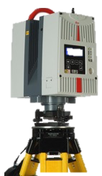


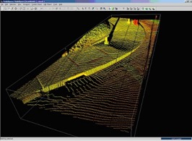
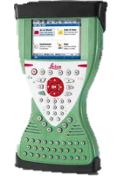

Field data
Point cloud registration
Voxelisation and noise reduction
Canopy structure metrics
Point
clouds
CYCLONE
Target locations
Stand structure metrics
Linear mixed effects models
DBH, height, species

