Slide 1
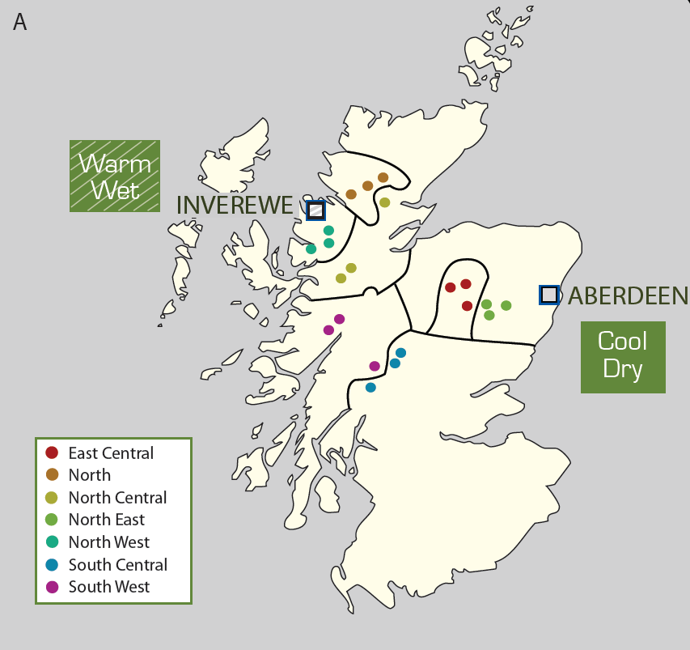
Scots pine common garden experiment (JHI, FR, CEH)
21 origin populations x 8 families
Glensaugh: x 4 replicates(blocks)
Inverewe: x 3 replicates(blocks)
Yair : x 4 replicates (blocks)
INVEREWE
GLENSAUGH
YAIR
YAIR
Warm
Dry
Notes:
Yair is further south than the collection points for all the populations, so can give reason as to why they might be more resistant or better

