Slide 1
BIG MART SALES PREDICTION
K V N SURYA TEJA
A BHAGYARAJU
G TEJESH
G JOHN
Team Lead
Data Inspection & Preprocessing
github.com/Sur2004
Member
Data Analysis & Visualization
github.com/BhagiKarthik
Member
ML Model Development & Comparison
github.com/tejesh-gorajana
Member
Documentation
github.com/johngouri8-sudo
🔗 Common Repository: Sur2004/Big-Mart-Sales-Prediction

Slide 2

PROBLEM STATEMENT & OBJECTIVES
Big Mart wants to understand the factors that affect the sales of its products across different outlets. This project analyzes historical sales data to predict Item_Outlet_Sales using machine learning models.
1
IDENTIFY KEY SALES DRIVERS
Determine which product and outlet features most strongly influence sales performance.
2
BUILD PREDICTIVE MODELS
Train and compare multiple ML regressors — Random Forest, Gradient Boosting, and XGBoost — for accurate sales forecasting.
3
GENERATE BUSINESS INSIGHTS
Translate analysis findings into practical suggestions to improve outlet-level sales and inventory planning.

Slide 3
DATASET OVERVIEW
Column | Type | Description
Item_Identifier | Categorical | Unique product code
Item_Weight | Numerical | Weight of product (avg 12.86)
Item_Fat_Content | Categorical | Low Fat / Regular
Item_Visibility | Numerical | Display area % (avg 0.066)
Item_Type | Categorical | Product category (e.g. Dairy, Meat)
Item_MRP | Numerical | Max retail price (avg 140.99)
Outlet_Identifier | Categorical | Unique outlet code
Outlet_Est._Year | Numerical | Year outlet was set up
Outlet_Size | Categorical | Small / Medium / High
Outlet_Location_Type | Categorical | City tier (Tier 1/2/3)
Outlet_Type | Categorical | Grocery Store / Supermarket
Item_Outlet_Sales | Numerical | Target variable
8,523 ROWS
Each row = one product at one outlet
12 COLUMNS
11 features + 1 target variable , which includes:
5 Numerical columns
7 Categorical columns
TRAIN / TEST SPLIT
80% training (6,818 rows) · 20% testing (1,705 rows)
Target Variable: Item_Outlet_Sales
Avg: 2181.29 · Range: 33.29 – 13086.96

Slide 4
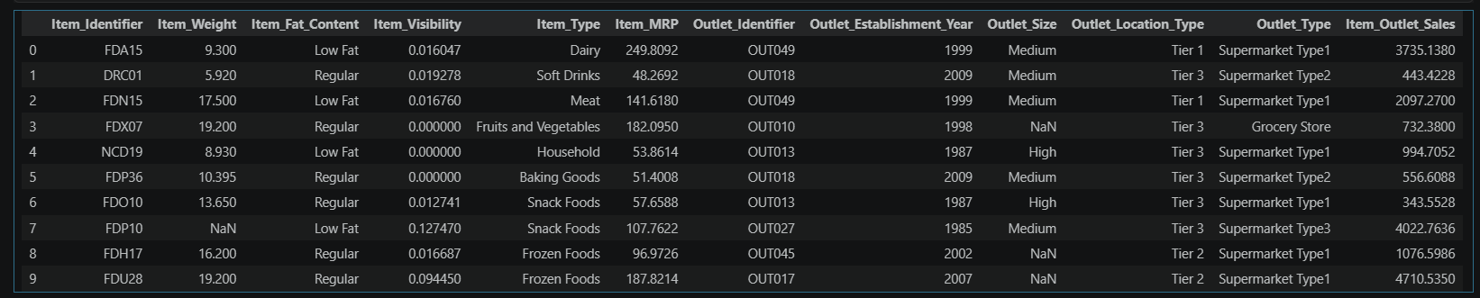
Dataset Values (first 10 rows)

Slide 5
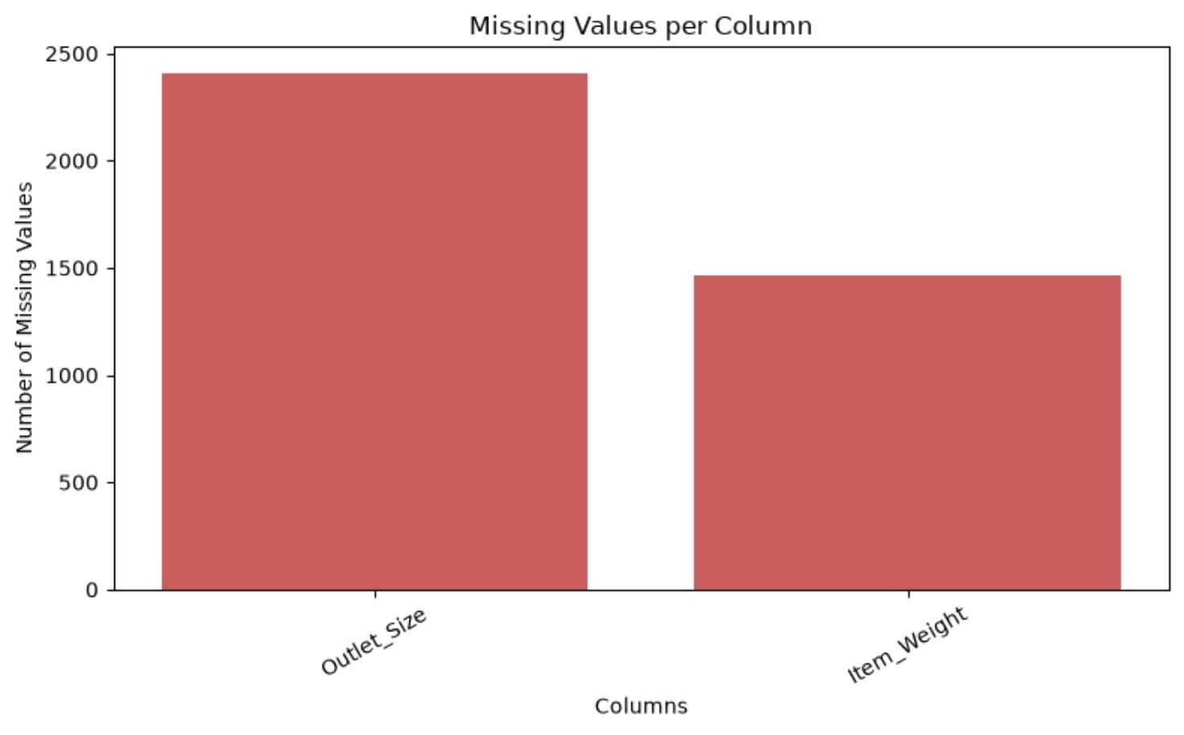
DATA INSPECTION & MISSING VALUES
KEY OBSERVATIONS
ITEM_WEIGHT
1,463 missing values — Numerical column. Filled using the median to avoid skew from outliers.
OUTLET_SIZE
2,410 missing values — Categorical column. Filled using the mode (most frequent category).
NO DUPLICATES
Dataset checked for duplicate rows — none found, so no rows were removed.
RESULT
After treatment, the dataset had zero missing values remaining.

Slide 6

DATA PREPROCESSING WORKFLOW
MISSING VALUES
LABEL FIXES
FEATURE ENG.
ENCODE CATAGORICAL COLUMNS
LOG TRANSFORMATION
MISSING VALUE TREATMENT
LABEL CLEANING
CATEGORICAL ENCODING
Item_Weight → median ·
Outlet_Size → mode
Merged "LF", "low fat" → "Low Fat" for consistency in Item_Fat_Content
Outlet_Identifier → Extracted numeric ID from the actual values;
Outlet_Location_Type → Tier 1/2/3 mapped to 1/2/3
Item_Type, Outlet_Size, Outlet_Type, Item_Fat_Content → LabelEncoder;
FEATURE ENGINEERING
Outlet_Age = 2013 − Outlet_Establishment_Year (age is more meaningful than year)
TRAIN / TEST SPLIT
80% training (6,818 rows) · 20% testing (1,705 rows); same split used for all three models

Slide 7
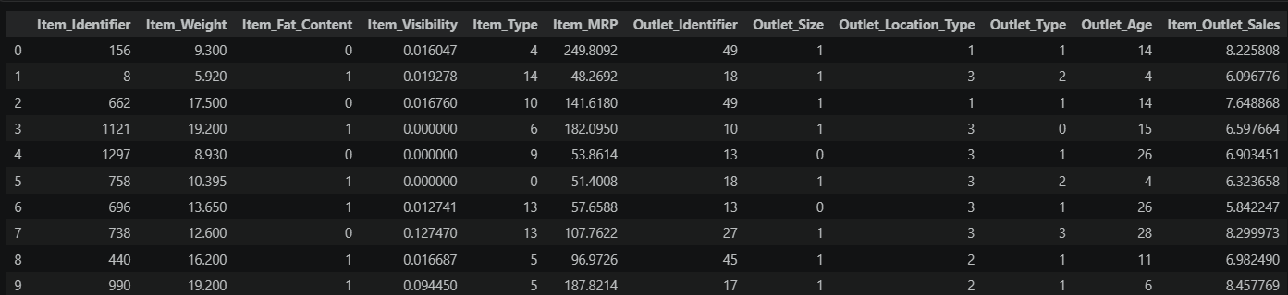
Dataset Values after Preprocessing (first 10 rows)

Slide 8
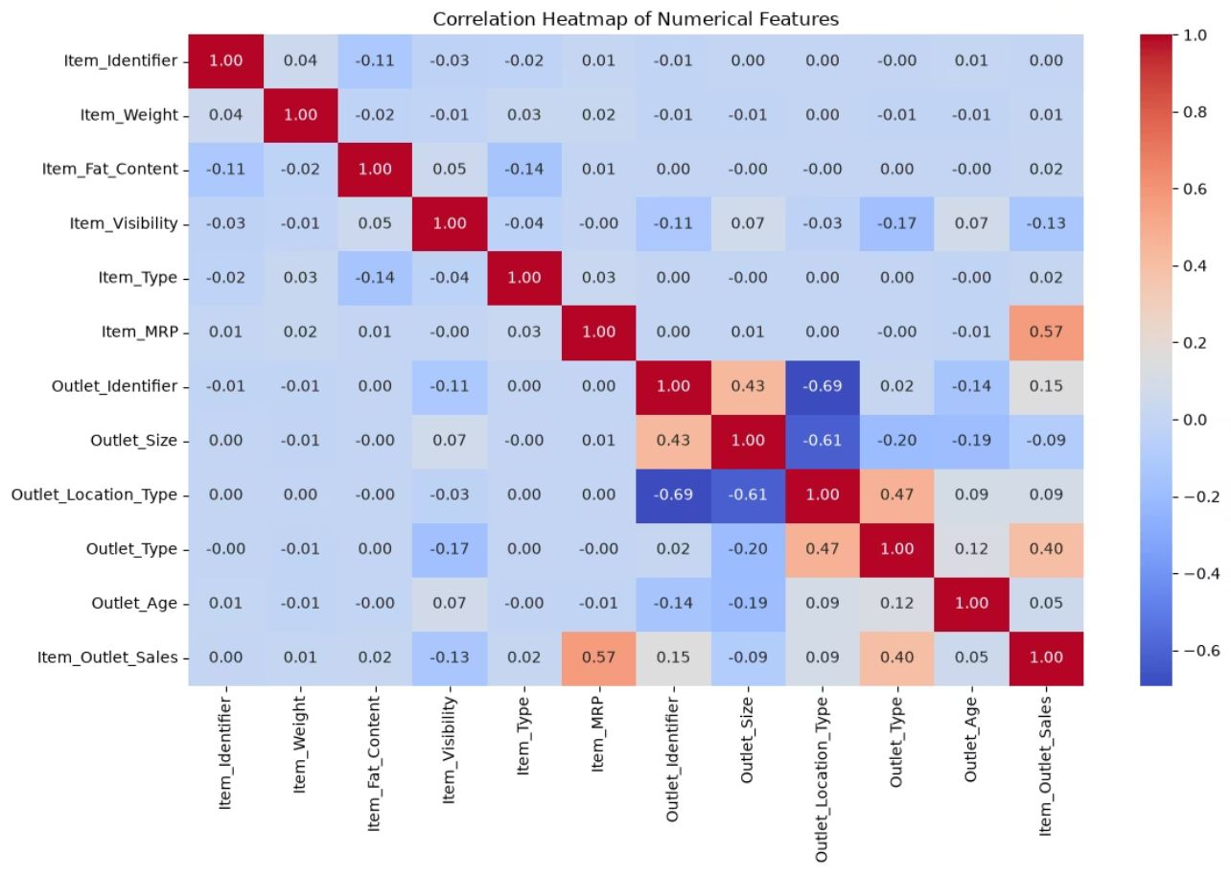

CORRELATION ANALYSIS
KEY INTERPRETATIONS
ITEM_MRP — R ≈ 0.57
Strongest positive correlation with sales. Higher-priced products consistently generate more revenue.
OUTLET_TYPE — R ≈ 0.40
Second strongest predictor. The type of outlet (Grocery vs Supermarket) has a large impact on how much a product sells.
OTHER FEATURES
Item_Visibility, Item_Weight, and Outlet_Age show weaker relationships, indicating price and outlet type dominate sales variation.
Top correlated features — Item_MRP and Outlet_Type — were selected for deeper target-variable analysis.

Slide 9
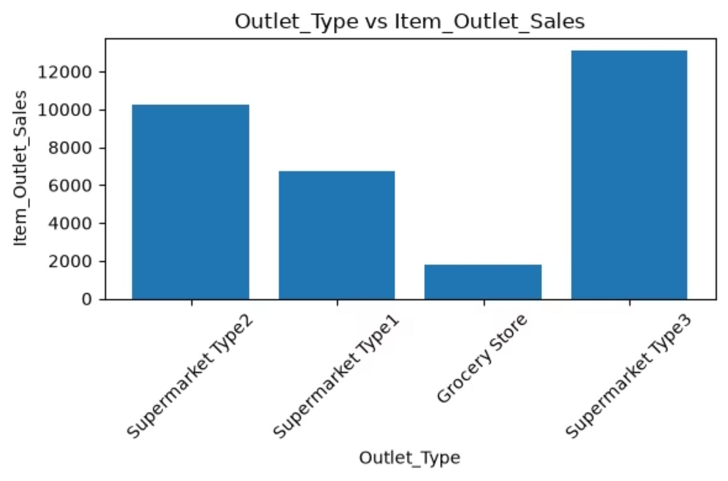
OUTLET TYPE VS ITEM_OUTLET_SALES
KEY FINDINGS
HIGH VARIABILITY ACROSS TYPES
Item_Outlet_Sales vary significantly across different outlet types — outlet type is a major driver of sales performance.
SUPERMARKET TYPE 3 LEADS
Supermarket Type 3 outlets consistently achieve the highest sales, indicating superior inventory, variety, or footfall.
GROCERY STORES UNDERPERFORM
Grocery Stores show the lowest sales overall — a strategic gap that represents an improvement opportunity.

Slide 10
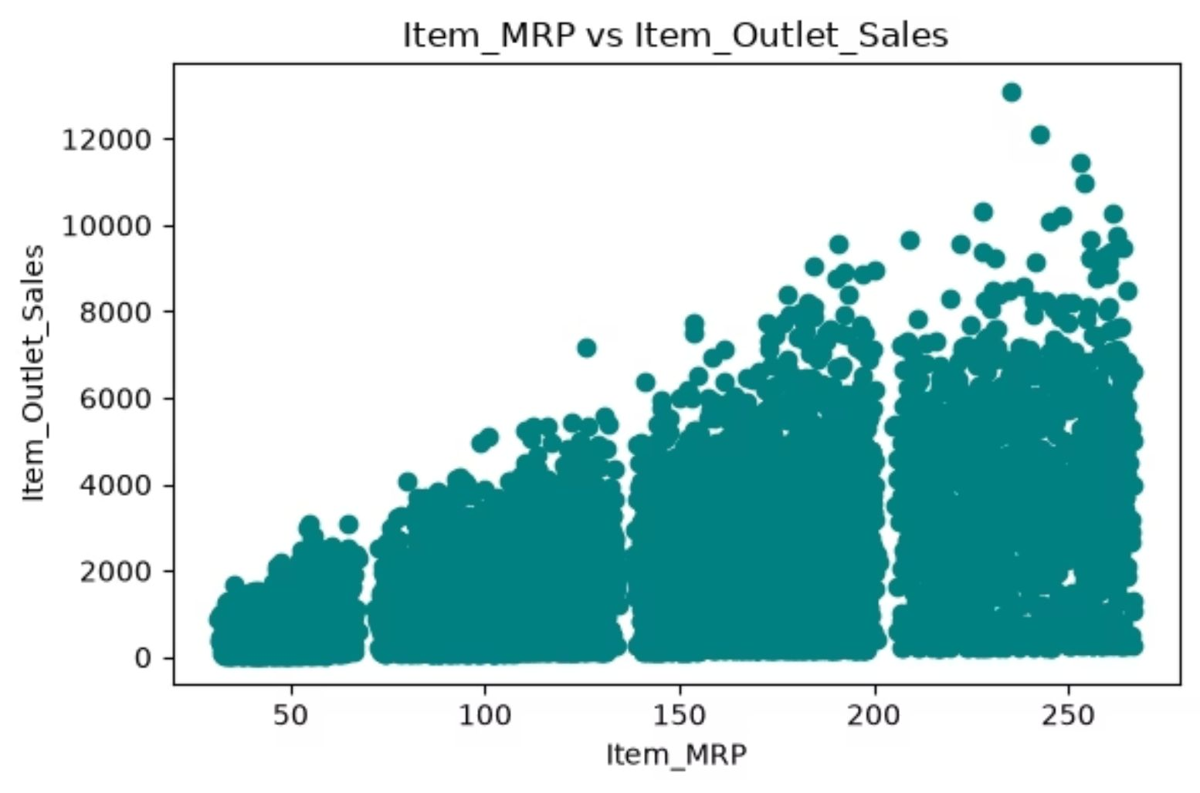
ITEM_MRP VS ITEM_OUTLET_SALES
KEY FINDINGS
STRONG POSITIVE TREND
As Item_MRP increases, Item_Outlet_Sales increase — confirming the r ≈ 0.57 correlation seen in the heatmap.
REVENUE FORMULA
Sales = Quantity × Price. High-MRP products generate more revenue even if fewer units are sold per transaction.
BUSINESS IMPLICATION
Stocking and promoting premium-priced products is a direct lever for increasing total outlet revenue.

Slide 11
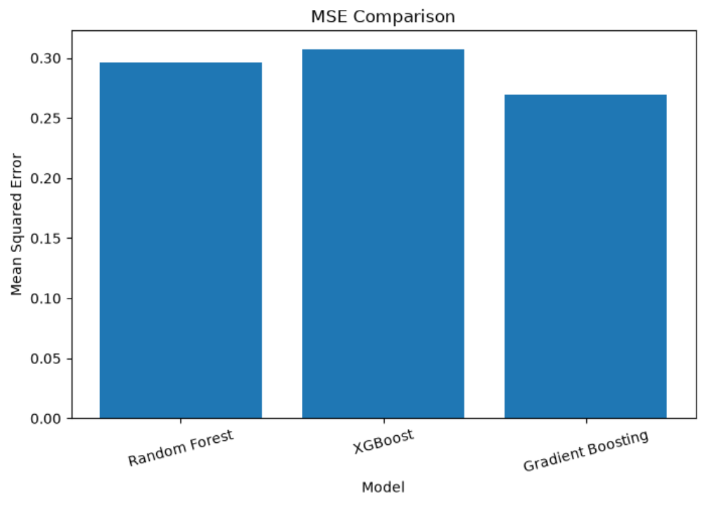
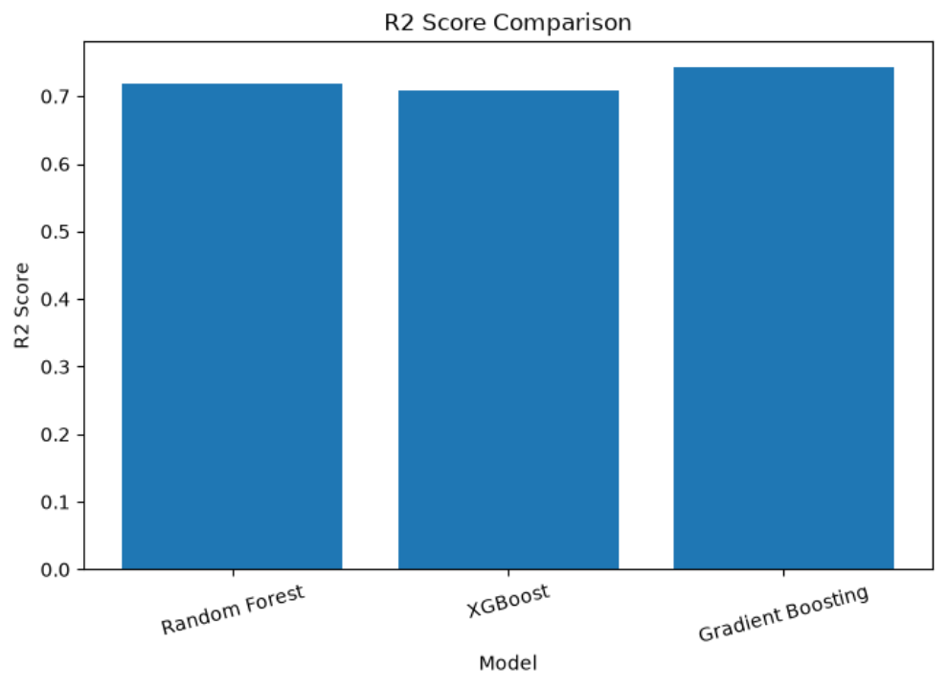
MACHINE LEARNING MODELS
MODEL TRAINING & PERFORMANCE COMPARISON
PERFORMANCE REPORT
KEY INTERPRETATIONS
Model | R² Score | MSE
Random Forest | 0.7182 | 0.2962
XGBoost | 0.7076 | 0.3074
Gradient Boosting | 0.7435 | 0.2697
GRADIENT BOOSTING WINS
Highest R² (0.7435) and lowest MSE (0.2697) — best overall prediction accuracy.
ALL MODELS TRAINED FAIRLY
Same 80/20 train-test split used across all three models for an unbiased comparison.
R² INTERPRETATION
~74% of sales variance is explained by the best model — strong result for retail data.
MSE COMPARISON
R² SCORE COMPARISON

Slide 12

BUSINESS INSIGHTS
SUGGESTIONS TO IMPROVE SALES
PRIORITIZE HIGH-MRP PRODUCTS
IMPROVE ITEM ORGANIZING STRATEGIES
BUNDLE LOW & HIGH VALUE ITEMS
Item_MRP has the strongest correlation to sales (r ≈ 0.57). Keep premium products well-stocked and prominently displayed.
Supermarket Type 3 leads all outlet types. Lower-performing outlets should adopt its inventory depth and product variety.
Pair lower-priced products with higher-value items to boost average basket size and total transaction value.
OPTIMIZE OUTLET INVENTORY
Give more stock and product variety to outlets that show stronger sales.

Slide 13
CONCLUSION
KEY FINDINGS & CONCLUSION
PRODUCT PRICE IS THE #1 DRIVER
Item_MRP shows the strongest positive relationship with sales (correlation ≈ 0.57). Higher-priced products generate significantly more revenue.
MODELS TRAINED
DATASET
Random Forest · XGBoost · Gradient Boosting
8,523 samples · 12 features · Big Mart train.csv
OUTLET TYPE MATTERS
Outlet_Type is the second-strongest predictor (correlation ≈ 0.40). Supermarket Type 3 consistently outperforms other outlet formats.
BEST R² SCORE
0.7435 — Gradient Boosting Regressor
BEST MODEL: GRADIENT BOOSTING
Among all three models, Gradient Boosting Regressor achieved the highest R² score (0.7435) and the lowest MSE (0.2697) — making it the recommended model for sales prediction and inventory planning.

Slide 14
Thank You

