Slide 1
Which method of delay discounting is the best method of measuring impulsive behavior?
John-Henry Pezzuto
Perspectives on Computational Research
April 4, 2018
Notes:
then a little bit of background about what’s going on
Then I am going to tell you how I propose to study it

Slide 2
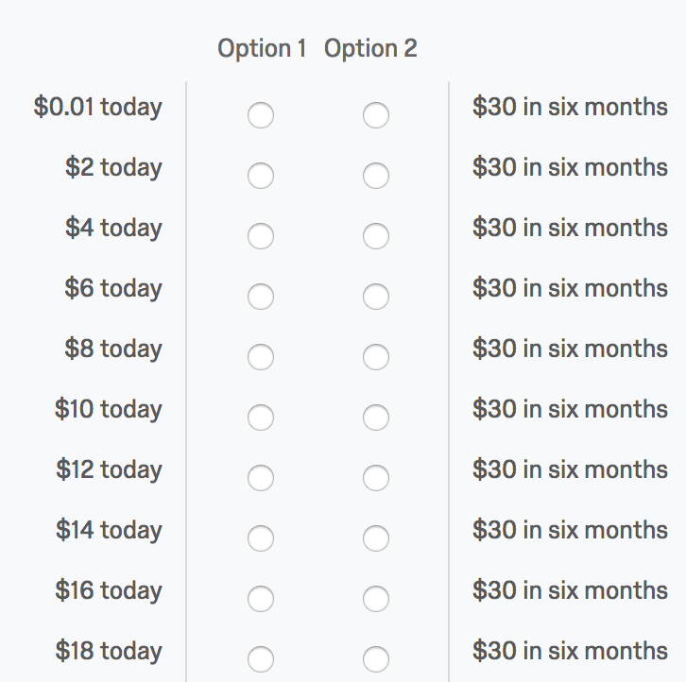
Background
Monetary Delay Discounting is a psychological technique used in measuring patience.
It is solicited by finding an individuals indifference point by asking them series of now or later questions about money
Method 1: Time Discounting
(small, present)
Notes:
Start with my research question,

Slide 3
Background
Monetary Delay Discounting is a psychological technique used in measuring patience.
It is solicited by finding an individuals indifference point by asking them series of now or later questions about money
Method 1: Time Discounting
(small, present)
Notes:
Start with my research question,

Slide 4
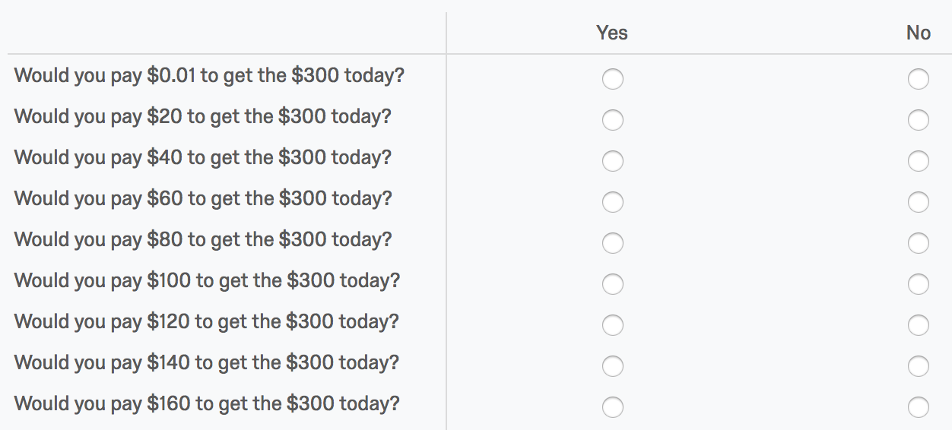
But there are different ways to measure delay discounting. These can also vary across size and time
Method 2: Speedup Method (large, present)
Notes:
Likewise I instead of just giving you the money I can ask you how much you would like to pay. But instead of just thirty

Slide 5
In this study we will measure delay discounting 8 (2x4) different ways
Time Discounting (either or small now or larger later) | Speed Up Method (pay to get money now or wait for full amount later)
Small present | Small present
Large present | Large present
Small future | Small future
Large future | Large future
30 now
300 now
30 in one month
300 in one month
All of these methods involve indifference points that can be standardized and then compared via AUC
x₂- x₁ [(y₁ + y₂)/2], where x1 and x2 are successive delays and y1 and y2 are the indifference points associated with those delays

Slide 6
Which method of the 8 time discounting methods is the best at measuring impulsive behavior?
Previously, delay discounting has been linked to many impulsive and patient behaviors…*
Risky Sexual Behavior (Chesson, 2006)
Debt and poor financial planning (Chabris et al., 2008)
Not finishing prescriptions (Chabris et al., 2008)
Poor dental status (Kang & Ikeda, 2015)
Interest in the political campaigns (Fowler & Kam, 2006)
*Full references available upon request
Notes:
Now you know about delay discount, let’s talk about behavior

Slide 7
The Proposed Study:
A large mTurk survey establishing a rate with all 8 methods AND questions about various categories of impulsive behaviors (n ≈ 600)
Survey will cover substance use, political interest, financial behavior, health behavior, & sexual behavior (approx. 100 questions total)
Already IRB approved & will be paid for by our friends at Chicago Booth
Useful for finding most accurate predictor of behavior for future research or supports the idea that there is no best predictor
Multivariate Regression

Slide 8
Why is this important?
Discounting is useful for summarizing the results of experiments on sensitivity to delayed rewards
Has powerful cross-species, cross-population, as well as intraindividual replicability
If we provide more evidence of that humans either treat the models differently or not, this can be useful for researchers

Slide 9
Predictions
Based on findings from behavioral economics, I think we can expect to see large, present condition willingness to pay will be the best overall predictor
Most discounting research overlooks the question of stakes instead opting to use a standardized questionnaire

Slide 10
Questions

