Slide 1
Cybersecurity Survey Data Analysis
Submitted by: john herald gantuangco

Slide 2
Research questions/hypotheses
Research Question 1: Is there a significant relationship between Multi-Factor Authentication (MFA) and phishing success rates?
Null Hypothesis (H₀): There is no significant relationship between MFA and phishing success rates.
Alternative Hypothesis (H₁): There is a significant relationship between MFA and phishing success rates.
Research Question 2: Do users who employ a password manager have significantly longer passwords than those who do not?
Null Hypothesis (H₀): There is no significant difference in password length between users who use a password manager and those who do not.
Alternative Hypothesis (H₁): Users who use a password manager have significantly longer passwords than those who do not.

Slide 3


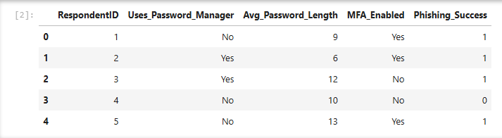
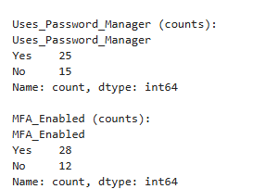
Descriptive stats results.

Slide 4
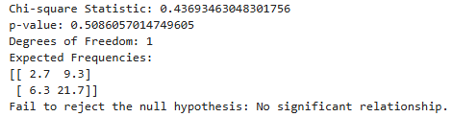
Inferential test results

Slide 5
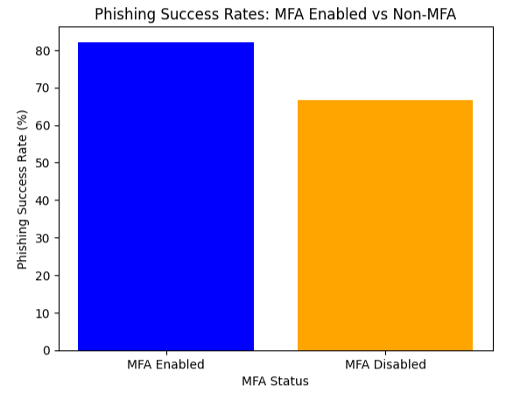
Visualizations

