Slide 1
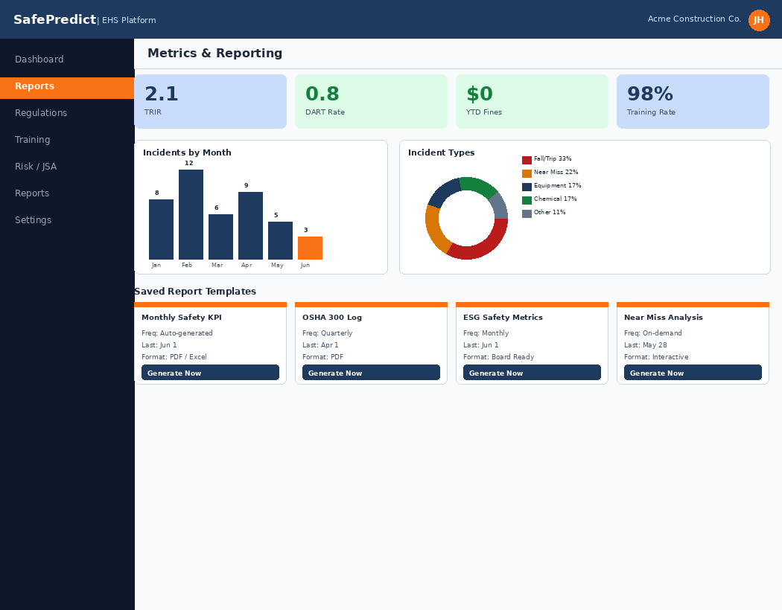
SafePredict
AI-Powered EHS Intelligence
for Construction
Stop managing safety. Start predicting it.
5 AI-powered modules | One integrated safety platform

Slide 2
Your EHS Team Is Doing Too Much Manually
01
02
03
04
05
Incident
Reporting
Regulatory
Tracking
Training
Management
Risk
Assessments
Metrics &
Reporting
Forms take hours.
Data is inconsistent.
Trends go unnoticed.
Rules change constantly.
Gaps are only found
during audits.
Certifications lapse.
Spreadsheets fail.
Gaps grow silently.
JSAs go stale.
Field updates take
hours every time.
Data lives everywhere.
Reports take days
to compile manually.
CHALLENGE
CHALLENGE
CHALLENGE
CHALLENGE
CHALLENGE
SafePredict replaces manual processes with AI — across every one of these areas

Slide 3
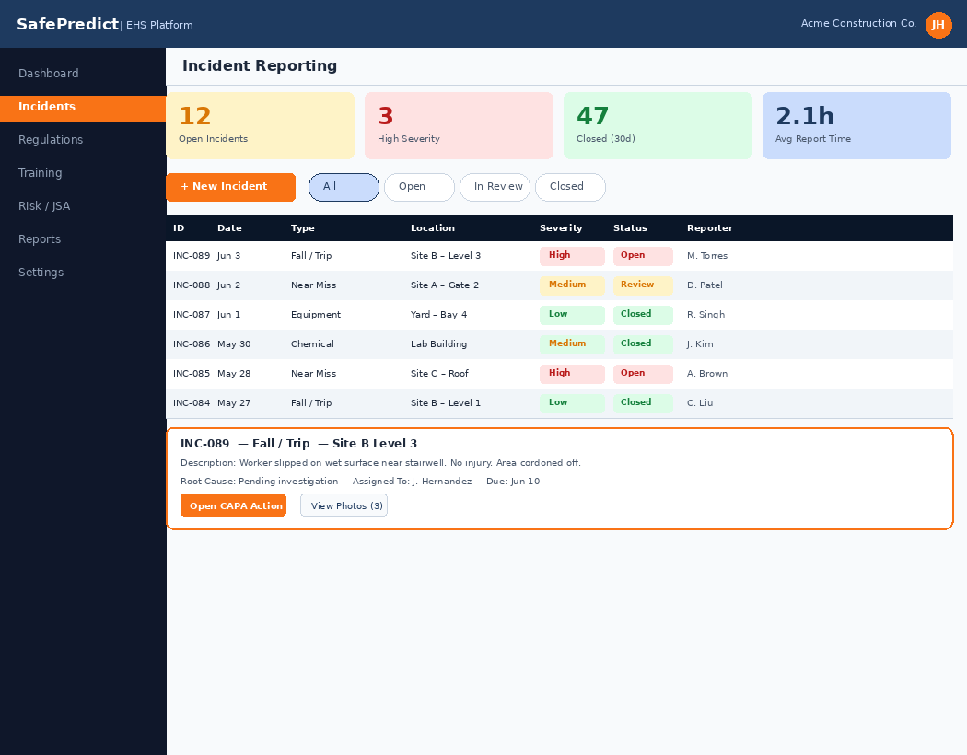
01
Incident Reporting
THE CHALLENGE
SAFEPREDICT IN ACTION
Time-consuming, inconsistent data
Workers spend 2-4 hours per incident report
Paper forms and emails create data gaps
No visibility into patterns or root causes
Near-miss reports often go unsubmitted

Slide 4
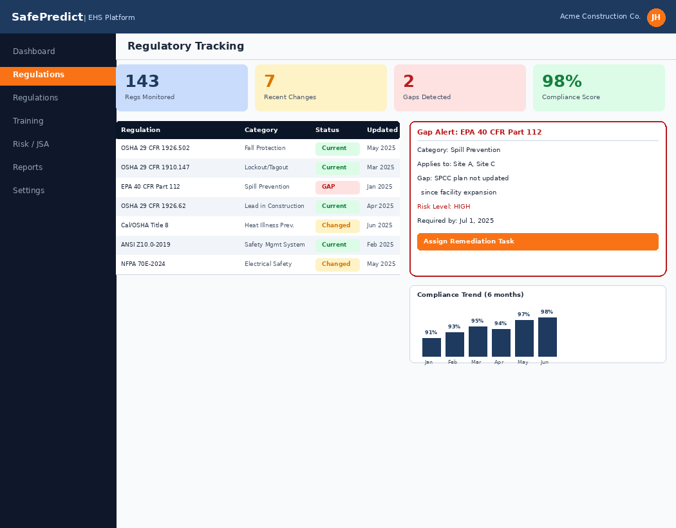
02
Regulatory Tracking
THE CHALLENGE
SAFEPREDICT IN ACTION
Constant changes, hard to monitor
OSHA and state regs update without warning
Compliance gaps found only during audits
No systematic tracking of which regs apply
Legal exposure from missed requirements

Slide 5
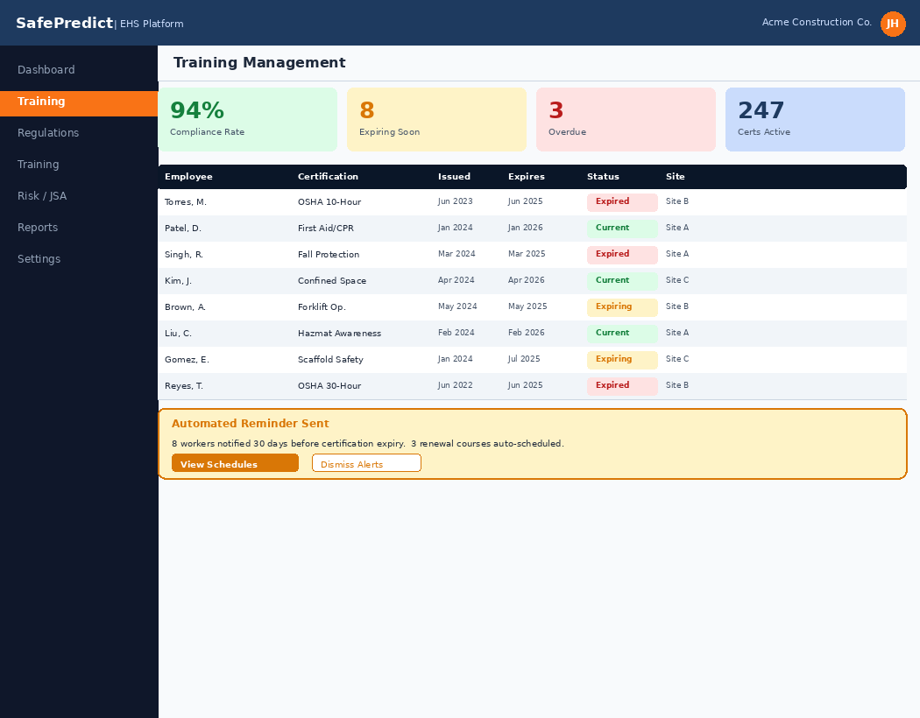
03
Training Management
THE CHALLENGE
SAFEPREDICT IN ACTION
Manual tracking, expiration lapses
Spreadsheets miss certification expiry dates
Admin burden on already-stretched EHS staff
New hire onboarding is inconsistent by site
No single view of team-wide compliance status

Slide 6
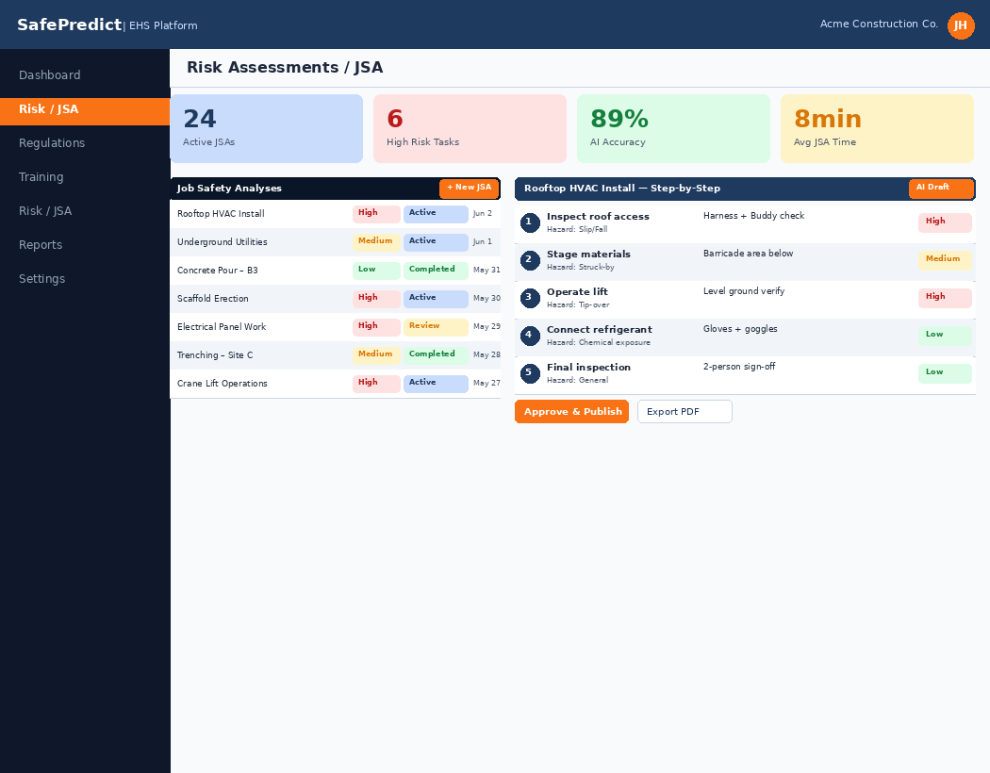
04
Risk Assessments
THE CHALLENGE
SAFEPREDICT IN ACTION
Outdated JSAs, field time required
Job Safety Analyses go stale between projects
Supervisors spend hours drafting new JSAs
Risk ratings are subjective and inconsistent
Hazard data rebuilt from scratch every time

Slide 7
05
Metrics & Reporting
THE CHALLENGE
SAFEPREDICT IN ACTION
Data scattered, manual effort
Safety data lives in spreadsheets and emails
Monthly reports take days to compile
Leadership has no real-time safety visibility
ESG reporting is reactive and ad-hoc

Slide 8
The Impact of AI-Driven Safety
70%
3x
94%
Reduction in incident
reporting time
Faster regulatory
gap identification
Training compliance
rate achieved
Average across first 6 months of deployment
vs. manual review processes
vs. industry average of 71%
"Zero regulatory fines in 18 months"
"Cut JSA creation from 3 hours to 8 minutes"
"Board-ready ESG reports in one click"
"Passed OSHA audit with zero citations"
— EHS Director, Tier-1 GC
— Safety Manager, 500-person crew
— VP of Operations, Industrial GC
— EHS Manager, Infrastructure project
Results from early adopter customers — individual outcomes may vary

Slide 9
Platform at a Glance
01
02
03
04
05
Incident
Reporting
Regulatory
Tracking
Training
Management
Risk
Assessments
Metrics &
Reporting
Auto-drafting,
pattern detection
Reg-change alerts,
gap analysis
Predictive alerts,
auto-assignment
AI templates,
risk scoring
Auto-dashboards,
ESG summaries
AI-POWERED
AI-POWERED
AI-POWERED
AI-POWERED
AI-POWERED
All modules are integrated — data flows across your entire safety program automatically

Slide 10
Why EHS Teams Choose SafePredict
1
2
3
Built for
Construction EHS
AI That
Learns Your Site
Always
Compliance-Ready
Purpose-Built
Adaptive AI
Audit-Proof
Not a generic compliance tool adapted for safety — SafePredict is designed ground-up for construction EHS workflows, terminology, and regulatory requirements.
The platform learns from your incident history, your trades, and your sites — getting smarter and more accurate over time without manual tuning.
Every action creates an automated audit trail. Generate compliance reports, OSHA 300 logs, and ESG summaries in one click — any time, without manual prep.
Matches how field crews and EHS managers actually work
Pre-built for OSHA, EPA, and state-level construction regs
Templates and risk libraries tuned for construction hazards
Pattern detection personalized to your specific operation
Risk scoring improves with every assessment completed
Predictive insights based on your actual workforce and sites
Complete digital documentation of all safety activities
One-click OSHA 300/301 log generation
ESG-ready reporting for board and investor review

Slide 11
Fast to Deploy. Easy to Use.
1
▶
2
▶
3
Week 1–2: Connect & Configure
Week 3–4: Train & Pilot
Month 2+: Full Deployment
Connect existing safety data
Configure site and crew settings
Map regulations to your operations
Admin training (2 hours)
Field crew mobile onboarding
Pilot on first active site
Roll out all 5 modules
Live dashboards operational
Dedicated success manager
Works With Your Existing Stack
Procore
Oracle P6
BambooHR
DocuSign
Autodesk
Most customers are fully operational within 6 weeks — with zero disruption to active projects

Slide 12
Ready to Transform Your EHS Program?
Here's how to get started:
1
Schedule a live platform demo
tailored to your EHS program
"SafePredict cut our incident reporting time by 70% in the first month."
2
Run a free 30-day pilot
on one site or project
— EHS Director,
Tier-1 General Contractor
3
Deploy across your organization
with full onboarding support
safepredict.ai | hello@safepredict.ai | 1-800-SAFE-PRD
SafePredict | Built for Construction. Powered by AI. Ready for Your Team.

