Slide 1


SAFETY360DOCS
The platform, in action
A guided tour of the real product — live dashboards, field workflows, compliance, and the AI engine that forecasts injury risk before it happens.
Presented by Steven Sladky, CSP · Reliance EHS
Real screenshots · Universal overview

Slide 2
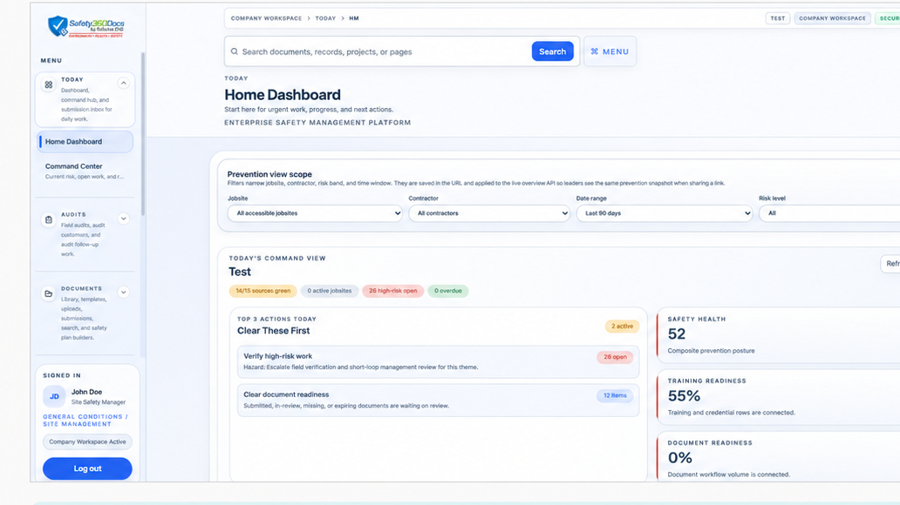



COMMAND CENTER
Your whole operation, one live view
LIVE PRODUCT
Risk, open work, and AI recommendations in a single command center — no more hunting across binders and inboxes.
Live risk score & top hazards
Open issues, permits & JSAs at a glance
AI recommendations for your company
Safety360Docs · by Reliance EHS
2

Slide 3
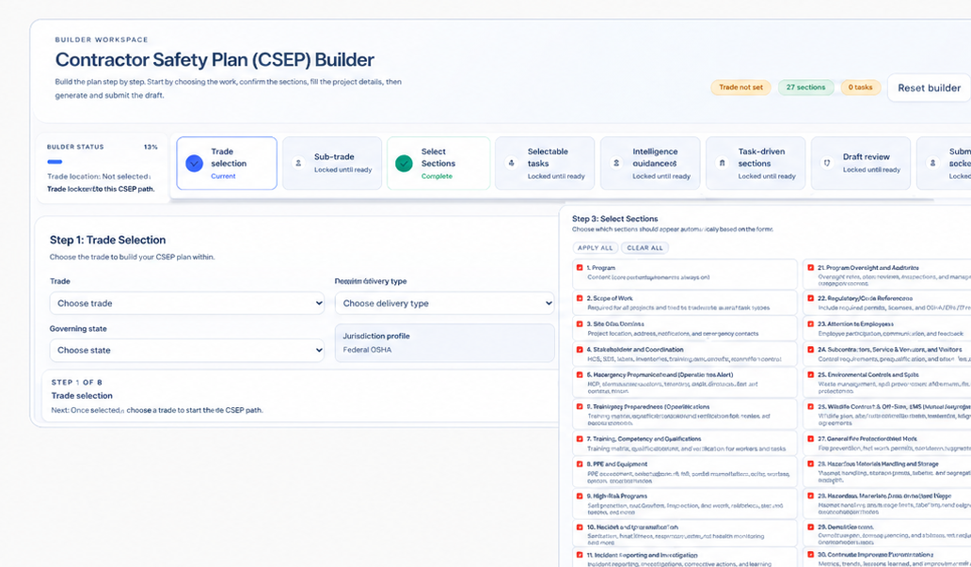



DOCUMENT & PLAN BUILDERS
Build safety plans with a guided workflow
LIVE PRODUCT
Structured JSAs, CSEP/SSP, and safety programs — no blank-page guesswork, no inconsistent formatting.
Step-by-step guided builders
One library, always current
Export review-ready documents
Safety360Docs · by Reliance EHS
3

Slide 4
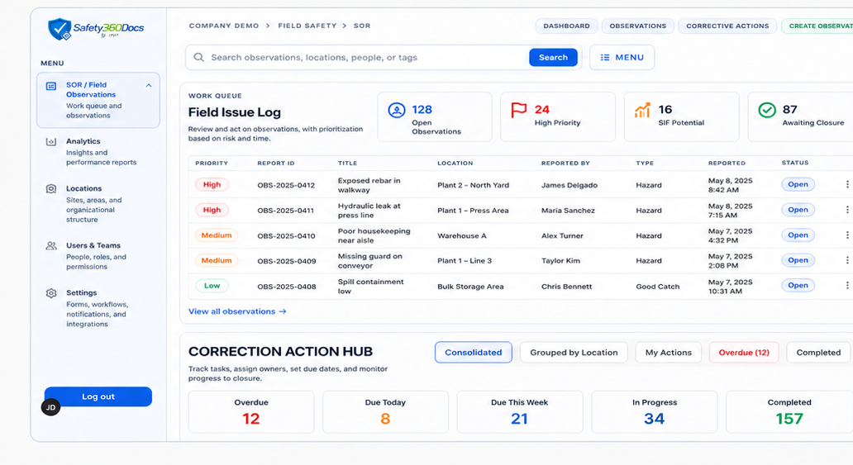


FIELD OBSERVATIONS
Capture hazards before they become incidents
LIVE PRODUCT
Log observations with severity, SIF potential, owner, due date, and photo proof — straight from the field.
Fast capture on any device
SIF-potential flagged separately
Closure tracked to verification
Safety360Docs · by Reliance EHS
4

Slide 5
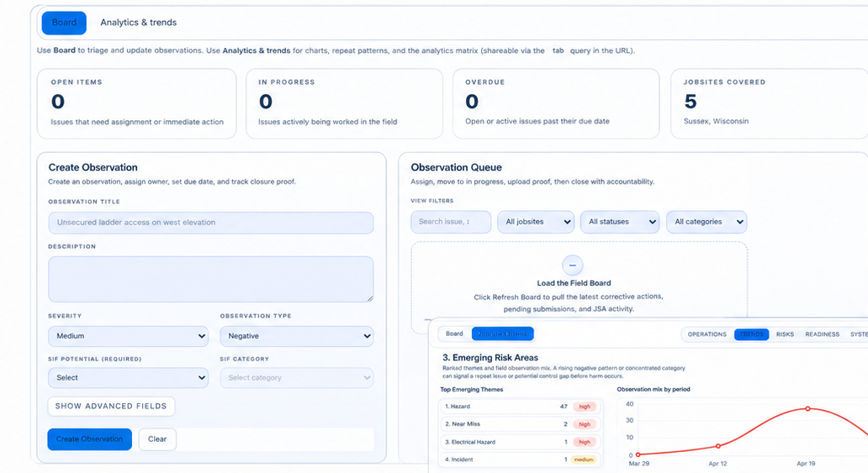

ISSUE LOG & CORRECTIVE ACTIONS
Know what needs attention now
LIVE PRODUCT
Priority signals and a correction-action hub keep the highest-risk work from getting buried in the backlog.
Risk-ranked work queue
Overdue & due-today visibility
Corrective actions driven to closure
Safety360Docs · by Reliance EHS
5

Slide 6
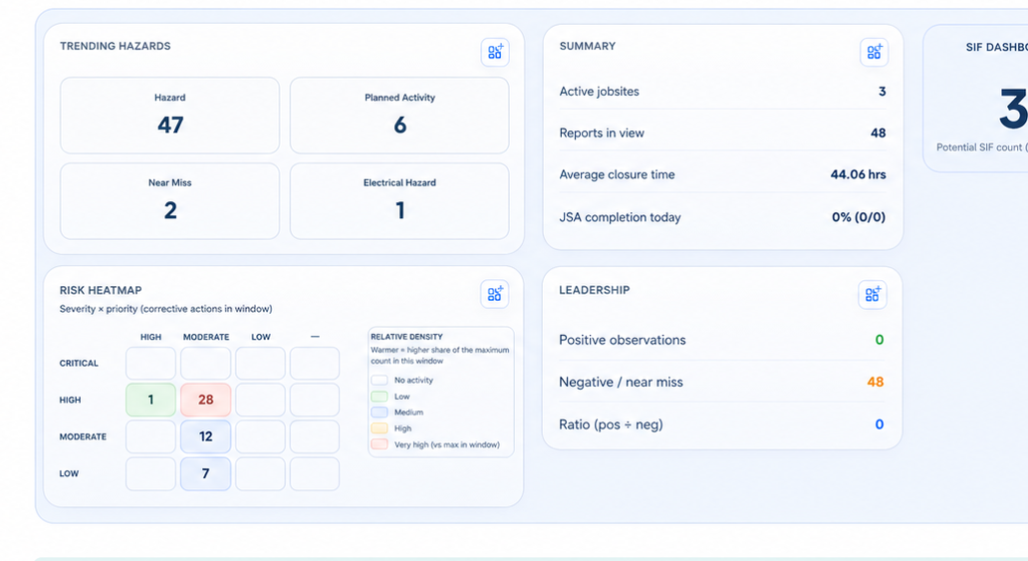



ANALYTICS & TRENDS
See where exposure is building
LIVE PRODUCT
Trends, SIF counts, and heatmaps show what's increasing and where risk is clustering — so leaders focus early.
Trending hazards by category
Severity × priority heatmap
Leadership snapshot & ratios
Safety360Docs · by Reliance EHS
6

Slide 7
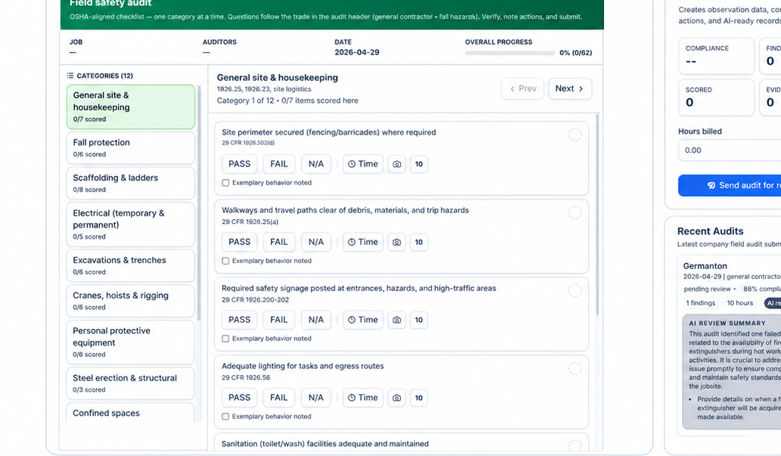


COMPLIANCE & AUDITS
Field audits that simplify compliance
LIVE PRODUCT
Run structured, OSHA-aligned audits and submit review-ready records from one connected workflow.
Category-based guided audits
Findings become corrective actions
AI review summary on every audit
Safety360Docs · by Reliance EHS
7

Slide 8
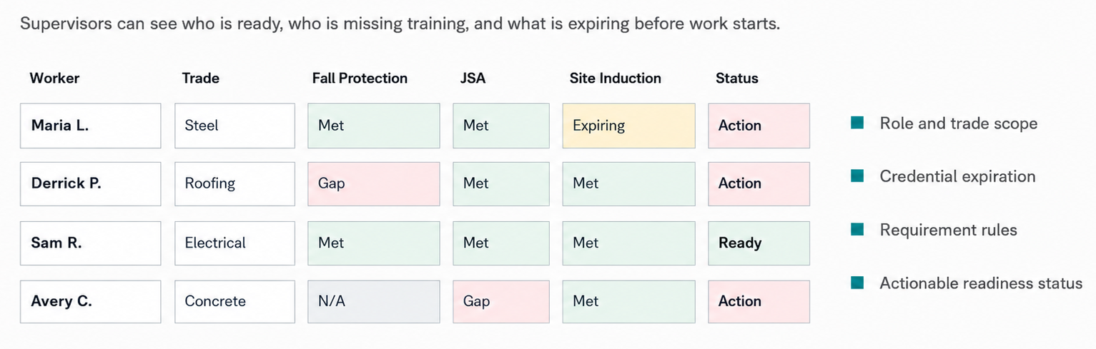


READINESS MATRIX
Prove readiness — don't just store certificates
LIVE PRODUCT
See who's ready, who's missing training, and what expires before work starts, across every trade and crew.
Role & trade scope
Credential & expiration tracking
Actionable readiness status
Safety360Docs · by Reliance EHS
8

Slide 9
THE AI ENGINE
From data to a forecast —
and a plan to prevent it
The same data your crews log every day becomes an evidence-backed prediction of what's most likely to hurt your team — with the actions to stop it.

Slide 10
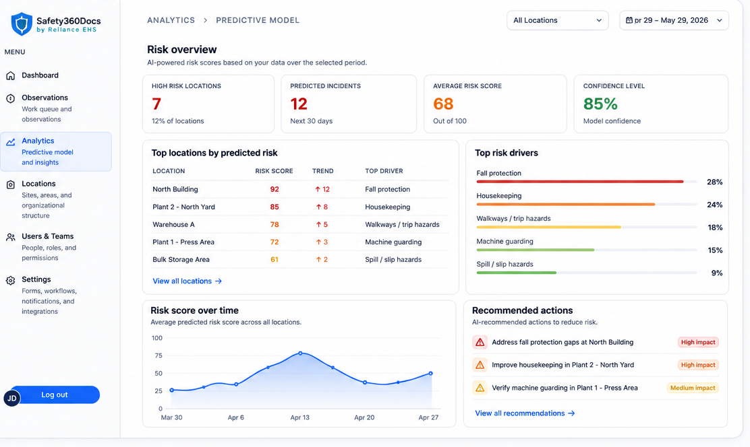


AI · PREDICT
Predict risk before it happens
LIVE PRODUCT
AI-powered risk scores rank the locations and hazards most likely to cause injury — built only from your data.
High-risk locations & predicted incidents
Top risk drivers, ranked
Model confidence on every forecast
Safety360Docs · by Reliance EHS
10

Slide 11
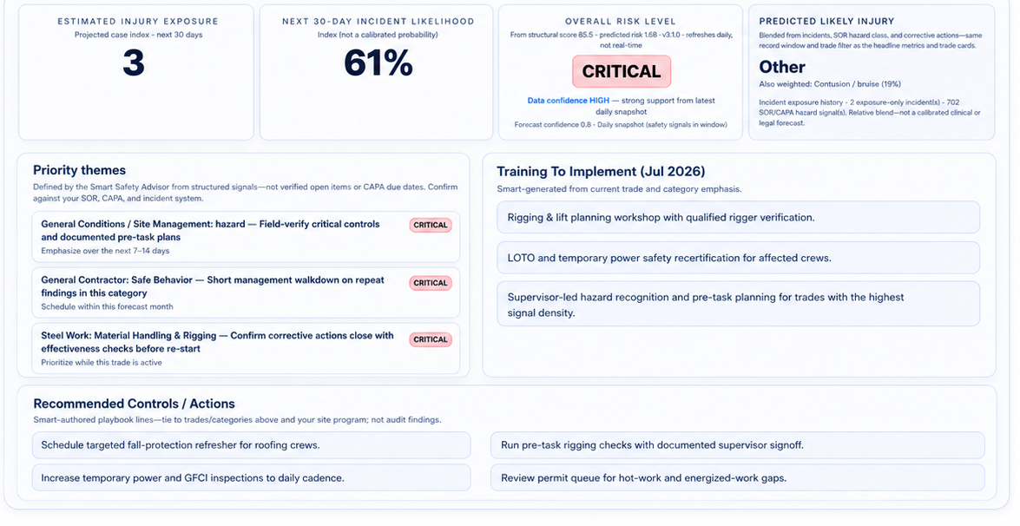
AI · PREVENT
Turn predictions into focused action
LIVE PRODUCT
Every forecast comes with priority themes, training, and controls to implement now — so you prevent, not just react.
Likely injury exposure & 30-day likelihood
Priority themes for leadership
Recommended controls & training
Safety360Docs · by Reliance EHS
11

Slide 12

BUSINESS IMPACT
Save time, cut admin cost, and lower risk before incidents happen
Safety360Docs replaces scattered manual work with one connected workflow for documents, observations, audits, readiness, and predictive visibility.
Time saved
Cost saved
Risk reduction
Cut repetitive admin across documents, audits, follow-up, and readiness so your team focuses on the work that matters.
Lower labor and admin burden, reduce inefficiencies, and scale with confidence — without adding headcount.
Predictive signals, earlier warnings, and preventive actions help teams act before incidents, not after.
Use predictive tools and preventive measures to reduce risk while saving time across your operation.
Safety360Docs · by Reliance EHS
12

Slide 13




PLATFORM TIERS
Flexible tiers designed to grow with your operation
Start with the core tools your team needs, then expand into compliance, document workflows, and predictive insights as your program matures.
Essentials
Professional
Advanced
Enterprise
Get the basics organized
Stronger compliance visibility
Document-heavy operations
Multi-site scale & AI insights
JSAs & permits
Everything in Essentials
Everything in Professional
Everything in Advanced
Field observations
Compliance matrix
Safety document builders
AI injury-forecast model
Audits & inspections
Credential & training tracking
CSEP / SSP workflows
Trend analytics
Incident reporting
Submission workflows
Document exports
Multi-jobsite visibility
Basic dashboards
Review visibility
Admin review queue
Admin controls & support
Choose the level that fits today — and add capability as your team, jobsites, and data grow.
Safety360Docs · by Reliance EHS
13

Slide 14




GET STARTED
Start small, prove value, then scale
1. Scope a pilot
2. Prove value
3. Scale with confidence
Pick 1–3 jobsites and the core modules your team needs first.
Run real workflows for a defined window and measure time saved and risk surfaced.
Expand modules, sites, and predictive insights as adoption grows.
Ready to modernize safety with a cleaner, predictive operating model?
(913) 857-2515
stevenssladky1@gmail.com
Steven Sladky, CSP
Reliance EHS
Schedule a follow-up call

