Slide 1
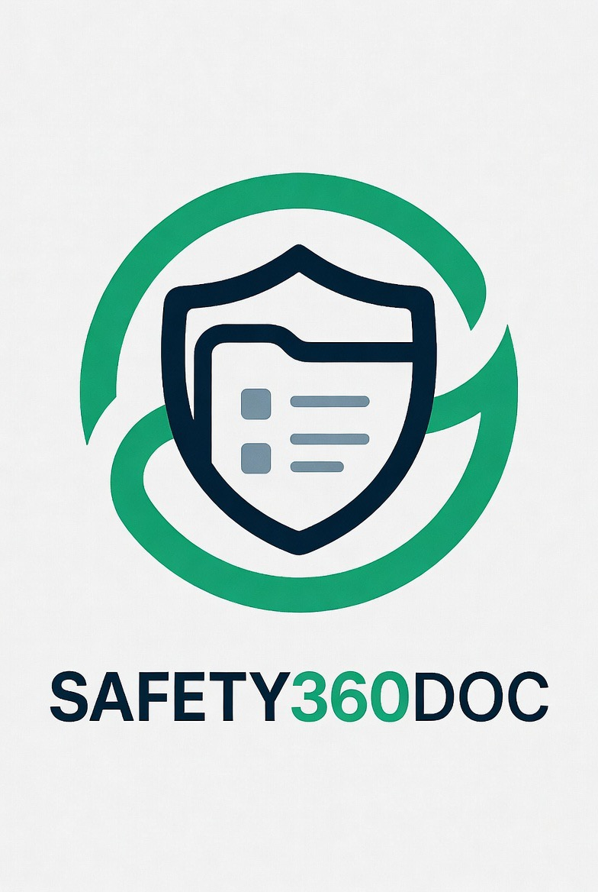

SAFETY360DOCS
The platform, in action
A guided tour of the live product — the launch-readiness dashboard, the AI prediction and prevention engine, and workforce readiness, straight from the platform.
Presented by Steven Sladky, CSP · Reliance EHS
Live screenshots · Current build

Slide 2
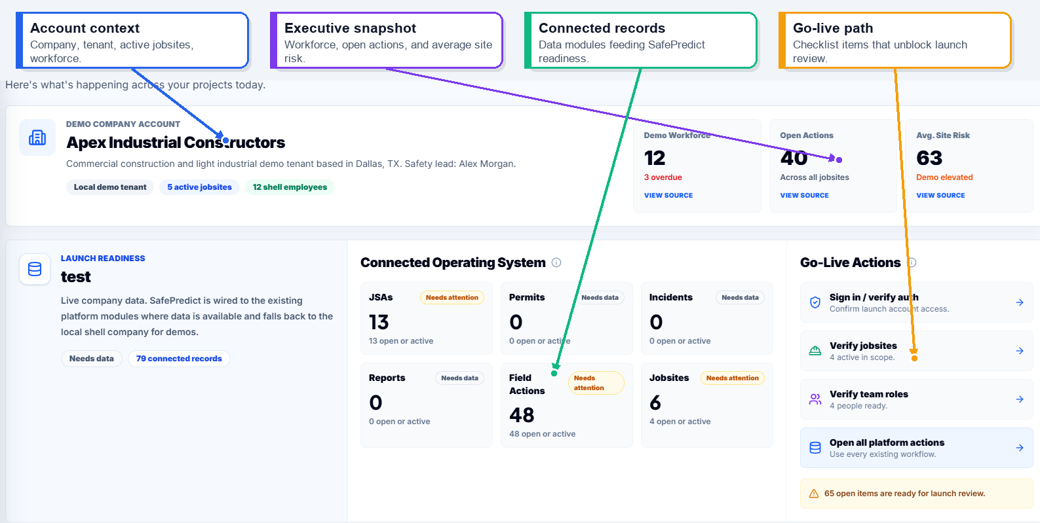
COMMAND CENTER
See launch readiness at a glance
Account context, an executive snapshot, connected records, and your go-live path — in one connected operating view.
LIVE PRODUCT
Safety360Docs · by Reliance EHS
2

Slide 3
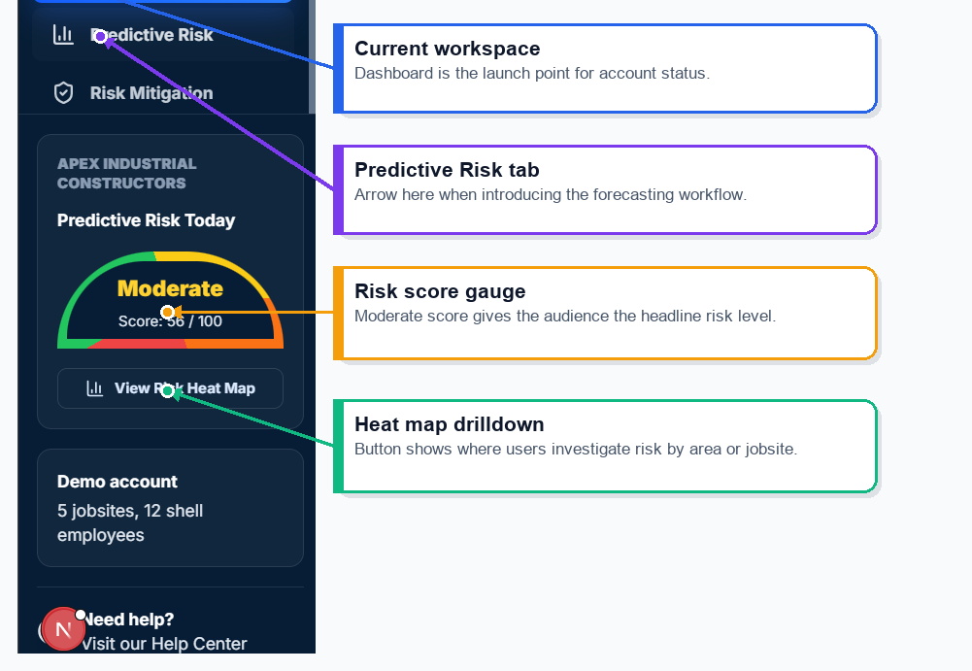
DASHBOARD NAVIGATION
Your safety cockpit — one click away
Jump straight to the current workspace, predictive risk, the live risk gauge, and the next step that matters most.
LIVE PRODUCT
Safety360Docs · by Reliance EHS
3

Slide 4

THE AI ENGINE
Predict the risk —
then act to prevent it
The engine forecasts where injury risk is building over the next 30 days and hands your team the prioritized actions to stop it.

Slide 5
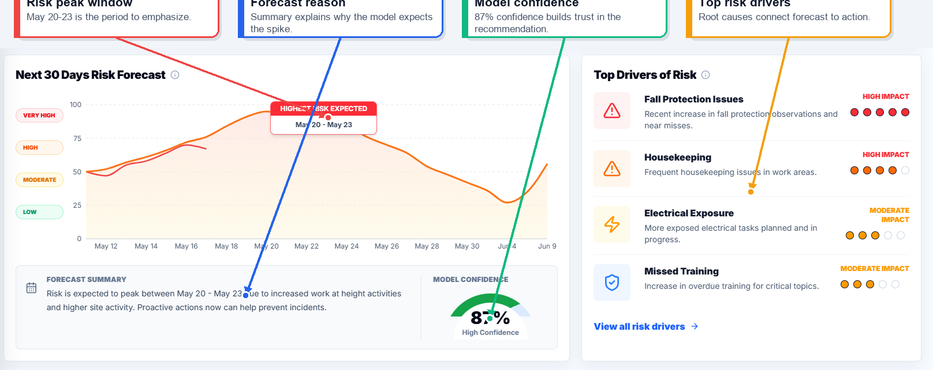
AI · PREDICT
Predict risk 30 days out
Risk index, trend, and model confidence highlight where exposure is building — before it turns into an incident.
LIVE PRODUCT
Safety360Docs · by Reliance EHS
5

Slide 6
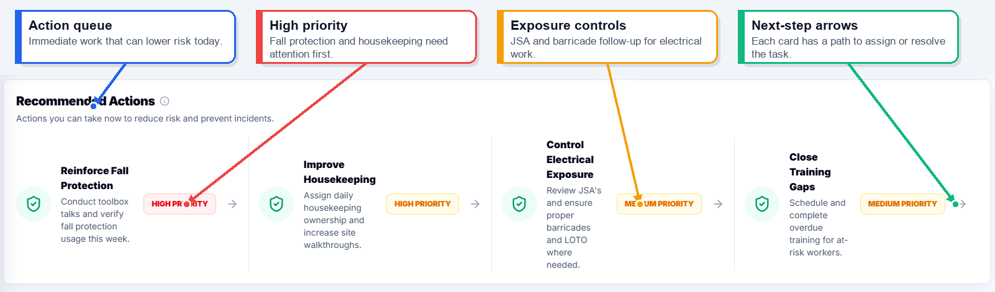
AI · PREVENT
AI tells you what to fix first
Prioritized actions — fall protection, housekeeping, electrical, training — each with a clear path to assign or resolve.
LIVE PRODUCT
Safety360Docs · by Reliance EHS
6

Slide 7
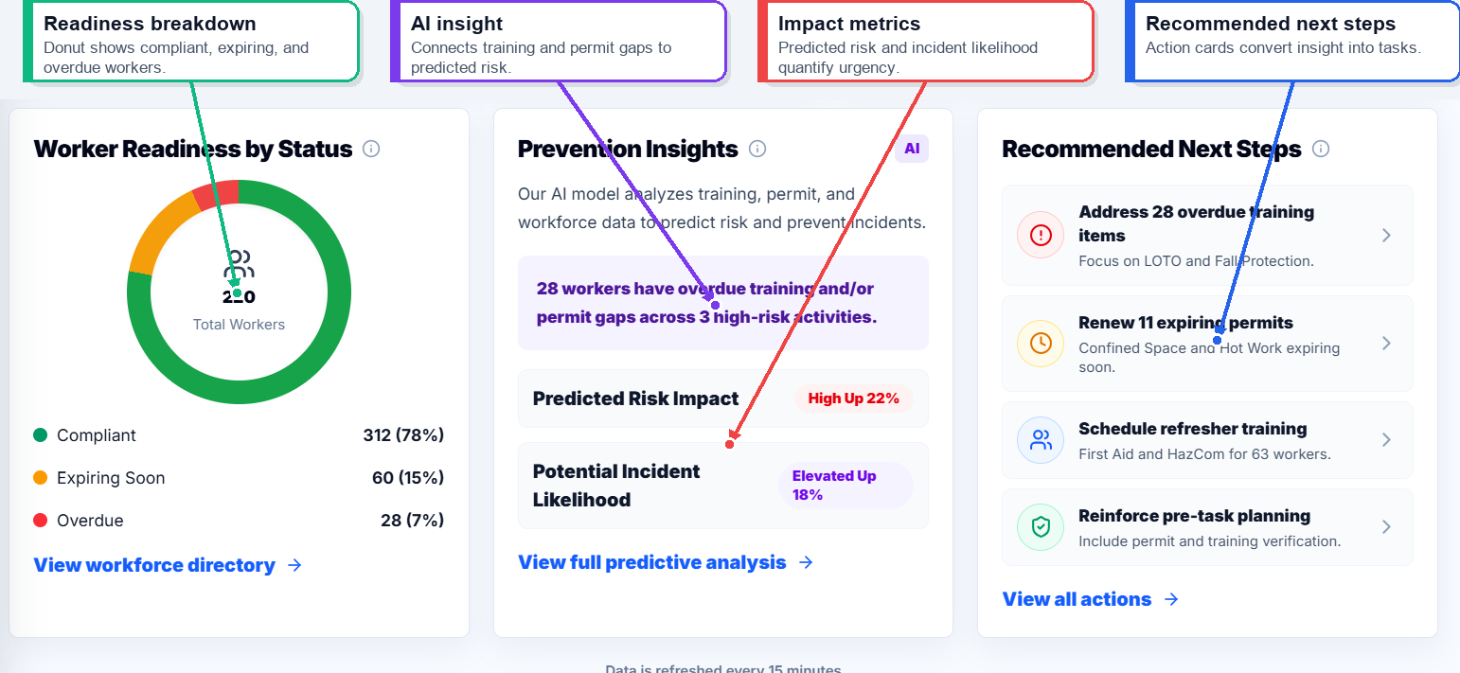
READINESS & PREVENTION
Prevent incidents before they happen
Worker readiness by status, prevention insights, and recommended next steps — all in one prevention hub.
LIVE PRODUCT
Safety360Docs · by Reliance EHS
7

Slide 8
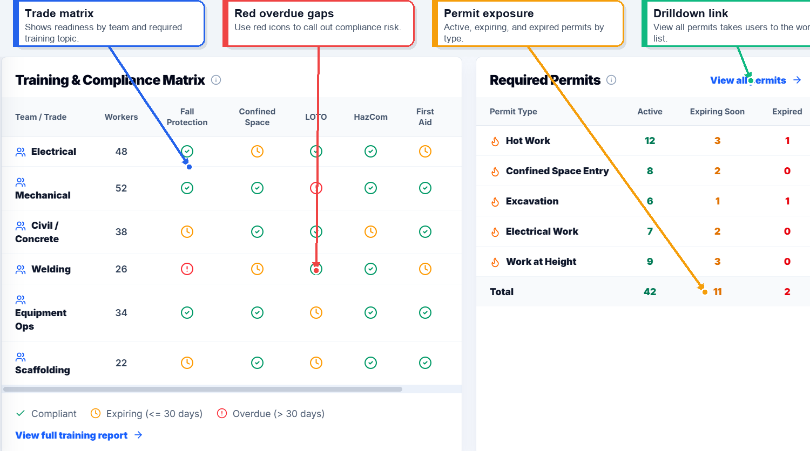
TRAINING & PERMITS
Prove training and permit readiness
A compliance matrix and supplied-records view show who's ready, what's missing, and what expires before work starts.
LIVE PRODUCT
Safety360Docs · by Reliance EHS
8

Slide 9


BUSINESS IMPACT
Save time, cut admin cost, and lower risk before incidents happen
Safety360Docs replaces scattered manual work with one connected workflow for documents, observations, audits, readiness, and predictive visibility.
Time saved
Cost saved
Risk reduction
Cut repetitive admin across documents, audits, follow-up, and readiness so your team focuses on the work that matters.
Lower labor and admin burden, reduce inefficiencies, and scale with confidence — without adding headcount.
Predictive signals, earlier warnings, and preventive actions help teams act before incidents, not after.
Use predictive tools and preventive measures to reduce risk while saving time across your operation.
Safety360Docs · by Reliance EHS
9

Slide 10







PLATFORM TIERS
Flexible tiers designed to grow with your operation
Start with the core tools your team needs, then expand into compliance, document workflows, and predictive insights as your program matures.
Essentials
Professional
Advanced
Enterprise
Get the basics organized
Stronger compliance visibility
Document-heavy operations
Multi-site scale & AI insights
JSAs & permits
Everything in Essentials
Everything in Professional
Everything in Advanced
Field observations
Compliance matrix
Safety document builders
AI injury-forecast model
Audits & inspections
Credential & training tracking
CSEP / SSP workflows
Trend analytics
Incident reporting
Submission workflows
Document exports
Multi-jobsite visibility
Basic dashboards
Review visibility
Admin review queue
Admin controls & support
Choose the level that fits today — and add capability as your team, jobsites, and data grow.
Safety360Docs · by Reliance EHS
10

Slide 11






GET STARTED
Start small, prove value, then scale
1. Scope a pilot
2. Prove value
3. Scale with confidence
Pick 1–3 jobsites and the core modules your team needs first.
Run real workflows for a defined window and measure time saved and risk surfaced.
Expand modules, sites, and predictive insights as adoption grows.
Ready to modernize safety with a cleaner, predictive operating model?
(913) 857-2515
stevenssladky1@gmail.com
Steven Sladky, CSP
Reliance EHS
Schedule a follow-up call

