Slide 3
Conda list revisions or conda install revision N
https://sriramjaju.github.io/2018-05-30-2-minute-recipe-how-to-rollback-your-conda-environment/
https://medium.com/@wilpat456/fix-broken-anaconda-environment-due-to-recent-package-download-9094fb0f3a04
https://towardsdatascience.com/a-guide-to-conda-environments-bc6180fc533
http://blog.rtwilson.com/conda-revisions-letting-you-rollback-to-a-previous-version-of-your-environment/
the hardware guy à what to do when you cannot see your environment by reimport Ipykernel
https://www.youtube.com/watch?v=6kXLUvsnhuI
forecasting
https://www.analyticsvidhya.com/blog/2018/02/time-series-forecasting-methods/
https://www.machinelearningplus.com/time-series/time-series-analysis-python/
https://machinelearningmastery.com/arima-for-time-series-forecasting-with-python/ ß interesting alternative to Portilla
https://machinelearningmastery.com/time-series-forecasting-methods-in-python-cheat-sheet/

Slide 4
Option to autoarima
https://machinelearningmastery.com/grid-search-arima-hyperparameters-with-python/
Guide to handle environments
https://towardsdatascience.com/a-guide-to-conda-environments-bc6180fc533
Video about ARIMA
https://www.youtube.com/watch?v=D9y6dcy0xK8

Slide 5
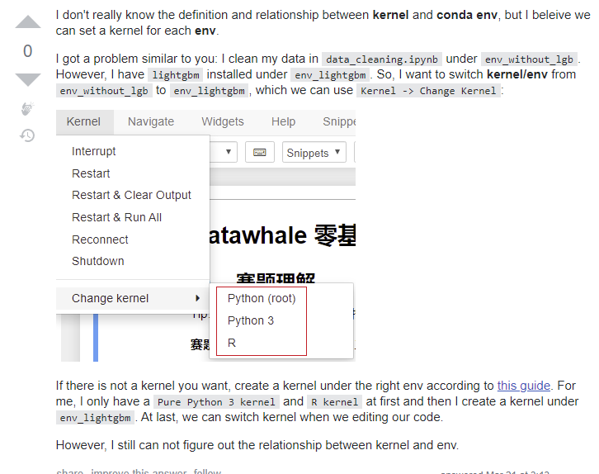
Changing Kernels in Jupiter Notebook

