Slide 1
EOHHS AI Pilot Program Phase 4
AI Software Development Using AWS Kiro
2026-06-11

Slide 2
AI Powered Software Development Using AWS Kiro
Team/Role:
John Hogan:
Developer/Architect EHS-Enterprise Architecture Team
Anand Geetey:
User Interface Designer/Architect EHS-Enterprise Architecture Team

Slide 3
Problem & Motivation
Problem
Traditional software development is slow, expensive and error prone.
EOHHS has 10s or 100s of apps representing a significant burden
version upgrades,
security vulnerabilities
New apps and features
Motivation
Leverage the EOHHS AI Pilot Phase 4 to determine how AI tools like Kiro might help
AI Period 4 - Workstream Item: AI-Powered Coding Environments
We selected AWS’s new Kiro IDE
Would evaluate Kiro doing a fictitious project
A generic PDF doc generation microservices project.
A pdf manger backend microservice and pdf administrator user interface. The backend features restful web services to maintain document templates and documents generated from these templates.
Notes:
These have accumulated significant technical debt.
Objective: Can an AI-driven IDEs like Kiro produce readable, usable, bug-free code throughout the entire SDLC?
AI Period 4Find out if Kiro can:
Ease our maintenance burden for existing catalog of applications
Speed up software development
Help us with upgrades, vulnerability remediation and new feature development.

Slide 4
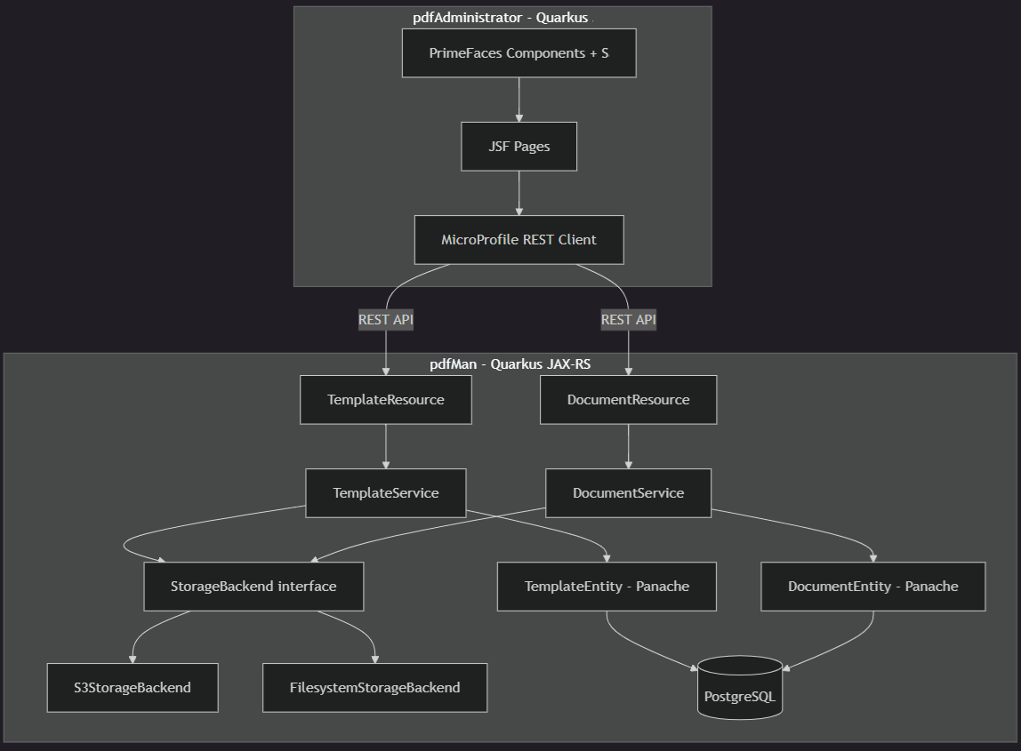
Generic PDF doc gen (pdfMan and PdfAdministrator)
AI Powered Software Development Using AWS Kiro

Slide 5
AI-Powered Coding Environments
Status | Summary
Green Yellow Red | Describe the current state of the workstream in 1-2 sentences.
Theme | Objective | Team Members
AI Technology Proof of Concept | Can an AI-driven IDE like Kiro produce readable, usable, bug-free code throughout the entire SDLC? | John Hogan (lead), technical SME TBD
Milestone | Due Date | Status | Notes
Successful Micro-Services (MS) Architecture Implemented. |  | Green | Fully operational microservices system with independently scalable services and postgres database deployed.
User Interface MS delivered |  | Green | User interface adhering to State Of Massachusetts compliant design guide lines.
Restful services layer delivered. |  | Green | User interface with State Of Massuchusett complient guide lines.
Comprehensive Test Suite delivered |  | Green | 100% coverage with passing unit and integraton across all components.
End to system integration |  | Green | All MS successfully communicating with high reliability and performance.
Deploy system to AWS ECS |  | Yellow | Stretch goal
Integrate security |  | Yellow | Stretch goal
Status Detail + Notes
Complete MS system deploys with two microservices and relational database! Collaborated with EHS-Enterprise-Architecture Team’s UI architect (Anand Geetey) to incorporate State Of Massachusetts design in front end MS. Zero defects currently with complete test coverage to verify.
Risk | Status | Notes
Kiro licensing | Green | Eval license was insufficient. AI Team Management addressed with AWS.
 | Yellow
 | Red

Slide 6
Thank you! Any questions?

