Slide 1
EOHHS AI Pilot Program Phase 4
AI Software Development Using AWS Kiro
2026-06-11

Slide 2
AI Powered Software Development Using AWS Kiro
Team/Role:
John Hogan:
Architect EHS-Enterprise Architecture Team
Anand Geetey:
Architect EHS-Enterprise Architecture Team

Slide 3
Problem & Motivation
Problem
Traditional software development is slow, expensive and error prone.
EOHHS has 10s or 100s of apps representing a significant maintenance burden
version upgrades,
security vulnerabilities
New apps and features
Motivation
Leverage the EOHHS AI Pilot Phase 4 to determine how AI tools like Kiro might help
AI Period 4 - Workstream Item: AI-Powered Coding Environments
We asked to participate in this workstream and selected AWS’s new Kiro IDE
Would evaluate Kiro doing a fictitious project
A generic PDF doc generation microservices project.
A pdf manager backend pdf manager (pdfMan) and pdf administrator (PdfAdministrator) user interface.
Notes:
The backend features restful web services to maintain document templates and documents generated from these templates.
These have accumulated significant technical debt.
Objective: Can an AI-driven IDEs like Kiro produce readable, usable, bug-free code throughout the entire SDLC?
AI Period 4Find out if Kiro can:
Ease our maintenance burden for existing catalog of applications
Speed up software development
Help us with upgrades, vulnerability remediation and new feature development.

Slide 4
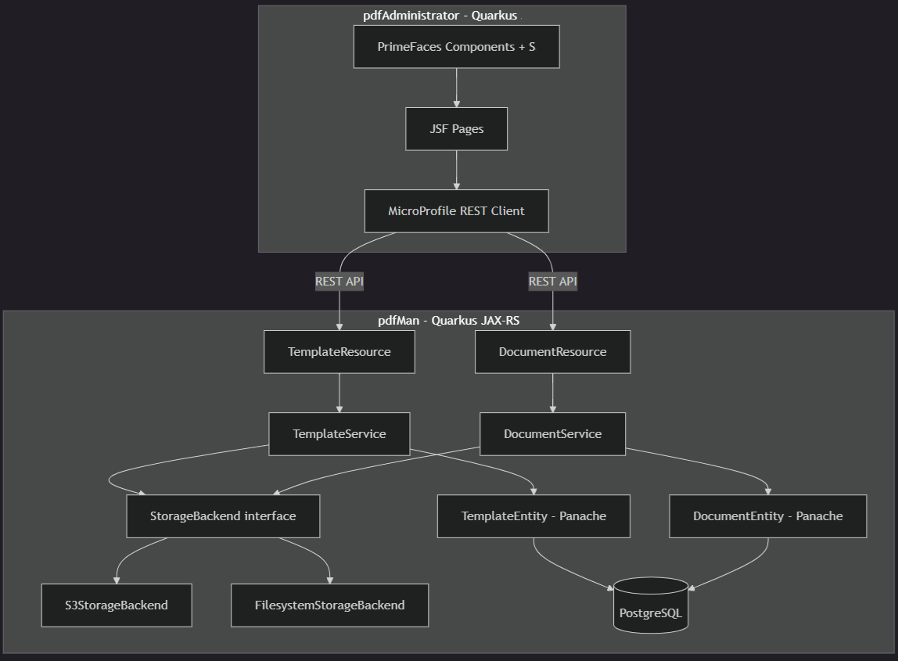
Generic PDF doc gen (pdfMan and PdfAdministrator)
AI Powered Software Development Using AWS Kiro

Slide 5
Backend Deep Dive (pdfMan)
Tech stack info
The pdfMan tech stack features include:
Templates
5 restful/jax-rs web services for maintaining templates (crud and list)
CRUD services for pdf templates and pdf document generation
Document templates used to create new documents are defined using JSON
New JSON templates trigger generation of a corresponding html templates for web form and pdf formatting
Rest resources have CDI service beans to manipulate data access
Hibernate/JPA components for persistence
Postgres database
Documents
5 restful/jax-rs web services for maintaining templates (crud and list)
CRUD services for pdf documents generation
Document meta data use to create new documents, JSON stored in db. Allows docs to be edited and pdf regenerated.

Slide 6
User Interface Deep Dive (pdfAdministrator)
Tech stack info
The pdfAdministrator tech stack features include:
Templates
Java Server Faces (JSF) user interface
Primefaces JSF implementation
Incorporates EOHHS design for user interface guidelines for web pages
Documents
Java Server Faces (JSF) user interface
Primefaces JSF implementation
Incorporates EOHHS design for user interface guidelines for web pages and generated pdf files
Writes pdf to file system or AWS S3
Stores document meta data to Postres Db

Slide 7
Design Process
We started with discussing and drawing the workflows.
For the UI elements. This provides us plenty of accessible UI components and patterns that are responsive to the users’ screen size.
Following Massachusetts Design guidelines helps us to create a scalable system that can be quickly customized to meet different project needs.
Exploring Kiro’s Advice Markdown files to create generic reusable style templates.

Slide 8
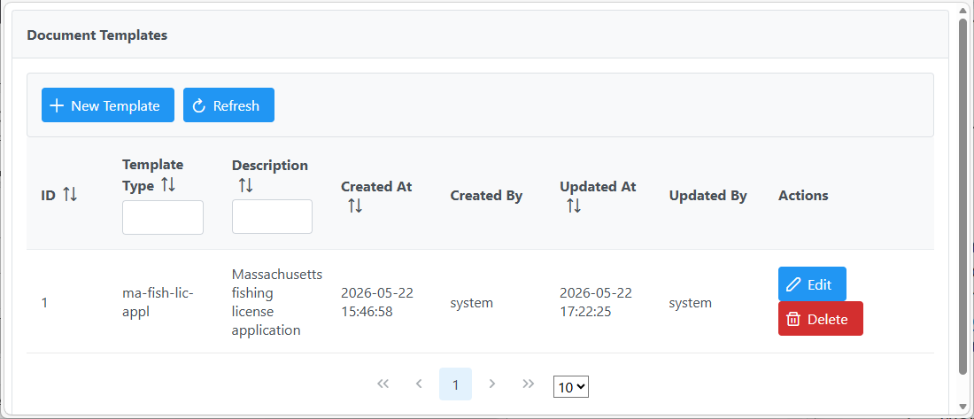
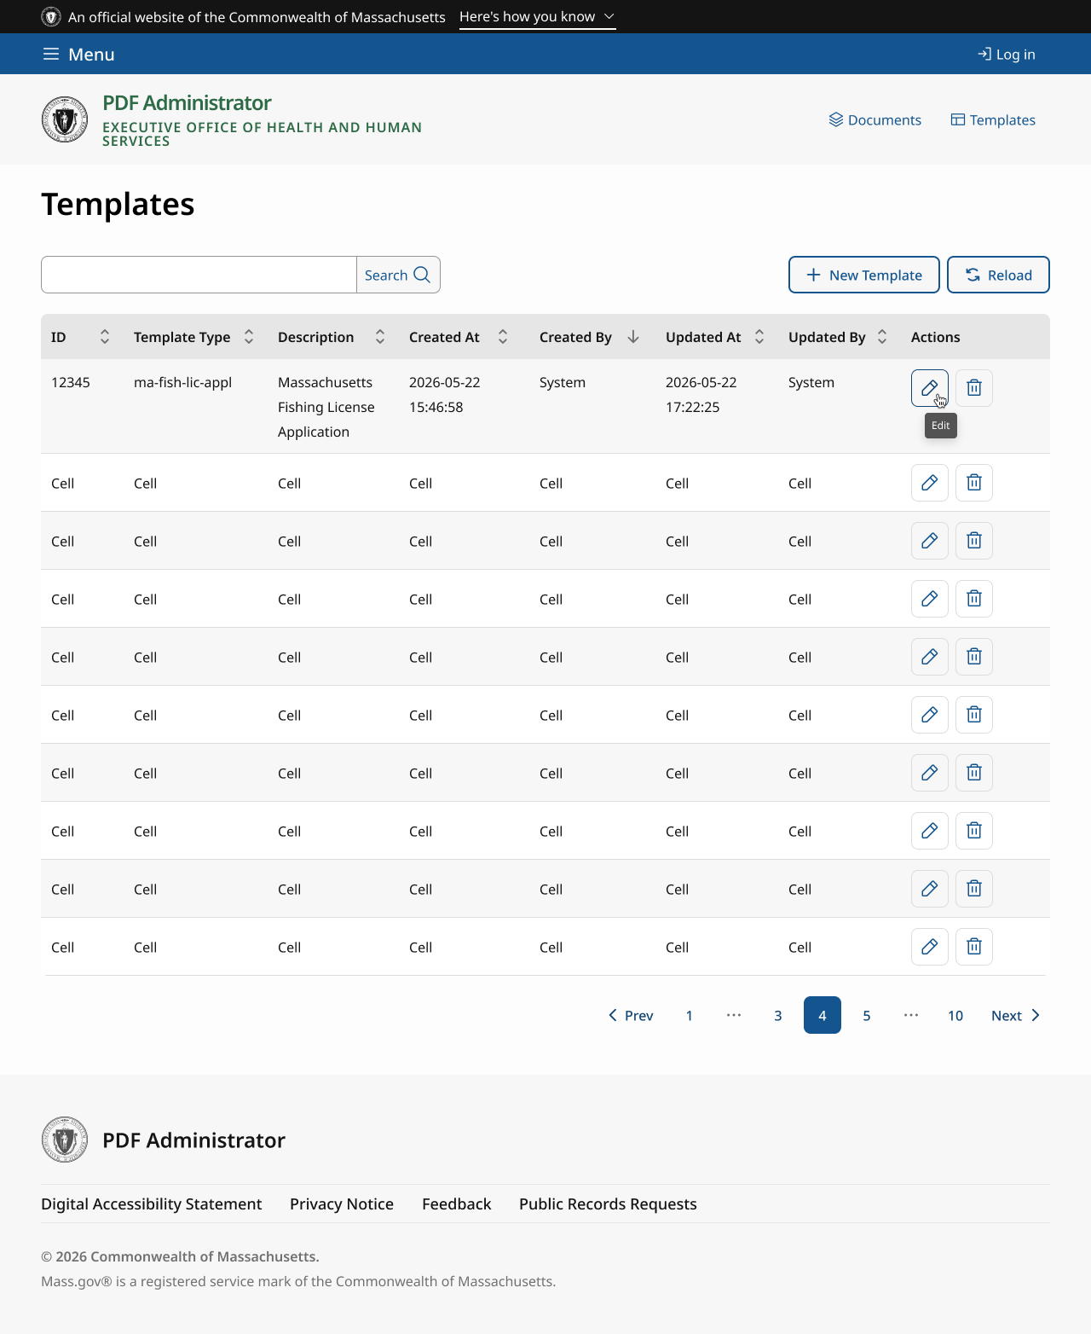
Progress so far
Templates Page (before v/s after)

Slide 9
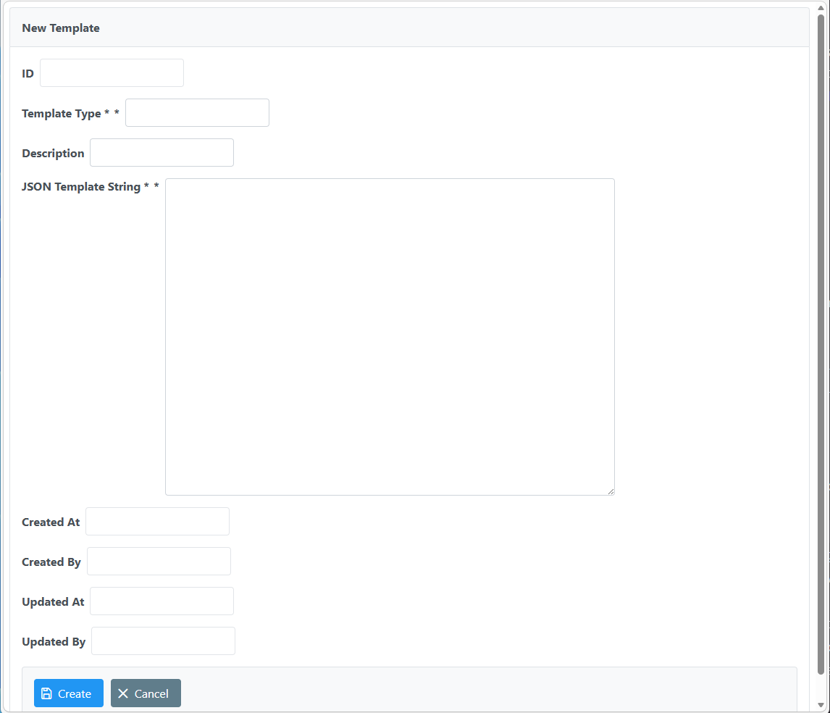
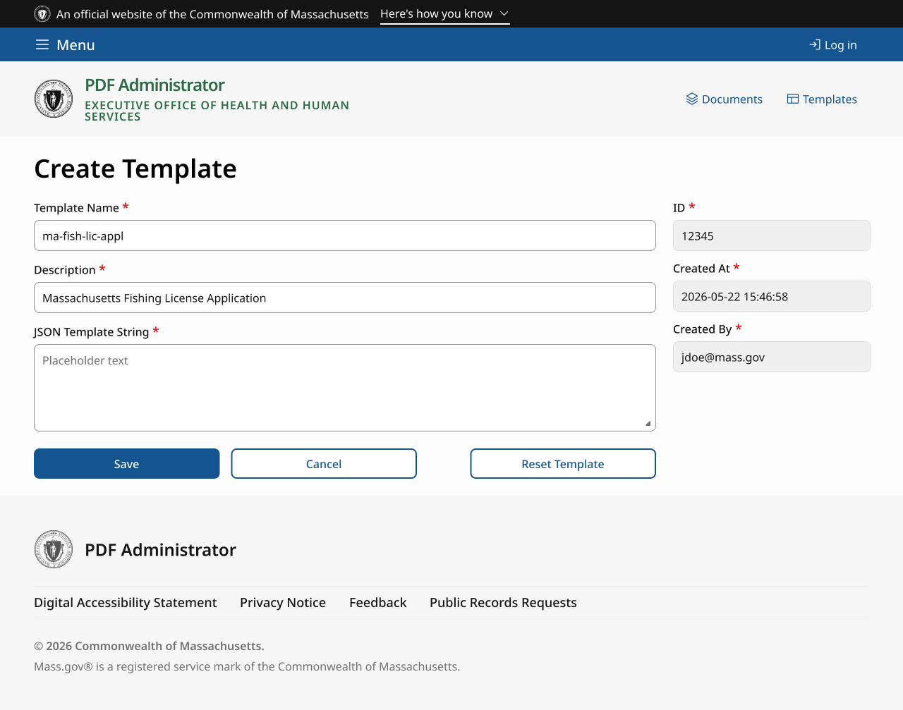
Progress so far
Create Template Page (before v/s after)

Slide 10
Thank you! Any questions?

