Slide 1
EOHHS AI Pilot Program Phase 4
AI Software Development Using AWS Kiro
John Hogan and Anand Geetey
EHS-Enterprise Architecture Team
2026-06-24

Slide 2
Problem & Motivation
Problem
Traditional software development is slow, expensive and error prone.
EOHHS has 60 + applications representing a significant maintenance burden
version upgrades,
security vulnerability fixes,
new apps and features
Motivation
Leverage the EOHHS AI Pilot Phase 4 to determine how AI tools like Kiro might help
AI Period 4 - Workstream Item: AI-Powered Coding Environments
We asked to participate in this workstream and selected AWS’s new Kiro IDE
Would evaluate Kiro doing a fictitious project
A generic PDF doc generation microservices project.
A pdf manager backend pdf manager (pdfMan) and pdf administrator (PdfAdministrator) user interface.
Notes:
The backend features restful web services to maintain document templates and documents generated from these templates.
These have accumulated significant technical debt.
Objective: Can an AI-driven IDEs like Kiro produce readable, usable, bug-free code throughout the entire SDLC?
AI Period 4Find out if Kiro can:
Ease our maintenance burden for existing catalog of applications
Speed up software development
Help us with upgrades, vulnerability remediation and new feature development.

Slide 3
How Kiro Solves Problems
Stakeholder | Pain Point
Developers | Repetitive coding, context switching
QA | Missing test coverage
Team Leads | Inconsistent implementation patterns
Business Analysts | Requirements lost during development
Managers | Difficulty predicting delivery outcomes
Executives | Faster delivery often increases risk

Slide 4
Turning Business Intent into Production-Ready Software
Kiro's Approach: "Make the specification—not the prompt—the unit of work."
Business Need
Requirements
Design Document
Task Breakdown
Code Generation
Tests & Validation
Documentation
Key Features
Generates requirements and user stories
Creates technical design documents
Breaks work into implementable tasks
Produces code, tests, and documentation
Enforces team standards through steering files and hooks
Value
Less ambiguity
Better handoffs
Reduced work
Improved traceability
Notes:
Kiro is designed to transform natural language requests into requirements, design artifacts, code, tests, and documentation in a structured workflow.

Slide 5
What’s In It For Me?
Role | Benefit
Developers | Faster implementation and less boilerplate
QA | Tests generated alongside features
Team Leads | Consistent architecture and coding standards
Business Analysts | Requirements lost during development
Project Managers | Better estimation through task decomposition
Executives | Faster time-to-market with governance

Slide 6
Business Value & Outcomes
Why Organizations Are Interested
Faster Delivery
Less manual documentation
Faster feature implementation
Reduced onboarding time
Greater Organizational Learning
Design decisions become reusable assets
Documentation stays closer to implementation
Better Quality
Built-in testing
Automated validation hooks
Consistent engineering practices
Bottom Line
Less manual documentation
Kiro helps teams move from prototype to production while maintaining engineering discipline and business alignment
Lower Risk
Requirements traceability
Reduced technical debt
Knowledge captured in specification
Notes:
Kiro is designed to transform natural language requests into requirements, design artifacts, code, tests, and documentation in a structured workflow.

Slide 7
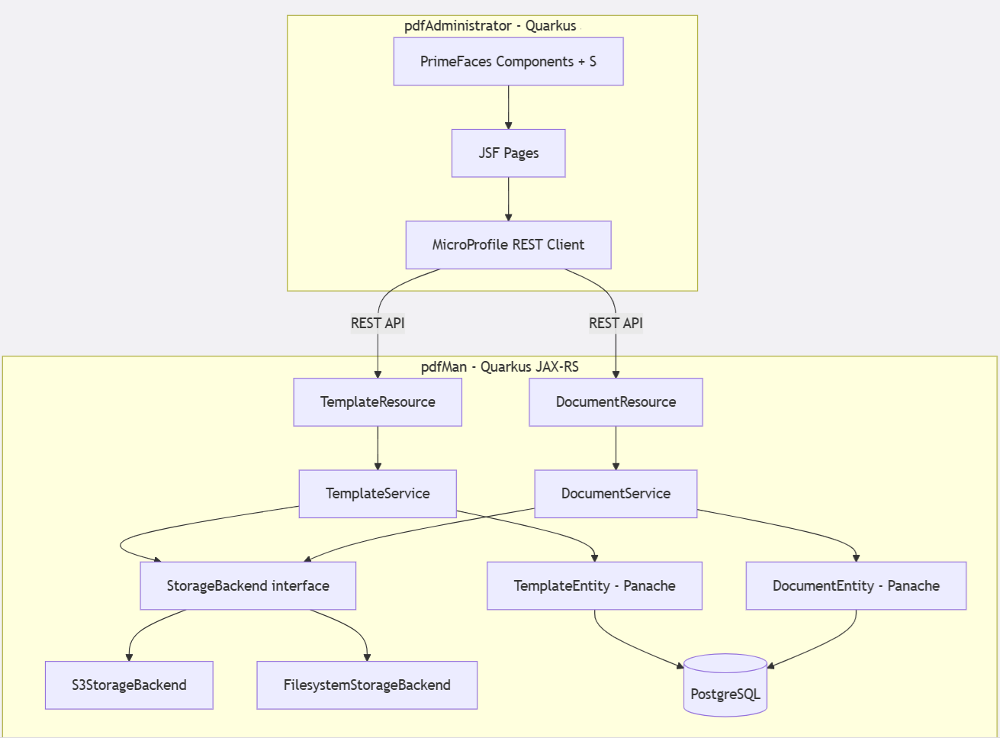
Sample App Architecture: System of Two Microservice Apps
PDF Administrator User Interface
AI Powered Software Development Using AWS Kiro
PDF Manager backend web services

Slide 8
Design Process
We started with discussing and drawing the workflows.
For the UI design, we use Massachusetts Design System. This provides us plenty of accessible UI components and patterns that are responsive to the users’ screen size.
Following Massachusetts Design guidelines helps us to create a scalable system that can be quickly customized to meet different project needs.
Exploring Kiro’s Steering markdown files* to create generic reusable style templates. *A plain text file that uses simple formatting symbols to create structured documents. For eg: README.md
Basic Markdown Syntax
# Main Title
## Section
### Subsection
You can also have markdown syntax for Lists, Numbered Lists, Bold and Italics, Code and Links.
Notes:
Markdown Files: A Markdown file is a plain text file that uses simple formatting symbols to create structured documents.
For eg: README.md
Basic Markdown Syntax
# Main Title
## Section
### Subsection
You can also have markdown sysntax for Lists, Numbered Lists, Bold and Italics, Code and Links.

Slide 9
Kiro’s Steering files
We are writing the custom Steering files for Commonwealth that could drive the UX and front-end development. Some of the standards that we have at Commonwealth:
Sentence case for titles, labels, page titles or other brief texts.
Sentence case for headings, subheadings and card titles.
Date and time formatting.
Address formatting
Button menu items, calls-to-action
Links
Reference: https://www.mass.gov/info-details/user-experience-ux-microcopy

Slide 10
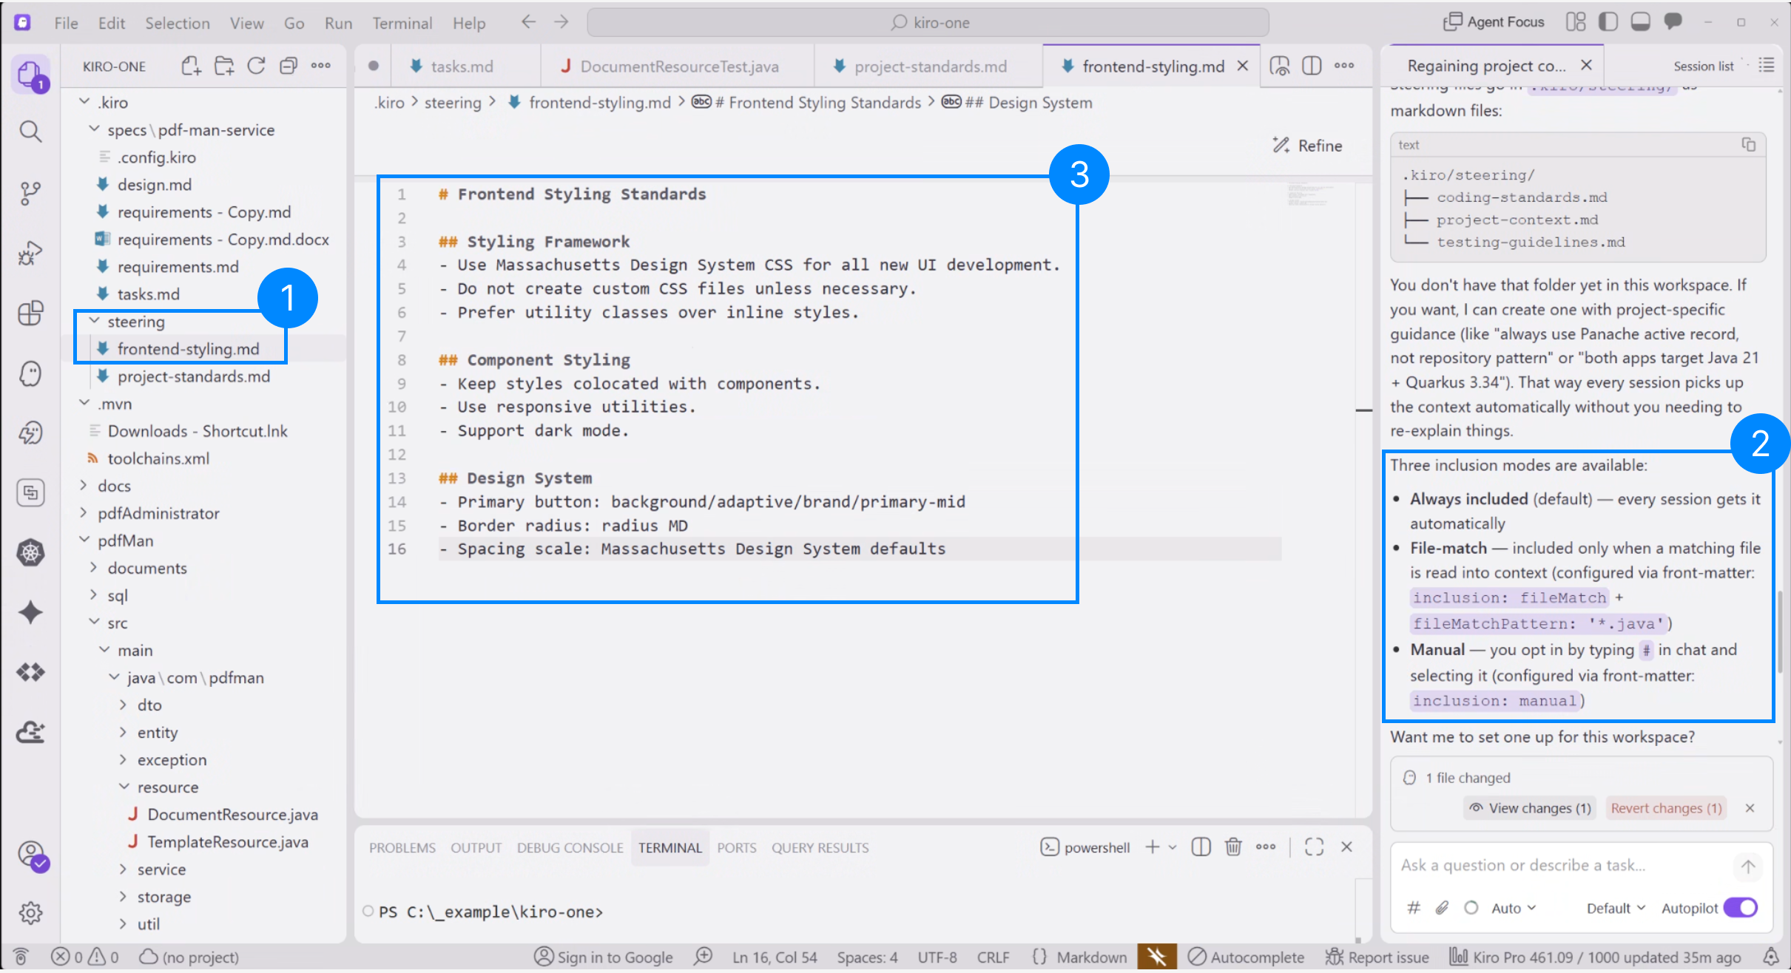
Kiro’s Steering customized for Commonwealth
Steering gives Kiro persistent knowledge about the workspace through markdown files.
Instead of explaining the conventions in every chat, steering files ensure Kiro consistently follows the established patterns, libraries, and standards. Example:

Slide 11
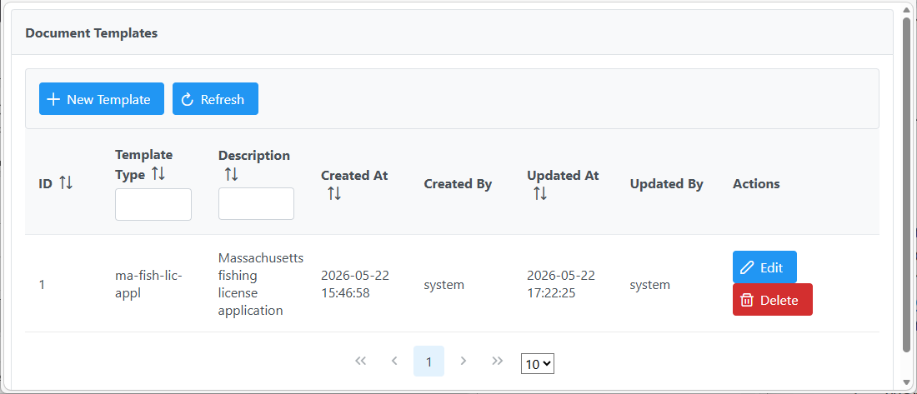
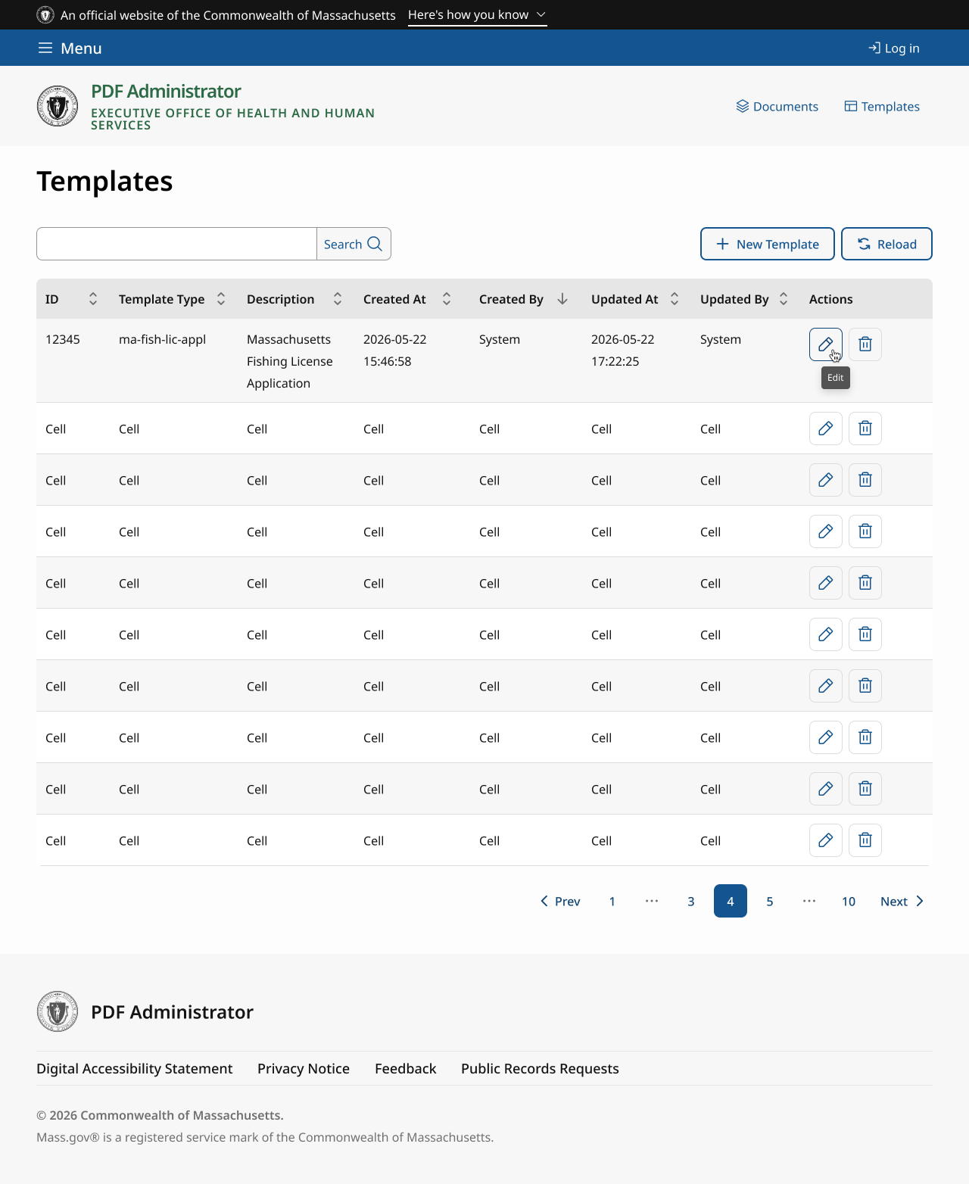
Progress on UX so far
Templates Page (before v/s after)

Slide 12
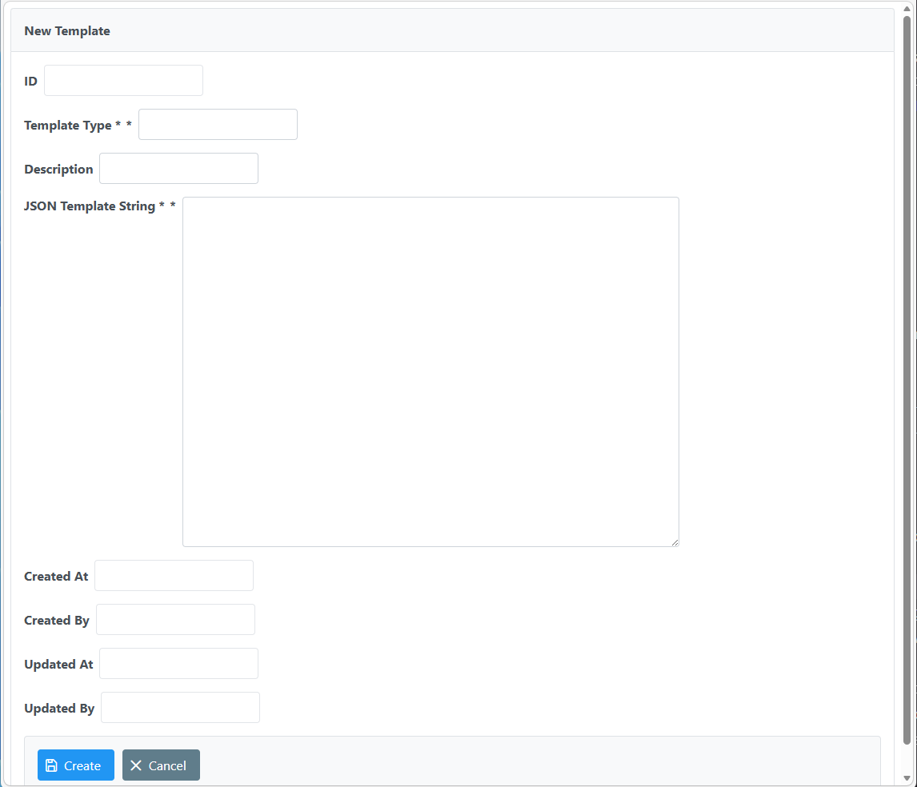
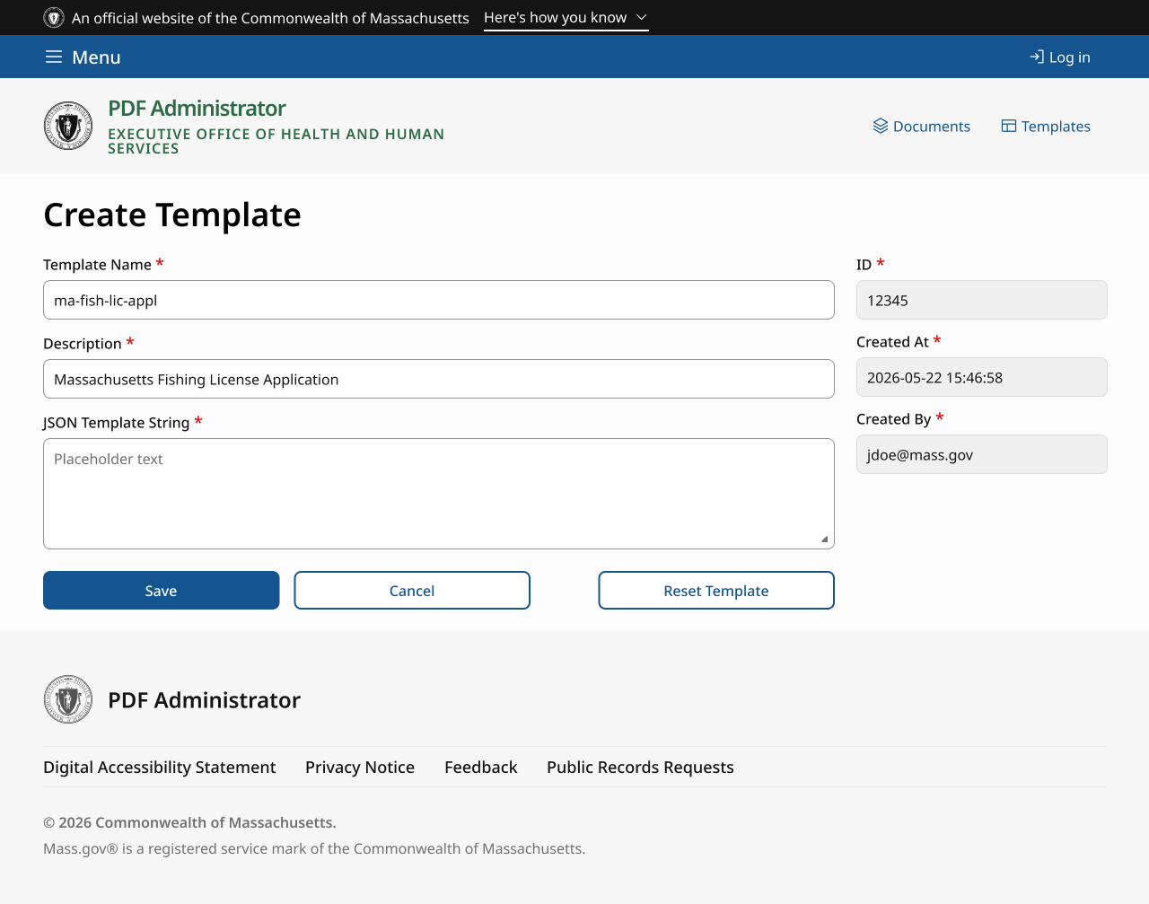
Progress so far
Create Template Page (before v/s after)

Slide 13
Thank you! Any questions?

