Slide 1
Malicious Software & Secure Coding
Chapter 10, Stallings Network Security Essentials 5th Edition

Slide 2
Contents
Malicious Software
Viruses
Worms
Mobile Code
Spam
Trojan horses
Distributed DOS
Countermeasures
Secure Coding

Slide 3
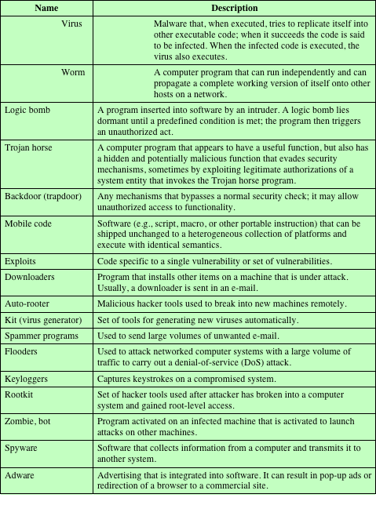
Terminology for Malicious Software
(This table can be found on page 301 in the textbook.)

Slide 4
A Broad classification of malware
Can be classified into two broad categories:
Propagation mechanisms:
Include infection of existing executable or interpreted content by viruses that is subsequently spread to other system
Exploit of software vulnerabilities either locally or over a network by worms or drive-by-downloads to allow the malware to replicate
Social engineering attacks that convince users to bypass security mechanisms to install trojans or to respond to phishing attacks
Based first on how it spreads or propagates to reach the desired targets
Then on the actions or payloads it performs once a target is reached

Slide 5
Broad classification (continued)
Earlier approaches to malware classification distinguished between:
Those that need a host program, being parasitic code such as viruses
Those that are independent, self-contained programs run on the system such as worms, trojans, and bots
Another distinction used was:
Malware that does not replicate, such as trojans and spam e-mail
Malware that does, including viruses and worms
Payload actions performed by malware once it reaches a target system can include:
Corruption of system or data files
Theft of service in order to make the system a zombie agent of attack as part of a botnet
Theft of information from the system, especially of logins, passwords, or other personal details by keylogging or spyware programs
Stealthing where the malware hides its presence on the system from attempts to detect and block it
Blended attack
Uses multiple methods of infection or propagation to maximize the speed of contagion and the severity of the attack

Slide 6
Attack kits
Initially the development and deployment of malware required considerable technical skill by software authors
This changed with the development of virus-creation toolkits in the early 1990s and more general attack kits in the 2000s
These toolkits are often known as crimeware
Include a variety of propagation mechanisms and payload modules that even novices can combine, select, and deploy
Can easily be customized with the latest discovered vulnerabilities in order to exploit the window of opportunity between the publication of a weakness and the deployment of patches to close it
These kits greatly enlarged the population of attackers able to deploy malware

Slide 7
Attack sources
Another significant malware development over the last couple of decades is the change from attackers being individuals to more organized and dangerous attack sources
These include politically motivated attackers, criminals, organized crime, organizations that sell their services to companies and nations, and national government agencies
This has significantly changed the resources available and motivation behind the rise of malware leading to development of a large underground economy involving the sale of attack kits, access to compromised hosts, and to stolen information

Slide 8
Viruses
Parasitic software fragments that attach themselves to some existing executable content
Can “infect” other programs or any type of executable content and modify them
The modification includes injecting the original code with a routine to make copies of the virus code, which can then go on to infect other content
One reason viruses dominated the malware scene in earlier years was the lack of user authentication and access controls on personal computer systems

Slide 9
Virus Structure
A computer virus and many contemporary types of malware includes one or more variants of each of these components:
Infection mechanism
The means by which a virus spreads or propagates, enabling it to replicate
Also referred to as the infection vector
Trigger
The event or condition that determines when the payload is activated or delivered
Sometimes known as a logic bomb
Payload
What the virus does, besides spreading
May involve damage or benign but noticeable activity

Slide 10
Virus phases
During its lifetime, a typical virus goes through the following four phases:
Dormant phase
The virus is idle
Will eventually be activated by some event
Not all viruses have this stage
Propagation phase
The virus places a copy of itself onto other programs or into certain system areas on the disk
Triggering phase
The virus is activated to perform the function for which it was intended
Can be caused by a variety of system events
Execution phase
The function is performed

Slide 11
Virus Classification by target
Boot sector infector
Infects a master boot record or boot record and spreads when a system is booted from the disk containing the virus
File infector
Infects files that the operating system or shell consider to be executable
Macro virus
Infects files with macro or scripting code that is interpreted by an application
Multipartite virus
Infects files in multiple ways
Includes the following categories:

Slide 12
Virus classification by concealment strategy
Includes the following categories:
Encrypted virus
Portion of the virus creates a random encryption key and encrypts the remainder of the virus
When an infected program is invoked, the virus uses the stored random key to decrypt the virus
When the virus replicates, a different random key is selected
Because the bulk of the virus is encrypted with a different key for each instance, there is no constant bit pattern to observe
Stealth virus
A form of virus explicitly designed to hide itself from detection by antivirus software
The entire virus, not just a payload is hidden
Polymorphic virus
A virus that mutates with every infection, making detection by the “signature” of the virus impossible
Metamorphic virus
Mutates with every infection
Rewrites itself completely at each iteration, increasing the difficulty of detection
May change their behavior as well as their appearance

Slide 13
Macro and scripting viruses
Macro viruses infect scripting code used to support active content in a variety of user document types
Threatening for a number of reasons:
A macro virus is platform independent
Macro viruses infect documents, not executable portions of code
Macro viruses are easily spread, as the documents they exploit are shared in normal use
Because macro viruses infect user documents rather than system programs, traditional file system access controls are of limited use in preventing their spread

Slide 14
Worms
A program that actively seeks out more machines to infect
Upon activation, the worm may replicate and propagate again
To replicate itself, a worm uses some means to access remote systems:
Electronic mail or instant messenger facility
File sharing
Remote execution capability
Remote file access or transfer capability
Remote login capability

Slide 15
Worm phases
A worm typically uses the same phases as a computer virus:
Dormant
Propagation
Triggering
Execution
The propagation phase generally performs the following functions:
Search for appropriate access mechanisms to other systems to infect by examining host tables, address books, buddy lists, trusted peers, and other similar repositories of remote system access details
Use the access mechanisms found to transfer a copy of itself to the remote system and cause the copy to be run

Slide 16
The Morris worm
Released onto the Internet by Robert Morris in 1988
Designed to spread on UNIX systems and used a number of different techniques for propagation
When a copy began execution its first task was to discover other hosts known to this host that would allow entry from this host
For each discovered host, the worm tried a number of methods for gaining access:
It attempted to log on to a remote host as a legitimate user
It exploited a bug in the UNIX finger protocol, which reports the whereabouts of a remote user
It exploited a trapdoor in the debug option of the remote process that receives and sends mail

Slide 17
Worm Technology
Multiplatform
Newer worms can attack a variety of platforms
Multi-exploit
New worms penetrate systems in a variety of ways, using exploits against Web servers, browsers, e-mail, file sharing, and other network-based applications, or via shared media
Ultrafast spreading
Exploit various techniques to optimize the rate of spread of a worm to maximize its likelihood of locating as many vulnerable machines as possible in a short time period
Polymorphic
To evade detection, skip past filters, and foil real-time analysis, each copy of the worm has new code generated on the fly using functionally equivalent instructions and encryption techniques
Metamorphic
In addition to changing their appearance, metamorphic worms have a repertoire of behavior patterns that are unleashed at different stages of propagation
Transport vehicles
Because worms can rapidly compromise a large number of systems, they are ideal for spreading a wide variety of malicious payloads
Zero-day exploit
To achieve maximum surprise and distribution, a worm should exploit an unknown vulnerability that is only discovered by the general network community when the worm is launched

Slide 18
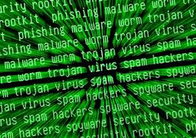
Recent attacks
Stuxnet Virus (June 2010)
http://vimeo.com/25118844
US Olympic Games
http://www.nytimes.com/2012/06/01/world/middleeast/obama-ordered-wave-of-cyberattacks-against-iran.html?pagewanted=all

Slide 19
Recent attacks
Flame (May 2012)
attacks computers running the Microsoft Windows operating system.
used for targeted cyber espionage in Middle Eastern countries.
spreads over a LAN or via USB stick.
records audio, screenshots, keyboard activity, Skype conversations and network traffic.
victims included governmental organisations, educational institutions and private individuals.
65% of the infections happened in Iran, Israel, Sudan, Syria, Lebanon, Saudi Arabia, and Egypt.
supports a "kill" command which wipes all traces of the malware
initial infections of Flame stopped operating after its public exposure, and the "kill" command was sent
http://www.wired.com/threatlevel/2012/05/flame/

Slide 20
Recent attacks
DuQu ( Sep 2011)
Related to Stuxnet experts compared the similarities and found three of interest:
The installer exploits zero-day Windows kernel vulnerability(ies).
Components are signed with stolen digital keys.
Duqu and Stuxnet are both highly targeted and related to the nuclear program of Iran.
Mystery language solved
http://www.wired.com/threatlevel/2012/03/duqu-mystery-language-solved/

Slide 21
Mobile code
Refers to programs that can be shipped unchanged to a heterogeneous collection of platforms and execute with identical semantics
Transmitted from a remote system to a local system and then executed on the local system without the user’s explicit instruction
Often acts as a mechanism for a virus, worm, or Trojan horse to be transmitted to the user’s workstation
Popular vehicles for mobile code include: Java applets, ActiveX, JavaScript, VBScript
The most common ways of using mobile code for malicious operations on local system are:
Cross-site scripting
Interactive and dynamic Web sites
E-mail attachments
Downloads from untrusted sites or of untrusted software

Slide 22
Drive-by-downloads
Exploits browser vulnerabilities so that when the user views a Web page controlled by the attacker, it contains code that exploits the browser bug to download and install malware on the system without the user’s knowledge or consent
Does not actively propagate as a worm does, but rather waits for unsuspecting users to visit the malicious Web page in order to spread to their systems

Slide 23
Spam
Unsolicited bulk e-mail
Imposes significant costs on both the network infrastructure needed to relay this traffic and on users who need to filter their legitimate e-mails
Most recent spam is sent by botnets using compromised user systems
Is a significant carrier of malware
May be used in a phishing attack
Although a significant security concern, in many cases it requires the user’s active choice to view the e-mail and any attached document or to permit the installation of some program, in order for the compromise to occur

Slide 24
Trojan horses
Is a useful, or apparently useful, program or utility containing hidden code that, when invoked, performs some unwanted or harmful function
Can be used to accomplish functions indirectly that the attacker could not accomplish directly
Fit into one of three models:
Continuing to perform the function of the original program but modifying the function to perform malicious activity or to disguise other malicious activity
Performing a malicious function that completely replaces the function of the original program
Continuing to perform the function of the original program and additionally performing a separate malicious activity

Slide 25
Payload – system corruption
Once malware is active on the target system, the next concern is what actions it will take on this system
Examples:
Data destruction on the infected system when certain trigger conditions were met
Display unwanted messages or content on the user’s system when triggered
Encrypt the user’s data and demand payment in order to access the key needed to recover this information (ransomware)
Inflict real-world damage on the system
Attempt to rewrite the BIOS code used to initially boot the computer
Target specific industrial control system software
Logic bomb
Code embedded in the malware that is set to “explode” when certain conditions are met

Slide 26
Payload – attack agent
Malware subverts the computational and network resources of the infected system for use by the attacker
Bot (robot), zombie, drone
Secretly takes over another Internet-attached computer and then uses that computer to launch or manage attacks that are difficult to trace to the bot’s creator
A botnet is a collection of bots often capable of acting in a coordinated manner

Slide 27
Uses of bots
Distributed denial-of-service (DDoS) attacks
Spamming
Sniffing traffic
Keylogging
Spreading new malware
Installing advertisement add-ons and browser helper objects (BHOs)
Attacking Internet Relay Chat (IRC) networks
Manipulating online polls/games

Slide 28
Payload – information theft
Keylogger
Captures keystrokes on the infected machine to allow an attacker to monitor user login and password credentials
Spyware
Developed in response to efforts to try and stop keylogging
Subvert the compromised machine to allow monitoring of a wide range of activity on the system which can result in significantly compromising the user’s personal information
Phishing
Exploits social engineering to leverage the user’s trust by masquerading as communication from a trusted source
Spear-phishing
An e-mail claiming to be from a trusted source, however, the recipients are carefully researched by the attacker, and each e-mail is carefully crafted to suit its recipient specifically

Slide 29
Payload – stealthing
Backdoor
Also know as a trapdoor
Is a secret entry point into a program that allows someone who is aware of the backdoor to gain access without going through the usual security access procedures
Code that recognizes some special sequence of input or is triggered by being run from a certain user ID or by an unlikely sequence of events
Usually implemented as a network service listening on some nonstandard port that the attacker can connect to and issue commands through to be run on the compromised system

Slide 30
Payload –stealthing
Rootkit
A set of programs installed on a system to maintain covert access to that system with administrator (or root) privileges, while hiding evidence of its presence to the greatest extent possible
Alters the host’s standard functionality in a malicious and stealthy way
An attacker has complete control of the system and can add or change programs and files, monitor processes, send and receive network traffic, and get backdoor access on demand
Hides by subverting the mechanisms that monitor and report on the processes, files, and registries on a computer

Slide 31
Countermeasures
Policy
Awareness
Vulnerability mitigation
Threat mitigation
Elements of prevention:
One of the first countermeasures that should be employed is to ensure all systems are as current as possible, with all patches applied, in order to reduce the number of vulnerabilities that might be exploited on the system
The next is to set appropriate access controls on the applications and data stored on the system, to reduce the number of files that any user can access, and hence potentially infect or corrupt, as a result of them executing some malware code
The third common propagation mechanism, which targets users in a social engineering attack, can be countered using appropriate user awareness and training

Slide 32
Host-based scanners
First generation
Simple scanners
Scanner requires a malware signature to identify the malware
Second generation
Heuristic scanners
Uses heuristic rules to search for probable malware instances
Integrity checking
Third generation
Activity traps
Memory-resident programs that identify malware by its actions rather than its structure in an infected program
Fourth generation
Full-feature protection
Packages consisting of a variety of antivirus techniques used in conjunction
Four generations of antivirus software:

Slide 33
Host-based behavior-blocking software
Integrates with the operating system of a host computer and monitors program behavior in real time for malicious actions
The software then blocks potentially malicious actions before they have a chance to affect the system
Can block suspicious software in real time so it has an advantage over antivirus detection techniques such as fingerprinting or heuristics
Limitations:
Because the malicious code must run on the target machine before all its behaviors can be identified, it can cause harm before it has been detected and blocked

Slide 34
Perimeter scanning approaches
Antivirus software is used on an organization’s firewall and IDS
Typically included in e-mail and Web proxy services running on these systems
May also be included in the traffic analysis component of an IDS
Two types of monitoring software may be used:
Ingress monitors
Located at the border between the enterprise network and the Internet
They can be part of the ingress-filtering software of a border router or external firewall or a separate passive monitor
Egress monitors
These can be located at the egress point of individual LANs on the enterprise network as well as at the border between the enterprise network and the Internet
Designed to catch the source of a malware attack by monitoring outgoing traffic for signs of scanning or other suspicious behavior

Slide 35
Distributed Denial of Service Attacks (DDOS)
Attacks that make computer systems inaccessible by flooding servers, networks, or even end-user systems with useless traffic so that legitimate users can no longer gain access to those resources
One way to classify DDoS attacks is in terms of the type of resources that are consumed
The resource consumed is either an internal host resource on the target system or data transmission capacity in the local network in which the target is attacked

Slide 36
DDos
Stallings shows an example of an internal resource attack - the SYN flood attack.
The attacker takes control of multiple hosts over the Internet
The slave hosts begin sending TCP/IP SYN (synchronize/initialization) packets, with erroneous return IP address information, to the target
For each such packet, the Web server responds with a SYN/ACK (synchronize/acknowledge) packet. The Web server maintains a data structure for each SYN request waiting for a response back and becomes bogged down as more traffic floods in.

Slide 37
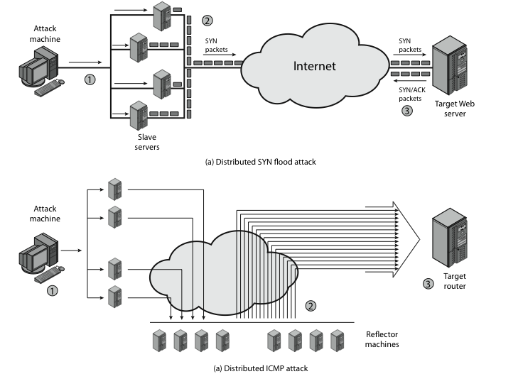
Distributed Denial of Service Attacks (DDoS)
Notes:
.

Slide 38
DDoS
Stallings illustrates an example of an attack that consumes data transmission resources.
The attacker takes control of multiple hosts over the Internet, instructing them to send ICMP ECHO packets with the target’s spoofed IP address to a group of hosts that act as reflectors
Nodes at the bounce site receive multiple spoofed requests and respond by sending echo reply packets to the target site.
The target’s router is flooded with packets from the bounce site, leaving no data transmission capacity for legitimate traffic

Slide 39
Distributed Denial of Service Attacks (DDoS)
Notes:
.

Slide 40
Direct DDoS attacks
In a direct DDoS attack the attacker is able to implant zombie software on a number of sites distributed throughout the Internet.
Often, the DDoS attack involves two levels of zombie machines: master zombies and slave zombies.
The hosts of both machines have been infected with malicious code. The attacker coordinates and triggers the master zombies, which in turn coordinate and trigger the slave zombies.
The use of two levels of zombies makes it more difficult to trace the attack back to its source and provides for a more resilient network of attackers.

Slide 41
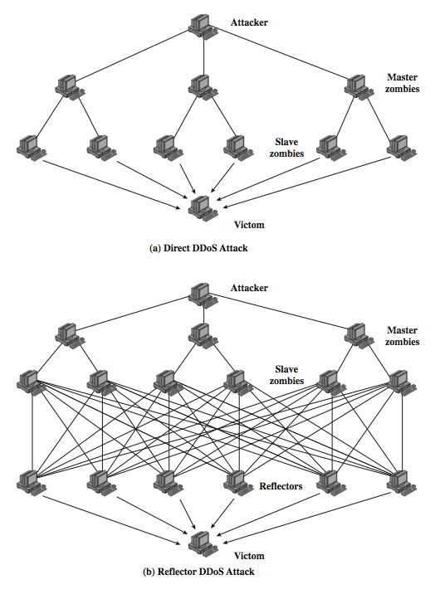
DDoS Flood Types

Slide 42
Reflector DDoS attacks
A reflector DDoS attack adds another layer of machines.
In this type of attack, the slave zombies construct packets requiring a response that contain the target's IP address as the source IP address in the packet's IP header.
These packets are sent to uninfected machines known as reflectors.
The uninfected machines respond with packets directed at the target machine. A reflector DDoS attack can easily involve more machines and more traffic than a direct DDoS attack and hence be more damaging.
Further, tracing back the attack or filtering out the attack packets is more difficult because the attack comes from widely dispersed uninfected machines.

Slide 43
DDoS Flood Types

Slide 44
Constructing the Attack Network
The first step in a DDoS attack is for the attacker to infect a number of machines with zombie software that will ultimately be used to carry out the attack
Essential ingredients:
Software that can carry out the DDoS attack
A vulnerability in a large number of systems
A strategy for locating vulnerable machines (scanning)
Scanning strategies:
Random
Each compromised host probes random addresses in the IP address space, using a different seed
Hit list
The attacker first compiles a long list of potential vulnerable machines
Topological
This method uses information contained on an infected victim machine to find more hosts to scan
Local subnet
If a host is infected behind a firewall, that host then looks for targets in its own local network

Slide 45
DDoS Countermeasures
In general, there are three lines of defense against DDoS attacks:
Attack prevention and preemption (before the attack)
These mechanisms enable the victim to endure attack attempts without denying service to legitimate clients
Attack detection and filtering (during the attack)
These mechanisms attempt to detect the attack as it begins and respond immediately
Attack source traceback and identification (during and after the attack)
This is an attempt to identify the source of the attack as a first step in preventing future attacks
Notes:
In general, there are three lines of defense against DDoS attacks [CHAN02]:
• Attack prevention and preemption (before the attack): These mechanisms
enable the victim to endure attack attempts without denying service to legitimate
clients. Techniques include enforcing policies for resource consumption
and providing backup resources available on demand. In addition, prevention
mechanisms modify systems and protocols on the Internet to reduce the possibility
of DDoS attacks.
• Attack detection and filtering (during the attack): These mechanisms attempt
to detect the attack as it begins and respond immediately. This minimizes the
impact of the attack on the target. Detection involves looking for suspicious
patterns of behavior. Response involves filtering out packets likely to be part
of the attack.
• Attack source traceback and identification (during and after the attack): This
is an attempt to identify the source of the attack as a first step in preventing
future attacks. However, this method typically does not yield results fast
enough, if at all, to mitigate an ongoing attack.
The challenge in coping with DDoS attacks is the sheer number of ways in
which they can operate. Thus, DDoS countermeasures must evolve with the threat.

Slide 46
Secure coding
Easily avoided software defects
primary cause of commonly exploited software vulnerabilities.
By identifying insecure coding practices and developing secure alternatives,
software developers can take practical steps to reduce or eliminate vulnerabilities before deployment

Slide 47
Cert secure coding initiative
Secure Coding standards
CERT Program working with software developers to develop standards for commonly used programming languages.
Development Tools and Libraries
The CERT Program has developed tools and libraries that help software developers reduce the number of vulnerabilities in their code.

Slide 48
OWASP
https://www.owasp.org/index.php/Secure_Coding_Principles
10 Secure Coding Principles – Please read
Minimize attack surface area
Establish secure defaults
Principle of Least privilege
Principle of Defense in depth
Fail securely
Don’t trust services
Separation of duties
Avoid security by obscurity
Keep security simple
Fix security issues correctly

Slide 49
Buffer Overflow
Exploit that takes advantage of a program that is waiting on a user's input.
Two main types:
Heap based
Heap-based attacks flood memory space - rare because of difficulty.
Stack based
Most common.
Program being exploited uses a stack to store user input.
Normally, the stack is empty until the program requires user input.
At that point, the program writes a return memory address to the stack and then the user's input is placed on top of it.
When the stack is processed, the user's input gets sent to the return address specified by the program.

Slide 50
Buffer overflow
The programmer must reserve a specific amount of space for the stack.
If the user's input is longer than the amount of space reserved for it within the stack, then the stack will overflow.
This isn't a huge problem……but it becomes a huge security hole when combined with malicious input.

Slide 51
example
Suppose a program is waiting for a user to enter his or her name.
Rather than enter the name, the hacker would enter a short executable command that exceeds the stack size.
In a Linux environment the command is typically EXEC("sh"), which tells the system to open a command prompt window, known as a root shell in Linux.

Slide 52
Example contd.
Overflowing the buffer with an executable command doesn't mean that the command will be executed.
The attacker must then specify a return address that points to the malicious command.
The program partially crashes because the stack overflowed.
It then tries to recover by going to the return address, but the return address has been changed to point to the command specified by the hacker.

Slide 53
Program permissions
The last part of the equation is the executable program's permissions.
Most modern operating systems have a mechanism to control the access level of the user currently logged on and executable programs typically require a higher level of permissions.
When a stack-overflow attack runs the command found at the new return address, the program thinks it is still running.
This means that the command prompt window that has been opened is running with the same set of permissions as the application that was compromised.
Generally speaking, this often means that the attacker will gain full control of the operating system.

