Slide 1
Field Service Management Web Application
John Hodmon
Student Number 98163813

Slide 2
Functions
The application will be designed to help businesses who service
products in the field, for example a company
who looks after the servicing of washing machines
Manage information about each customer and their products.
Manage information about each product including bill of material
Manage service history for each product
Manage jobs including the spare parts used on a job
Hold data on engineers, customers, products, parts and invoices

Slide 3
ER Diagram
The many to many
Relationship between
Product and part is
Handled by a join
table called parts_list which also
Stores the quantity of
each part.
Similarly, a join table stores
Information on the parts
used to carry out repair
on a job.
A table called customer_products
handles the m-m relationship
between customers and products
This table also stores serial number

Slide 4
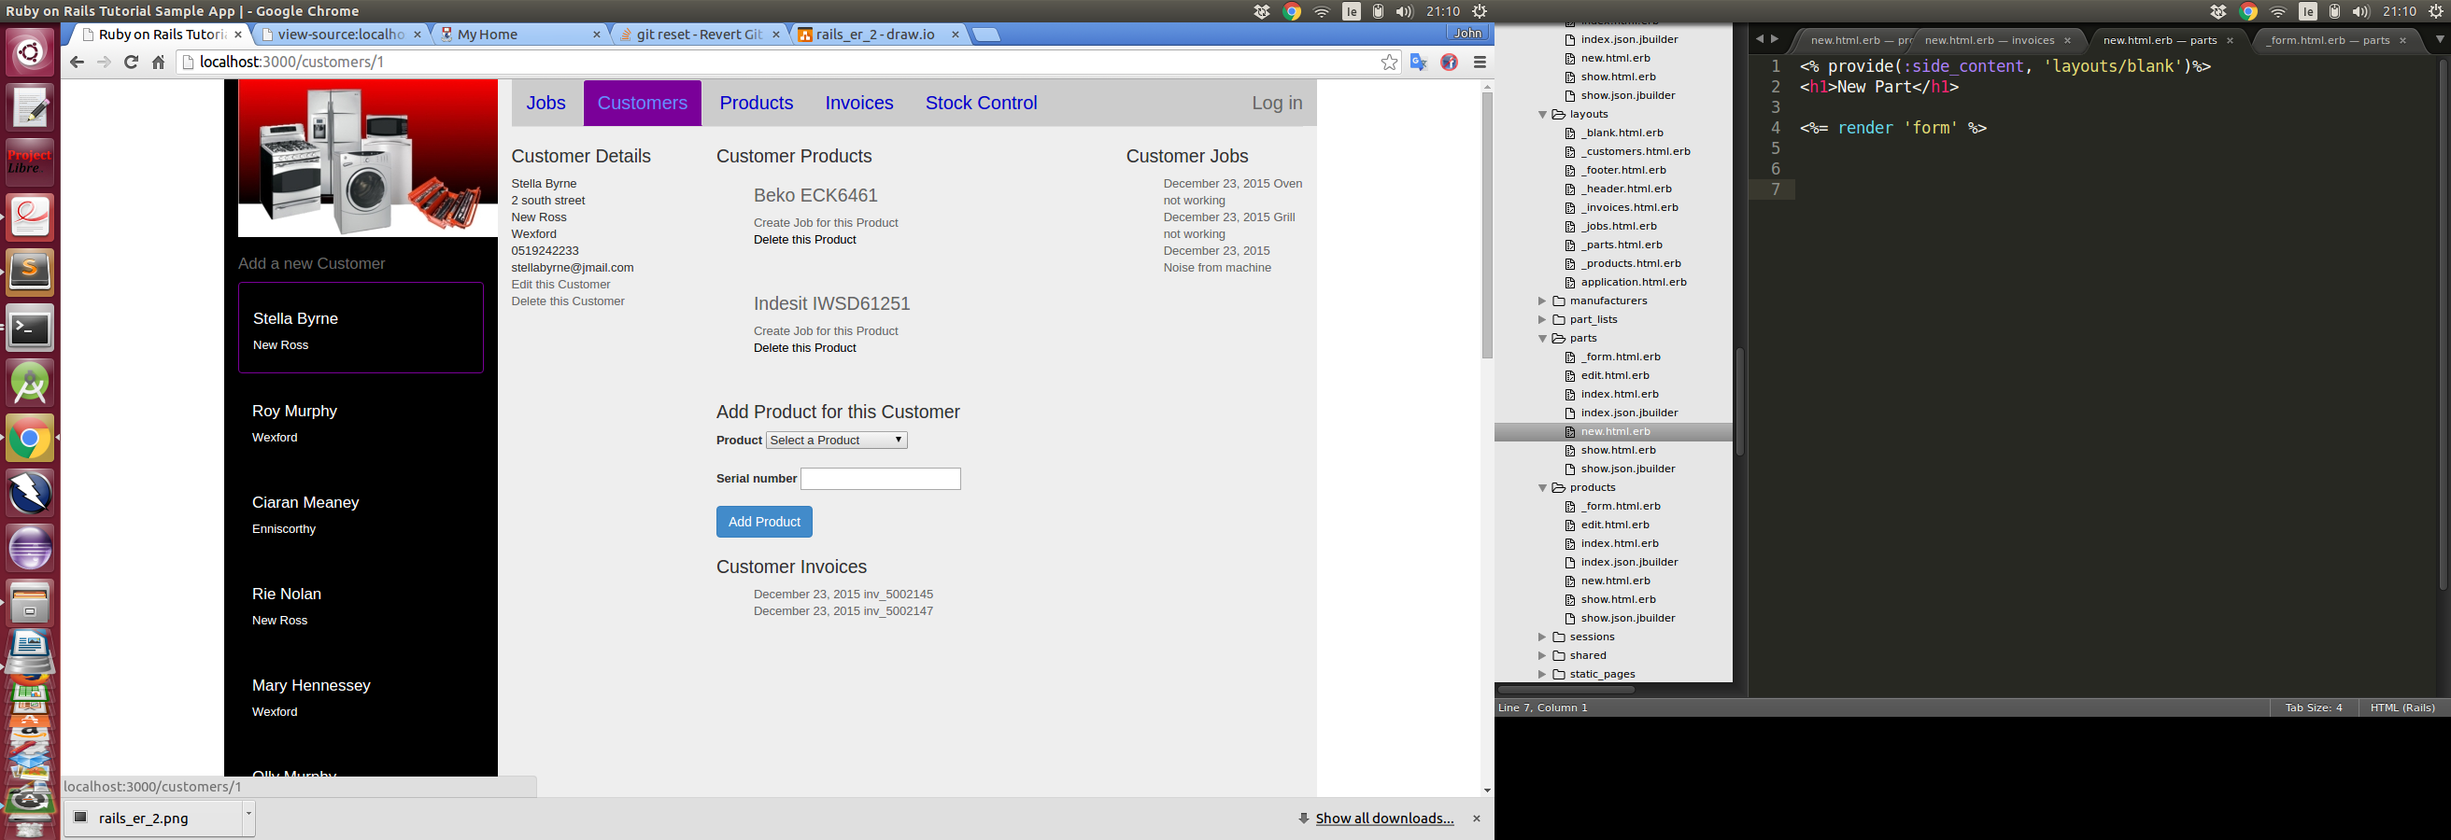
Customers Screen
For all screens the information on screen dynamically updates depending on the item selected on the
left of the screen.
Customer details can be edited or customer can be deleted
Hyperlinks exist to the products of the customer, and previous customer jobs
Jobs can be created for the customers product or a customers product can be deleted

Slide 5
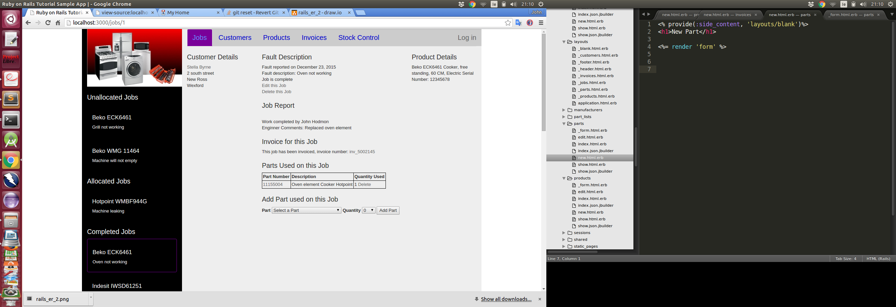
Jobs Screen
Parts used on a job can be added
Parts in the drop down menu are from the bill of material of the product being repaired
List of parts used dynamically updates as parts are added
Hyperlink to customer page
Job can be edited or deleted

Slide 6
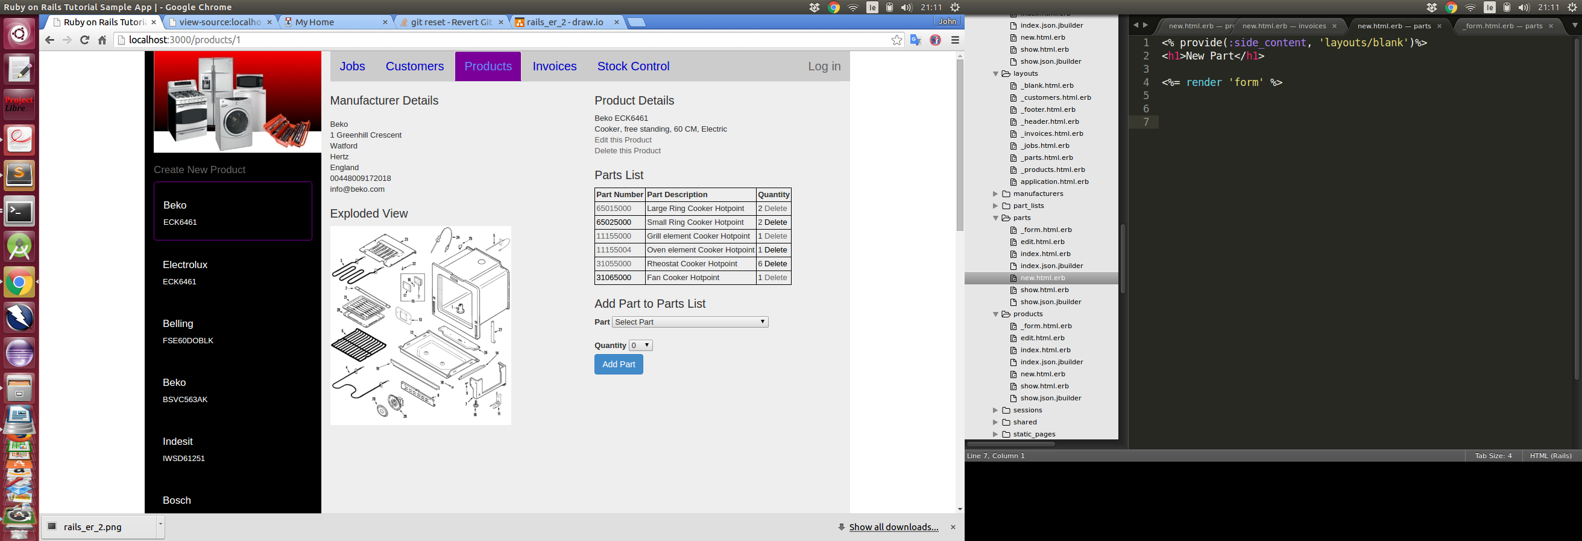
Products Screen
Product can be edited or deleted
Parts can be added or deleted from the part list for the product

Slide 7
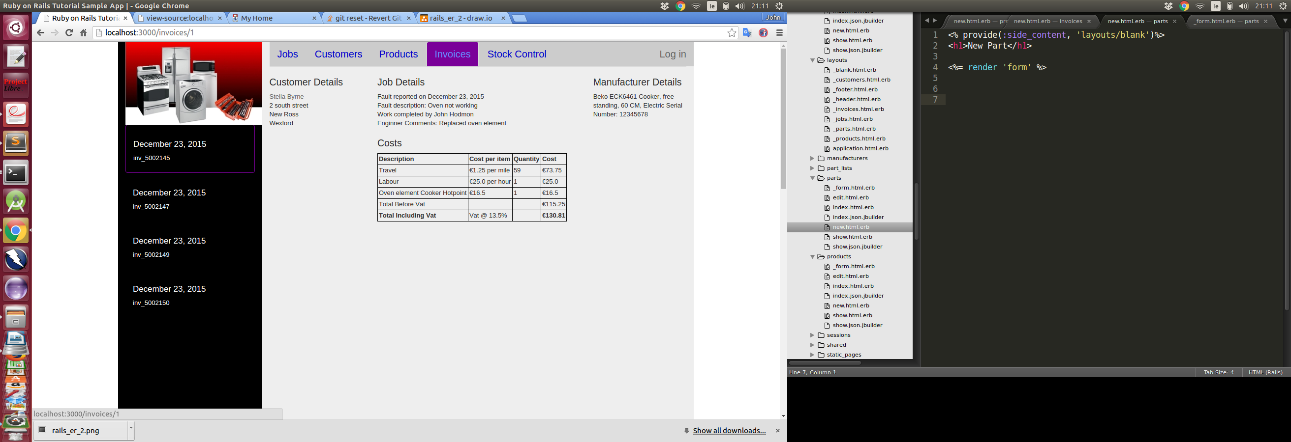
Invoices Screen
Hyperlink to customers page
Hyperlink to jobs page
Costs automatically calculated using Invoice class attributes and values from Job

Slide 8
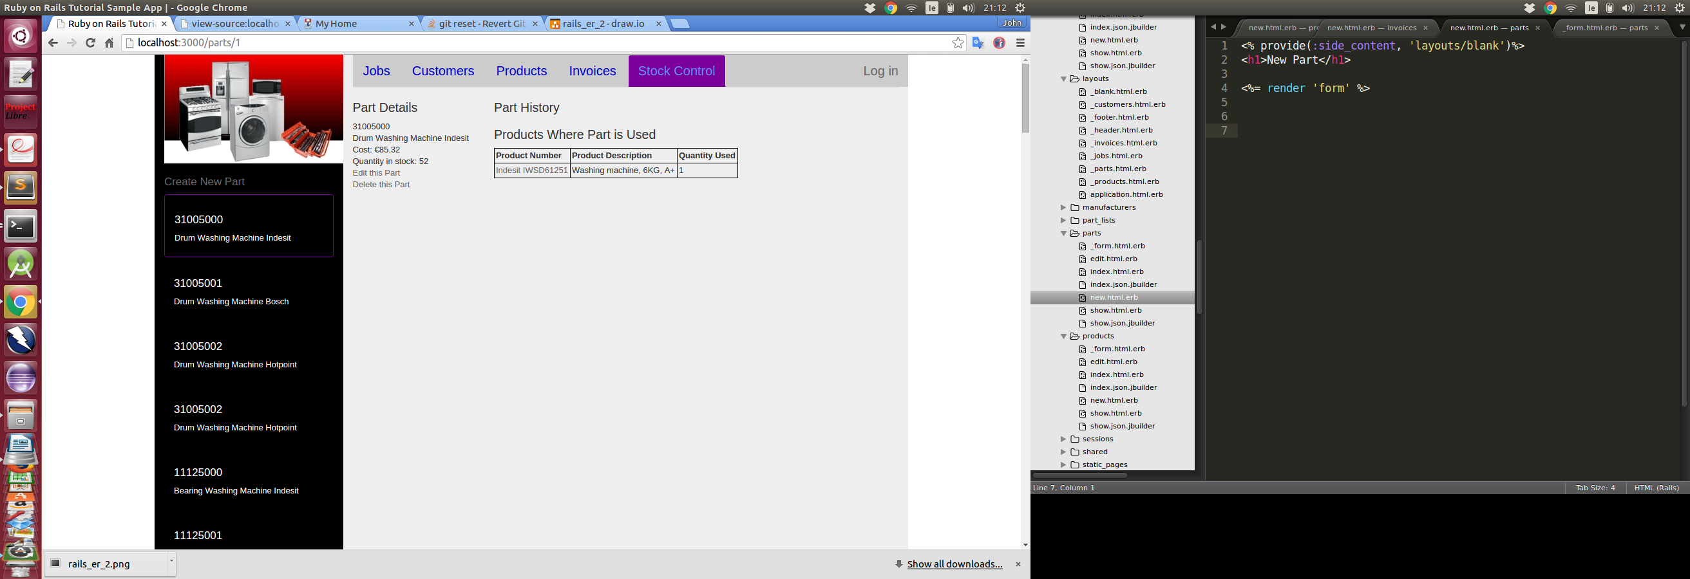
Stock Control Screen
Parts can be edited and deleted
A history of what jobs the part has been used on can be seen with hyperlinks to those jobs
The products which have the part in their parts lists can be seen with hyperlinks to those products

