Slide 1
Spartan Health Database
Group: : Germell, Jackie, Sharanitha, Nick, John

Slide 2
Scene one
Login Page
Username and password needed for all users except administration
Admin sign in process solely requires an universal passcode

Slide 3
Scene two
Admin: Manipulates data through adding and removing information about all users
Physician: Manipulates data through adding and removing information about staff/employees and patients
Staff: Manipulates data through adding and removing information about patients only
Patient: Restricted to adjusting to their own personal information

Slide 4
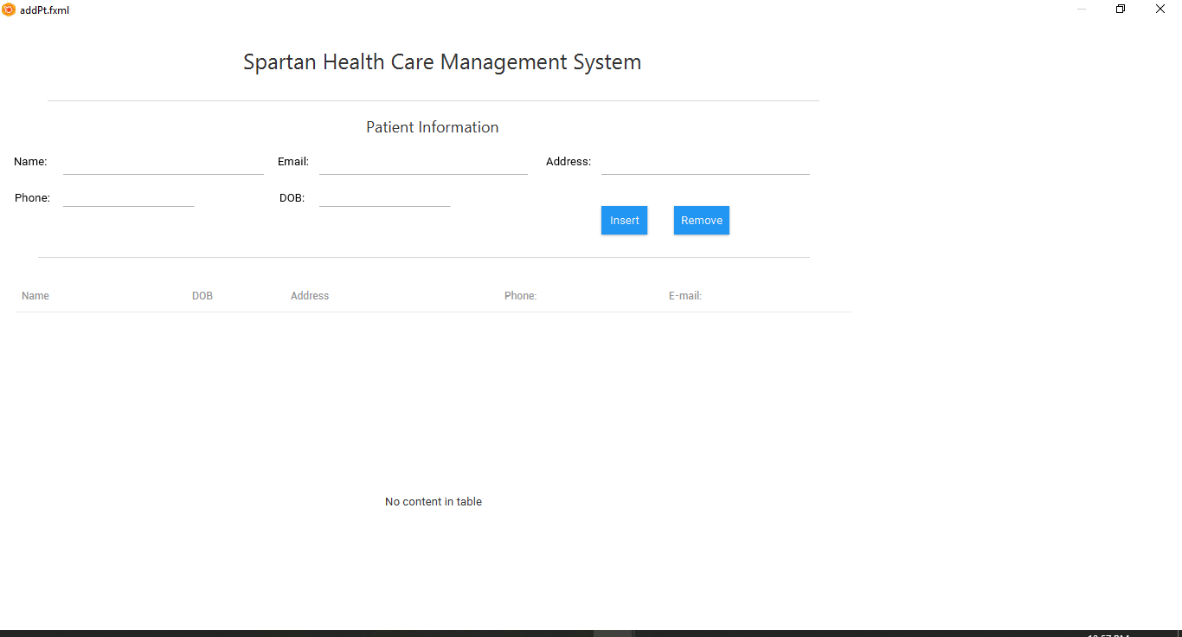
Patient Information
This displays the demo scene for accessing patient’s information

Slide 5
Lists, Sorting, etc.
Bubble Sort – Sort patient payments to look for highest balance
Linked List – Possibly used for a patient’s list of medication
Binary Sort – Possibly used to search for a specific appointment
Still working on Hashmap and TreeSet implementation

Slide 6
Inserting into database
MySQL database has been created
Patient table currently being populated
Still planning Doctor, Assistant, and Appointment tables (columns, data types)
Debating creating a credit card table

Slide 7
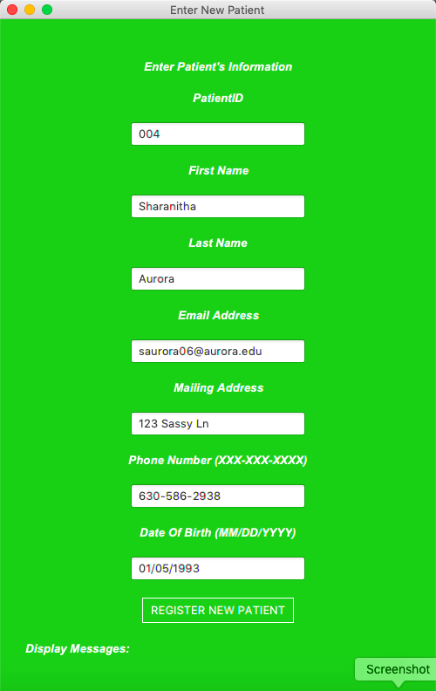
Demo of data insertion
into the database

Slide 8
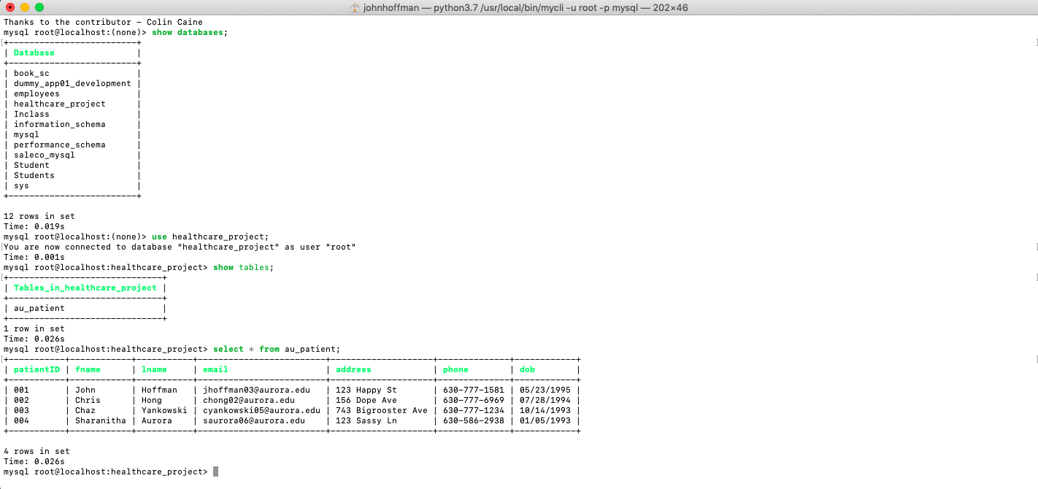

Slide 9
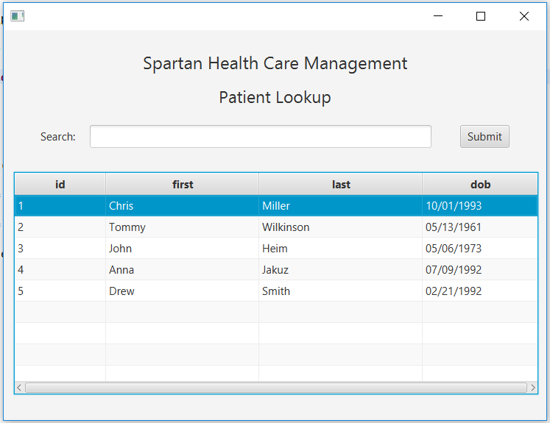
Demo GUI To Display Database Data

Slide 10
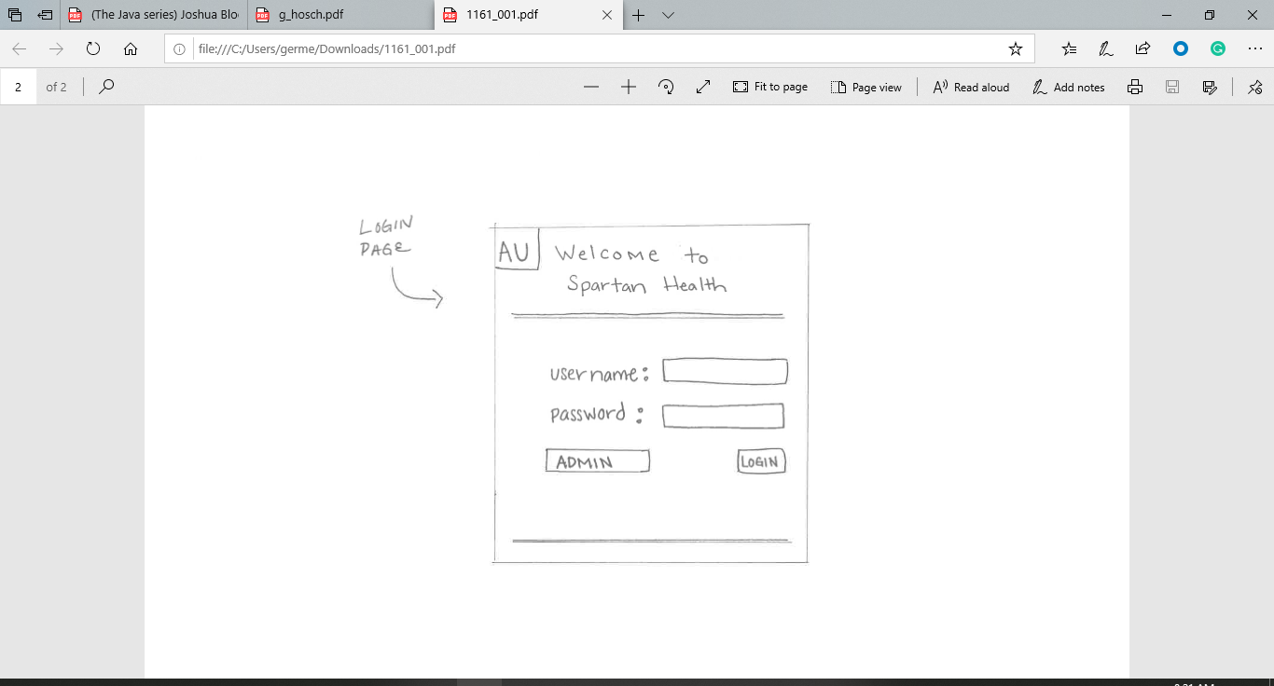

Slide 11
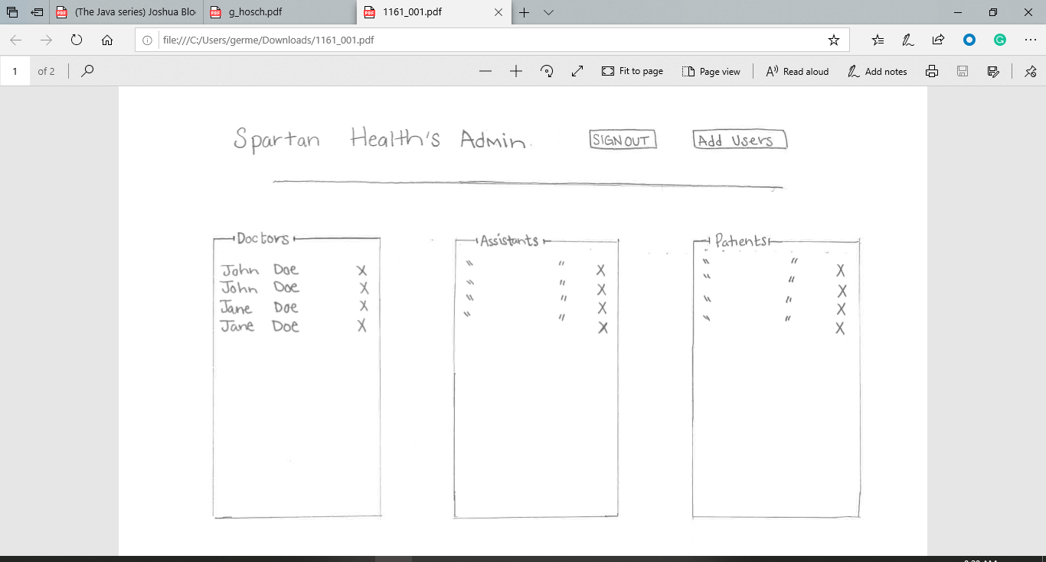

Slide 12
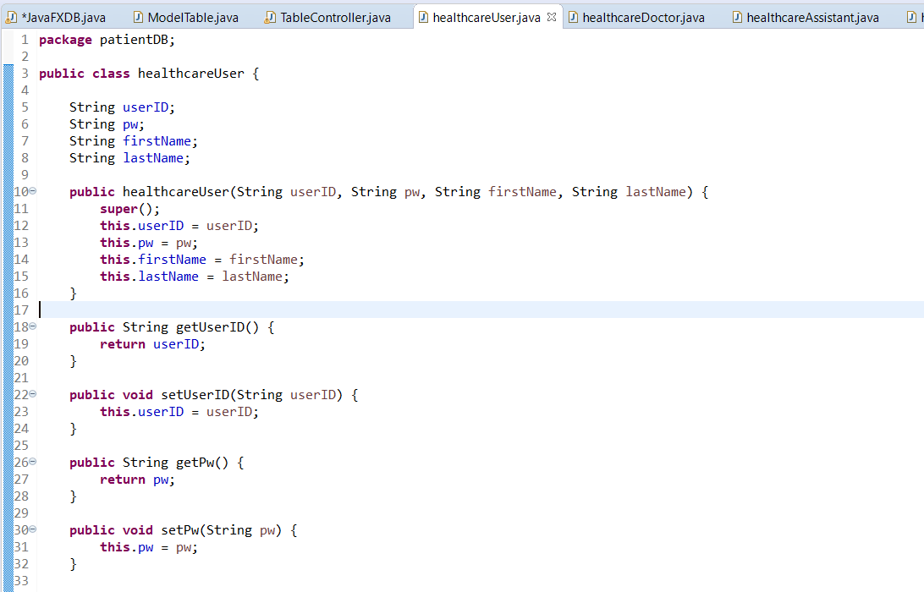

Slide 13
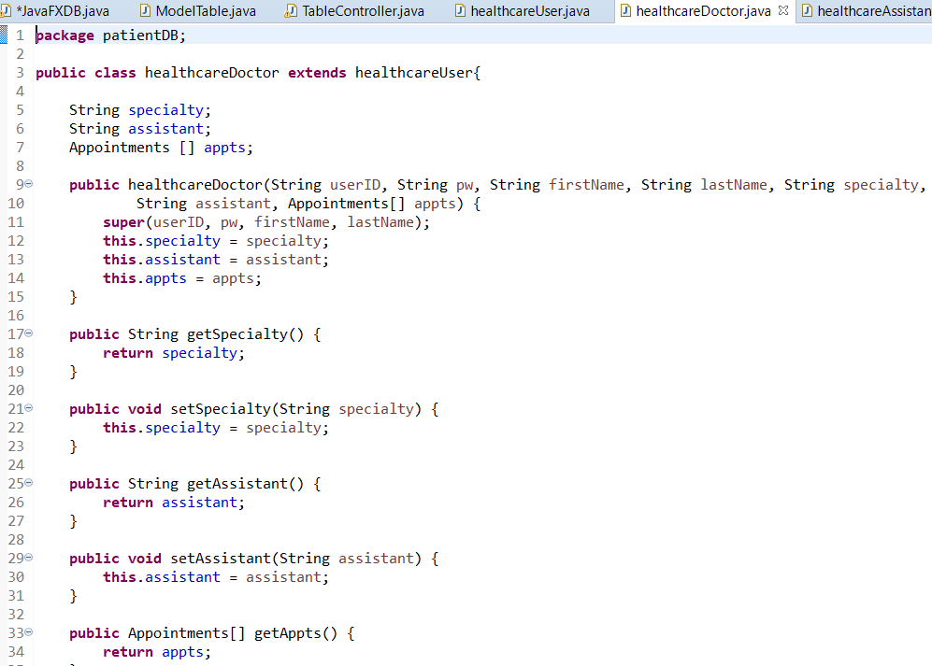

Slide 14
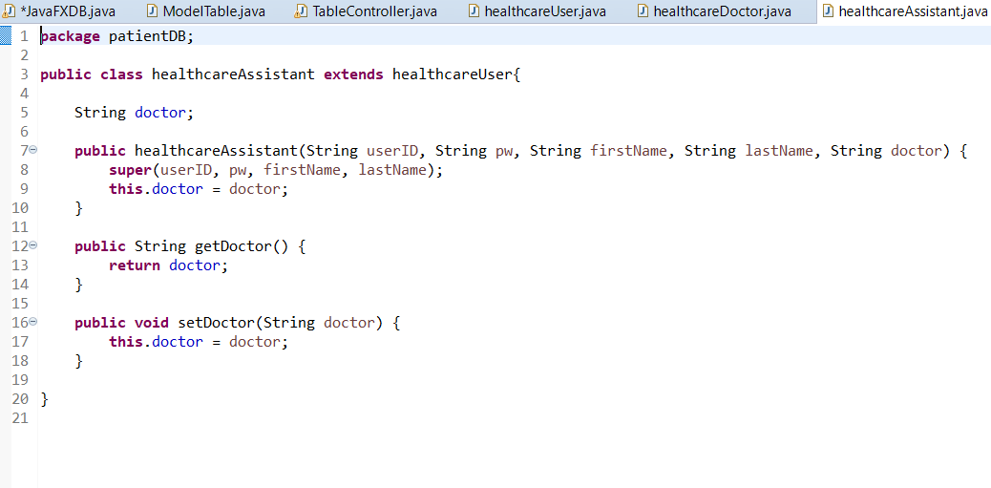

Slide 15
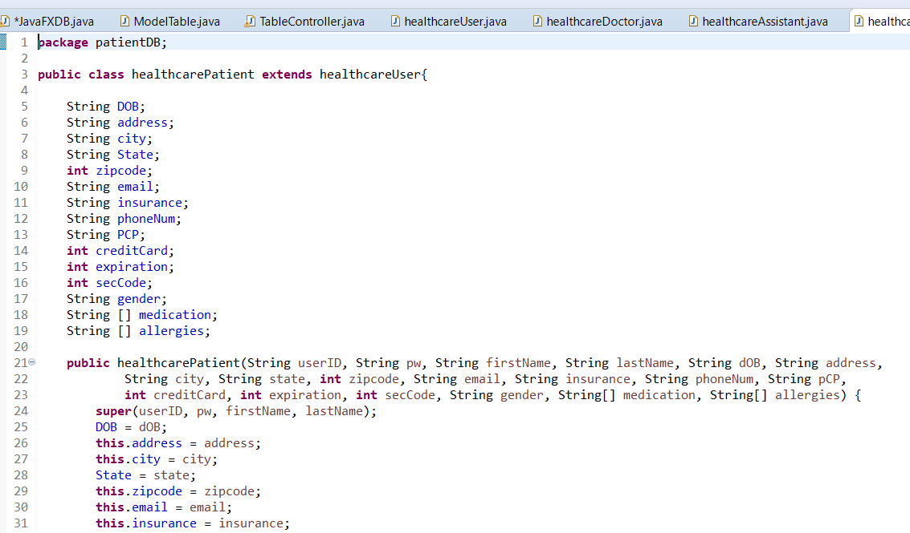

Slide 16
