Slide 1

Multimodal Playlist Generation
Using emotion, physiology & activity data to recommend the perfect music
Gabby Cordelli, Anjali Goel, and John Hope
Notes:
“Hi everyone — we’re excited to share our project Vibes by Design, a multimodal AI system that recommends music based on your emotional, physical, and behavioral state.”

Slide 2
Why this project?
Music boosts mood, motivation, and focus
But playlists don’t always match what we feel
Can AI personalize music using multimodal signals?
Notes:
“We wanted to solve a relatable problem — we often don’t get playlists that match our current vibe. Pre-made playlists may not tailor to our moods as well as our own markers can. So, we set out to build a system that reads your face, stress level, and activity to suggest music accordingly.” As of right now, platforms like Spotify have emotion-based playlists, but they are not tailored to individual user and do not take into account subconscious biological & psychological markers

Slide 3
Data Sources
FER-2013
Facial emotion images
7 emotion classes
WESAD
Biometric time-series (HR, EDA)
Label: stress, neutral
Capture-24 / HAR
Accelerometer data
Labels: walking, sitting, etc.
Notes:
“We used three datasets — one for facial emotion, one for biometrics, and one for activity — each giving a different lens on how a user might be feeling in the moment.”
We were unable to include Capture-24 data in our final model because it was not able to map on to emotions, which ended up being necessary for our final model, in as direct a way as Biometric and facial data

Slide 4
Spotify Song Data
Pulled 1,000+ songs using Spotify API
Extracted audio features:
valence, energy, tempo, danceability, mode
Goal: classify each song by emotion + activity-fit
Notes:
We originally pulled 10,000 songs in 1,000 sing increments for our playlist generator, but had to reduce scale for feasibility based on resources

Slide 5
Classifying Songs by Vibe
Used thresholds and rule-based logic
Example:
High energy + low valence = angry
High danceability + moderate tempo = workout
Mapped all songs to 7 vibe categories (happy, sad, angry, neutral, disgust, fear, surprise)

Slide 6
System Pipeline
Input data (face, sensor, activity) →
Models →
Fusion logic →
Predicted vibe tag →
Matching to song categories →
Playlist output
Notes:
“We designed our pipeline to handle multiple data types and fuse their predictions to find an appropriate mood tag, which we then use to query Spotify’s API for a playlist.”

Slide 7
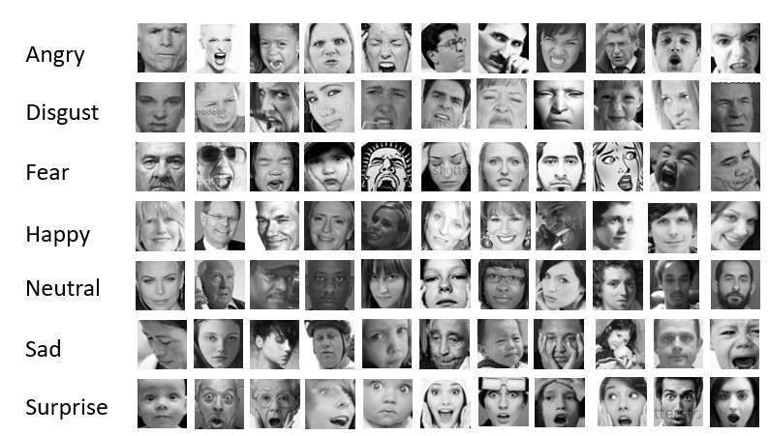
Emotion Classifier (FER-2013)
CNN-based image classifier
Trained on grayscale facial images
7 emotion classes (happy, sad, angry, neutral, disgust, fear, surprise)
Validation Acc: 66.3%
Notes:
“We trained a CNN on FER-2013 to predict emotions like happy, sad, and angry from facial images. This helped identify the user’s emotional state from visual input.”

Slide 8
WESAD Stress Classifier
Time-series data from chest-worn sensors
Used LSTM-based model
Predicted stress vs. non-stress
Acc: X%

Slide 9
Fusion + Spotify Integration
Rule-based logic to fuse 3 model outputs
Mapped to mood categories (e.g., ‘sad + walking → chill’)
Spotify API used to generate playlists
Notes:
“We fused the outputs and matched them to mood tags — like ‘sad and stressed’ → ‘lo-fi sad beats’ — and used the Spotify API to pull a curated playlist.”

Slide 10
Sample Outputs
Notes:
🎤 Say: “These are just a few examples of how our system reacts to different multimodal inputs to deliver a music experience that actually fits.”

Slide 11
Where this could go
Limitations to our project
Amount of data (not enough songs, accelerometer data is overwhelming)
Lack of testing
Subjectivity of goal
Integration into wearables (e.g. Apple Watch, etc.)
Notes:
“We’re excited by the potential here. Real-time, wearable-based playlist generation could improve daily mood, mental health, and productivity in a lightweight way.”

