Slide 1


Where are we?
Linux?
Python?
Matlab?

Slide 2
Course Description
Learning to program is similar to learning a spoken language:
is hard to do
is easier for some people than others
is difficult to learn how on your own by just reading a book
requires practice, lots of practice

Slide 3
Matlab
Matlab (MATrix LABoratory)-
commercial product built initially to simplify learning Fortran and later rebuilt using C
Don’t have to declare variable type, handles matrix math handily, etc.
Matlab has tool packages to purchase, but don’t import such tools, already loaded
Let’s get going!
Find matlab on your mac

Slide 4
1.1 Starting MATLAB, MATLAB Windows
Window | Purpose
Command Window | Main window, enters variables, runs programs.
Figure Window | Contains output from graphic commands.
Editor Window | Creates and debugs script and function files.
Help Window | Provides help information.
Command History Window | Logs commands entered in the Command Window.
Workspace Window | Provides information about the variables that are stored.
Current Folder Window | Shows the files in the current folder.

Slide 5
1.2 Working in the Command Window
Command Window is MATLAB’s main window. Use it to:
Execute commands
Open other windows
Run programs that you’ve written
Manage the MATLAB software
ver- version. What version of Matlab is installed and toolboxes available

Slide 6
1.2 Working in the Command Window
Basic procedure
At prompt (>>), type in MATLAB command
Press ENTER key
MATLAB displays result in Command Window, followed by a prompt
Repeat from step 1

Slide 7
1.2 Working in the Command Window
Notes on Command Window
To start a command, make sure cursor is next to prompt
MATLAB won’t respond until you press ENTER
It then executes only last command
Commands before last one may still be visible, but MATLAB doesn’t execute them

Slide 8
1.2 Working in the Command Window
Can type several commands in same line by putting a comma between commands
Hard to read, so don’t do this often
If command too long to fit on line, can continue to next line by typing ellipsis (3 periods, i.e., … ) and then pressing ENTER

Slide 9
1.2 Working in the Command Window
When cursor is in bottom command line:
 key moves cursor one character to left
 key moves cursor one character to right
 key recalls preceding command
 key recalls command that follows one being displayed, i.e., undoes 

Slide 10
1.2 Working in the Command Window
To quickly execute a previous command but with minor changes
Recall command with up- and down-arrow keys
Use left- and right-arrow keys to move to characters to be altered
Use BACKSPACE or DELETE to remove old character, then type new character
Press ENTER to execute modified command

Slide 11
1.2 Working in the Command Window
Command History Window
Shows previous commands, including ones from previous MATLAB sessions
Double-clicking on command puts it in Command Window and executes it
Can drag command to Command Window, make changes in command, then execute it
To clear one or more commands, select the lines to delete, right click, choose Delete Selection
To clear entire history, right click, select Clear Command History

Slide 12
1.3 Arithmetic Operations with Scalars
Symbols for arithmetic are:
Operation | Symbol | Example
Addition | + | 5 + 3
Subtraction | – | 5 – 3
Multiplication | * | 5 * 3
Right division | / | 5 / 3
Exponentiation | ^ | 5 ^ 3 (means 5³ = 125)
What’s different in python?

Slide 13
1.3.1 Order of Precedence
Order in which MATLAB does arithmetic
Precedence | Mathematical Operation
First | Parentheses. For nested parentheses, the innermost are executed first.
Second | Exponentiation.
Third | Multiplication, division (equal precedence).
Fourth | Addition and subtraction.

Slide 14
1.3.1 Order of Precedence
Precedence order
Same as most calculators
Same as doing arithmetic by hand
For multiple operations of same precedence, MATLAB goes left to right
Can change order by using parentheses

Slide 15
1.3.2 Using MATLAB as a Calculator
Using MATLAB as a calculator
Type in mathematical expression
Press Enter key
MATLAB displays answer in Command Window as ans = followed by the result
Your display may appear on more than one line and have blank lines between text

Slide 16
Section 1.4 Display Formats
Can control display of numbers with format command
Once enter command, format stays the same until another format command
Default format is fixed point with four digits to right of decimal point
fixed-point means decimal point always between one’s-digit and one-tenth’s digit
Format only affects display of numbers. MATLAB always computes and saves numbers in full precision

Slide 17
Section 1.4 Display Formats
Some types of formatting

Slide 18
1.5 Elementary Math Built-in Functions
MATLAB expressions can include functions
A function takes inputs, does some computations with them, and produces outputs
function
x
function
tan(y/x)
Inputs
Outputs
y

Slide 19
1.5 Elementary Math Built-in Functions
A function
Has a name
Can have zero or more arguments (inputs)
Can produce zero or more outputs
y = sqrt( x )
output
name
argument

Slide 20
1.5 Elementary Math Built-in Functions
A function’s arguments can be
Numbers
Variables
Expressions involving numbers, variables, or functions
sqrt(64)
sqrt(a)
atan( y/sqrt(3^2+y^2) )
Argument is a number
Argument is the variable “a”
Argument to arctan function is an expression that has a number (3), a variable (y), and a function (sqrt)

Slide 21
1.5 Elementary Math Built-in Functions
Elementary math functions
sqrt(x) – square root
nthroot(x,n) – nth real root
exp(x) – e^{x}
abs(x) – absolute value
log(x) – natural log (base e)
log10(x) – log base 10
factorial(x) – x!
See Table 1-3 for details

Slide 22
1.5 Elementary Math Built-in Functions
Trigonometric functions
sin(x) – sine (x in radians)
sind(x) – sine (x in degrees)
cos(x) – cosine (x in radians)
cosd(x) – cosine (x in degrees)
tan(x) – tangent (x in radians)
tand(x) – tangent (x in degrees)
cot(x) – cotangent (x in radians)
cotd(x)- cotangent (x in degrees)
See Table 1-4 for details

Slide 23
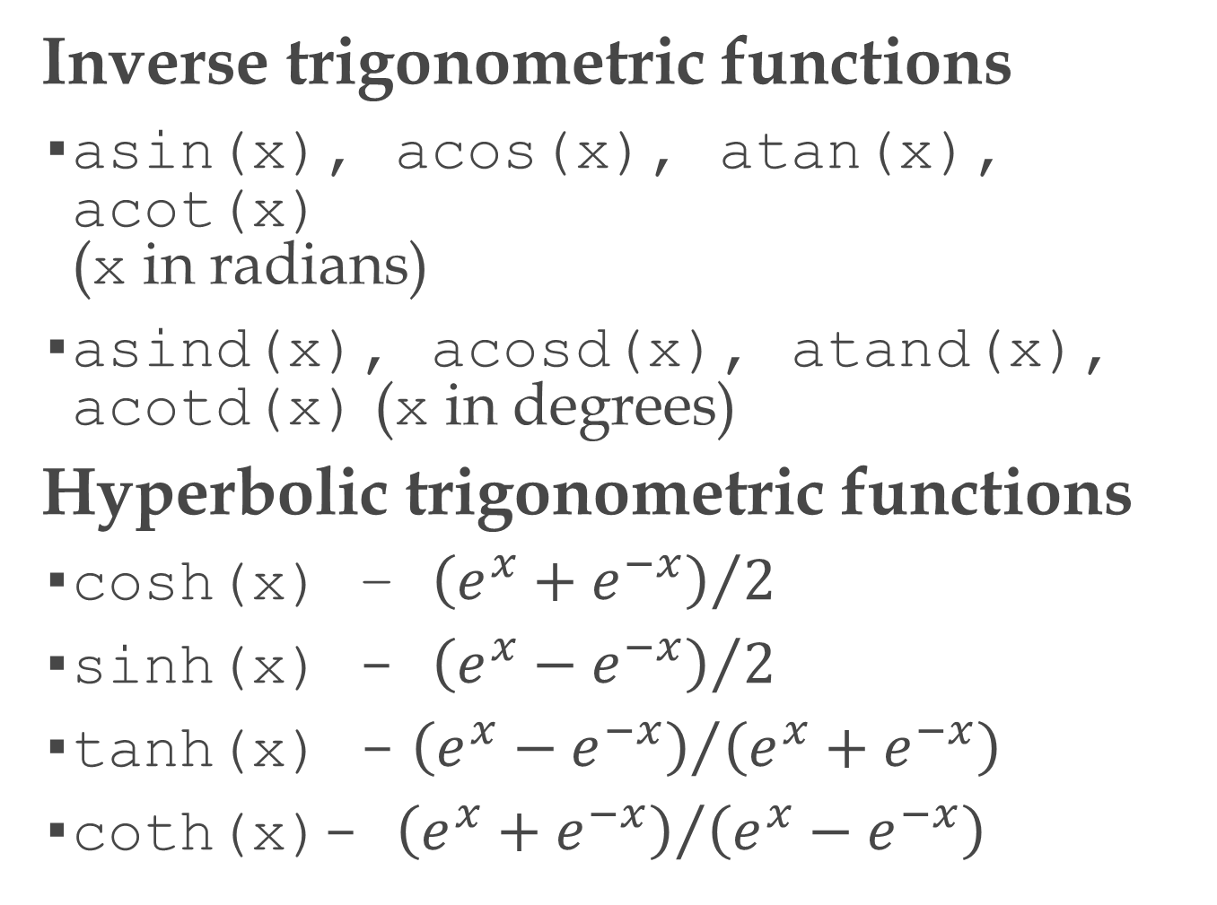
1.5 Elementary Math Built-in Functions
Inverse trigonometric functions
asin(x), acos(x), atan(x), acot(x) (x in radians)
asind(x), acosd(x), atand(x), acotd(x) (x in degrees)
Hyperbolic trigonometric functions
cosh(x) – ${\left(e^{x}+e^{−x}\right)}/2$
sinh(x) - ${\left(e^{x}−e^{−x}\right)}/2$
tanh(x) - ${\left(e^{x}−e^{−x}\right)}/{\left(e^{x}+e^{−x}\right)}$
coth(x)- ${\left(e^{x}+e^{−x}\right)}/{\left(e^{x}−e^{−x}\right)}$

Slide 24
1.5 Elementary Math Built-in Functions
Rounding functions
round(x) – round to nearest integer
fix(x) – round toward zero
ceil(x) – round toward infinity
floor(x) – round toward minus infinity
rem(x,y) – remainder after x is divided by y (also called modulus)
sign(x) – returns 1 if x is positive, -1 if x is negative, zero if x is zero
See Table 1-5 for details

Slide 25
1.6 Defining Scalar Variables
A variable is a name that is assigned a numerical value
Once assigned, can use variable in expressions, functions, and MATLAB statements and commands
Can read the variable (get its value)
Can write to the variable (set its value)

Slide 26
1.6.1 The Assignment Operator
= (equals sign) is MATLAB’s assignment operator. It evaluates the expression on its right side and stores the resulting value in the variable on its left side
>> a = 3
Create the variable called “a” and store the value 3 in it

Slide 27
1.6.1 The Assignment Operator
EXAMPLE
>> a = 3
a =
3
>> b = 10*a + 5
b =
35
Make a variable and store a number in it
Make a variable and store the value of an expression made up of a variable, numbers, and addition and multiplication

Slide 28
1.6.1 The Assignment Operator
= means “assign to” or “store in” but not “equals”!
x = x + 6 means “take whatever is in x, add 6 to that and store the result back into x”
Is python any different?

Slide 29
1.6.1 The Assignment Operator
EXAMPLE
>> x = 3;
>> x = x + 6
x =
9
>> x = 2 * x
x =
18
; at end prevents MATLAB from displaying value of x
takes what’s in x (3), adds 6 to it to get 9, then stores 9 back into x
now x’s value is 9
takes what’s in x (9), multiplies it by 2 to get 18, then stores 18 back into x
now x’s value is 18

Slide 30
1.6.1 The Assignment Operator
A variable must have a value before you use it in an expression
>> x = 3;
>> x+2
ans =
5
>> x + y % assume y undefined
??? Undefined function or variable 'y'

Slide 31
1.6.1 The Assignment Operator
To find out the value of a variable, just type it and press ENTER
>> x = 3;
>> y = 10 * x;
>> z = y ^ 2;
>> y
y =
30
>> z
z =
900

Slide 32
1.6.1 The Assignment Operator
Can do multiple assignments on one line by separating with a comma or semicolon. If semicolon, no display for that assignment
>> a=12, B=4; C=(a-B)+40-a/B*10
a =
12
C =
18

Slide 33
1.6.1 The Assignment Operator
To change the value of a variable, just assign it the new value
>> ABB=72;
>> ABB=9;
>> ABB
ABB =
9

Slide 34
1.6.1 The Assignment Operator
You must define a variable (give it a value) before you can use it in an argument of a function
>> sqrt( x ) % assume x undefined
??? Undefined function or variable 'x'
>> x = 144;
>> sqrt( x )
x =
12

Slide 35
1.6.2 Rules About Variable Names
A variable name
Must begin with a letter
Can be up to 63 characters long
Can contain letters, digits, and underscores (_)
Can’t contain punctuation, e.g., period, comma, semicolon
Avoid using the name of a built-in function as the name of a variable, e.g., don’t call a variable exp or sqrt

Slide 36
1.6.2 Rules About Variable Names
MATLAB is case-sensitive, and does not consider an upper-case letter in a variable name to be the same as its lower-case counterpart, e.g., MTV, MTv, mTV, and mtv are four different variable names
Is python any different?

Slide 37
1.6.2 Rules About Variable Names
A variable name cannot contain a space. Two common alternatives:
Use an underscore in place of a space, e.g., speed_of_light
Capitalize the first letter of every other word, e.g., speedOfLight (This is known as camel case!)

Slide 38
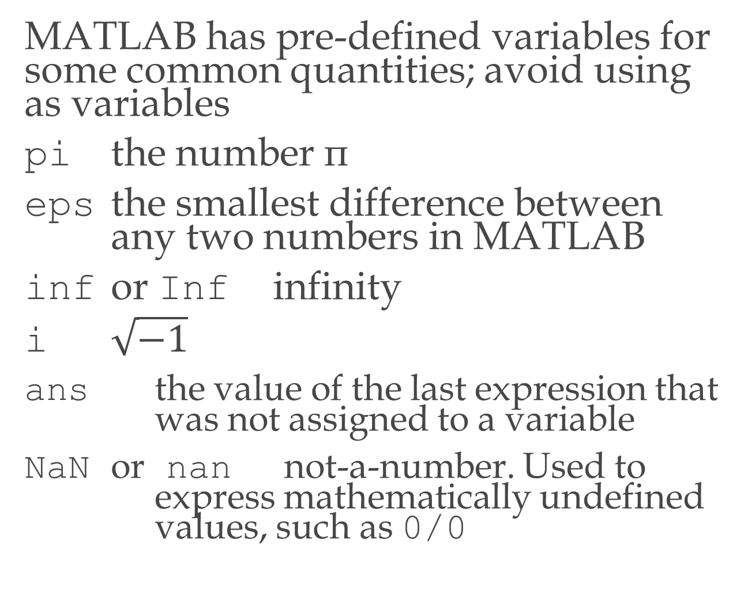
1.6.3 Predefined Variables and Keywords
MATLAB has pre-defined variables for some common quantities; avoid using as variables
pi the number π
eps the smallest difference between any two numbers in MATLAB
inf or Inf infinity
i $\sqrt{−1}$
ans the value of the last expression that was not assigned to a variable
NaN or nan not-a-number. Used to express mathematically undefined values, such as 0/0

Slide 39
1.7 Useful Commands for Managing Variables
Some commands for managing variables
Command Outcome
clear Removes all variables from memory
clear x y z Removes only variables x, y, and z from memory
who Displays a list of the variables currently in memory
whos Displays a list of the variables currently in memory and their size, together with information about their bytes and class (see Section 4.1)

Slide 40
1.1 Starting MATLAB, MATLAB Windows
Use Editor Window to write and debug MATLAB scripts. Open with edit command

Slide 41
1.8 Script Files
Program or Script file: save all commands in a file rather than typing at command line
Suffix for a script file is “.m”
With one command in Command Window, tell MATLAB to run all commands in file
What is the suffix for a program file in python?

Slide 42
1.8.1 Notes About Script Files
A script file/program/m file is a sequence of MATLAB commands
When a program runs (is executed), MATLAB performs the commands in the order they are written, just as if they were typed in the Command Window
When a script file has a command that generates an output (e.g. assignment of a value to a variable without semicolon at the end), the file displays the output in the Command Window

Slide 43
1.8.1 Notes About Script Files
Using a script file is convenient because it can be edited (corrected and/or changed) and executed many times
Script files can be typed and edited in any text editor and then pasted into the MATLAB editor

Slide 44
projectile.m and projectile_function.m
script file and a function file
compare to the python code
differences:
can compute trig functions in degrees
not rigid on indenting
have to be careful to use array elementwise multiplication and exponentiation (discussed later)

Slide 45
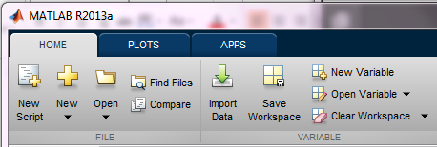
1.8.2 Creating and Saving a Script File
Use the Editor Window to work with script files
Can open window and create file two ways
Click on New Script icon
Click on New icon, select Script
In the Command Window, type edit and then press ENTER

Slide 46
1.8.2 Creating and Saving a Script File
Editor has tool strip on top with three tabs – EDITOR, PUBLISH, VIEW
MATLAB used most often with EDITOR tab selected

Slide 47
1.8.2 Creating and Saving a Script File
Type in commands line by line, pressing ENTER after each one
MATLAB automatically numbers lines

Slide 48
1.2 Working in the Command Window
Semicolon (;)
When typed at end of command, suppresses output. (Only prompt displayed at next line)
Useful for preventing display of large outputs
Used much more in scripts
Percent sign(%)
When typed at beginning of line, MATLAB treats line as a comment and doesn’t execute line
Used much more in scripts
What is the comment character in python?

Slide 49
1.8.2 Creating and Saving a Script File
Comment lines
Lines that start with percent sign (%)
Common for first few lines to be comments and to briefly explain what commands in file do
Editor Window shows comment lines in green

Slide 50
1.8.2 Creating and Saving a Script File
Before MATLAB can run commands in file, you must save file
If you haven’t named file yet, click on Save icon, MATLAB brings up Save As dialog box
If you’ve already named and saved file, just click on Save icon
If you don’t add an extension (.xxx) to the file name, MATLAB adds “.m”
Rules for file names are same as rules for function names
Don’t use names of your variables, predefined variables, MATLAB commands, or MATLAB functions

Slide 51
1.8.3 Running (Executing) a Script File
To execute a script file means to run all of the commands in it. You can execute a file by
Pressing the Run icon (a green arrow)
Typing the file name in the Command Window and pressing ENTER
MATLAB will execute file if it is in MATLAB’s current folder or if the file’s folder is in the search path

Slide 52
1.8.4 Current Folder
The current folder is the folder that MATLAB checks first when looking for your script file
Can see current folder in desktop toolbar
Can also display current folder by issuing MATLAB command pwd

Slide 53
1.8.4 Current Folder
Can change current folder in Current Folder Window
To show Current Folder Window, click on Layout icon in desktop, then select Current Folder

Slide 54
1.8.4 Current Folder
Can change current folder from command line using cd command, space, new folder name in single quote marks, ENTER, i.e.,
>> cd 'new folder'
For example,
>> cd 'F:\slides\Chapter 1'

