Slide 1
Today’s Objectives
Creating and Using Matlab Arrays
Example using simple array of wildfire statistics
Download files from github and look at wildfires.csv in the data subdirectory

Slide 2
2.10 Strings and Strings as Variables
A string is an array of characters
Strings have many uses in MATLAB
Display text output
Specify formatting for plots
Input arguments for some functions
Text input from user or data files

Slide 3
2.10 Strings and Strings as Variables
Create a string by typing characters within single quotes (')
Many programming languages use the quotation mark (") for strings. Not MATLAB
Can have letters, digits, symbols, spaces
To type single quote in string, use two consecutive single quotes, e.g., make the string of English "Greg's car" by typing 'Greg''s car'
Examples: 'ad ef', '3%fr2', 'edcba:21!', 'MATLAB'

Slide 4
2.10 Strings and Strings as Variables
In a string variable
Numbers are stored as an array
A one-line string is a row vector
Number of elements in vector is number of characters in string
>> name = 'Howard the Duck';
>> size( name )
ans =
1 15

Slide 5
2.10 Strings and Strings as Variables
MATLAB stores strings with multiple lines as an array. This means each line must have the same number of columns (characters)
>> names = [ 'Greg'; 'John' ]
names =
Greg
John
>> size( names )
ans =
2 4

Slide 6
2.0
An array is MATLAB's basic data structure
Can have any number of dimensions. Most common are
vector - one dimension (a single row or column)
matrix - two or more dimensions
Arrays can contain numbers or letters
Number of columns must be the same in each row of matrix
Overall, Matlab is very similar to Numpy in Python.

Slide 7
Type this in the command window
aa = [1 2 3];
bb = [1 , 2, 3];
cc = [1 ; 2 ; 3];
In python, do square brackets mean a tuple or a list?

Slide 8
2.3 Notes About Variables in MATLAB
All variables are arrays
Scalar - array with only one element
Vector - array with only one row or column
Matrix - array with multiple rows and columns
Assigning to variable specifies its dimension
Don't have to define variable size before assigning to it, as you do in many programming languages
Reassigning to variable changes its dimension to that of assignment

Slide 9
2.5.1 Vector
Address of element is its position in the vector
"address" often called index
Addresses in Matlab always start at 1 (not 0 as in Python)
Address 1 of row vector is leftmost element
Address 1 of column vector is topmost element
To access element of a vector represented by a variable, follow variables name by address inside parentheses, e.g., v(2)=20 sets second element of vector v to 20

Slide 10
2.5.2 Matrix
>> MAT=[3 11 6 5; 4 7 10 2; 13 9 0 8]
MAT = 3 11 6 5
4 7 10 2
13 9 0 8
>> MAT(3,1)
ans = 13
>> MAT(3,1)=20
MAT = 3 11 6 5
4 7 10 2
20 9 0 8
>> MAT(2,4)-MAT(1,2)
ans = -9
Column 1
Element in row 3 and column 1
Row 3
Assign new value to element in row 3 and column 1
Only this element changed

Slide 11
2.6 Using a Colon : in Addressing Arrays
The colon : lets you address a range of elements
Vector (row or column)
va(:) - all elements
va(m:n) - elements m through n
Matrix
A(:,n) - all rows of column n
A(m,:) - all columns of row m
A(:,m:n) - all rows of columns m through n
A(m:n,:) - all columns of rows m through n
A(m:n,p:q) - columns p through q of rows m through n
Note Matlab is row then column order
Which option in Python is that F order or C order?

Slide 12
From github, download the course repository
find the matlab directory
national wildfires.csv file
Look at it with a text editor
3 columns: year, no. of fires, acres burned
We will do a bunch using the matlab code: wildfires.m
open that in matlab or click on the code to start up matlab

Slide 13
2.9 Built-in Functions for Handling Arrays
MATLAB has many built-in functions for working with arrays. Some common ones are:
length(v) - number of elements in a vector
size(A) - number of rows and columns in a matrix or vector
reshape(A,m,n) - changes number of rows and columns of a matrix or vector while keeping total number of elements the same. For example, changes 4x4 matrix to 2x8 matrix

Slide 14
2.1 Creating a One-Dimensional Array (Vector)
To create a vector with specified number of terms between first and last
v = linspace( xi, xf, n )
xi is first number
xf is last number
n is number of terms (= 100 if omitted)
yrc = 1:no_times;
yrb = no_times:-1:1;
Is numpy.linspace different?

Slide 15
2.2.1 The zeros, ones and, eye Commands
zeros(m,n) - makes matrix of m rows and n columns, all with zeros
ones(m,n) - makes matrix of m rows and n columns, all with ones
eye(n) - makes square matrix of n rows and columns. Main diagonal (upper left to lower right) has ones, all other elements are zero
diag(v) - makes a square matrix of zeroes with vector in main diagonal
diag(A) - creates vector equal to main diagonal of matrix

Slide 16
3.1 Addition and Subtraction
When adding/subtracting two arrays A and B, MATLAB adds/subtracts the corresponding elements, i.e.,
It adds/subtracts the element in the first row and first column of A to the element in the first row and column of B
It adds/subtracts the element in the first row and second column of A to the element in the first row and second column of B, etc.
This is elementwise addition/subtraction

Slide 17
3.1 Addition and Subtraction
Use + to add two arrays or to add a scalar to an array
Use – to subtract one array from another or to subtract a scalar from an array
When using two arrays, they must both have the same dimensions (number of rows and number of columns)
Vectors must have the same dimensions (rows and columns), not just the same number of elements

Slide 18
3.6 Built-in Functions for Analyzing Arrays
MATLAB has lots of functions for operating on arrays. For a vector v
mean(v) – mean (average)
max(v) – maximum value, optionally with index of maximum
min(v) – minimum value, optionally with index of minimum
sum(v) – sum
median(v) – median
std(v) – standard deviation
sort(v) – elements sorted into ascending order

Slide 19
3.2 Array Multiplication
There are two ways of multiplying matrices – matrix multiplication and elementwise multiplication
MATRIX MULTIPLICATION
Type used in linear algebra
MATLAB denotes this with asterisk (*)
Number of columns in left matrix must be same as number of rows in right matrix

Slide 20
3.4 Element-by-Element Operations
Another way of saying elementwise operations is element-by-element operations
Addition and subtraction of arrays is always elementwise
Multiplication, division, exponentiation of arrays can be elementwise
Both arrays must be same dimension
Most codes you develop will use elementwise multiplication and division

Slide 21

3.4 Element-by-Element Operations
Do elementwise multiplication, division, exponentiation by putting a period in front of the arithmetic operator
Do you need to use the .* in Python or just * in numpy?

Slide 22
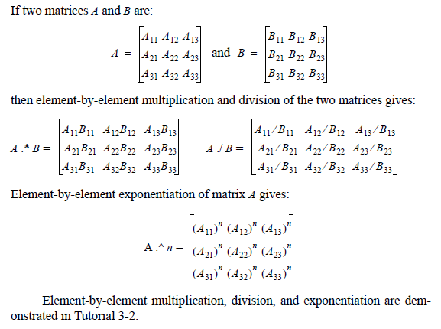
3.4 Element-by-Element Operations

Slide 23
3.4 Element-by-Element Operations
If matrices not same dimension in elementwise multiplication, MATLAB gives error
>> A = [ 1 2; 3 4];
>> B = [1 0]';
>> A .* B % Meant matrix multiplication!
??? Error using ==> times
Matrix dimensions must agree.
>> A * B % this works
ans =
1
3

Slide 24
3.4 Element-by-Element Operations
Be careful – when multiplying square matrices
Both types of multiplication always work
If you specify the wrong operator, MATLAB will do the wrong computation and there will be no error!
Difficult to find this kind of mistake

Slide 25
3.4 Element-by-Element Operations
EXAMPLE
>> A = [1 2; 3 4];
>> B = [0 1/2; 1 -1/2];
>> A .* B
>> ans
0 1
3 -2
>> A * B
ans =
2.0000 -0.5000
4.0000 -0.5000

Slide 26
3.4 Element-by-Element Operations
Elementwise computations useful for calculating value of a function at many values of its argument

Slide 27
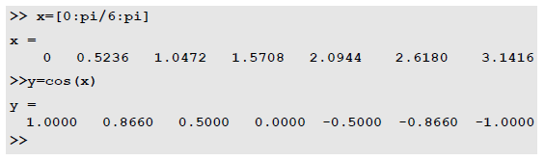
3.5 Using Arrays in MATLAB Built-in Functions
Built-in MATLAB functions can accept arrays as inputs
When input is array, output is array of same size with each element being result of function applied to corresponding input element
Example: if x is a 7-element row vector, cos(x) is [cos(x₁) cos(x₂) cos(x₃) cos(x₄) cos(x₅) cos(x₆) cos(x₇)]

