Slide 1
Today’s Objectives
reference material on I/O and plotting
Program logic
Download the files from github
We will repeat the accessing and plotting the sounding data

Slide 2
4.3.1 The disp Command
disp (display) command displays variable values or text on screen
Displays each time on new line
Doesn't print variable name
disp(variable_name) or
disp(variable_name,'text string')

Slide 3
4.3.2 The fprintf Command
fprintf
Means file print formatted
formatted text is text that can be read by people
unformatted text looks random to people but computers can read it
Can write to screen or to a file
Can mix numbers and text in output
Have full control of output display
Complicated to use

Slide 4
4.3.2 The fprintf Command
\n is an escape character, a special combination of two characters that makes fprintf do something instead of print the two characters
\n – makes following text come out at start of next line
\t – horizontal tab

Slide 5
4.3.2 The fprintf Command
>> fprintf( 'Joe is %d weighs %f kilos', age, weight )
Arguments
Number of arguments and conversion specifiers must be the same
Leftmost conversion specifier formats leftmost argument, 2nd to left specifier formats 2nd to left argument, etc.

Slide 6
4.3.2 The fprintf Command
Conversion specifier
>> fprintf( 'Joe weighs %f kilos', n1 )
Common conversion specifiers
%f fixed point (decimal always between 1's and 0.1's place, e.g., 3.14, 56.8
%e scientific notation, e.g, 2.99e+008
%d integers (no decimal point shown)
%s string of characters

Slide 7
4.3.2 The fprintf Command
Conversion specifier
>> fprintf( 'Joe weighs %6.2f kilos', n1 )
To control display in fixed or scientific, use %w.pf or %w.pe
w = width: the minimum number of characters to be displayed
p = “precision”: the number of digits to the right of the decimal point
If you omit "w", MATLAB will display correct precision and just the right length

Slide 8
4.3.2 The fprintf Command
Example
>> weight = 178.3;
>> age = 17;
>> fprintf( ['Tim weighs %.1f lbs'...
' and is %d years old'], weight, age )
Tim weighs 178.3 lbs and is 17 years old

Slide 9
4.3.2 The fprintf Command
Using the fprintf command to save output to a file:
Takes three steps to write to a file
Step a: – open file
fid=fopen('file_name','permission')
fid – file identifier, lets fprintf know what file to write its output in
permission – tells how file will be used, e.g., for reading, writing, both, etc.

Slide 10
4.3.2 The fprintf Command
Some common permissions
r - open file for reading
w - open file for writing. If file exists, content deleted. If file doesn't exist, new file created
a - same as w except if file exists the written data is appended to the end of the file
If no permission code specified, fopen uses r
See Help on fopen for all permission codes

Slide 11
4.3.2 The fprintf Command
Step b:
Write to file with fprintf. Use it exactly as before but insert fid before the format string, i.e.,
fprintf(fid,'format string',variables)
The passed fid is how fprintf knows to write to the file instead of display on the screen

Slide 12
4.3.2 The fprintf Command
Step c:
When you're done writing to the file, close it with the command fclose(fid)
Once you close it, you can't use that fid anymore until you get a new one by calling fopen
Be sure to close every file you open.

Slide 13
output_file = input('enter output file name: \n','s')
id = fopen(output_file,'w');
%use the transpose of the winds array to plot out the rows, rather than all
%one variable then the other
fprintf(id,'%.2f\t %.2f\n',winds');
fclose(id);
Look at file you created using text editor

Slide 14
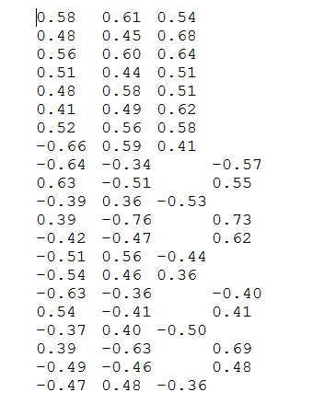
4.3.2 The fprintf Command
fprintf is vectorized, i.e., when vector or matrix in arguments, command repeats until all elements displayed
Displays matrix data column by column and row by row

Slide 15
5.0

Slide 16
5.11 Multiple Figure Windows
On execution, any plotting command
Creates a Figure Window (if none exists)
Erases any plot in that window
Draws new plot
Can be useful though to have plots in multiple windows. figure command lets you do this

Slide 17
5.11 Multiple Figure Windows
figure(n)
If Figure Window n exists, makes it the active window
If Figure Window n doesn't exist, creates it and makes it the active window
figure(n) useful in scripts, e.g., scripts in which data set 1 is displayed in Figure 1, data set 2 is displayed in Figure 2, etc.

Slide 18
5.11 Multiple Figure Windows
Use close command to close figure windows
close closes active Figure Window
close(n) closes Figure Window n
close all closes all open Figure Windows

Slide 19
5.1 THE plot COMMAND
plot command used to make basic 2D plots. Simplest form is
plot(y)
Plots vector y on vertical axis, numbers 1 through N on horizontal axis (N = number of points in y)
If there's a Figure Window, draws in it. Otherwise, creates a new Figure Window and draws in that

Slide 20
5.1 The plot Command
plot(y) default values
Both axes linear
MATLAB chooses axis ranges so that end values are nice
Points connected by straight lines
No point markers
Points and lines in blue

Slide 21
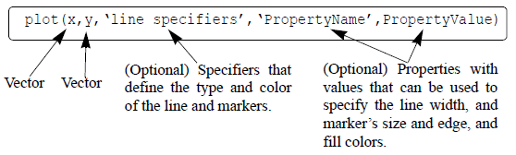
5.1 The plot Command
To use values other than defaults,

Slide 22
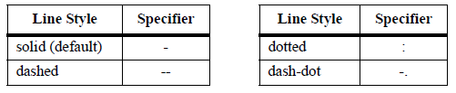
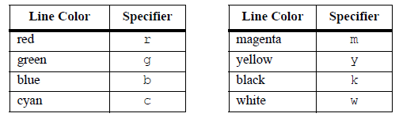
5.1 The plot Command
Line specifiers define style and color of lines, and marker types
Line Styles
Line Colors

Slide 23
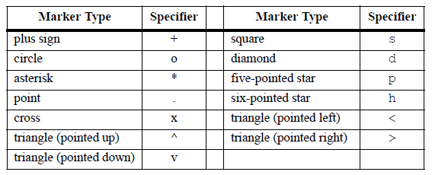
5.1 The plot Command
Marker Types

Slide 24
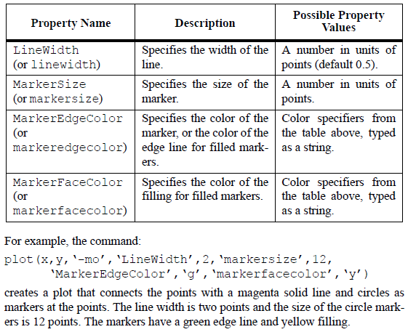
5.1 The plot Command
Property Name and Property Value:
In plot command, type property name in quote marks, then comma, then value

Slide 25
5.3.1 Using the plot Command
Plot two or more graphs on same plot as follows (example for three graphs)
plot(x,y,u,v,t,h)
Plots y vs. x, v vs. u, h vs. t
Vectors of each pair must be same size
Can be different than sizes in other pairs
Can use line specifiers by putting in triplets (x-data, y-data, specifier), e.g.,
plot(x,y,'-b', u,v,'--r','t,h,'g:')

Slide 26
5.3.2 Using the hold on and hold off Commands
Normally, each time you execute plot it erases previous plot and draws new one. To change this behavior:
Draw the first graph with plot
Issue the command hold on
Call plot for each of the remaining graphs
Issue the command hold off
Graphs drawn after hold on are added to plot. Graphs drawn after hold off erase plot

Slide 27
5.3.3 Using the line Command
line command adds additional graphs to an existing plot
line(x,y,'PropertyName','PropertyValue')
Example
line(x,y,'linestyle','--','color','r','marker','o')
adds graph drawn with dashed red line and circular markers to current plot

Slide 28
5.4.1 Formatting a Plot Using Commands
plot makes basic plot. After issuing that command, can use
xlabel('some text') writes label below horizontal axis
Example: xlabel('Time (sec)')
ylabel('some text') writes label to left of vertical axis
Example: ylabel('Current (mA)')

Slide 29
5.4.1 Formatting a Plot Using Commands
title('Some text') writes title above plot
Example: title('Diode Current')
text(x,y,'Some text') places text in figure with first character at (x,y)
Example: text(x,y,'Peak 3.5 sec after first')
gtext('Some text') – figure window opens, user clicks on graph where she wants text to appear

Slide 30
5.4.1 Formatting a Plot Using Commands
legend('text1','text2',...,pos) writes legend
For each graph (data set) displays short line in same style as graph line and adds specified text
First string goes with first graph plotted, second string goes with second graph plotted, etc.
Most useful for plots having at least two graphs
pos values in book are obsolete as of MATLAB 7.0 (R14). Type help legend or see documentation for new values

Slide 31
5.4.1 Formatting a Plot Using Commands
Formatting the text within the xlabel, ylabel, title, text and legend commands:
Can format text displayed by above commands
Can set font, size, character color, background color, sub/superscript, style (bold, italic, etc.)
Can display Greek letters
Can format using modifiers within text string or by adding property names and values to command

Slide 32
5.4.1 Formatting a Plot Using Commands
Text modifiers are placed inside text string and affect appearance of text
All text following modifier gets modified
To only modify some text put open brace ({), modifier, text-to-be-modified, close brace (})

Slide 33
5.4.1 Formatting a Plot Using Commands
Example titles
title('\it What You Should Never See')
makes
What You Should Never See
title('What You Should{\it Never} See')
makes
What You Should Never See

Slide 34
5.4.1 Formatting a Plot Using Commands
Some common modifiers
\bf – bold face
\it – italic
\rm – normal font
\fontname{fontname} – font name
\fontsize{fontsize} – font size

Slide 35
5.4.1 Formatting a Plot Using Commands
Subscript and superscript:
To make single character
Subscript – precede it by underscore (_)
Superscript – precede it by caret(^)
For multiple characters, same as above but enclose characters in (curly) braces
xlabel('H_2O (l)') makes H₂O
ylabel('e^{-k*sin(x)}') makes e^{-k*sin(x)}

Slide 36
5.4.1 Formatting a Plot Using Commands
Greek characters:
To make a Greek letter, follow backslash with letter name (in English!)
Name in lowercase makes lowercase Greek letter
Name with capitalized first letter makes uppercase Greek letter

Slide 37
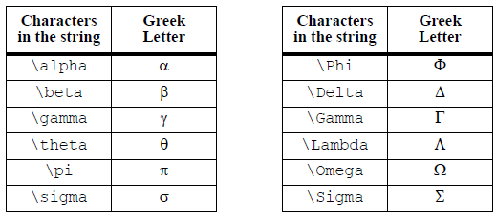
5.4.1 Formatting a Plot Using Commands
ylabel('Standard deviation (\sigma) of resistance in M\Omega')
makes
Standard deviation (σ) of resistance in MΩ
Some Greek characters

Slide 38
5.4.1 Formatting a Plot Using Commands
For xlabel, ylabel, title, text, can also change display of entire text string by using property name – property value pairs, e.g.,
text(x,y,'Some text',PropertyName,PropertyValue)
PropertyName is text string
PropertyValue is number if value is number or text string if value is letter or word
Example
text(x,y,'Depth','Rotation',45) makes
Depth

Slide 39
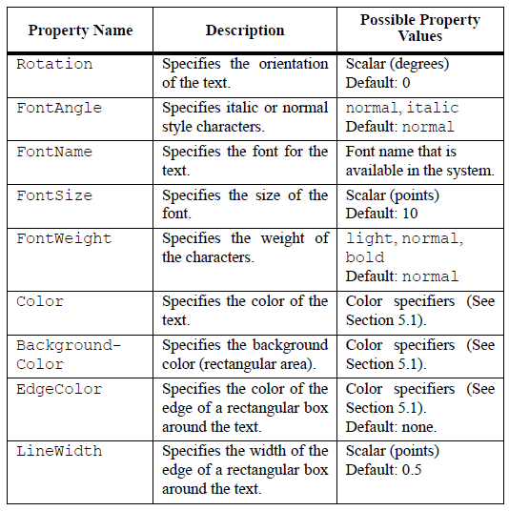
5.4.1 Formatting a Plot Using Commands
Some property-name property-value pairs

Slide 40
5.4.1 Formatting a Plot Using Commands
The axis command:
MATLAB makes axes limits in plot command so that all data appears and limits are nice numbers. Can change that with axis command

Slide 41
5.4.1 Formatting a Plot Using Commands
Common axis variations are:
axis([xmin xmax ymin ymax])
Sets limits of both axes
axis equal
Sets same scale for both axes
axis square
Sets axis region to be square
axis tight
Sets axes limits to range of data (not usually nice numbers!)

Slide 42
5.4.1 Formatting a Plot Using Commands
The grid command:
grid on
Adds grid lines to plot
grid off
Removes grid lines from plot

Slide 43
5.8 Histograms
A histogram is a plot of the distribution of data. Entire range of data broken into consecutive subranges or bins.
In histogram plot
Each bin represented by vertical bar
Left and right of vertical bar show range of data in bin
Height of vertical bar is number of data points in bin

Slide 44
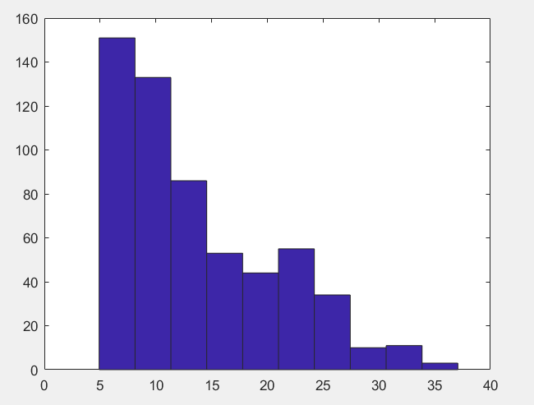
5.8 Histograms
MATLAB command hist makes histogram. Simplest form is hist(y)
y is vector of data points
hist divides range into ten equal bins, then plots result
figure(14)
hist(gust);
[N,XO] = hist(gust);
See next slide for the
Meaning of N, XO

Slide 45
5.8 Histograms
Can get histogram heights and center of bins if desired
n=hist(y) n=hist(y,nbins) n=hist(y,x)
Output n is a vector
Size of n is number of bins
Value of element of n is number of data points in corresponding bin
[n xout]=hist(y)
n same as before
xout(i) is center of ith bin

Slide 46
5.8 Histograms
Additional forms of hist
hist(y,nbins)
MATLAB divides range into nbins (scalar) bins of equal size
hist(y,x)
x (vector) specifies midpoint of each bin
Spacing between consecutive elements of x can be different
Bin edges are midpoints of consecutive bins

Slide 47
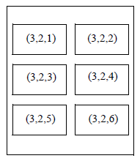
5.10 Putting Multiple Plots on the Same Page
subplot(m,n,p)
divides Figure Window into m rows and n columns of subplots
Subplots numbered from left to right and top to bottom, with upper left being subplot 1 and lower right subplot m*n. p in subplot command refers to this numbering
Subplot numbers for 3x2 set of subplots

Slide 48
5.10 Putting Multiple Plots on the Same Page
subplot(m,n,p)
m- # rows, n- # columns, p-pos
If subplots don't exist, subplot creates them and makes subplot p the current subplot
If subplots exist, subplot makes subplot p the current one
When subplot defines current subplot, next plot and formatting commands draw in current subplot

Slide 49
The logic of programming
Logic- use the correct reasoning to solve problems
Flow charts- describing what you want to do
What do you do first, next, last
Are there possible choices depending on the situation that require decisions?
Are they relational (>,=,<) or logical (and/or)?
Do you need to evaluate the decision many times?

Slide 50
6.2.1 The if-end Structure
A flowchart is a diagram that shows the code flow. It is particularly useful for showing how conditional statements work. Some common flowchart symbols are
represents a sequence of commands
represents an if-statement
shows the direction of code execution

Slide 51
6.1 Relational and Logical Operators
Relational operators:
Can't put space between operators that have two characters
"Not equal to" is "~=", not "!=" as in C or C++
"Equal to" comparison is two equal signs (==), not one.
Remember, "=" means "assign to" or "put into“
Result of comparing with a relational operator is always "true" or "false"
If "true", MATLAB gives the comparison a value of one (1)
If "false", MATLAB gives the comparison a value of zero (0)

Slide 52
6.1 Relational and Logical Operators
When comparing array to scalar
MATLAB compares scalar to every member of array
Result is an array that has same dimensions as original but only contains 1's and 0's
When comparing arrays
They must be the same dimensions
MATLAB does an elementwise comparison
Result is an array that has same dimensions as other two but only contains 1's and 0's

Slide 53
6.1 Relational and Logical Operators
A logical vector or logical array is a vector/array that has only logical 1's and 0's
1's and 0's from mathematical operations don't count
1's and 0's from relational comparisons do work
First time a logical vector/array used in arithmetic, MATLAB changes it to a numerical vector/array

Slide 54
6.1 Relational and Logical Operators
Can use logical vector to get actual values that satisfy relation, not just whether or not relation satisfied. Doing this is called logical indexing or logical subscripting
Do this by using logical vector as index in vector of values. Result is values that satisfy relation, i.e., values for which relationship are 1

Slide 55
6.1 Relational and Logical Operators
Logical operators:
Boolean logic is a system for combining expressions that are either true of false.
MATLAB has operators and commands to do many Boolean operations
Boolean operations in combination with relational commands let you perform certain types of computations clearly and efficiently

Slide 56
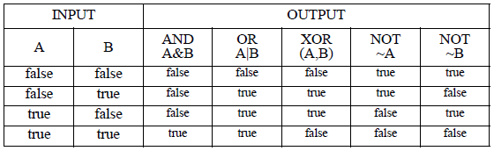
6.1 Relational and Logical Operators
A truth table defines the laws of Boolean logic. It gives the output of a logical operation for every possible combination of inputs. The truth table relevant to MATLAB is

Slide 57
6.1 Relational and Logical Operators
In words, the truth table says
AND is true if both inputs are true, otherwise it is false
OR is true if at least one input is true, otherwise it is false
XOR (exclusive OR) is true if exactly one input is true, otherwise it is false
NOT is true if the input is false, otherwise it is false

Slide 58
6.1 Relational and Logical Operators
An arithmetic operator, e.g., + or -, is a symbol that causes MATLAB to perform an arithmetical operation using the numbers or expressions on either side of the symbol
Similarly, a logical operator is a character that makes MATLAB perform a logical operation on one or two numbers or expressions

Slide 59
6.1 Relational and Logical Operators
MATLAB has three logical operators: &, |, ~
a&b does the logical AND operation on a and b
a|b does the logical OR operation on a or b
~a does the logical NOT operation on a
Arguments to all logical operators are numbers
Zero is "false"
Any non-zero number is "true"
Result (output) of logical operator is a logical one (true) or zero (false)

Slide 60
6.1 Relational and Logical Operators
When operating with array and scalar
MATLAB does element-wise operation on each array element with scalar
Result is an array that has same dimensions as original but only contains 1's and 0's
When using logical operator on arrays
They must be the same dimensions
MATLAB does an element-wise evaluation of operator
Result is an array that has same dimensions as other two but only contains 1's and 0's
(not only operates on one array so the first point is irrelevant)

Slide 61
6.1 Relational and Logical Operators
Can combine arithmetic, relational operators, and logical operators. Order of precedence is

Slide 62
6.1 Relational and Logical Operators
Built-in logical functions:
MATLAB has some built-in functions or commands for doing logical operations and related calculations. Three are equivalent to the logical operators
and(A,B) – same as A&B
or(A,B) – same as A|B
not(A) – same as ~A

Slide 63
6.1 Relational and Logical Operators
MATLAB also has other Boolean functions

Slide 64
find- powerful tool
I = find(X) returns a vector containing the linear indices of each nonzero element in array X
Very helpful for handling logical checks
in Python, is ‘where’ the functional equivalent of find?

Slide 65
Cell array
matlab arrays are a fixed size m x n of one type (string, float, etc.)
How to handle mixture of arrays with different sizes and types: cell array
Access the content of cell arrays using the cell index be accessed with { } brackets, e.g., C{1,2}
Access an element within the array embedded with a cell array by C{1,2}(10,1)
Convert one cell array e.g., C{1,2} to matrix by using cell2mat

Slide 66
Cell array
matlab arrays are a fixed size m x n of one type (string, float, etc.)
How to handle mixture of arrays with different sizes and types: cell array
Access the content of cell arrays using the cell index be accessed with { } brackets, e.g., C{1,2}
Access an element within the array embedded with a cell array by C{1,2}(10,1)

Slide 67
DateNumber = datenum(t) converts the datetime values in datetime array t to serial date numbers
Critical to handle time properly
%convert time to numerical time
time = datenum(M{1,2},'mm/dd/yyyy HH:MM');
%convert numerical time to vector
time_vec = datevec(time);

Slide 68
6.2 Conditional Statements
A conditional statement is a command that allows MATLAB to decide whether or not to execute some code that follows the statement
Conditional statements almost always part of scripts or functions
They have three general forms
if-end
if-else-end
if-elseif-else-end

Slide 69
6.2.1 The if-end Structure
If the conditional expression is true, MATLAB runs the lines of code that are between the line with if and the line with end. Then it continues with the code after the end-line

Slide 70
6.2.1 The if-end Structure
If the conditional expression is false, MATLAB skips the lines of code that are between the line with if and the line with end. Then it continues with the code after the end-line

Slide 71
6.2.1 The if-end Structure
The conditional expression is true if it evaluates to a logical 1 or to a non-zero number. The conditional expression is false if it evaluates to a logical 0 or to a numerical zero

Slide 72
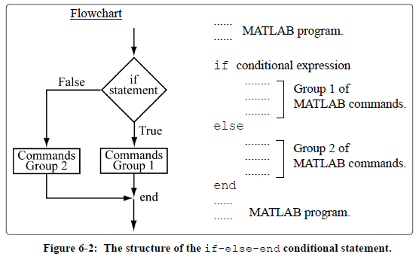
6.2.2 The if-else-end Structure
Fig. 6-2 shows the code and the flowchart for the if-else-end structure

Slide 73
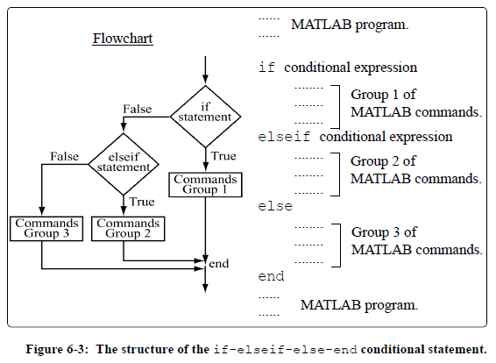
6.2.3 The if-elseif-else-end Structure
Fig. 6-3 shows the code and the flowchart for the if-elseif-else-end structure

Slide 74
6.3 The switch-case Statement
if-elseif-else-end structure gets hard to read if more than a few elseif statements. A clearer alternative is the switch-case structure
switch-case slightly different because choose code to execute based on value of scalar or string, not just true/false

Slide 75
6.4.1 for-end Loops
A for-loop executes set of commands a specified number of times. The set of commands is called the body of the loop
MATLAB has two ways to control number of times loop executes commands
Method 1 – loop executes commands a specified number of times
Method 2 – loop executes commands as long as a specified expression is true
Can often evaluate using either a for-loop or elementwise operations.
Elementwise operations are:
faster
easier to read
ADVICE – try to use elementwise operations; use for-loops when elementwise operations become too abstract

Slide 76
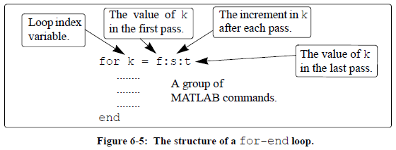
6.4.1 for-end Loops
Body of loop
The loop index variable can have any variable name (usually i, j, k, m, and n are used)
i and j should not be used when working with complex numbers. (ii and jj are good alternative names)

Slide 77
6.4.1 for-end Loops
Loop sets k to f, and executes commands between for and the end commands, i.e., executes body of loop
Loop sets k to f+s, executes body
Process repeats itself until k > t
Program then continues with commands that follow end command
f and t are usually integers
s usually omitted. If so, loop uses increment of 1
Body of loop

Slide 78
6.4.1 for-end Loops
Body of loop
Increment s can be negative
For example, k = 25:–5:10 produces four passes with k = 25, 20, 15, 10
If f = t, loop executes once
If f > t and s > 0, or if f < t and s < 0, loop not executed

Slide 79
6.4.1 for-end Loops
Body of loop
If values of k, s, and t are such that k cannot be equal to t, then
If s positive, last pass is one where k has largest value smaller than t
For example, k = 8:10:50 produces five passes with k = 8, 18, 28, 38, 48
If s is negative, last pass is one where k has smallest value larger than t

Slide 80
6.4.1 for-end Loops
Body of loop
In the for command k can also be assigned specific value (typed in as a vector)
For example: for k = [7 9 –1 3 3 5]
In general, loop body should not change value of k
Each for command in a program must have an end command

Slide 81
6.4.1 for-end Loops
Body of loop
Value of loop index variable (k) not displayed automatically
Can display value in each pass (sometimes useful for debugging) by typing k as one of commands in loop
When loop ends, loop index variable (k) has value last assigned to it

Slide 82
6.4.2 while-end Loops
while-end loop used when
You don't know number of loop iterations
You do have a condition that you can test and stop looping when it is false. For example,
Keep reading data from a file until you reach the end of the file
Keep adding terms to a sum until the difference of the last two terms is less than a certain amount

Slide 83
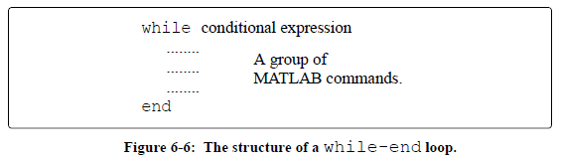
6.4.2 while-end Loops
Loop evaluates conditional-expression
If conditional-expression is true, executes code in body, then goes back to Step 1
If conditional-expression is false, skips code in body and goes to code after end-statement

Slide 84
6.4.2 while-end Loops
The conditional expression of a while-end loop
Has a variable in it
Body of loop must change value of variable
There must be some value of the variable that makes the conditional expression be false

Slide 85
6.4.2 while-end Loops
If the conditional expression never becomes false, the loop will keep executing... Forever as an infinite loop. Your program will just keep running, and if there is no output from the loop (as if often the case), it will look like MATLAB has stopped responding
If your program gets caught in an indefinite loop,
Put the cursor in the Command Window
Press CTRL+C

Slide 86
6.4.2 while-end Loops
Common causes of infinite loops:
No variable in conditional expression
distance1 = 1;
distance2 = 10;
distance3 = 0;
while distance1 < distance2
fprintf('Distance = %d\n',distance3);
end
distance1 and distance2 never change

Slide 87
6.4.2 while-end Loops
Common causes of infinite loops:
Variable in conditional expression never changes
minDistance = 42;
distanceIncrement = 0;
distance = 0;
while distance < minDistance
distance=distance+distanceIncrement;
end
Typo – should be 10

Slide 88
6.4.2 while-end Loops
Common causes of infinite loops:
Wrong variable in conditional expression changed
minDistance = 42;
delta = 10;
distance = 0;
while distance < minDistance
minDistance = minDistance + delta;
end
Typo – should be distance

Slide 89
6.5 Nested Loops and Nested Conditional Statements
If a loop or conditional statement is placed inside another loop or conditional statement, the former are said to be nested in the latter.
Most common to hear of a nested loop, i.e., a loop within a loop
Often occur when working with two-dimensional problems
Each loop and conditional statement must have an end statement

Slide 90
6.6 THE break AND continue COMMANDS
The break command:
When inside a loop (for and while), break terminates execution of loop
MATLAB jumps from break to end command of loop, then continues with next command (does not go back to the for or while command of that loop).
break ends whole loop, not just last pass
• If break inside nested loop, only nested loop terminated (not any outer loops)
break command in script or function file but not in a loop terminates execution of file
break command usually used within a conditional statement.
In loops provides way to end looping if some condition is met

Slide 91
6.6 The break and continue Commands
The continue command:
Use continue inside a loop (for- and while-) to stop current iteration and start next iteration
continue usually part of a conditional statement. When MATLAB reaches continue it does not execute remaining commands in loop but skips to the end command of loop and then starts a new iteration

Slide 92
6.6 The break and continue Commands
EXAMPLE
for ii=1:100
if rem( ii, 8 ) == 0
count = 0;
fprintf('ii=%d\n',ii);
continue;
end
% code
% more code
end
Every eight iteration reset count to zero, print the iteration number, and skip the remaining computations in the loop

Slide 93
Summary
There are many ways to muck up “for,while” loops and if-else logic.
Try to use elementwise calculations whenever possible
Check that you are getting the correct answers

