Slide 1


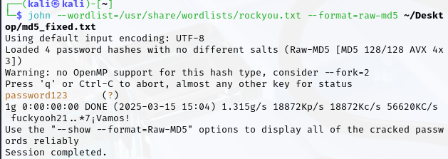
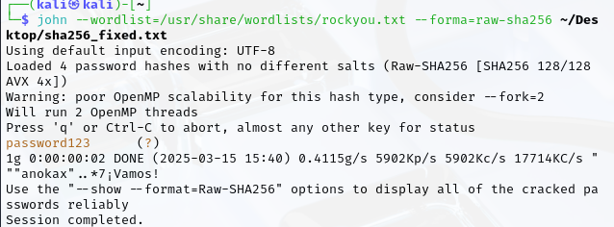
Breaking Passwords: Analyzing Cracking Techniques
and Security Best Practices
Hunter Carter
The University of North Georgia
ABSTRACT
In an era where digital security becomes a larger priority every day, weak passwords remain as one of the largest vulnerabilities in cybersecurity. Despite advancements in authentication methods, users continue to rely on incredibly simple passwords, making them susceptible to attacks. While extensive research exists on password security, there is a gap in practical analysis comparing different password-cracking methods and their effectiveness against varying levels of password complexity.
Passwords are not stored in plaintext; instead, they are saved in a hashed format using cryptographic algorithms such as MD5, SHA-256, and bcrypt. Since hashing is an irreversible process, attackers cannot directly retrieve the original password from the hash and rely on password-cracking tools that attempt to determine the corresponding plaintext password for a given hash. This research evaluates the efficiency of several different methods of password attack, such as dictionary, hybrid, rainbow table, brute force, and credential stuffing. The experiment will take place in a controlled testing environment, where password hashes will be generated and analyzed for their susceptibility to various attack techniques.
Analyzing how quickly each tool can crack passwords of varying complexity will demonstrate the real-world risks of using weak passwords and return results of which hashing methods are the most secure. Additionally, this research will explore modern best practices, including the use of MFA, password managers, passphrases, etc. The argument to be made is that current password policies often fail to protect users from consistently changing threats. Providing real evidence on password vulnerabilities means that this study can offer actionable recommendations for improving password security, strengthening cybersecurity defenses against unauthorized access for everyday people
MOTIVATION
With the increasing number of data breaches and cyberattacks, weak passwords continue to be a leading cause of compromised accounts. Many users still rely on easily guessable passwords or reuse them across multiple sites, making them vulnerable to attacks. This project aims to demonstrate how attackers crack passwords, highlight the risks associated with poor password practices, and provide actionable security recommendations. By raising awareness and promoting stronger authentication methods, we can help individuals and organizations better protect their sensitive information
REAL WORLD EVENT
The RockYou data breach was one of the most significant password leaks in history. In 2009, hackers exploied a vulnerability in RockYou’s web applications and gained access to a database containing over 32 million user passwords, all stored in palaintext with no encryption or hashing. This exposed how poor password storage practices put millions at risk and it created one of the largest password lists (used in this study) used by hackers and security researches today. This also showed that many people tend to rely on weak, common passwords..
Evaluating Password-Cracking Methods
!: Brute Force Attacks
Attempts every possible character technique until the correct password is found.
Short passwords are cracked almost instantly.
Longer passwords exponentially increase cracking time.
2: Dictionary Attack
Uses a predefined list of common passwords, words, and phrases to attempt logins.
Quickly cracks weak passwords based on common words.
Variations like P@ssword and 123456 are often included in dictionary lists.
3: Rainbow Table Attack
Uses precomputed hash values to crack hashed passwords efficiently.
Extremely fast against unsalted passwords.
Ineffective when salting is used before hashing.
4: Hybrid Attack
Combines Brute-Force and dictionary attacks by modifying dictionary words with numbers or symbols.
Can crack slightly more complex passwords, especially ones with predictable substitutions.
Experiment Setup
Tools Used;
John the Ripper & Hashcat: Industry Standard password cracking tools.
RockYou & SecLists datasets: Contain millions of leaked password users in real attacks.
Virtualized Testing Environment: Ensured ethical and controlled testing.
Different Hashing Algorithms: Evaluated Bcrypt, SHA-256, and MD5 for resilience.
Testing Methodology:
Password Selection: a dataset of passwords were created, ranging from weak to strong, alongside a few moderately secure ones.
Cracking Attempts: Each password was testing using different cracking methods.
Cracking time Recorded: Time taken to break each password was analyzed.
Findings/ Password Strength Analysis
Weak passwords (6-8 characters) were cracked in a fraction of a second
Moderate passwords (8-10 characters) lasted longer but were still crackable within hours.
Stronger passwords (12+ characters) remained uncracked in a reasonable timeframe.
Hashing and salting increased password security
*In these screenshots, we see weak passwords being cracked within in seconds.
Security Best Practices
To mitigate password vulnerabilities, users and organizations should follow these key practices:
1: Use long and complex passwords
12+ characters
Mix of uppercase, lowercase, numbers, and symbols
Avoid predictable substitutions (P@sswrd)
2: Enable Multi-Factor Authentication (MFA)
Adds an extra layer of security beyond just a password.
Even if a password is compromised, MFA prevents unauthorized access.
3: Use a password manager
Helps generate and store unique, strong passwords.
Prevents password reuse across multiple accounts.
4: Choose Strong Hashing Algorithms
Bcrypt, Argon2, PBKDF2 should be used for password storage.
Avoid outdated hashing methods such as SHA-1 or MD5.
5: Implement Account Lockout & Rate Limiting
Prevents brute-force attemps by locking an account after multiple failed logins.
Rate limiting slows down automated attacks.
EXAMPLE OF STRONG PASSWORDS
G7z!mQ@9v&x#2pB
jY$4M@kP!98vG#qL
A2Xp!vz9!M$g7Qk
*Stronger passwords are longer, and random, rendering w

