Slide 1
Comparative review of analytical ides
Analysis and Comparison of R-studio, SAS Studio, and Python Edu IDE
John Imbur, 6/23/2019

Slide 2



Introduction to review and analysis & Brief historical background
The purpose of this presentation is to do a high level comparison of the R-Studio, SAS Studio, and Python Edu IDE so that we can migrate from our current development environment. We will be looking at a range of different criteria, doing our best to reference sources to help make the comparison. Before beginning, we should introduce each of the three languages undergirding development environments.
“In 2000 the University of Auckland released the first version of R, a programming language primarily focused on statistical modeling and was open sourced under the GNU license.” (Kromme, 2017) “RStudio is an IDE using packages (knitr and rmarkdown) to develop composed documents with the code and output from the R language.” (Brittain, 2018)
“SAS was developed at the North Carolina State University and was primarily developed to be able to analyse large quantities of agriculture data.” (Kromme, 2017) Privately held and proprietary, “94 of the top 100 companies on the 2016 Fortune Global 500® are SAS customers.” (Brittain, 2018)
“Python—created by Guido Van Rossum as the successor of the ABC language and officially released in 1991—relies on the contribution of its wide community of users and developers self-identified as PUGs (Python User Groups)5 for its continuous evolution and growth” and has over 100,000 packages for use. () Brittain, 2018)

Slide 3
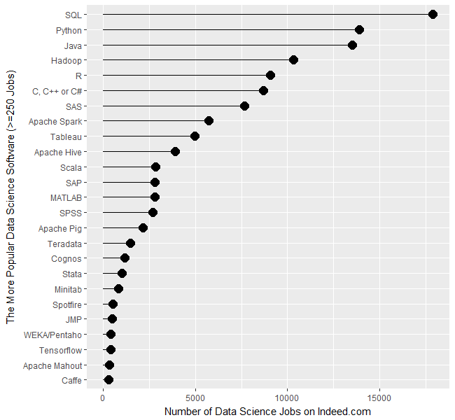
Job Perspective & availability / cost
For Indeed.com, in spring 2017, the jobs for “Python… in the 13,000’s… then R… and SAS… This is the first time this report has shown more jobs for R than SAS, but keep in mind these are jobs specific to data science.” (Muenchen, 2017)
SAS has a much higher entry cost than R-Studio and Python Edu IDE. While there are free versions for students and educators. That said the entry level license for SAS is $8,700, with typical SAS package with a license of $40,000 or $80,000 for either a dual or quad core server respectively. Lastly there is $200,000 for SAS E-miner. (Mishra, 2018)
(Muenchen, 2017)

Slide 4
Ease of usage/learning & data handling capabilities
At this point, all three of these development environments have fairly robust support for learning. While SAS Studio may have previously had the advantage in the past for ease of usage or learning, both R-Studio and Python Edu IDE having a growing community with resources supporting and providing training for the various packages in each. This said, SAS Studio may still have a slight edge for report generation based on the number of jobs listed on Indeed.com. (Muenchen, 2017)
SAS used to have some inherent benefits as it can natively handle very large data sets, but various limitations have been resolved, like data handling capability. “All three languages have good data handling capabilities and options for parallel computations. This I feel is no longer a big differentiation. They’ve all also brought on Hadoop and Spark integrations, with them also supporting Cloudera and Apache Pig.” (Jain, 2017)

Slide 5
Visualization capabilities & statistical capabilities
SAS is not particularly flexible when it comes to graphing. “R and Python offer much more opportunities to customize and optimize your graphs due to the wide range of modules that are available. The most widely used module for R is ggplot2, which has a wide set of graphs where you’re able to adjust practically everything. These graphs are also easily made interactive, which allows users to play with the data through applications like shiny.” (Kromme, 2017)
While SAS was the gold standard a decade ago and is still a leader in sectors like the financial industry, R and Python have the advantage of a growing set of packages that now cover most conceivable statistical needs. “One of the major advantages of open source tooling is that the community continuously improves and increases functionality.” (Kromme, 2107)

Slide 6
Data task scenarios & DEEP LEARNING SUPPORT
SAS has “significant less methods and techniques in comparison to R and Python.” (Kromme, 2017)
SAS has data mining tools (SAS Enterprise Miner), but these are beyond the typical SAS Studio and would represent another even larger license of $200,000 as noted previously.
Due to its extensibility, Python stands out among these three when it comes to Deep Learning and Machine Learning support. Python is mostly used in Data Mining or Machine Learning applications where a data analyst doesn’t need to intervene… Python is also the easiest language to use when using Big Data Frameworks like Spark.” (Kronne, 2017)

Slide 7
Customer service support and Community & Future Outlook
“SAS has good support services because it is paid software and R is freeware. So big companies prefer SAS over R” when the guaranteed access to support in general and for installation is paramount. (Gupta, 2106)
“99 out of 100 times (if not more often), your question has already been asked and answered on sites like Stack Overflow. On top of that, there are numerous companies that do provide professional support for R and Python. So, although there’s no official support for both R and Python, in practice we see that if you’ve got a question, you’ll likely have your answer sooner if it’s about R or Python than in case it’s SAS… related.” (Kromme, 2017)

Slide 8
Conclusion
In conclusion, I strongly recommend that we choose either R-Studio or the Python Edu Studio over the SAS Studio. From the overall cost due to the licenses to the limitations in adding new packages and customizing data visualizations, both of the open source options make the most sense. Coupled with the growing communities and the support that these avail, I feel that the there would be value in using either or both.
Since one must be chosen, I recommend the Python Edu IDE, especially since in a pinch R can still be leveraged with the rpy2 package. Python has the added benefit of being versatile in a lot of areas above and beyond data analysis and statistical number crunching, including website design and project development.

Slide 9
References:
Brittain, J.; Cendon, M.; Nizzi, J.; Pleis, J. (2018). Data Scientist’s Analysis Toolbox: Comparison of Python, R, and SAS Performance. SMU Data Science Review, 1(2)
Gupta, P. (2016). Which is best - SAS or Python or R? Retrieved from: https://www.quora.com/Which-is-best-SAS-or-Python-or-R
Jain, K. (2017). Python vs. R vs. SAS – which tool should I learn for Data Science? Retrieved from: https://www.analyticsvidhya.com/blog/2017/09/sas-vs-vs-python-tool-learn/
Kromme, J. (2017). R vs Python vs SPSS vs SAS. Retrieved from: http://www.theanalyticslab.nl/python-r-vs-spss-sas/
Mishra, G. (2018).What is the license fee for SAS? Retrieved from: https://www.quora.com/What-is-the-license-fee-for-SAS
Muenchen, B. (2017). Data Science Job Report 2017: R Passes SAS, But Python Leaves Them Both Behind. Retrieved from: https://www.r-bloggers.com/data-science-job-report-2017-r-passes-sas-but-python-leaves-them-both-behind/
Savaram, R. (). Python VS Sas Vs R. Retrieved from: https://mindmajix.com/python-vs-sas-vs-r

