Slide 1
Heart Disease Diagnosis
Lynn Hoang – Gavin Wan – John James – Isaac Rodriguez Ocampo

Slide 2

Cause of death in the world
#1

Slide 3

Develop a predictive model for early detection of heart diseases
Analyzing various medical and lifestyle factors
Provide accurate risk assessments for individuals

Slide 4

Cleveland heart disease dataset from UCI Repository

Slide 5





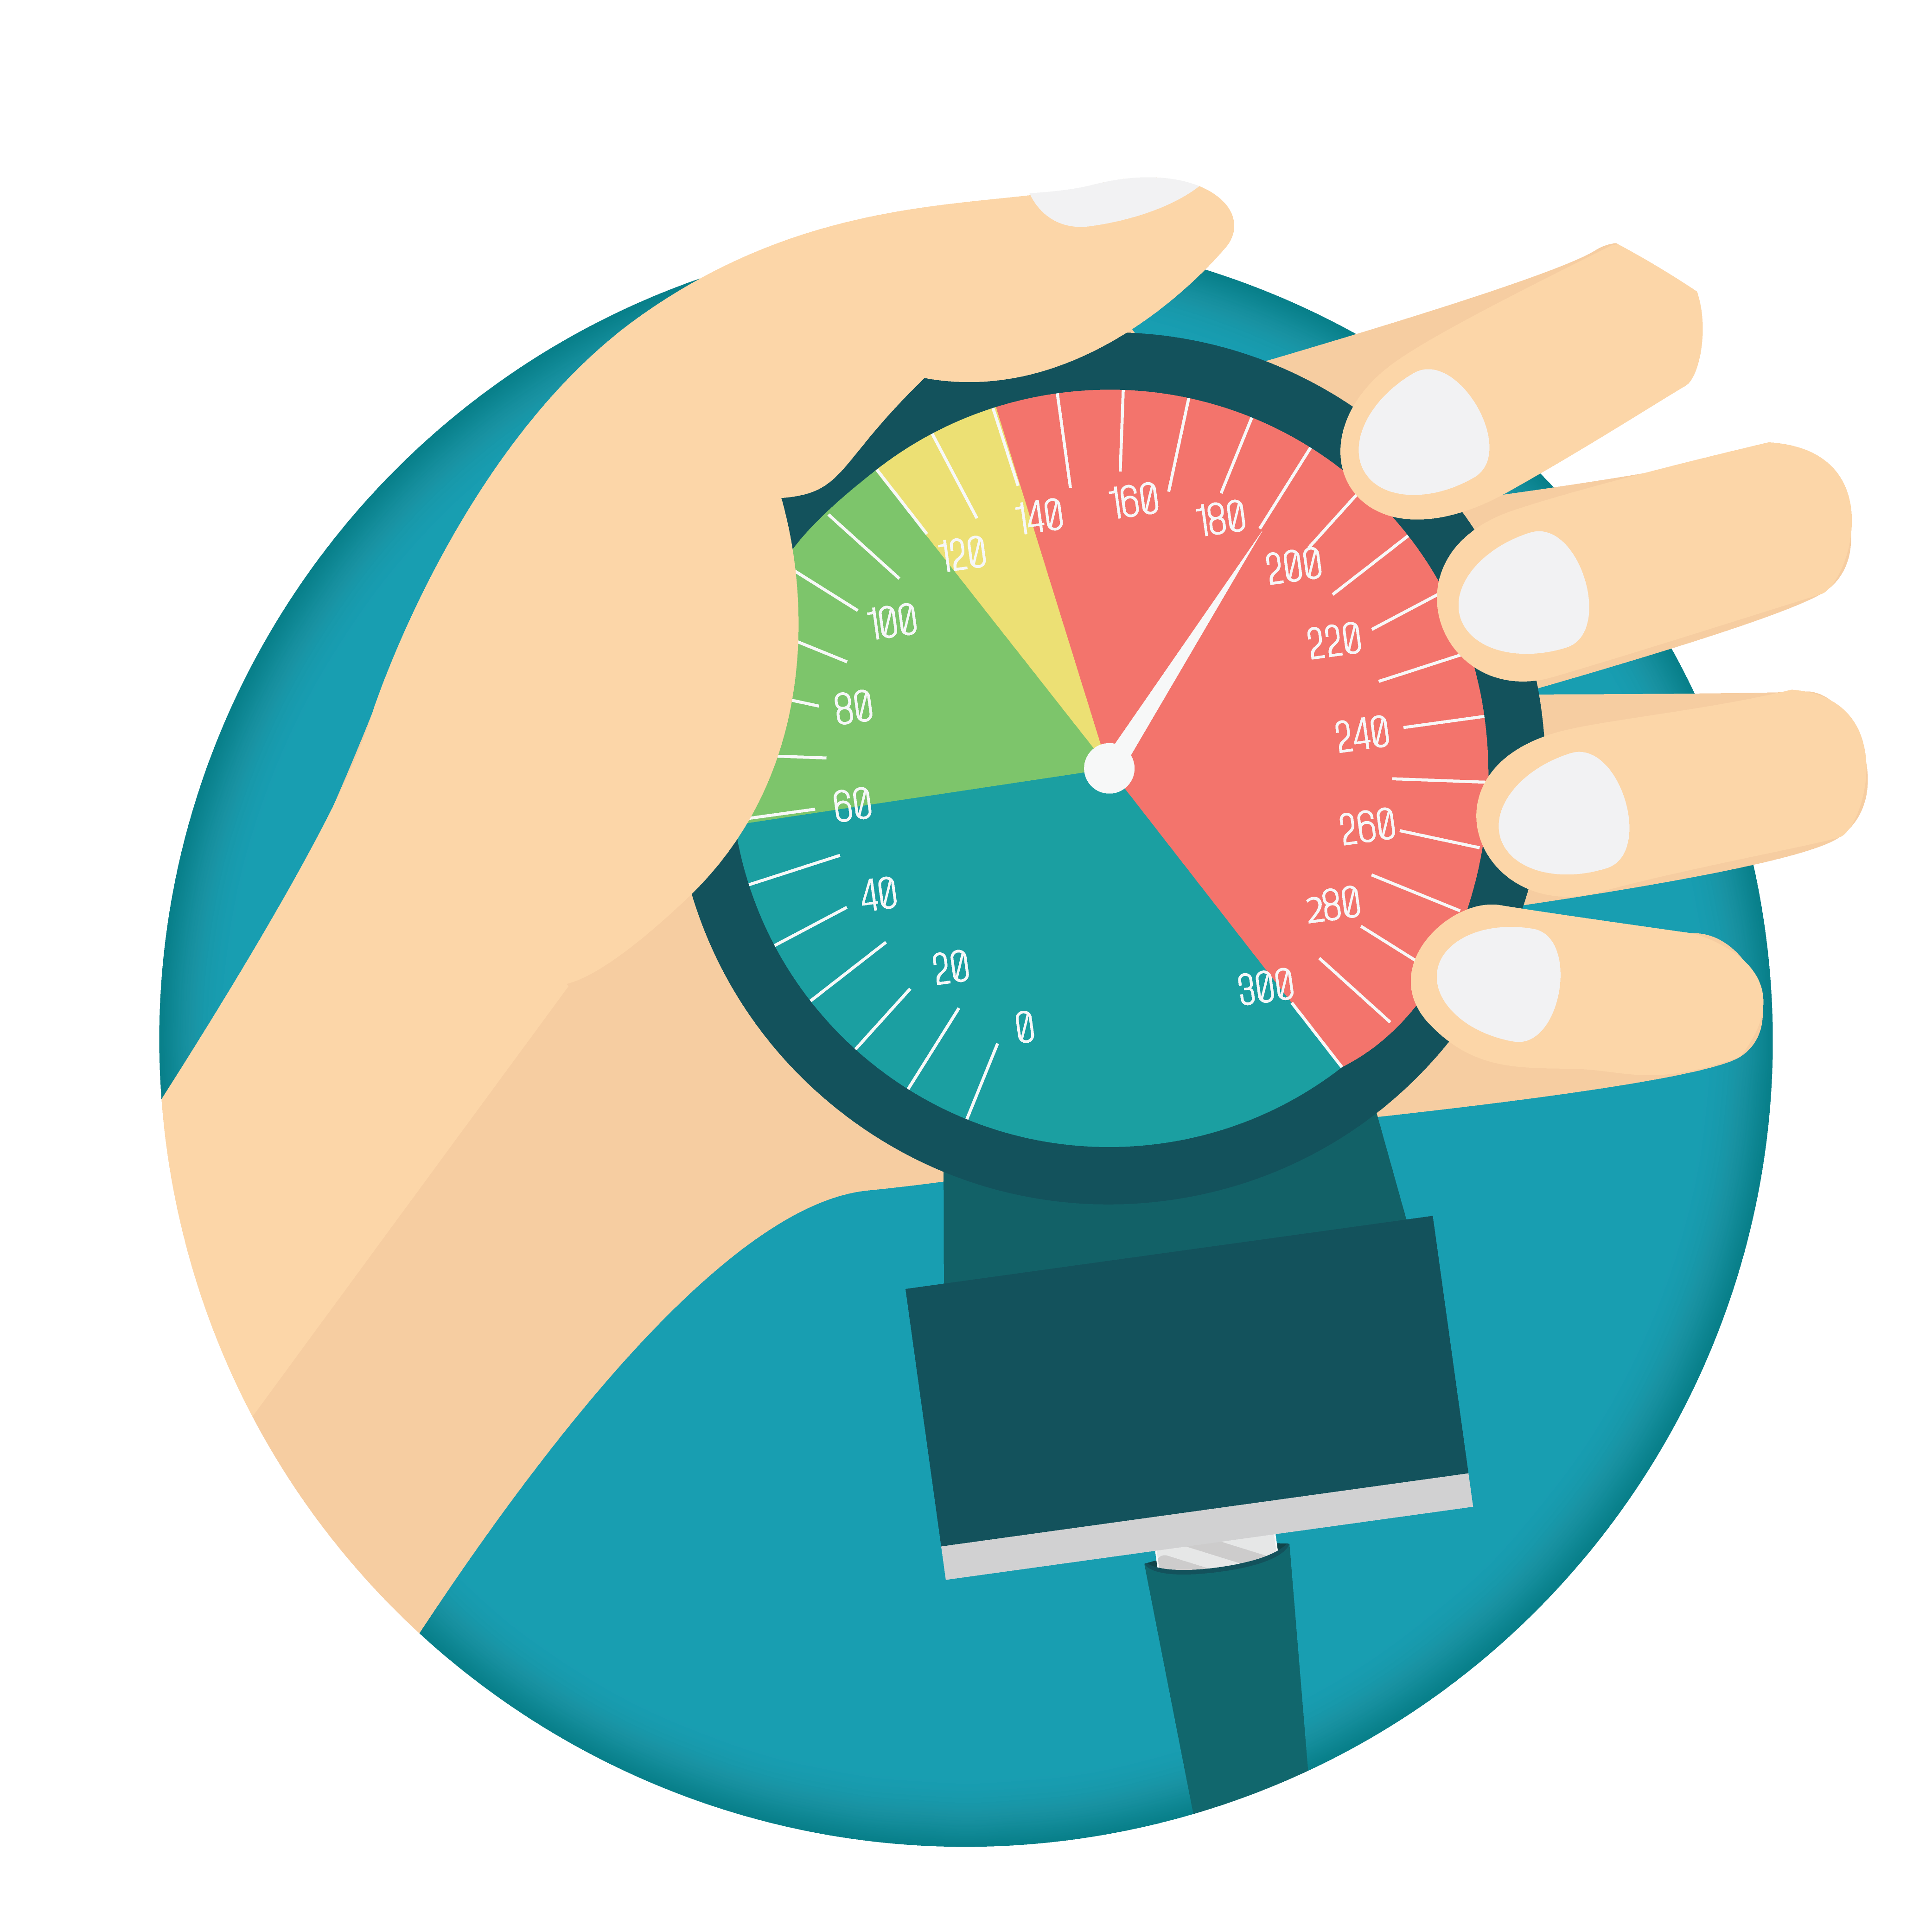


Key variables
Age
Exercise
Sex
Heart rate
Blood pressure
Lipid profile

Slide 6

Data Visualization

Slide 7
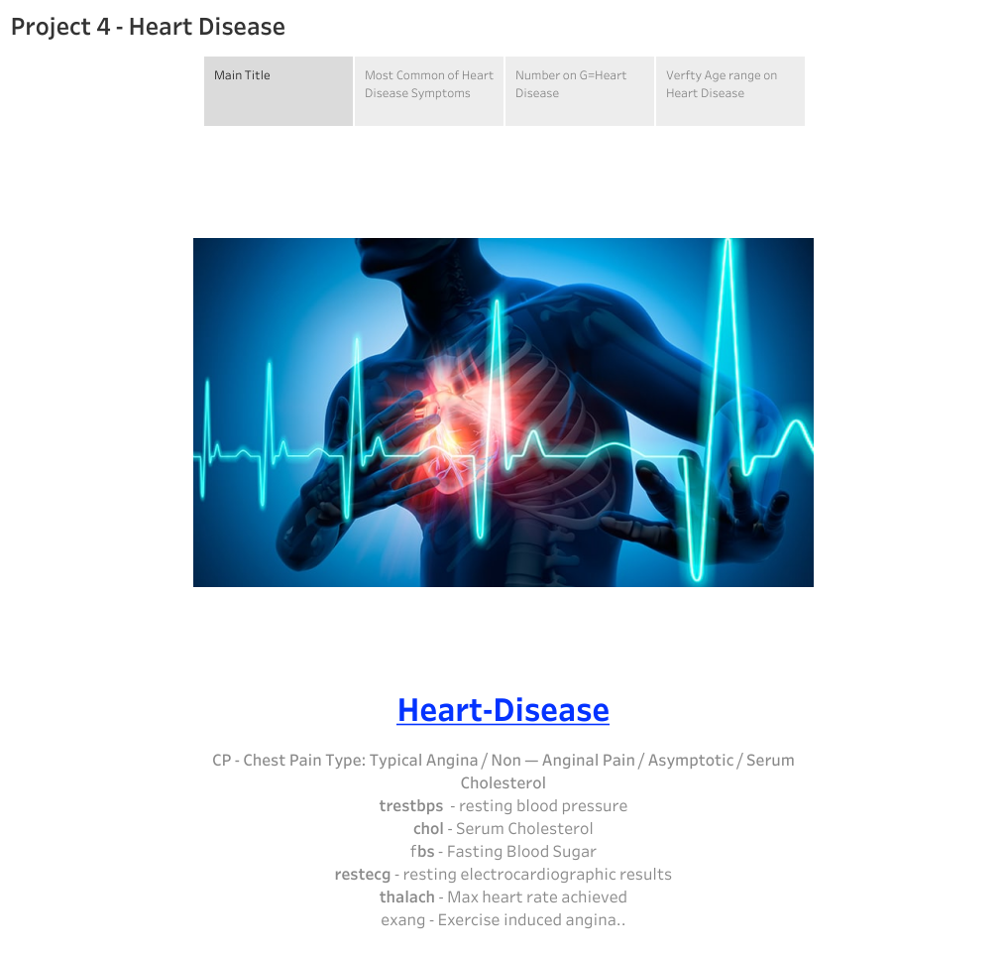

Slide 8
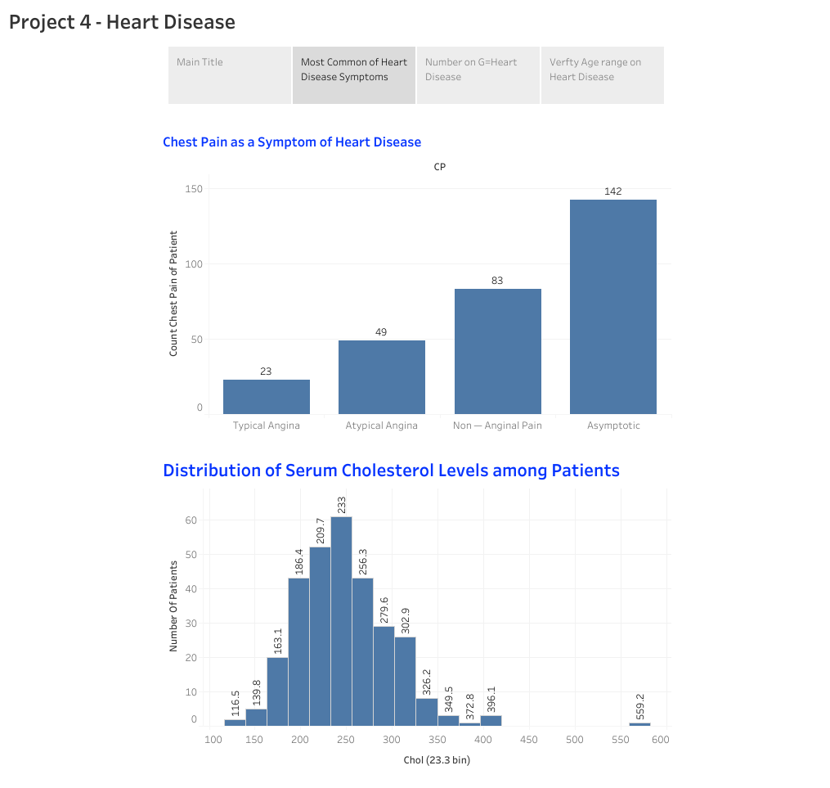

Slide 9
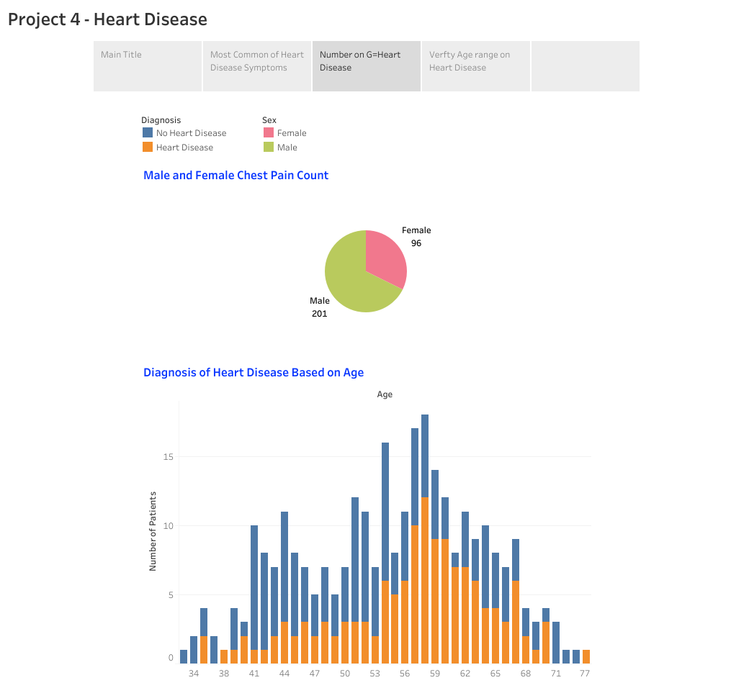

Slide 10
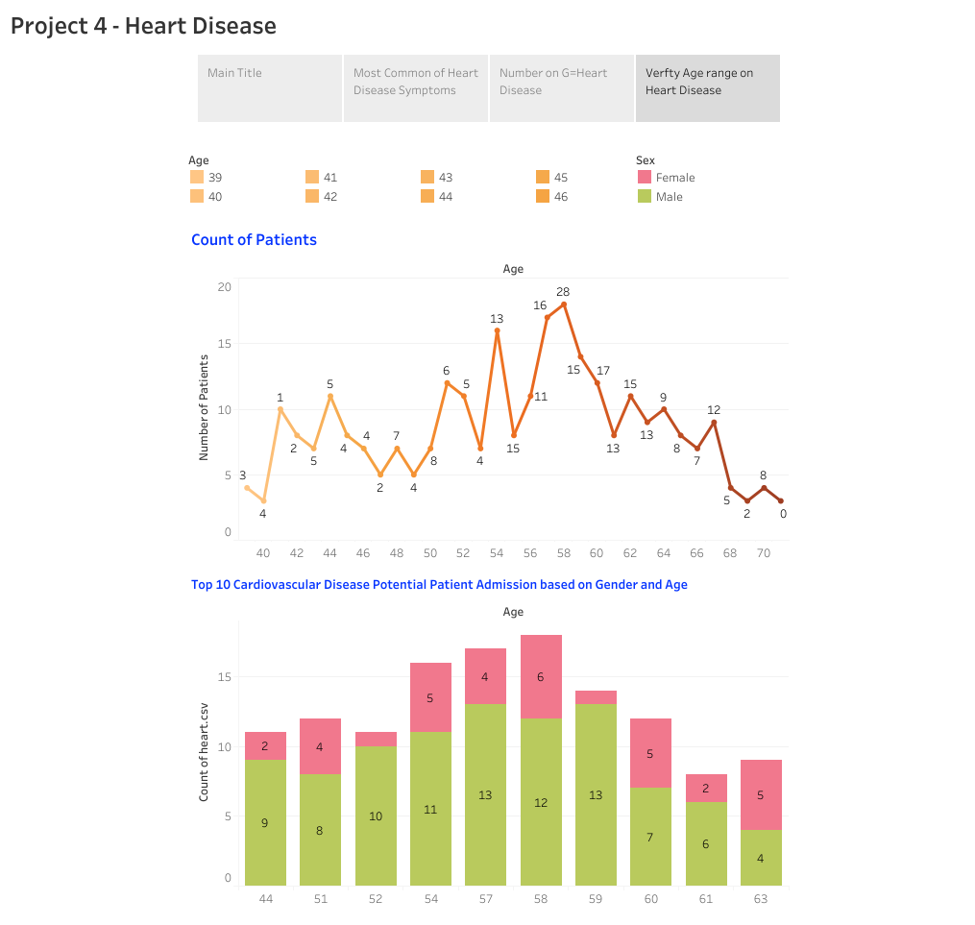

Slide 11

Machine Learning

Slide 12
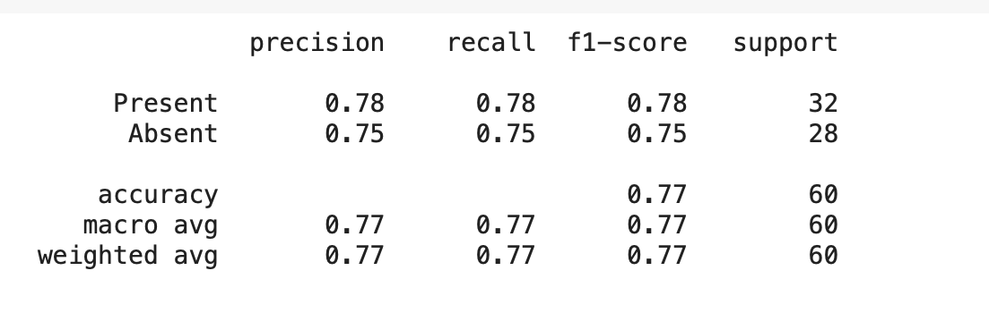
Decision Tree
77%

Slide 13
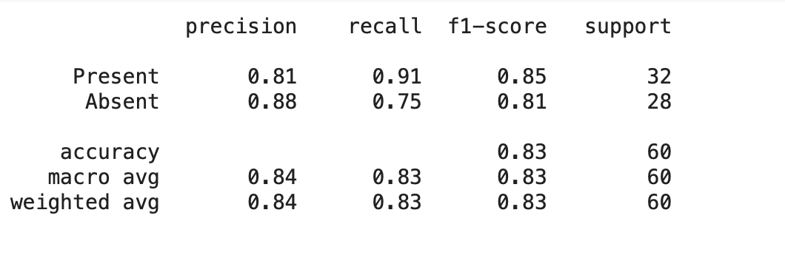
Random Forest
83%

Slide 14
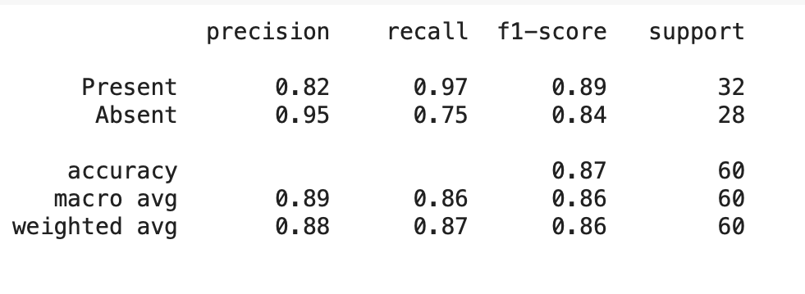
Logistic Regression
87 %

Slide 15
SVM
87%

Slide 16
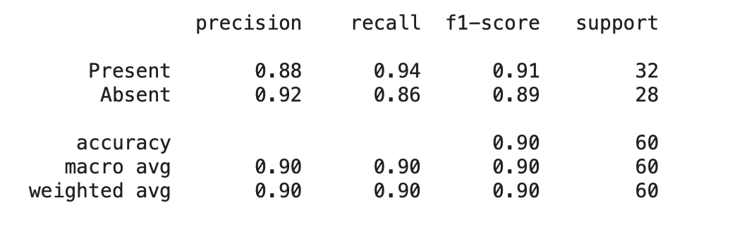
90%
K Nearest Neighbors

Slide 17
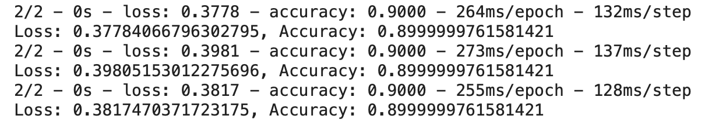
Neural Network
Top 3 Metrics

Slide 18
Neural Network
Top 3 Parameters

Slide 19
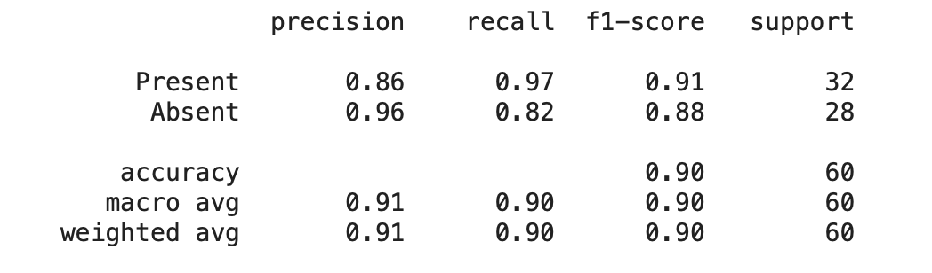
Neural Network
Best Metrics

Slide 20

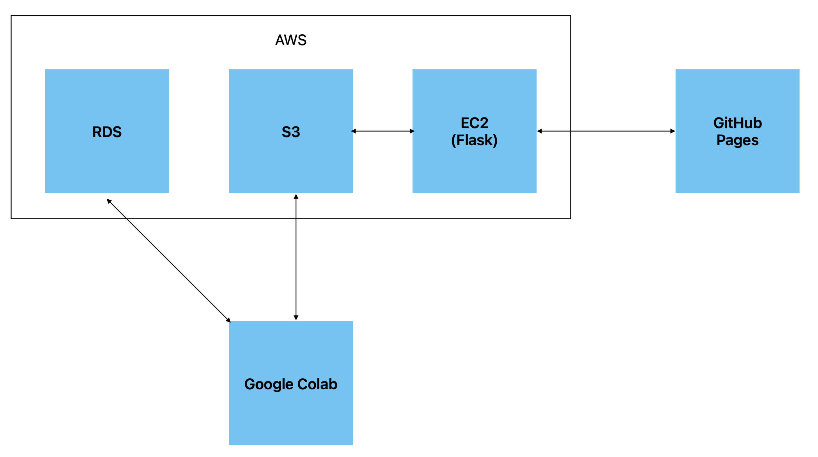
High Level System Design

Slide 21

Heart Diseases Detection

Slide 22
