Slide 1
BAR Tower Redesign
John Jasa
Pietro Bortolotti
Garrett Barter
May 14, 2020

Slide 2
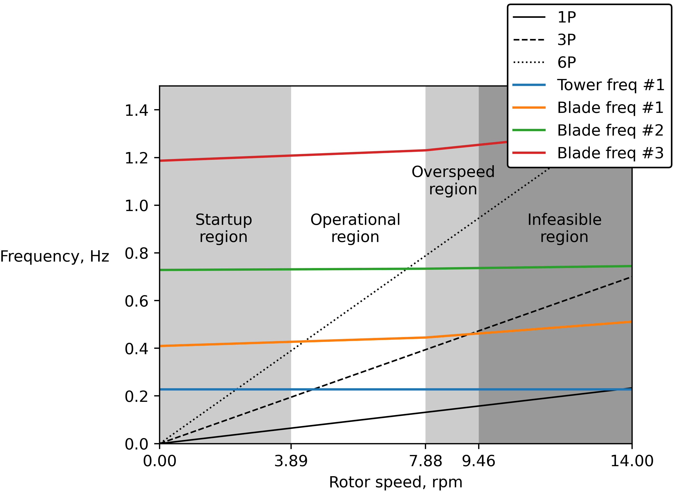
The original tower for the BAR project violates design constraints
A placeholder tower design has been used since the project focuses on other subsystems
The initial tower has a base diameter of 10 m and violates both shell buckling and frequency constraints
The Campbell diagram shows the original tower’s natural frequency in blue intersecting the dashed 3P line, which is potentially problematic

Slide 3
To design a new tower, we used the BAR_00 case in TowerSE within WISDEM
RNA loads and moments come from DriveSE
Varied max diameter constraints: 4.5 m, 6.0 m, and 8.0 m
Restricted design to a soft-stiff conical tubular steel configuration
Did not consider fatigue due to limitations in modeling tools
Minimum diameter-to-thickness ratio = 120
Max taper ratio = 0.2
Minimize: Tower mass
With respect to: Tower outer diameter
Tower wall thickness
Subject to: Stress
Global (column) buckling
Shell (plate) buckling
Diameter-to-thickness ratio
Taper ratio
Frequency
Objective
Design Variables
Constraints
21 design variables and 120 constraints

Slide 4
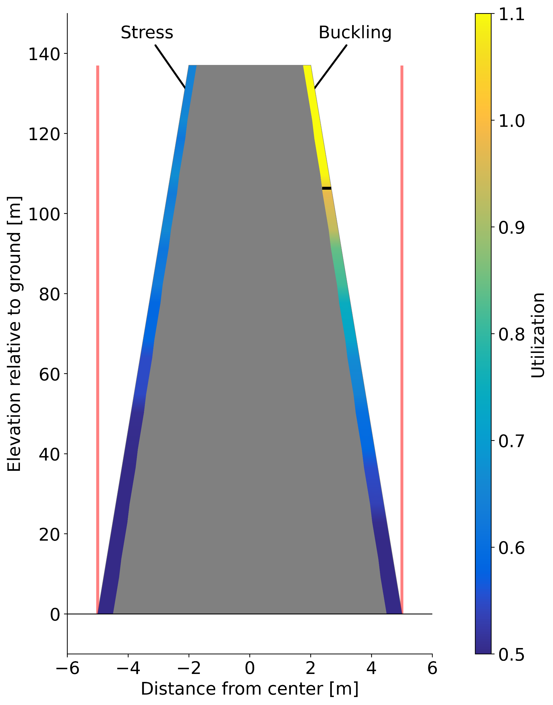
How to read this optimal tower design diagram
Shows the optimal tower diameter and wall thickness distributions
The wall thickness is exaggerated 10x for visualization
The stress and buckling utilization constraints are shown by coloration, where values above 1.0 mean the constraint is violated
A band is shown via a black line where utilization=1.0 if the constraint is violated
Stress and buckling values are radially constant; they only vary with tower elevation
The vertical red lines show the maximum tower diameter allowed for that case
Figure idea adapted from Hegseth et al. 2020

Slide 5
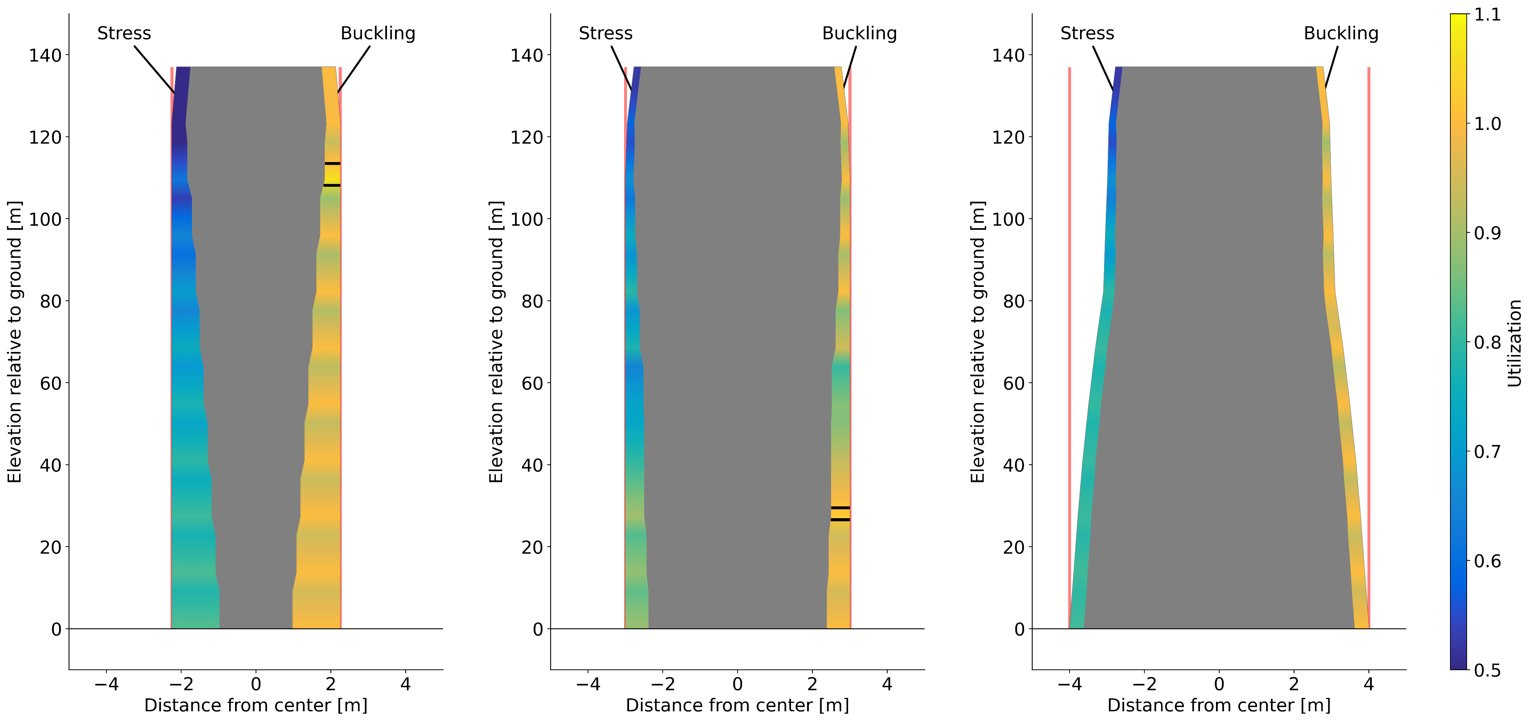
Only the 8.0 m case satisfied all constraints
The smaller diameter towers cannot satisfy both the buckling constraint and the wall thickness limit imposed by the minimum diameter-to-thickness ratio
Both designs infeasible due to D-to-t ratio and buckling constraints
Feasible

Slide 6
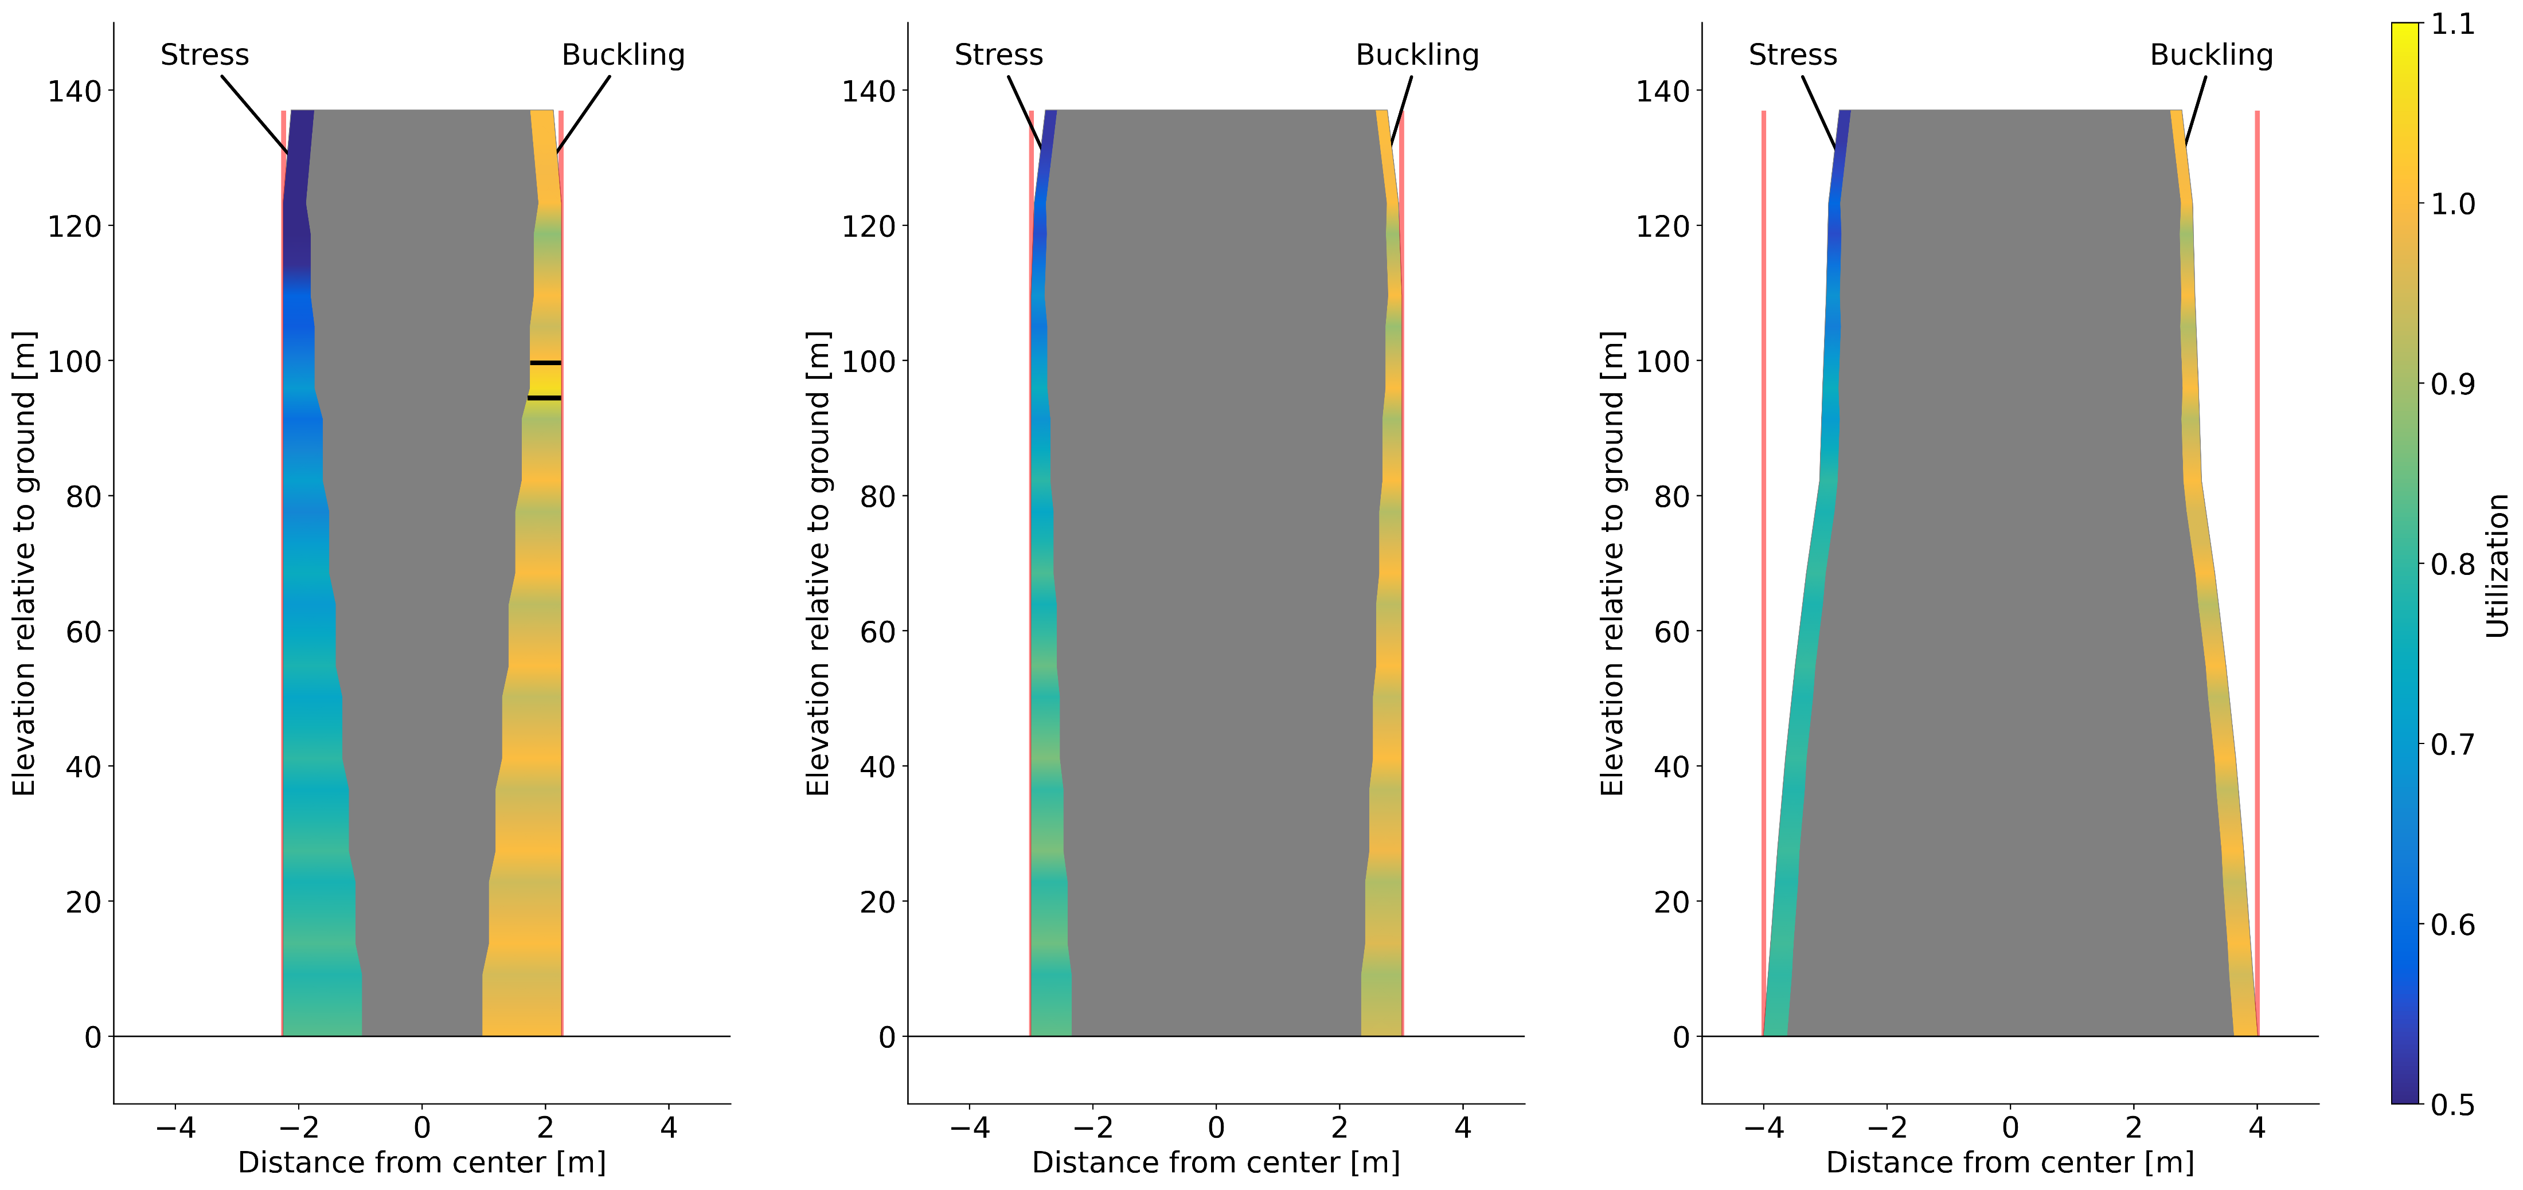
Lowering the minimum diameter-to-thickness ratio to 90 makes the 6.0 m case feasible
The diameter-to-thickness ratio is a measure of manufacturability
Different references have different values for the minimum D-to-t ratio
Infeasible due to D-to-t ratio and buckling
Feasible
Feasible

Slide 7
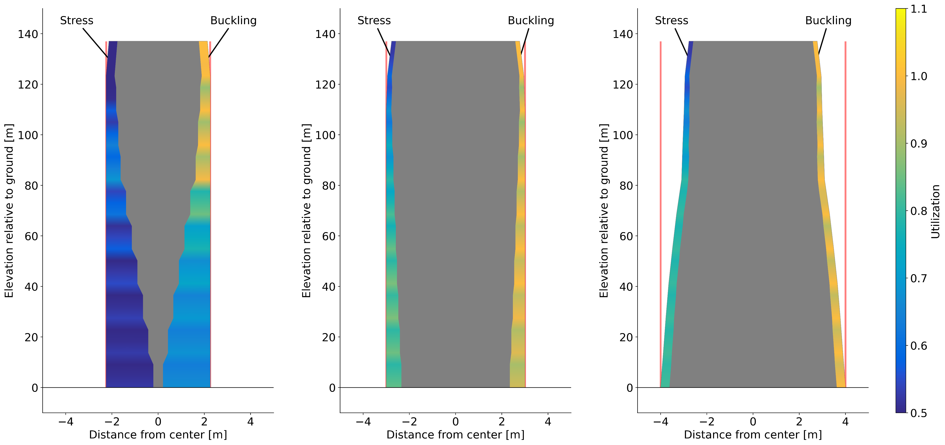
All cases are feasible without the diameter-to-thickness constraint, but the results are not manufacturable with traditional methods
Feasible
Feasible
Feasible

Slide 8
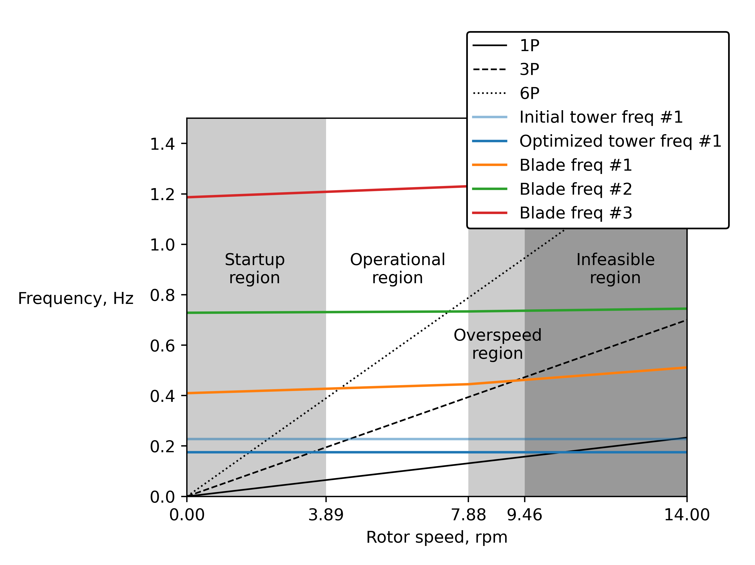
The optimized 8.0 m limit design moves the fundamental frequency below the 3P crossing
These results are for the minimum diameter-to-thickness ratio of 100
Modern controllers can bypass problematic frequencies, but this study did not consider that level of control

Slide 9
The optimized 8.0 m base diameter tower has a 26% lower mass compared to the original design
Measure | Original design | Optimized 6.0 m limit design | Optimized 8.0 m limit design
Tower mass, metric tons | 1073. | 917.0 | 793.7
Tower natural frequency, Hz | 0.227 | 0.157 | 0.175
All constraints satisfied | No | Yes | Yes
These case results come from the minimum diameter-to-thickness = 90 studies
Soft-soft configurations could not satisfy all constraints with any diameter limit
A 4.5 m diameter limit is not reasonable for the constraints as analyzed by WISDEM
All designs have a larger blade tip-to-tower clearance than the original design

Slide 10
We may need to consider modern approaches for the tower design in future studies
On-site manufacturing, assembling interlocking steel pieces, or hybrid materials could provide feasible designs
Assuming a more robust controller that uses frequency avoidance provides greater tower design freedom

