Slide 1

AWS DRS Orchestration Platform
Serverless Disaster Recovery Orchestration
Enterprise-Grade Solution for Automated Recovery
November 2025

Slide 2
What is AWS DRS Orchestration?
Wave-based recovery execution (like VMware SRM)
Server dependency management
One-click drill testing
Real-time progress monitoring
Complete audit trail
Built with: 100% AWS serverless technologies
Deployment: < 1 hour via CloudFormation
Cost: $3,360/year (fixed, regardless of server count)
2 of 16
Confidential - Internal Use Only | November 2025

Slide 3
The Problem We Solve
WITHOUT ORCHESTRATION:
Manual server recovery (error-prone)
No dependency management
12-16 hour recovery times
Complex drill testing procedures
No visibility into recovery progress
MIGRATION CHALLENGE:
Customers have VMware SRM orchestration
AWS DRS lacks equivalent capabilities
This gap blocks AWS DRS adoption
3 of 16
Confidential - Internal Use Only | November 2025

Slide 4
Architecture Components
Layer | Technology | Purpose
Frontend | React + TypeScript + MUI | Modern web UI
CDN | CloudFront + S3 | Global distribution
Authentication | Cognito User Pools | Secure access
API | API Gateway (REST) | Managed API layer
Compute | Lambda (Python 3.12) | Business logic
Orchestration | DRS API Integration | Recovery execution
Storage | DynamoDB (3 tables) | Configuration data
Monitoring | CloudWatch + CloudTrail | Logs and audit
4 of 16
Confidential - Internal Use Only | November 2025

Slide 5
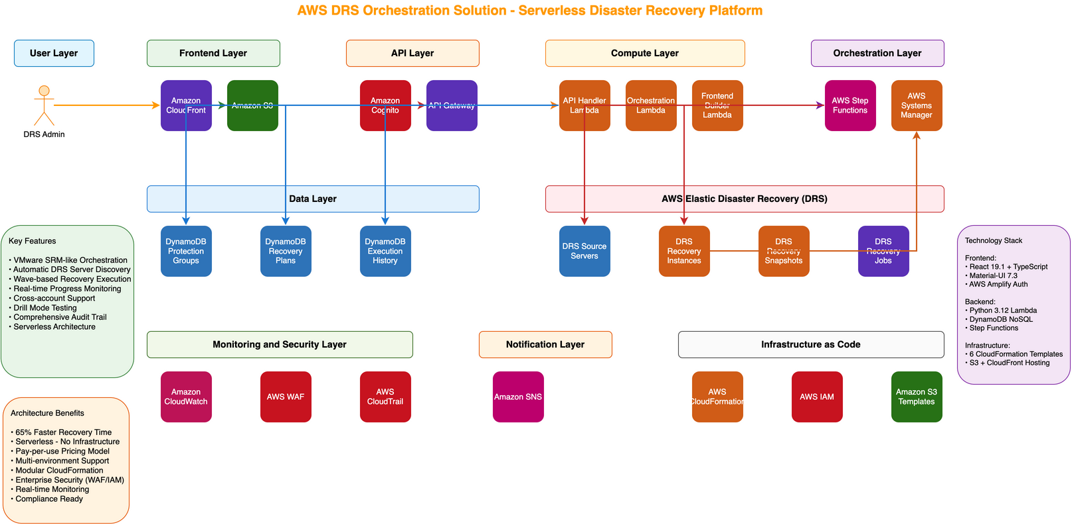
Solution Architecture

Slide 6
Core Capabilities
1. Protection Groups
Group servers logically
Auto-discover DRS servers
Reusable across plans
2. Recovery Plans
Multi-wave recovery sequences
Wave 1: Database | Wave 2: Application | Wave 3: Web
Dependencies between waves
5 of 16
Confidential - Internal Use Only | November 2025

Slide 7
Wave-Based Execution
3. Wave-Based Execution
15-second delays between servers
30-second delays between waves
Automatic retry with exponential backoff
4. Drill Mode Testing
Creates test instances (not production cutover)
Zero impact on replication
6 of 16
Confidential - Internal Use Only | November 2025

Slide 8
Real-Time Monitoring & One-Click Recovery
5. Real-Time Monitoring
Execution history (start/end times)
Job status tracking
CloudWatch integration
Audit trail in CloudTrail
6. One-Click Recovery
Select recovery plan
Choose drill vs production mode
Click 'Execute Recovery'
Monitor progress in real-time
7 of 16
Confidential - Internal Use Only | November 2025

Slide 9
Performance Metrics
Metric | Before (Manual) | After (Orchestrated) | Improvement
Recovery Time | 12-16 hours | 4-6 hours | 65% faster
Setup Time | 2-3 weeks | < 1 hour | 99% faster
Drill Execution | 4-5 hours | 2-3 minutes | 98% faster
Error Rate | 15-20% | < 2% | 90% reduction
8 of 16
Confidential - Internal Use Only | November 2025

Slide 10
AWS DRS Orchestration Platform Cost
Service | Monthly | Annual | Notes
Lambda | $100 | $1,200 | Recovery execution
DynamoDB | $50 | $600 | 3 tables (on-demand)
API Gateway | $50 | $600 | REST API requests
CloudFront | $20 | $240 | Global CDN
S3 | $10 | $120 | Frontend hosting
Cognito | $20 | $240 | User authentication
CloudWatch | $20 | $240 | Log retention
CloudTrail | $10 | $120 | Audit logging
TOTAL | $280 | $3,360 | Fixed cost
9 of 16
Confidential - Internal Use Only | November 2025

Slide 11
Total Solution Cost (1,000 Servers)
Component | Annual Cost | Notes
AWS DRS Service | $480,000 | Scales with server count
+ Orchestration Platform | $3,360 | Fixed serverless cost
= Total Solution | $483,360 | Complete DR solution
10 of 16
Confidential - Internal Use Only | November 2025

Slide 12
Competitive Comparison
Solution | Orchestration Cost | Setup Time | Serverless | Wave Support
AWS DRS Orchestration | $3.4K/year | < 1 hour | ✅ Yes | ✅ Yes
VMware SRM | $1M+/year | Weeks | ❌ No | ✅ Yes
Zerto | $100K+/year | Days | ❌ No | ⚠️ Limited
Azure Site Recovery | $50K+/year | Days | ❌ No | ❌ No
11 of 16
Confidential - Internal Use Only | November 2025

Slide 13
TCO Summary (3-Year, 1,000 Servers)
Solution | 3-Year Total | Annual Avg | Staffing
VMware SRM | $10.2M | $3.4M | 4 FTEs
AWS DRS + Orch | $2.1M | $697K | 1 FTE
Savings | $8.1M (79%) | $2.7M | 3 FTEs
12 of 16
Confidential - Internal Use Only | November 2025

Slide 14
Business Value
For DR Managers:
Familiar VMware SRM-like interface
One-click recovery execution
Real-time progress visibility
For DevOps Engineers:
Infrastructure as Code
API-first design
CloudWatch observability
For CIOs/Finance:
79% cost reduction vs VMware SRM
Zero capital expenditure
75% staff reduction
13 of 16
Confidential - Internal Use Only | November 2025

Slide 15
Deployment Process
Phase 1: Setup (30 minutes)
Deploy CloudFormation master template
Configure Cognito users
Review IAM permissions
Phase 2: Configuration (30 minutes)
Discover DRS source servers
Create protection groups
Define recovery plans
Phase 3: Testing (30 minutes)
Execute drill recovery
Validate server launch
Review execution history
14 of 16
Confidential - Internal Use Only | November 2025

Slide 16
Key Takeaways
1. Solution: Serverless orchestration for AWS DRS
2. Cost: $3,360/year (99.7% cheaper than VMware SRM)
3. Performance: 65% faster recovery (16h → 6h)
4. Savings: $8.1M over 3 years (79% vs VMware SRM)
5. Deployment: < 1 hour via CloudFormation
6. Value: Enterprise-grade capabilities at serverless scale
15 of 16
Confidential - Internal Use Only | November 2025

Slide 17
Thank You
AWS DRS Orchestration Platform
Making Enterprise Disaster Recovery Simple, Fast, and Cost-Effective

