Slide 1


Final Presentation: Robson College Website Redesign
Presented by Web Wizards
Improving Accessibility and Engagement
Team Members: Brendan Myers, Michael Kelly, Tim Brewer, Jack Williams, John Jimenez

Slide 2

Introduction
Welcome to our final presentation on the Robson College Website Redesign.
Our project aims to transform the current Robson College website into a more user-friendly, accessible, and efficient online platform.
This redesign will cater to the needs of potential students, current students, faculty, and staff, ensuring that everyone can find information quickly and easily.

Slide 3

Fundamentals of the Presentation
This presentation covers the essentials of our redesign project including the project's value, the underlying research, the proposed budget, a showcase of our prototype, and a clear articulation of the problem we aim to solve.
We have ensured that the presentation is designed for clarity and engagement, with consistent graphic styles and large, readable text

Slide 4

Value Statement
The value of our redesign lies in its ability to enhance user engagement and satisfaction, leading to increased enrollment and improved communication within Robson College.
Our redesign directly impacts the organization by providing a more navigable and accessible platform that reflects the college's commitment to innovation and community involvement.

Slide 5

Problem Statement
Our project addresses two major issues: First, the current website's poor user engagement and accessibility, which deter potential and current students as well as faculty from using the website effectively.
Second, the inefficiency of the existing Content Management System, which complicates content updates and information dissemination, affecting the timeliness and accuracy of information available.

Slide 6

Survey Insights and Feedback
Our quantitative analysis involved responses from over 2,750 stakeholders which provided us with a clear picture of the current website's performance and areas for improvement.
Key findings indicated that a significant number of users found the website challenging to navigate and expressed concerns over the security of their personal information.
Enhancements in IT infrastructure were deemed necessary by a majority of the respondents to improve organizational effectiveness.

Slide 7

Technology Stack and Tools
For our redesign, we leveraged a modern technology stack to ensure robust performance and security. Key components include:
Content Management: WordPress with specific plugins for enhanced functionality and security measures such as Wordfence.
Hosting Solutions: Microsoft hosting services ensuring reliable and scalable web presence.
Security Suite: Avast Ultimate Business Security and CCleaner Cloud for endpoint protection of 300 devices, ensuring all user data is protected against the latest threats.

Slide 8

Prototype Demonstration
Next, we'll demonstrate our working prototype which incorporates advanced search functionalities and an adaptable design for better accessibility across all devices.
This prototype illustrates our solution to the identified problems and showcases potential improvements in user experience

Slide 9
Prototype presentation/demonstration
NOT AVAILABLE / MISSING

Slide 10

Project Needs
Implementing our project will require careful scheduling, a clear budget, and considerations for additional resources.
We have outlined a timeline for completion and a detailed budget that covers all necessary expenses including software, hardware, and labor.

Slide 11
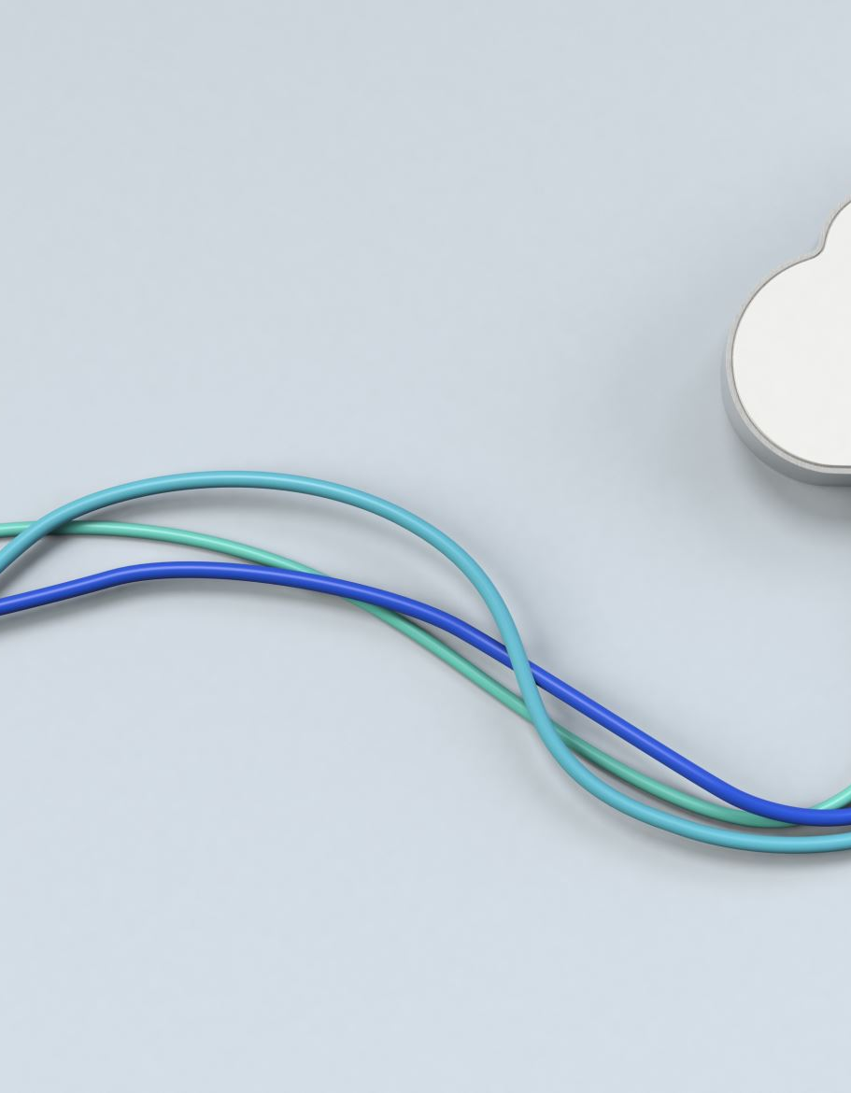
Comprehensive Budget Breakdown
Total Software Costs: $1,125 per year, covering WordPress and its plugins, themes, Adobe Creative Suite, and cloud backup software.
Hardware Investments: $3,120 one-time purchase for desktop computers, cameras, microphones, lighting, teleprompters, and tripods.
Annual Web Hosting and Support: $150 for the hosting computer, including ongoing support costs.
Labor Costs: $36 per hour plus 25% fringe benefits for web page design, creation, review, and continuous updates totaling approximately 776 hours per year.
This meticulous budget planning ensures a smooth rollout and maintenance of the redesigned website, aligning with project timelines and resource allocation.

Slide 12

Projected Outcomes and Success Metrics
Post-implementation, we expect to see a 30% improvement in user engagement metrics such as session time and reduced bounce rates.
User satisfaction should see a measurable increase, with feedback loops integrated to continuously adapt and evolve the website functionalities.
We aim for a 20% increase in new student applications within the first year, demonstrating the success of the redesign in attracting prospective students.

