Slide 1

OmniLog Your Ultimate Media Companion!
By: Jason Schleifer, Brayden Poorvin, Michael Whelan, John Jimenez, and John Camel
Notes:
brayden

Slide 2
Presentation at a Glance
Basic project information
Video prototype
Scope of work
Risk assessment
Cost
Communication Plan
Gantt Chart
Plan Assessment
Next Steps

Slide 3
Description
OmniLog is a user-friendly and fully functional website that allows users to log and review various types of media, including TV shows, movies, books, and music. The website will allow users to connect with friends and share this information amongst each other.
Notes:
brayden

Slide 4




Vision
Turning mindless, asocial media consumption into a process that encourages self-reflection and connection with others.
Totality
Availability
Discovery
Community
Notes:
brayden

Slide 5
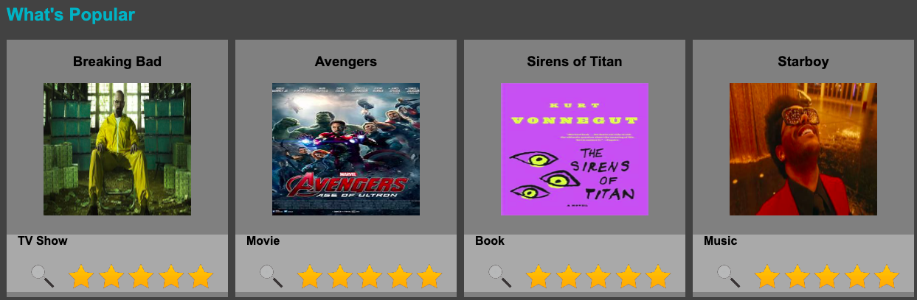
Goals of OmniLog
At OmniLog, we envision a comprehensive platform that revolutionizes the way individuals engage with and experience media content. Our goal is to provide users with a seamless, intuitive, and personalized platform for tracking, logging, and rating their favorite movies, TV shows, books, and songs.
Notes:
John C.

Slide 6
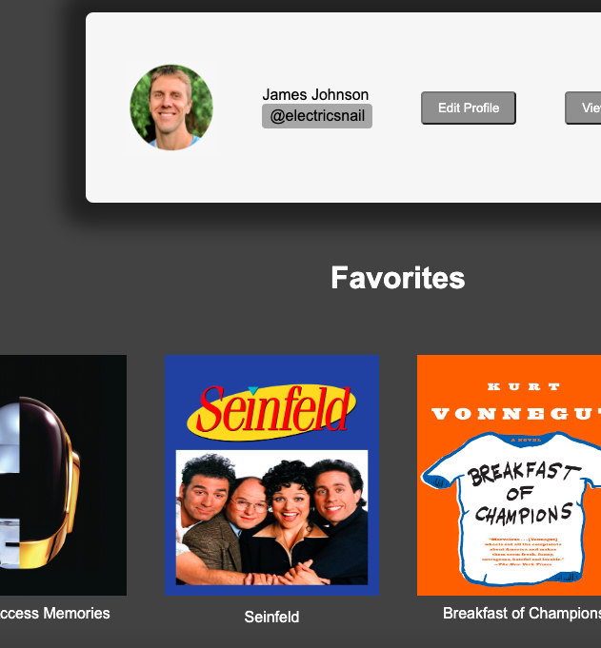
Value OmniLog Brings
OmniLog offers significant value to users by providing a comprehensive and user-friendly platform for logging, sharing, and discovering media consumption. Here are some key aspects of the value that OmniLog brings:
Centralized Logging: Omnilog serves as a centralized hub where users can log all their media consumption in one place.
User-Friendly Interface: The platform prioritizes user experience with a clean and intuitive interface.
Social Integration: OmniLog facilitates social interaction by allowing users to share their media logs with friends.
Personalized Recommendations: One of OmniLog's standout features is its personalized recommendation system.
Trending Content: Omnilog keeps users informed about the latest trends in media consumption with its "What's Hot" section.
Notes:
John C.

Slide 7

Notes:
Michael W

Slide 8

Project Plan
Scope: Our project's scope includes developing a user-friendly website that enables users to create accounts, log media consumption, and share these logs with friends. Key features include logging books, movies, TV shows, and music, a “What’s Hot” section for trending media, and a personalized “Plan to” list based on friends' logs. Indicators of project completion include successful website functionality testing, development of branding, infrastructure setup, and website deployment. Our project will not venture into streaming services or attempt to replace any existing logging software, maintaining a unique position in the market.
Notes:
John J

Slide 9
Risk Assessment
Cybercrime:
Scan web application for vulnerabilities
Include strict input sanitization
Follow web administration best practices
Implement DDoS prevention services
Legal Issues:
Reach out to the media outlets to ask for permission
Contacting law officials and removing certain media that is not given permission
Technical Challenges:
Upgrade servers
Implement server monitoring software
Performance testing
Database optimization
Notes:
Michael W

Slide 10
Cost
Budget:
Project Management and Planning
Project Manager Salary: $10,000
Planning and Design Tools: $1,500
Development
Developer Salaries (4 Developers): $48,000
Software Licenses (Development Tools & Database): $5,000
Hardware (Server Equipment): $10,000
Hosting (Initial Setup and 6 Months Prepaid): $3,000
Testing and Revision
Quality Assurance Testing Tools: $2,000
External Beta Testing (Feedback tools, incentives): $2,000
Marketing and Deployment
Branding (Logo, Website Design): $5,000
Digital Marketing (Social Media, Ad Campaigns): $8,000
Launch Event (Virtual): $1,500
Contingency Fund (Unforeseen costs and overruns): $14,000
Miscellaneous (Team training, subscriptions, etc.): $5,000
Total Budget: $125,000
Notes:
John J

Slide 11
Communication Plan
Stakeholder(s) | Reasons for communications | Method of communications | Timing | Who is communicating with them?
Supervisor | Ensure project goals are being met including timeline and budget | Hour long in-person meetings | Weekly | Project Lead
Team Members | Maintain shared vision for project. Update on individual progress | Meetings, email, text messages, OneDrive documents | Twice Weekly | Entire team
End users | Researching user needs | Focus groups | Biweekly | Entire team
Notes:
Jason

Slide 12
Timeline
This project will be completed in 7 months
Planning and Design – month 1
Development – months 2-5
Testing and Revision – month 6
Marketing and Deployment – month 7
Notes:
Jason

Slide 13
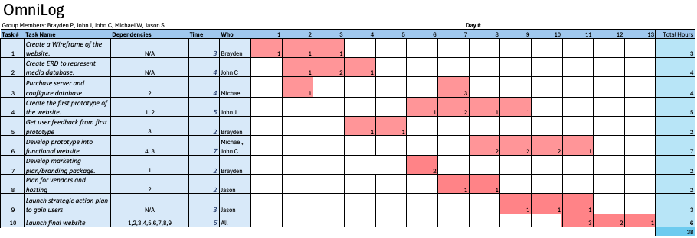
Gantt Chart
Notes:
Jason

Slide 14
Gantt Chart cont.
 |  |  |  |  | Day #
Task # | Task Name | Dependencies | Who | Cost per hour | 1 | 2 | 3 | 4 | 5 | 6 | 7 | 8 | 9 | 10 | 11 | 12 | 13 | Total Cost
1 | Create a Wireframe of the website. | N/A | Brayden | $50.00 | $50 | $50 | $50 |  |  |  |  |  |  |  |  |  |  | $150
2 | Create ERD to represent media database. | N/A | John C | $45.00 |  | $45 | $90 | $45 |  |  |  |  |  |  |  |  |  | 180
3 | Purchase server and configure database | 2 | Michael | $45.00 |  | $45 |  |  |  |  | $135 |  |  |  |  |  |  | 180
4 | Create the first prototype of the website. | 1, 2 | John.J | $30.00 |  |  |  |  |  | $30 | $60 | $30 | $30 |  |  |  |  | 150
5 | Get user feedback from first prototype | 3 | Brayden | $50.00 |  |  |  | $50 | $50 |  |  |  |  |  |  |  |  | 100
6 | Develop prototype into functional website | 4, 3 | Michael, John C | $90.00 |  |  |  |  |  |  |  | $180 | $180 | $180 | $90 |  |  | 630
7 | Develop marketing plan/branding package. | 1 | Brayden | $50.00 |  |  |  |  |  | $100 |  |  |  |  |  |  |  | 100
8 | Plan for vendors and hosting | 2 | Jason | $50.00 |  |  |  |  |  |  | $50 | $50 |  |  |  |  |  | 100
9 | Launch strategic action plan to gain users | N/A | Jason | $50.00 |  |  |  |  |  |  |  |  | $50 | $50 | $50 |  |  | 150
10 | Launch final website | 1,2,3,4,5,6,7,8,9 | All | $220.00 |  |  |  |  |  |  |  |  |  |  | $660 | $440 | $220 | 1320
 |  |  |  |  |  |  |  |  |  |  |  |  |  |  |  |  |  | $3,060

Slide 15
Plan Assessment
Achievements:
Prototype Developed: Functional prototype of OmniLog site completed.
Budget Adherence: Budget tracked and within projected limits.
Timeline Compliance: Development is on schedule as planned.
Communication Efficiency: Regular updates and feedback loops established with stakeholders.
Pending Actions:
Prototype Testing: Begin user testing for feedback and improvements.
Budget Review: Assess current spending and adjust for next phases.
Timeline Update: Refine project timeline based on prototype feedback.
Enhance Communication: Intensify engagement with stakeholders based on prototype insights.
Notes:
John C

Slide 16
Next Steps
Undergo user testing with prototype website
Find API to auto-populate media on site
Purchase servers and other equipment
Begin marketing
Notes:
Michael W

Slide 17
Thank you!
Questions?

