Slide 1

Our Future Is Your Future: Save California State University
Prepared by CSU Long Beach Faculty
Summer 2009
Notes:
Dear Presenter, We believe that education in California is in crisis. This presentation aims to equip all faculty, staff, students, and friends of California State University to become ambassadors for change. By understanding the role played by the California State University system in the state of California, and by helping spread the word about the importance of higher education, you can make a difference! The final slides provide action points for listeners—please encourage people to take the action suggested. We provide the copy of the one-click letter on the www.savethecsu.com website on the next-to-last slide. You can make copies of that as well and distribute them at any talk you give.
We imagine that this presentation can be modified for local campuses to highlight the social, economic, and cultural impact of each university in its local context. For this reason, we are distributing the CSU version and the CSULB version to provide two different models. Please consider using the presentations in the following ways: (a) as a teach-in activity to raise awareness about the budget cuts; (b) posting them on your course management system so students can download them and share with their families and friends; (c) as part of a public education support effort at PTAs, schools, places of worship, and other local organizations in which you might be involved.
Finally, please stay tuned for updated budget numbers as the California fiscal crisis unfolds. And please continue to help all of us advocate for the restoration of funding to public education in the state of California. If you have questions, please contact Lisa Vollendorf (lvollend@csulb.edu) or Daniel O’Connor (oconnor@csulb.edu). Thank you.
Data in this presentation taken from:
CSU impact on state data: http://www.calstate.edu/impact
CSU industry impact: http://www.calstate.edu/impact/industrylist.shtml
c. California at the Edge Report: http://www.calfac.org/CalAtTheEdge.html
d. Public Policy Institute of California “California 2025: Taking on the Future” http://www.ppic.org/main/publication.asp?i=489

Slide 2
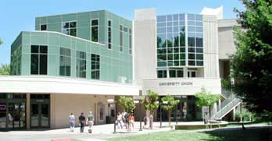
The mission of the CSU
Educational mission
High quality instruction
Affordability
Scholarship
Global citizenship and engagement
Preparing California’s workforce
Notes:
High quality, affordable education with an emphasis on scholarship and preparing students for the global economy are at the core of our educational mission. Perhaps most importantly for many of us, we prepare California’s workforce, as the data in this presentation confirm.
[The entire mission statement can be found at: http://www.calstate.edu/PA/info/mission.shtml]

Slide 3
What is the CSU system?
Statewide scope
Largest university system in the nation
23 campuses
450,000 students
47,000 faculty/staff
91,600 graduates (2009)
2,000,000 alumni

Slide 4
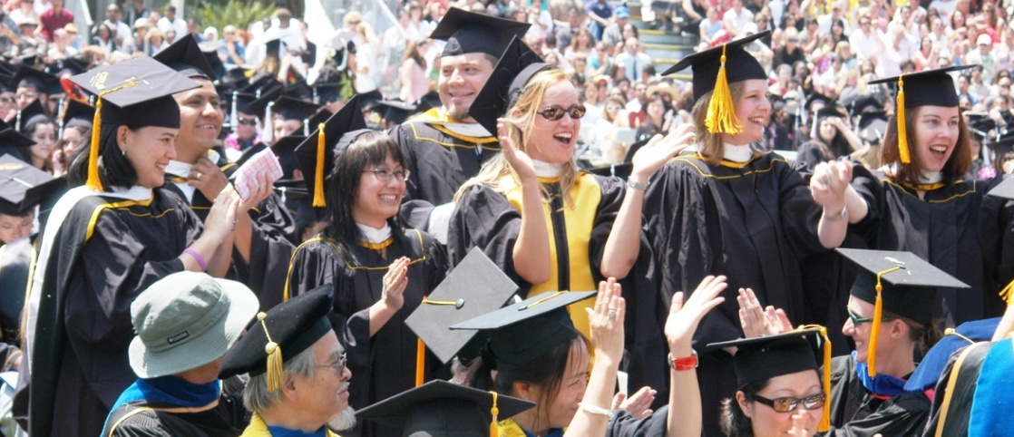
What is the CSU system? Part 2
In 2009, the CSU graduated the largest class in the history of American higher education!

Slide 5
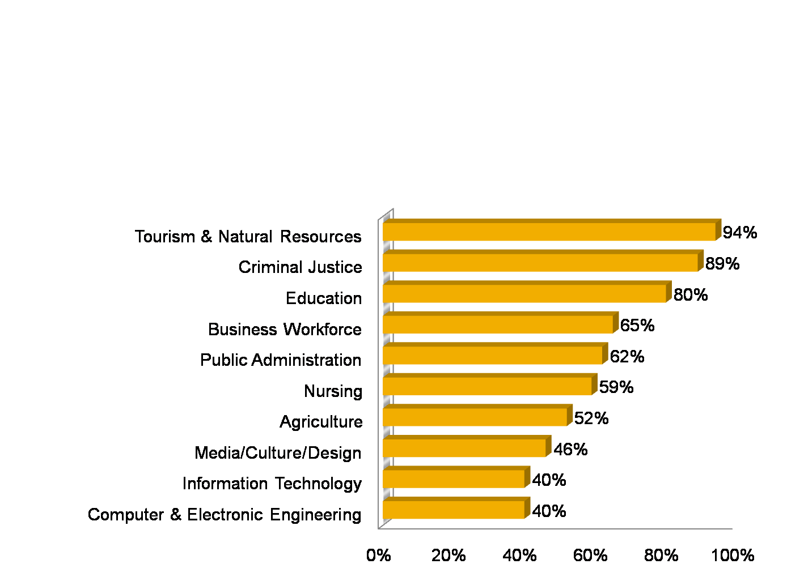
We make California work
California’s Workforce: % Bachelor’s degrees from CSU
Notes:
These statistics speak for themselves: the CSU educates the workforce in California. Without the CSU, thousands of businesses and numerous industries would not be able to find qualified employees. And thousands of students would be denied access to the professions that have made the state into one of the most important economic forces in the world.

Slide 6
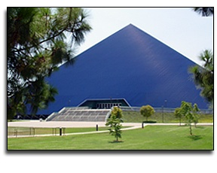
Cal State University Long Beach
Highly valued degrees
Largest undergraduate university in California
Over 65,000 students apply
Over 36,000 students enrolled
40th among all top public universities in “Mid-Career Graduate Earnings”

Slide 7
Cal State University Long Beach continued
Among the Nation’s Best
Total degree productivity
Top ten annually in degrees granted to minority students
Affordability
“Best University Value” - Princeton Review - US News & World Report
Notes:
CSULB is among the nation’s best in total degree productivity. This is a measure of our high productivity in graduation numbers (currently over 9000, which is among the nation's best) and of our overall efficiency in what it "costs" to produce a graduate. The CSU system is a national leader in this arena, and finds itself in the company only of some universities in Florida on this measure. Our tuition is among the lowest in the nation. When factoring quality and affordability, numerous publications (including the Princeton Review and U.S. News and World Report) have found us to be among the top three public education values in the west.

Slide 8

We deliver the dream
CSULB Student Population
34% First Generation Students
98% In-State Californians
60% African-American, Latino, Asian-American
Over 500 Veterans “Troops to College”
Notes:
The CSU system prides itself on being open to all people in California. We have a diverse student population, we believe in serving our veterans, and, above all, we take pride in helping individuals and families achieve the educational dream. Cal State University, Long Beach’s statistics appear above.

Slide 9
We help youth prepare for college
Early Assessment Program (EAP)
Helps high school juniors assess college readiness
Impacts 75% of all California high school juniors
Educational Opportunity Program (EOP)
Access & retention program (low-income students)
Thousands served
Parent Institute for Quality Education (PIQE)
Promotes parent involvement in K-12 education
“How to Get to College”
Shows middle & high school students how to prepare for college
Notes:
The CSU makes a concerted effort to support public education at all levels, including helping students prepare for college, reaching out to low-income students, and promoting parents’ involvement in K-12 education.
CSU outreach efforts include:
The CSU Early Assessment Program (EAP) allows 11th grade students to assess their college readiness in English and math, enabling students to spend their last year in high school filling any academic gaps for CSU admission.
The Educational Opportunity Program (EOP) is an educational access and retention program that supports low-income, educationally disadvantaged students, many of whom are first-generation college students. EOP plays a critical role in helping these students prepare for CSU admission. 70% of the state’s juniors take this test!
The CSU’s "How to Get to College" poster outlines steps for middle and high school students to prepare for college. The CSU has distributed more than 3 million copies in English, Spanish, Vietnamese, Korean and Chinese.
As part of its African American Initiative, the CSU has partnered with churches throughout California to bring awareness to students, parents and families about the importance of early preparation for college. In 2009, the fourth annual Super Sunday event reached an estimated 90,000 people at 68 churches in Northern and Southern California.
The CSU partners with the Parent Institute for Quality Education (PIQE), which helps strengthen parent involvement in elementary and middle school students’ education. Parents learn how to improve their child’s classroom performance and identify steps to help their child attend college during an intensive training program.
CSU is part of the state-wide Troops to College initiative, which is a developed academic outreach and enrollment plan to help California’s 60,000 veterans attend colleges and universities.
http://www.calstate.edu/PA/2009Facts/

Slide 10
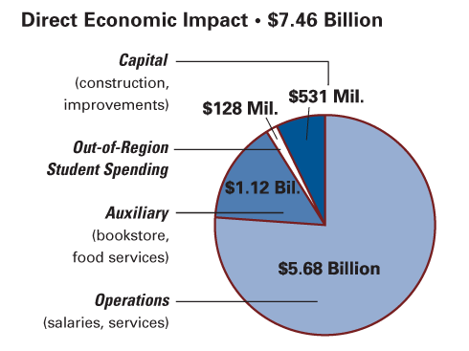
CSU economic impact
Cal State University
$7.46 billion direct impact
$4.41 returned for every $1 invested
Sustains 207,000 jobs
Graduates
Earn $89 billion
Pay $760 million in taxes
Notes:
The CSU pays out over $7 million in the state, which recovers $4.41 for every $1 invested. The system supports over 200,000 jobs in the state of California. Its 2 million graduates earn $89 billion and pay $760 million in taxes.
http://www.calstate.edu/PA/2009Facts/

Slide 11
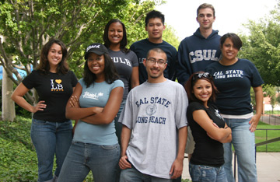
CSULB economic impact
CSU Long Beach
3rd largest employer in Long Beach
$65 million in taxes generated
$2.8 million daily in region’s economy
$35 million spent by students in Long Beach ($11,200 per student annually)
$4.33 generated in economic activity for every
$1 invested
Notes:
CSULB has a major impact on the Long Beach economy. We are the third largest employer in the city and generate $65 million in taxes. Similarly, every single day we are in operation, we generate $2.8 million in the region’s economy. $11,200 per year is spent in our community by each student on our campus. The return on the investment is amazing: $4.33 is generated in economic activity for every $1 invested.
Data from this slide taken from:
CSULB Economic Impact Report
http://www.csulb.edu/president/government-community/economic_impact/index.html

Slide 12

California education in crisis
Decreasing educational attainment
1977-83: California was a national leader in adults over 25 with at least a high school education
Decreasing college enrollments
1996: 43% of CA 19-year-olds enrolled
Today: less than 30% of CA 19-year-olds enrolled
Decreasing state support for education
2009: California ranked among the bottom 5 states in % of students in college and in tax effort for K-12 public education
For decades, California was the envy of the world thanks to the Master Plan for education and the resources put toward education. This helped us become one of the largest economies in the world. But our standard of living is in decline. That decline occurred in direct relationship to the decreased resources we have put towards education in the state. Cuts in education will only exacerbate that decline. The statistics on this slide put the decline in perspective.
Notes:
For decades, California was the envy of the world thanks to the Master Plan for education and the resources put toward education. This helped us become one of the largest economies in the world. But our standard of living is in decline. That decline occurred in direct relationship to the decreased resources we have put towards education in the state. Cuts in education will only exacerbate that decline. The statistics on this slide put the decline in perspective.
Indeed, numerous studies, including one of the leading K-12 finance textbooks on the market by Alexander and Salmon (Financing Public Education) , suggest that California has dropped to the bottom both in the percent of students in college and in tax effort for K-12 public education.

Slide 13

CSU in crisis
Worst funding crisis in history
$584 million reduction in state funding
No funding for 95,000 students
Deeper cuts anticipated in 2010
Impact = shrinking CSU
Tens of thousands of students denied admission
Longer time to graduation
Thousands of classes cut
Classroom overcrowding
Thousands of layoffs and furloughs
All student fees drastically increased
Notes:
These budget numbers grow worse for every day that California has no budget. As of July 2009, the $584 million cut in funding to the CSU was the equivalent of not funding 95,000 students. Similarly, in 2009, the state put $255 million of the federal stimulus money into the CSU appropriation. This money may not be replaced by the state in 2010. Our budget is in crisis and in decline. Only with the help of the public can we all work together to restore funding. For 2010, we are expecting deficits between $12-18 million on our biggest campuses (such as CSU Long Beach).

Slide 14

Why support the CSU?
Return on investment
CSU generates over $4 for every $1 invested
College graduates earn $1 million more than high school graduates in lifetime
Notes:
Supporting the Cal State system is a smart investment for the state, for our kids, and for our future.

Slide 15

CSU needs your support
By 2025
40% of California jobs will require college education
30% of population will have college education
1.8 million more graduates needed in the form of:
46% more Bachelor’s degrees
50% more graduate degrees
Less education = an unprepared workforce
Notes:
NOTE: Presenters should keep in mind that the California 2025 report (see below) was released before the severe budget cuts, so these numbers now are overly optimistic.
Facts about college education needs in California taken from: www.ppic.org
“California’s Future Workforce Will There Be Enough College Graduates?”
By Deborah Reed with research support from Qian Li
Supported with funding from The William and Flora Hewlett Foundation

Slide 16
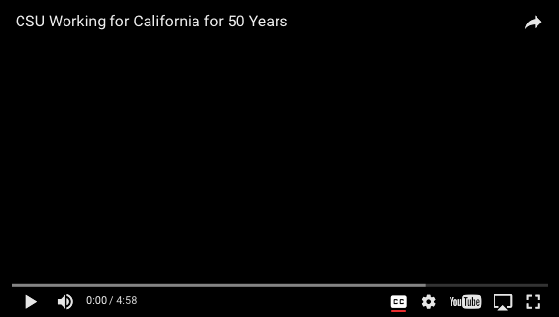
What the CSU thinks and sees

Slide 17

What kind of California do you want?
We must demand more funding for education so we can educate today’s students for tomorrow’s economy.
Join the thousands of students, faculty, parents, and concerned citizens fighting to save education in California!

Slide 18
Education is the solution
Get the message out.
Express your support for education funding
before it is too late!
Contact the governor
(916) 445-2841 or fax (916) 558-3160
Contact your representatives
http://www.legislature.ca.gov
Contact Chancellor Reed
creed@calstate.edu or (562) 951-4700 or fax (562) 951-4986
Join us online: Save the CSU (savethecsu.com)
Notes:
Please visit the savethecsu.com website to find a one-click letter that requests immediate restoration of funding to higher education in California.
A copy of the message appears below. Presenters and friends of the CSU can simply cut and paste this into a Word document to distribute as copies at an event. Or you can simply invite people to visit the website: http://www.savethecsu.com.
Dear Friend, As we suffer the worst economic crisis since the Great Depression, our government has bailed out banks, corporations, and executive management. Now these hard times are threatening our California educational system and our children's future. Help us encourage the state to renew the promise, restore the funding, and revive California's future. Visit www.savethecsu.com to send a one-click letter to CSU Chancellor Reed, Governor Schwarzenegger, and key California legislators. The prosperity of California depends on education. CSU students are tomorrow's work force, and they need quality education today. The university system has long served as a foundation for California business and economic growth. These cuts to the CSU undermine California's economic recovery. These cuts jeopardize the future of our students who depend on access to higher education today to prepare for the jobs of tomorrow. Did you know that our universities are already severely weakened by years of underfunding? California education is celebrated around the world, but the ominous truth is that higher education is already in trouble. Budget cuts now will deny about 50,000 students access to CSU. It already takes 6 years to finish a “4-year” degree at a CSU. Fewer classes will make it even harder for students to graduate. Without a college degree, high school graduates are twice as likely to be unemployed. This heavy burden threatens California’s future.
Our future is your future, California.
Sincerely, CSU Faculty, Students, Staff, and Friends Save the CSU (http://www.savethecsu.com/)

Slide 19

Education is the solution continued
Our future is your future!
Support education!
Support the CSU!

