Slide 1
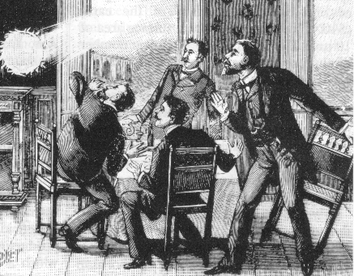
The possible role of metastable molecules to explain Ball Lightning. John J. Lowke and Anthony B Murphy CSIRO Manufacturing, Sydney NSW, Australia

Slide 2
Properties of Ball Lightning Inside of houses and aeroplanes
Usually appears from closed glass windows – leaving no trace.
Brightness of a 100W incandescent light bulb.
About the size of an orange.
Lasts about 10 seconds.

Slide 3
Metastable “singlet delta” oxygen molecules.
Metastable formation e + O₂ → O₂* + e
O₂* is the a¹Δ_{g} state of oxygen
Energy 1 eV
Radiative Lifetime about an hour.
Densities of 10¹⁷ /cc (> 1%) have been made in laboratory
discharges at 1 bar; PSST 22, 035012, 2013.
Detaches electrons from Negative Ions O₂⁻ + O₂* → 2O₂ + e

Slide 4
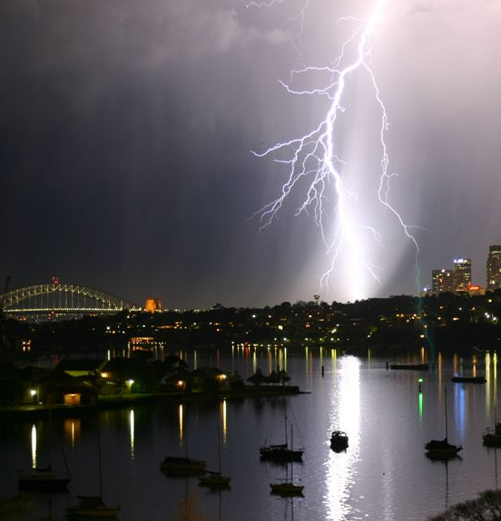
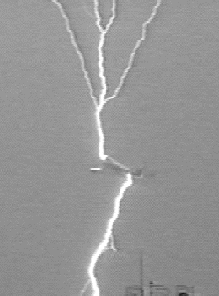
Ions in the sky

Slide 5
Ball Lightning through windows
Glass
+
+
+
+
+
+
+
-
-
-
-
-
-
-
Ball
Lightning
Net Positive Charge
Positive Ion stream
Background E field
+ + + +
+ + + + +
+ + +
Background E field doubled!
Lowke et al J. Geophys. Res. 117, D19107, 2012

Slide 6
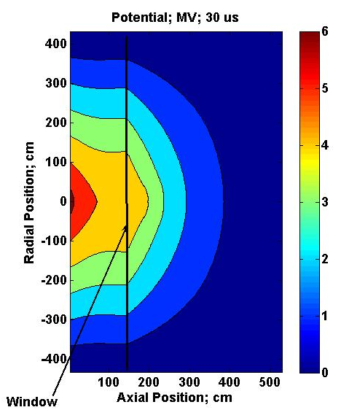
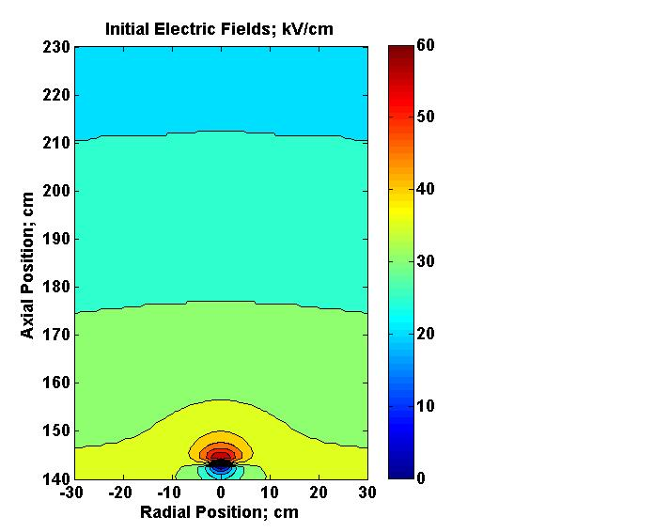
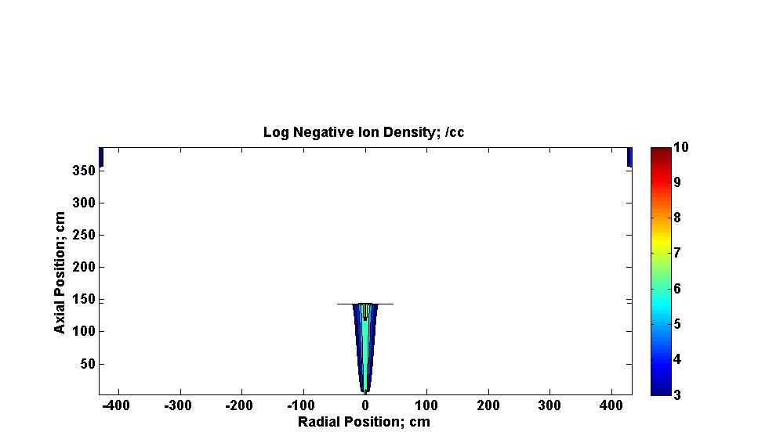
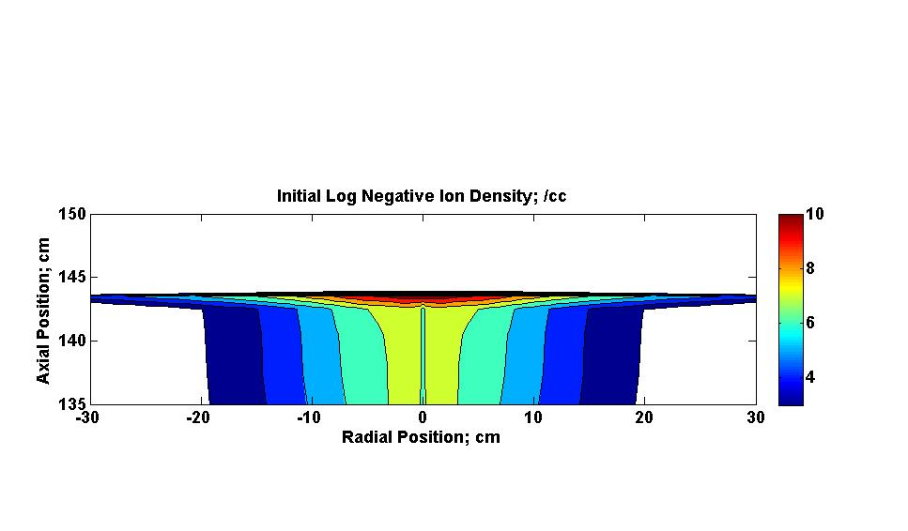
Calculations at Glass Window; 0 µs; 6 MV
Glass
Window
Initial Field
kV/cm
Initial Boundary
Potentials
Log Negative
Ions; /cc
Log Incident
Negative Ions; /cc

Slide 7

Equations
Electrons
Positive Ions
Negative Ions
Metastables
Space Charge
+
+
∇ ⋅ E =

Slide 8
Ionization and Attachment Coefficients in Air at 1 bar.

Slide 9
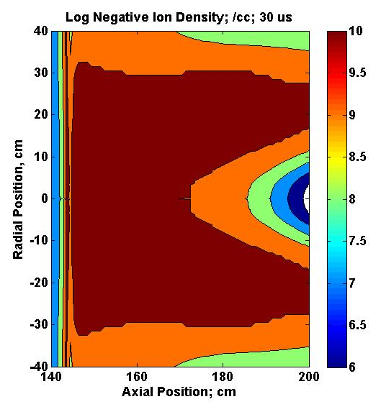
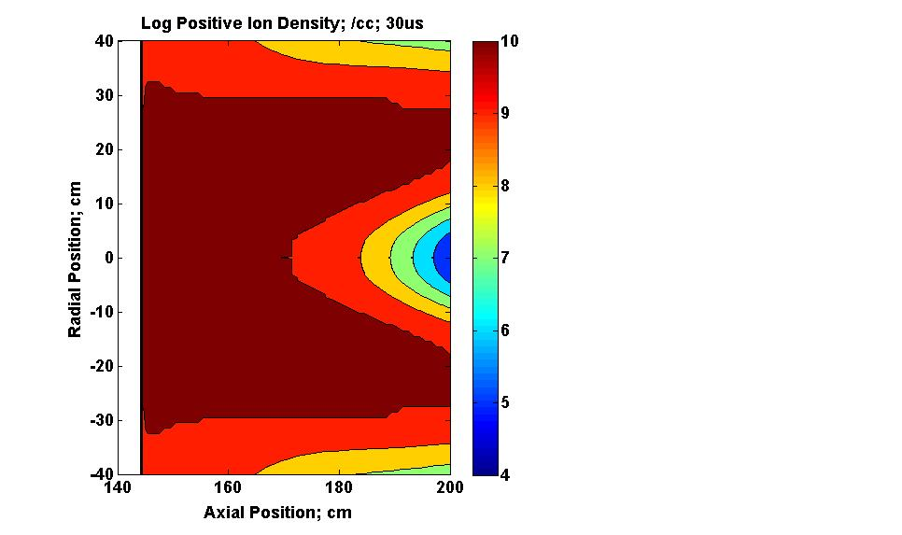
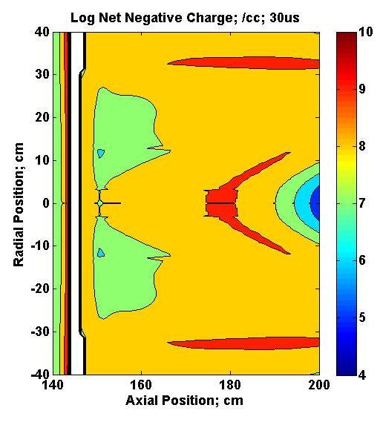
Particle Densities; 30 μs;
Negative Ions, Positive Ions and Net Negative Charge

Slide 10
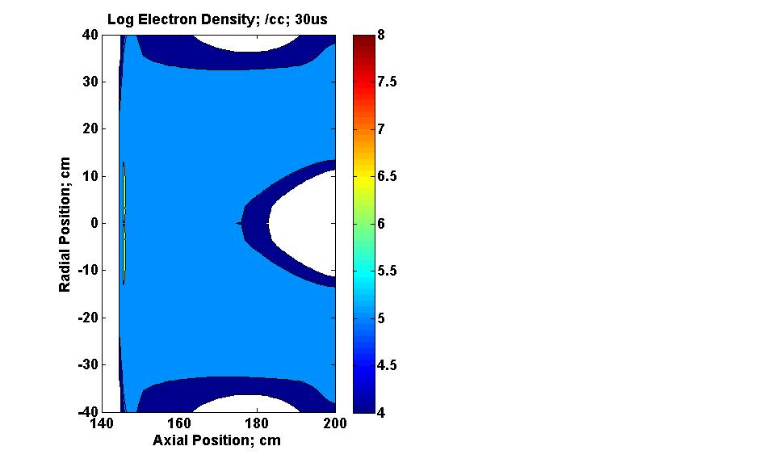
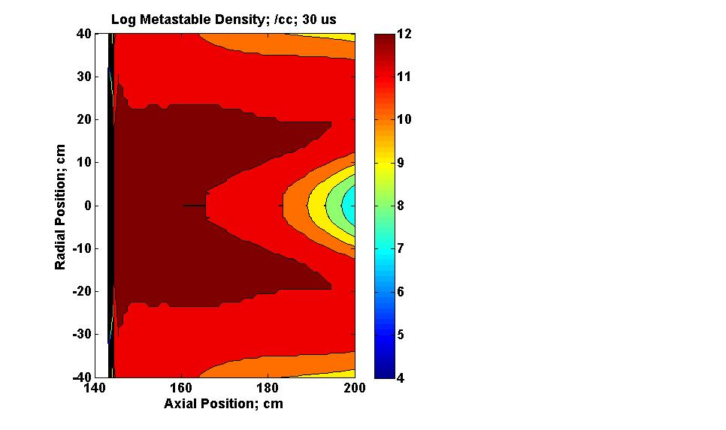
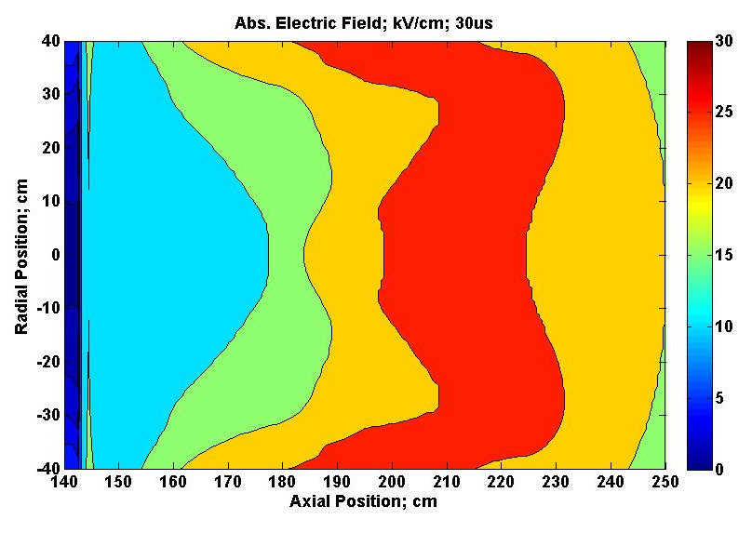
Electric Field; Electron Density; Metastable Density; 30 μs

Slide 11
Ball Lightning through windows
Glass
-
-
-
-
-
-
-
+
+++
+
+
+
+
Ball
Lightning
Net Negative Charge
Negative Ion stream
Background E field
- - --
- - -
- - -
Background E field doubled!
Lowke et al J. Geophys. Res. 117, D19107, 2012

Slide 12
Discharge is Pulsed!

Slide 13
Thousands of Pulses
Equilibrium of electron attachment to form negative ions and
electron detachment from Negative Ions by metastables.
Negative Ion formation e + O₂ → O₂⁻
Detachment of Negative Ions O₂⁻ + O₂* → 2O₂ + e
∂n_{m}∂t = n_{i} n_{m} k_{D} = n_{e} n_{o} k_{a}
= 1/ n_{i} k_{D} ~ 10 s for n_{i} = 10⁹ /cc
n_{e}/ n_{i} = n_{m} k_{D}/n_{o}k_{a} = 0.001 for n_{m} = 10¹²/cc
need n_{m} ~ 10¹⁷/cc for n_{e}/ n_{i} ~ 1

Slide 14
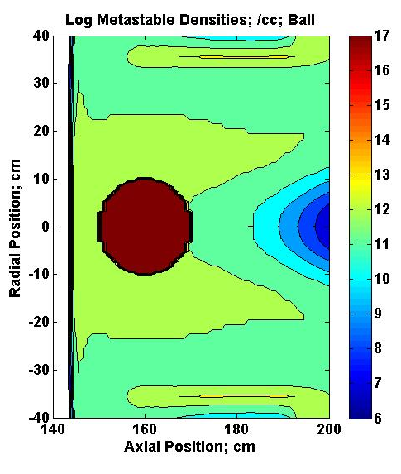
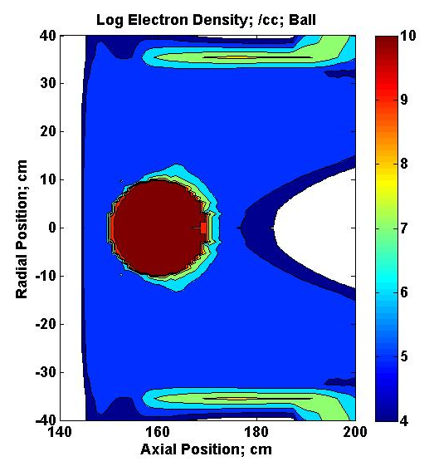
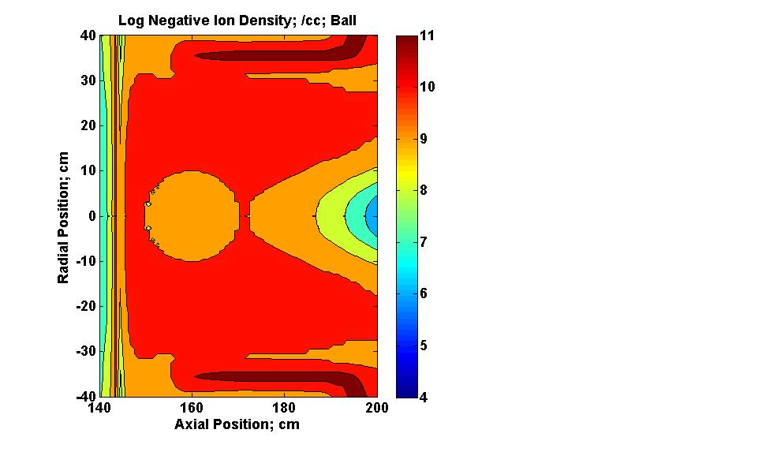
Particle Densities after accumulation of Metastables
Metastables, Electrons and Negative Ions

Slide 15
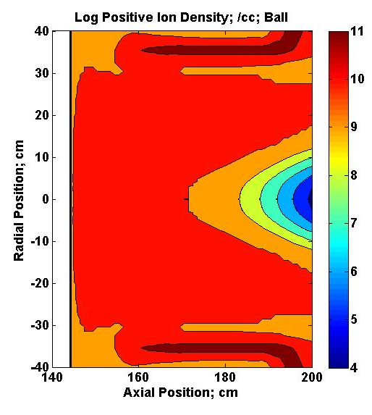
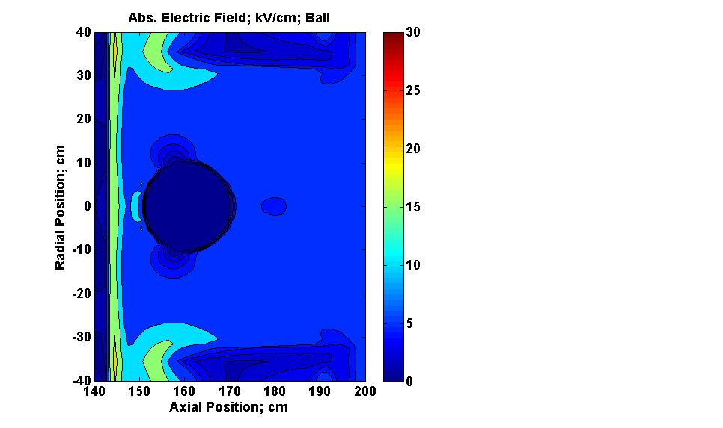
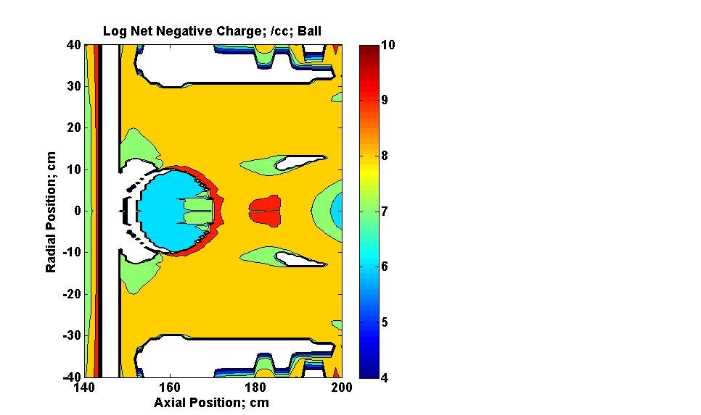
Electric Field after accumulation of Metastables

Slide 16
Energy
Ball Lightning 1 % 100 W Incandescent light for 10 s = 10 J
Ball, Radius 10 cm, metastable density 10¹⁷ /cc
Energy = 1V × 10¹⁷ × e (10⁻¹⁹) × 10³ = 10 J

Slide 17
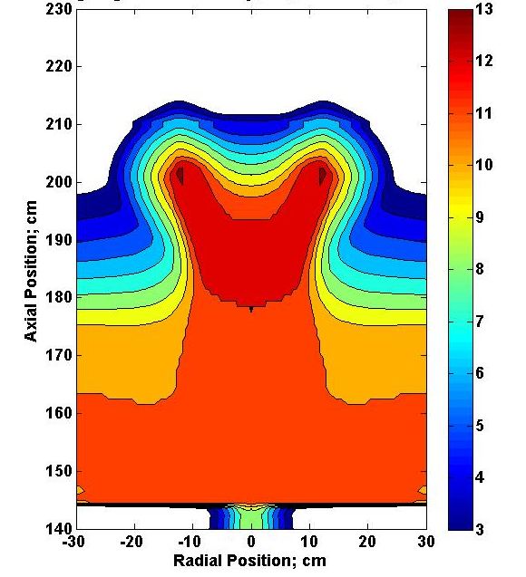
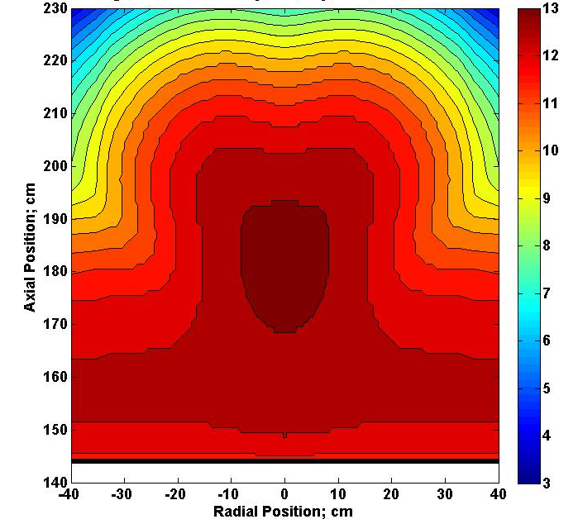
Circular Shape
Effect of Diffusion of metastables
Initial
After Diffusion

Slide 18
Calculated Particle Densities

Slide 19
Calculated Volt-Amp Characteristics with oxygen Metastables

Slide 20
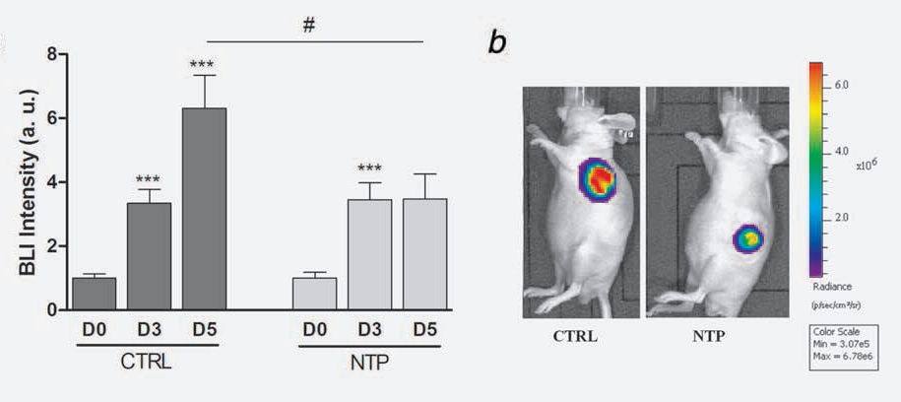
Non-Thermal Plasmas (NTP)
Reduce Cancer Tumors!
M. Vandema et al, Int. J. et Cancer, 130(9), 2185, 2012

Slide 21
Microplasmas Sousa et al
Plasma Source Sc. and Tech.
22, 035012, 2013
1 mm hole
0.5 mm alumina separation plate
0.1 mm thick electrodes Mo; 1 kV
Obtain 10¹⁷ /cc, 1%
a¹Δ_{g} at 1 bar
20 microplasmas in a
row

Slide 22
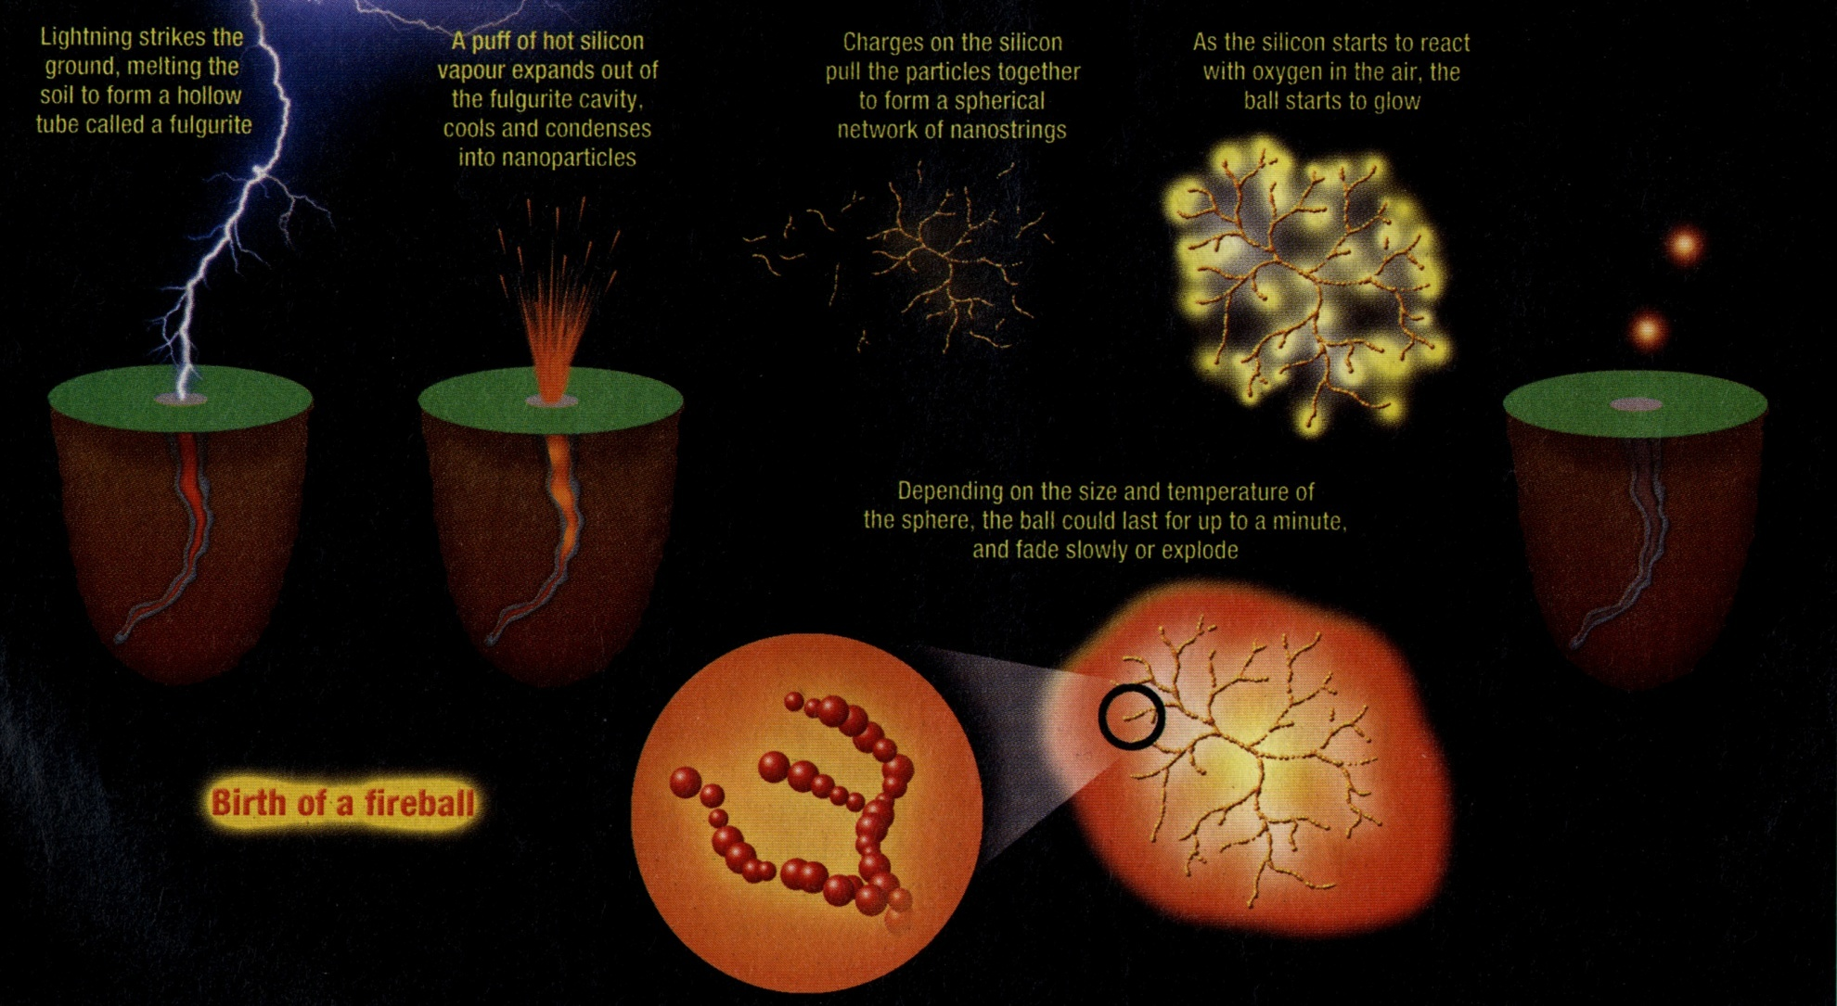
Burning Silicon Fluff – Abrahamson & Dinniss SiO₂ + C → CO₂ + Si; Si + O₂ → SiO₂

Slide 23
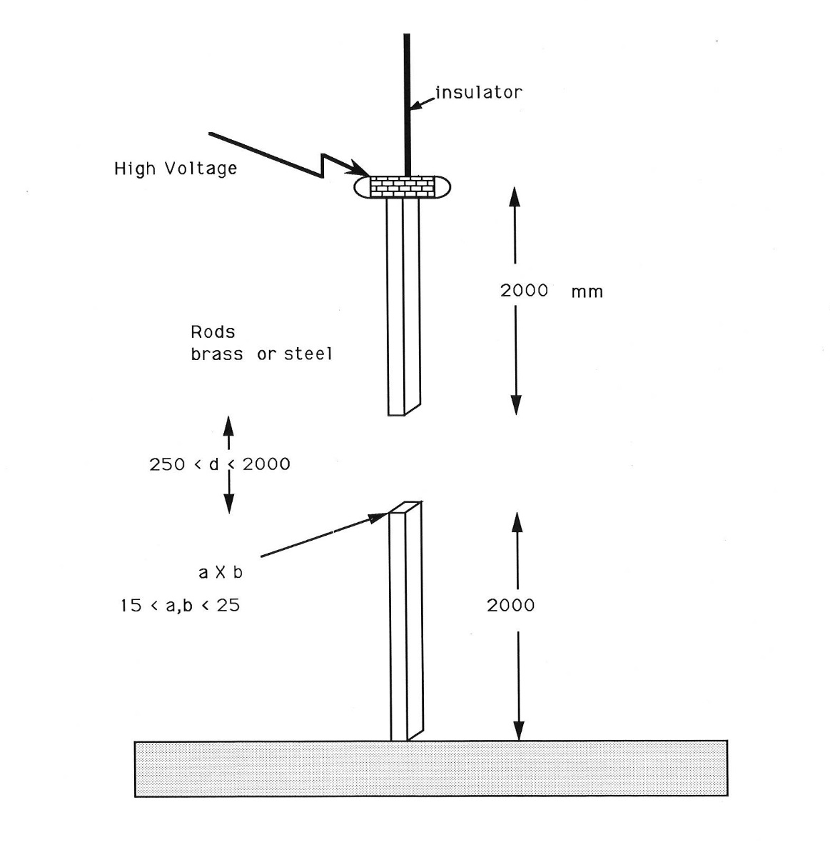
Measurement of Breakdown Voltage. Feser and Hughes; Electra 117, 23, 1988,

Slide 24
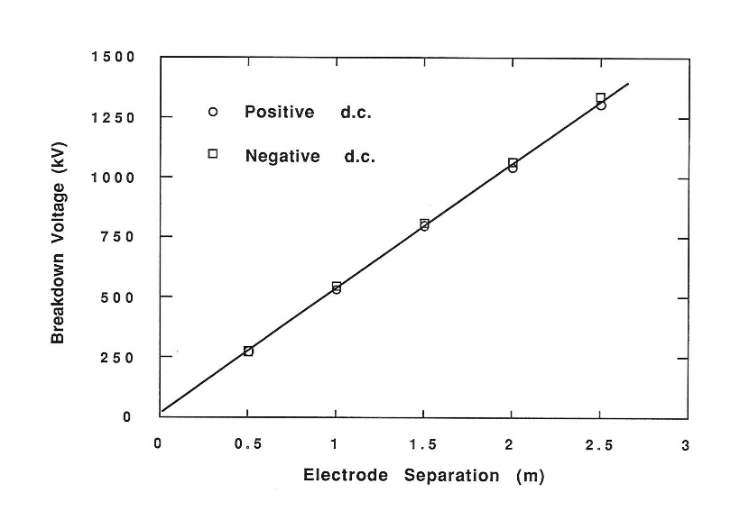
Measured Breakdown Voltage as a function of electrode separation.

