Slide 1

Three issues of Plasma Physics Related to Arc Welding
John J Lowke
CSIRO Materials Science and Engineering
Sydney, AUSTRALIA

Slide 2
Plasma Physics Issues for Welding
Radiation Transfer
Net Emission Coefficients
Effective Thermal Conductivity
Method of “Partial Characteristics”
2. Sheath Voltages – MIG Welding 15 V.
3. Electrical Breakdown in Air – nitrogen vibrational states
(1) Initial Breakdown 25 kV/cm
(2) Corona 5 kV/cm
(3) Welding Arc 20 V/cm

Slide 3
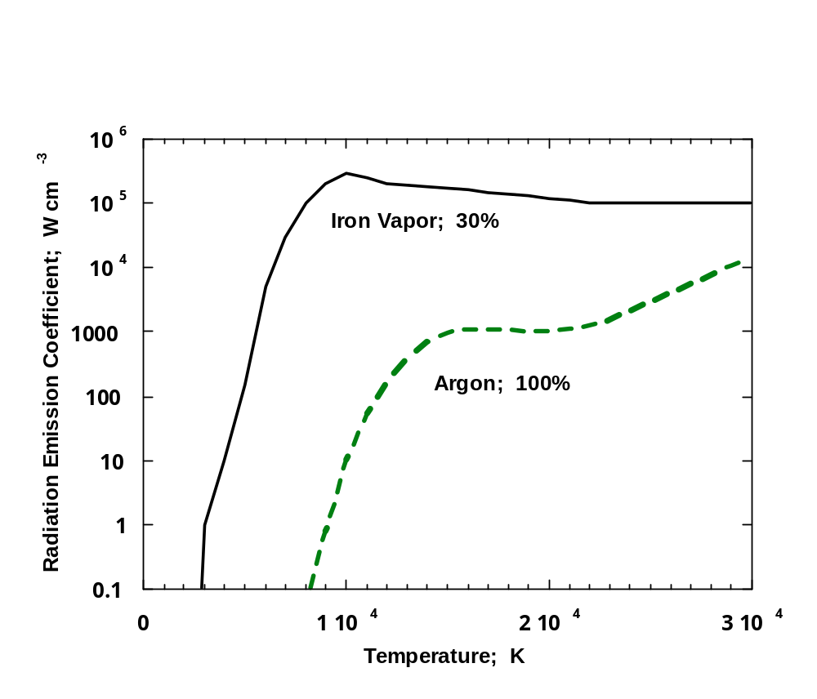
(1) Radiation
Emission Coefficients
Argon and Argon with 30% iron vapor

Slide 4
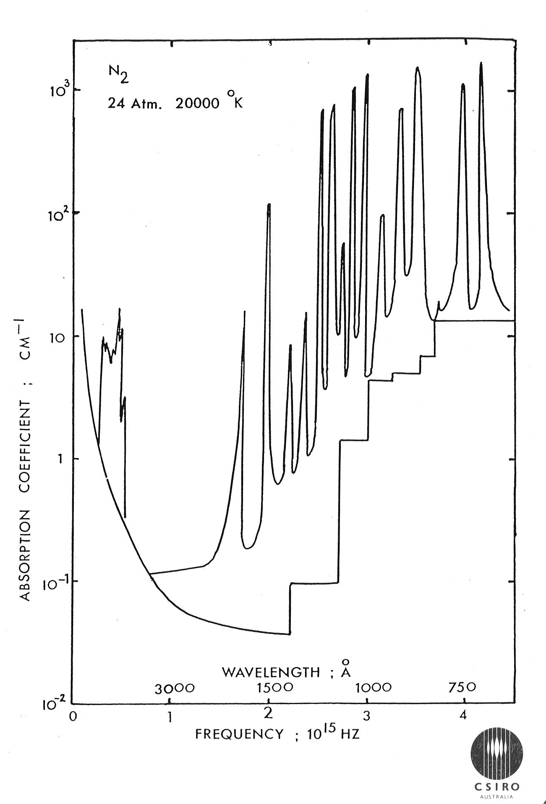
Radiation Absorption Coefficients, N₂

Slide 5
Radiation Transfer Equation
I_{ν}
Δ I_{ν}
ΔI_{ν} = (ε_{ν} − Ι _{ν} K_{ν}) Δ x
= (Β _{ν} K_{ν} − Ι _{ν} K_{ν}) Δ x
Optically Thin Approximation
Planck Mean = K_{P} =
Δ x
∫ Β _{ν} K_{ν}dν
∫ Β _{ν}

Slide 6
Optically Thick Approximation
Flux = -D ∇n = (λc/3) ∇n
F_{Rν} = -c/(3K_{ν}) ∇(J_{ν}/c)
= -1/(3K_{ν}) (dB_{ν}/dT)∇T
Eddington Approximation
Optically Thick Approximation
Rosseland Mean K_{R}
1 = ∫(1/K_{ν}) (dB_{ν}/dT) dν
K_{R} ∫ (dB_{ν}/dT) dν

Slide 7
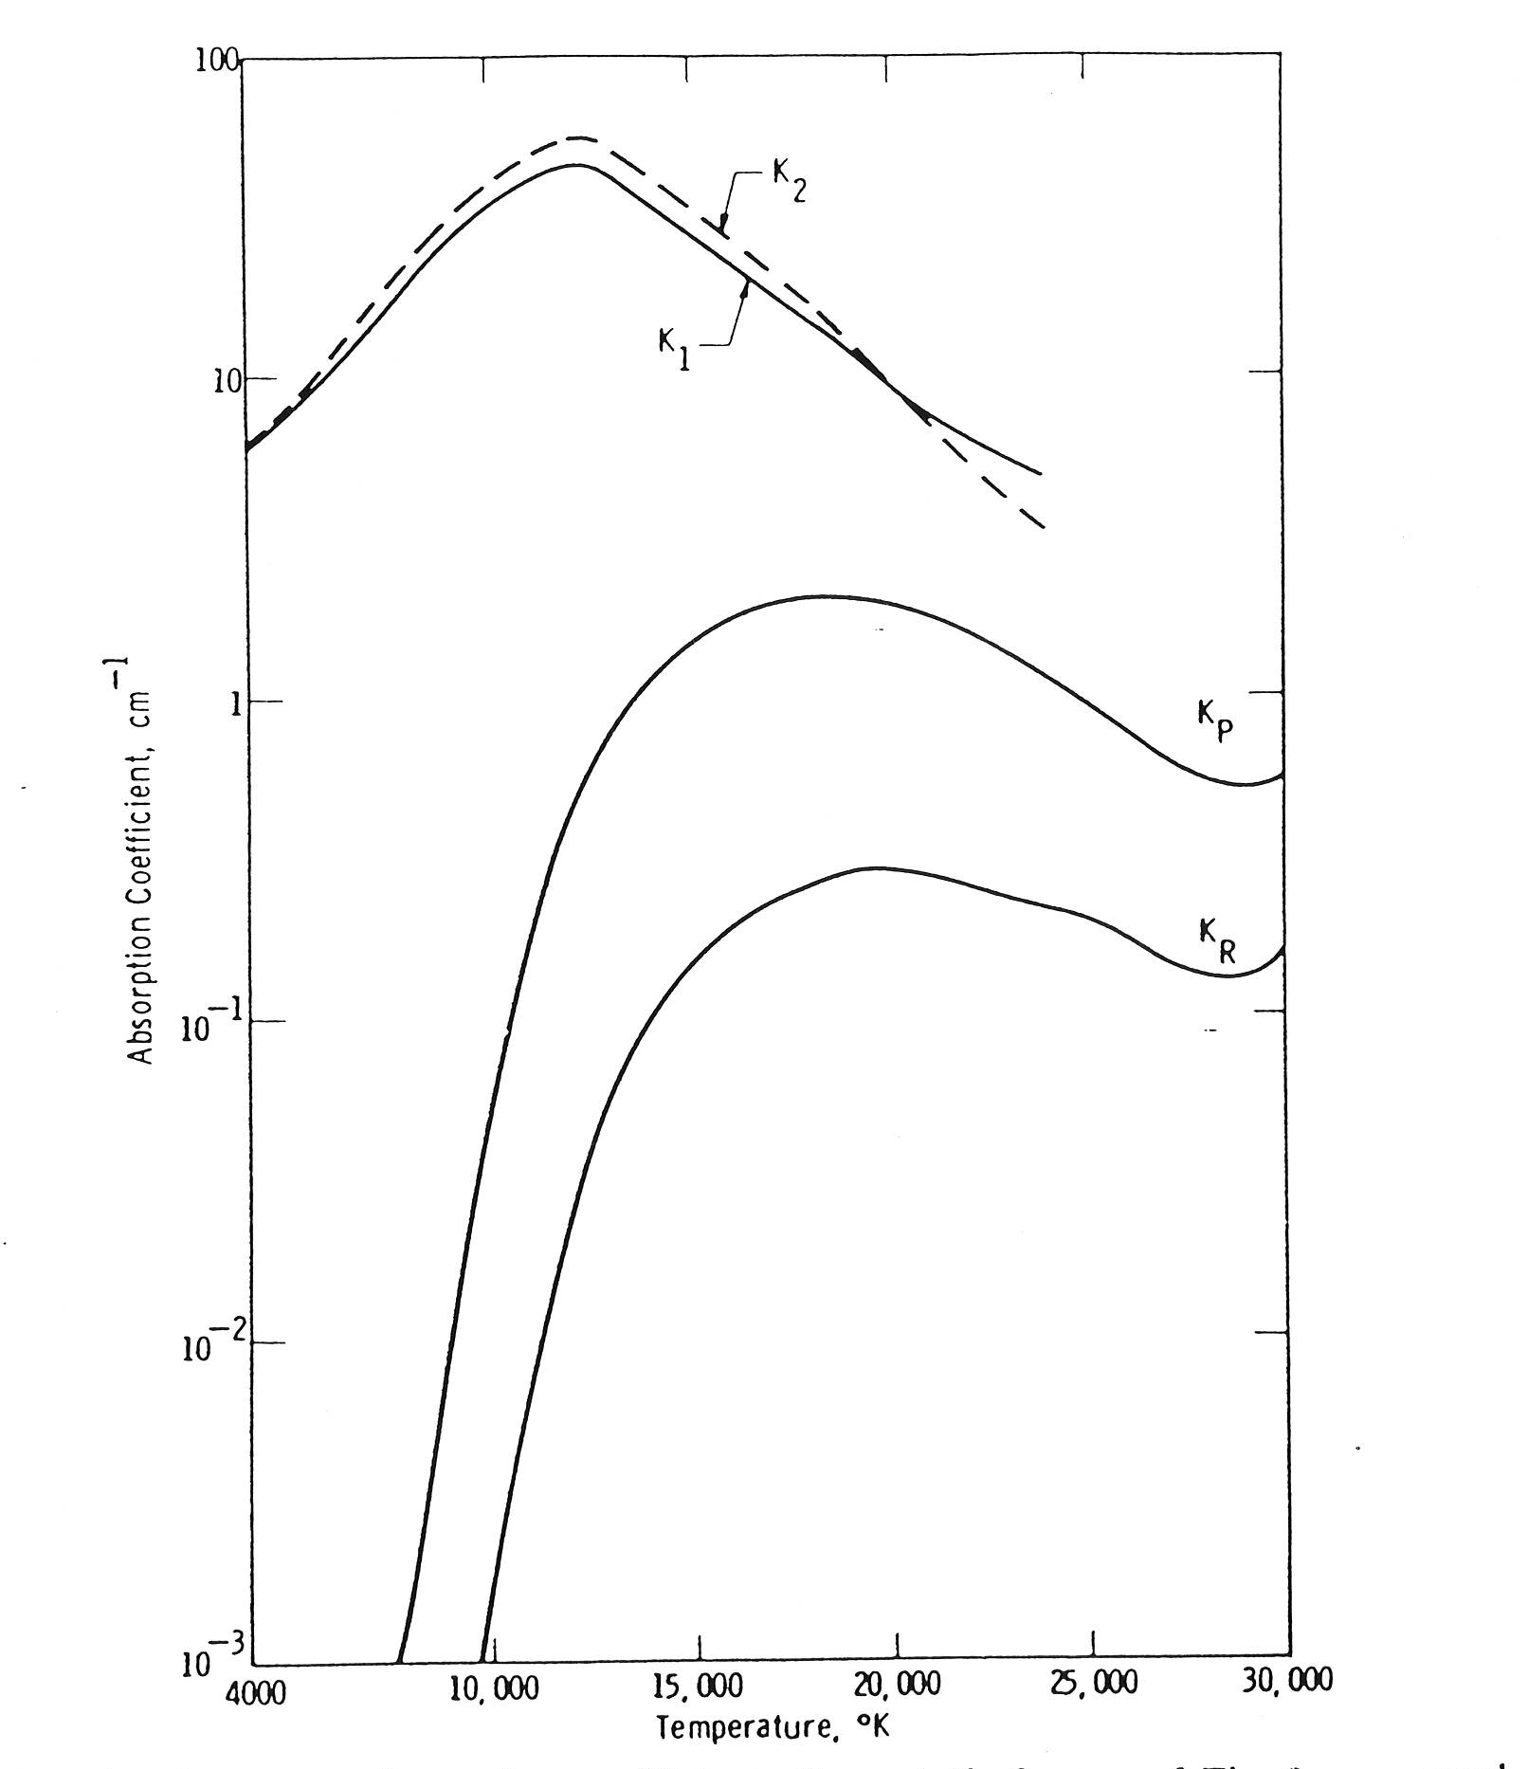
Problem of Averaging Absorption Coefficients K_{ν} with Wavelength or
Radiation Frequency
Thin
Higher K_{ν} higher emission
Thick
Higher K_{ν} less emission
Introducing radiation with very high K_{ν} does not change radiation flux, but greatly increases average K_{ν}

Slide 8
Net Emission Coefficients
Two dimensional data, T, R
I_{ν}
ΔI_{ν} = (ε_{ν} − Ι _{ν} K_{ν}) Δ x
= (Β _{ν} K_{ν} − Ι _{ν} K_{ν}) Δ x Ι _{ν} = Β _{ν} (1− e^{-∫K}ν^{dx})
= Β _{ν} K_{ν} e^{-∫K}ν^{dx}
(1) Optically Thin Approximation ε = ∫Β _{ν} K_{ν} dν
(2) Net Emission Coefficient ε_{N} = ∫Β _{ν} K_{ν} e^{-K}ν^{R} dν
(3) Absorption at arc edge - Negative ε_{N} at edge.
Δ I_{ν}
Δ x
R

Slide 9
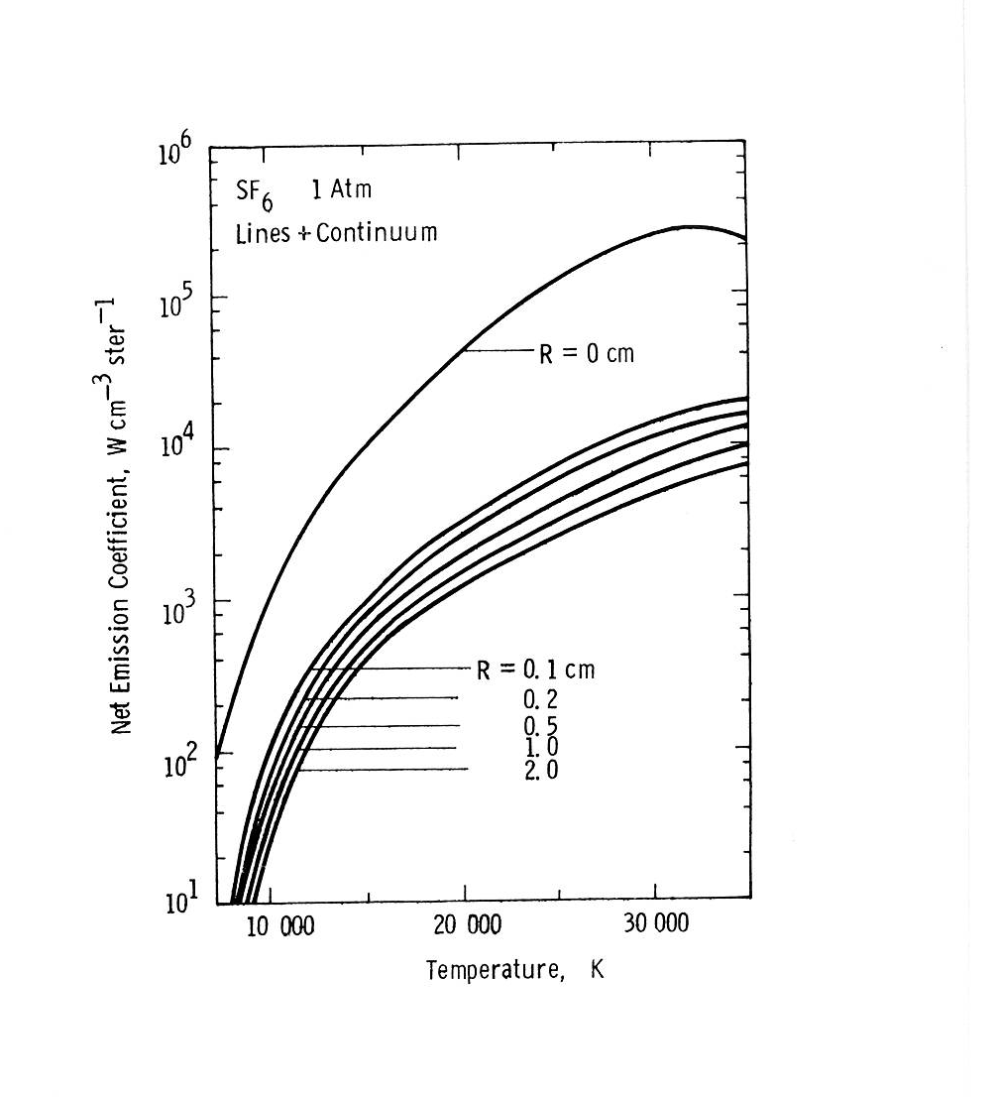
Radiation Emission Coefficients
as a function of Temperature and Arc Radius

Slide 10
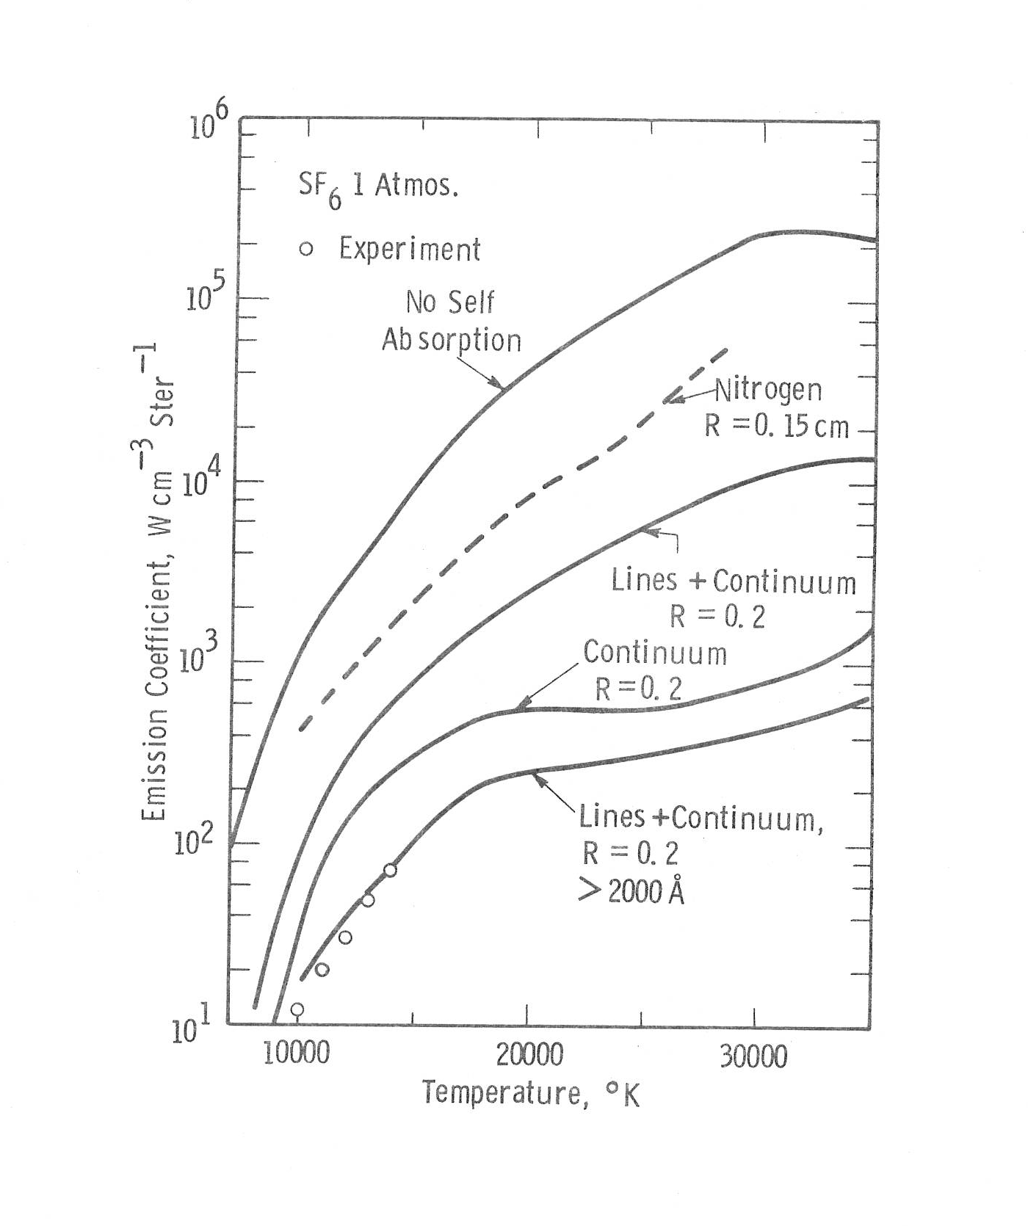
Radiation Emission Coefficients
Components of Line, Continuum and Ultra Violet Radiation

Slide 11
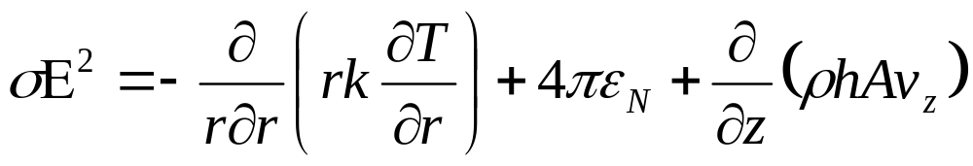
Arc Profiles
Dominated by Conduction, Radiation or Convection
Ohmic Heating
Radiation
Convection
Conduction

Slide 12
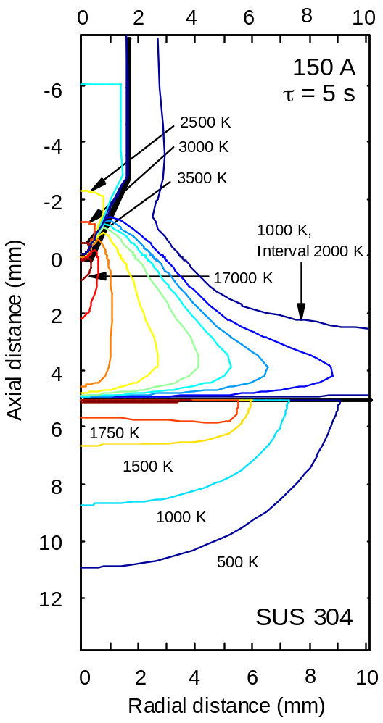
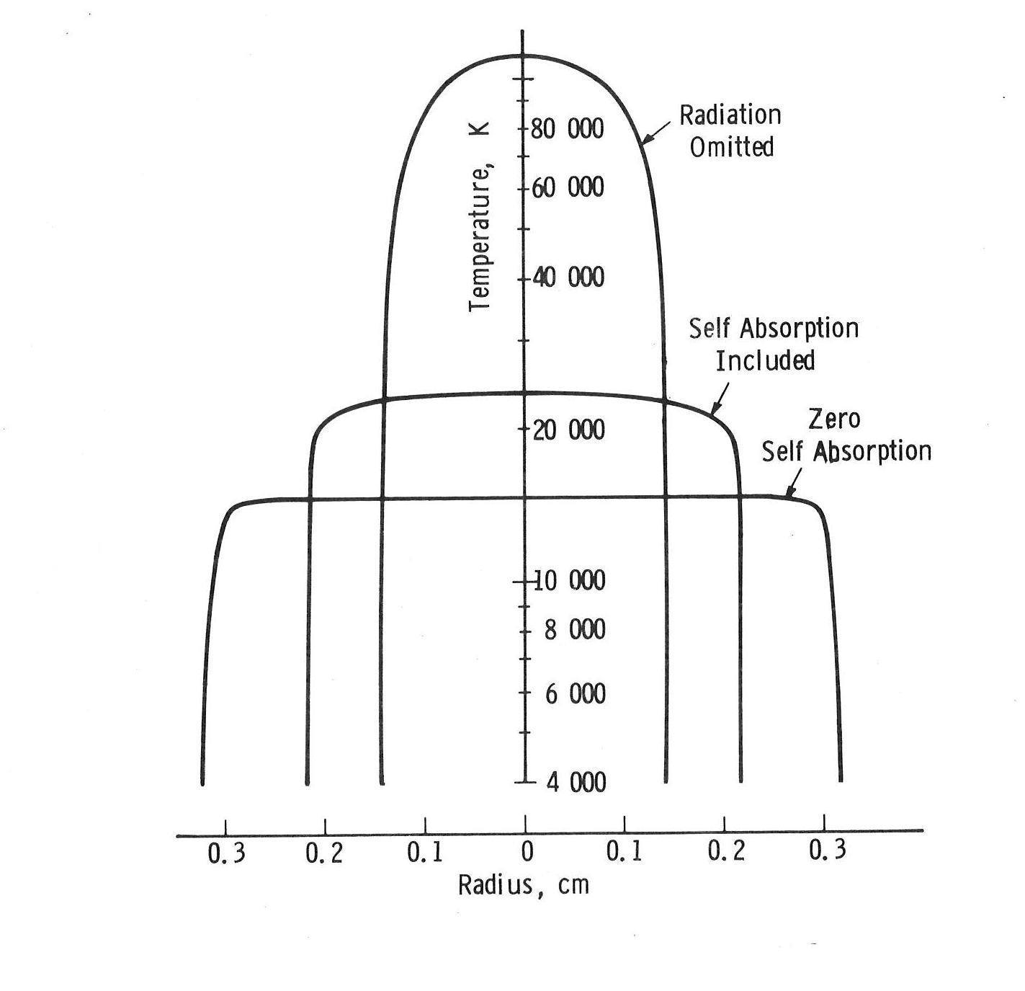
Calculated Arc Profiles, Air 2800 A, 30 bar
Conduction Dominated
Radiation Dominated
Convection Dominated
Welding

Slide 13
Method of “Partial Characteristics”
Som(T₁, T₂, R); 3 Dimensions of data
I_{ν}
ΔI_{ν} = (ε_{ν} − Ι _{ν} K_{ν}) Δ x
= (Β _{ν} K_{ν} − Ι _{ν} K_{ν}) Δ x Ι _{ν} = Β _{ν} (1− e^{-∫K}ν^{dx})
= Β _{ν} K_{ν} e^{-∫K}ν^{dx}
Net Emission Coefficient ε_{N} = ∫Β _{ν} K_{ν} e^{-K}ν^{R} dν = ε_{N} (T,R)
Partial Characteristics Som = ∫Β _{ν} K_{ν} exp(∫-K_{ν}dx ) dν
= Som (T_{1 ,}T_{2,} R)
Temperature variation between T₁ and T₂ assumed linear
Δ I_{ν}
T₁
T₂
Δ x

Slide 14
(2) Sheath Voltages
MIG welding
Wire
Anode
Drop
Arc
25 V
10 V
Work Piece
15 V
Cathode
Cathode Spot

Slide 15
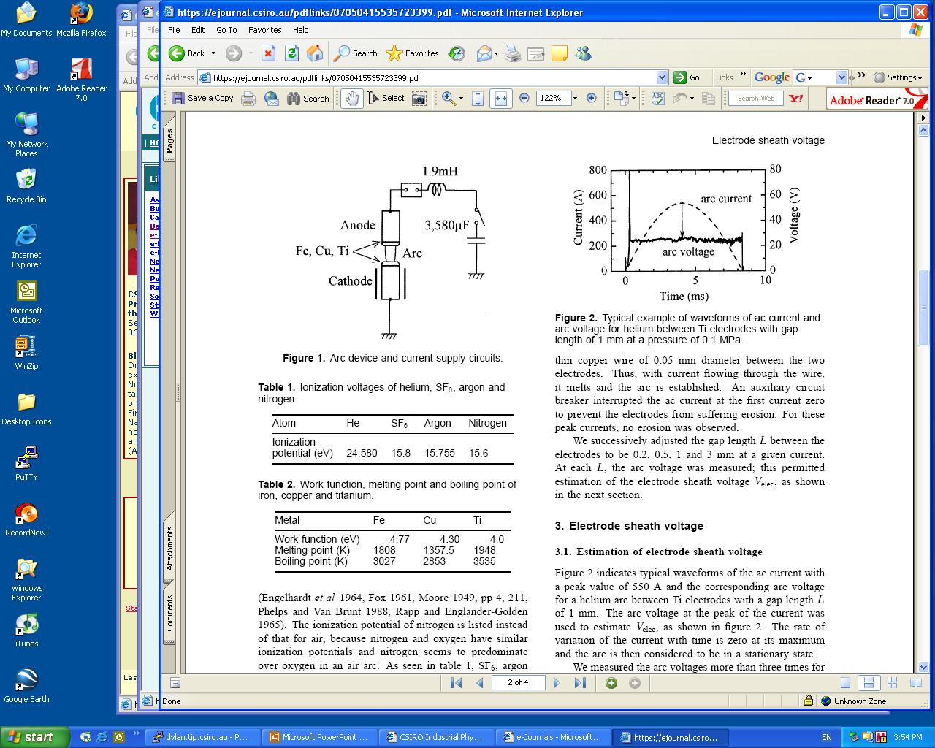
Sheath Voltage is Independent of Current!
Yokomizu et al, J Phys D 31, 880 (1998)

Slide 16
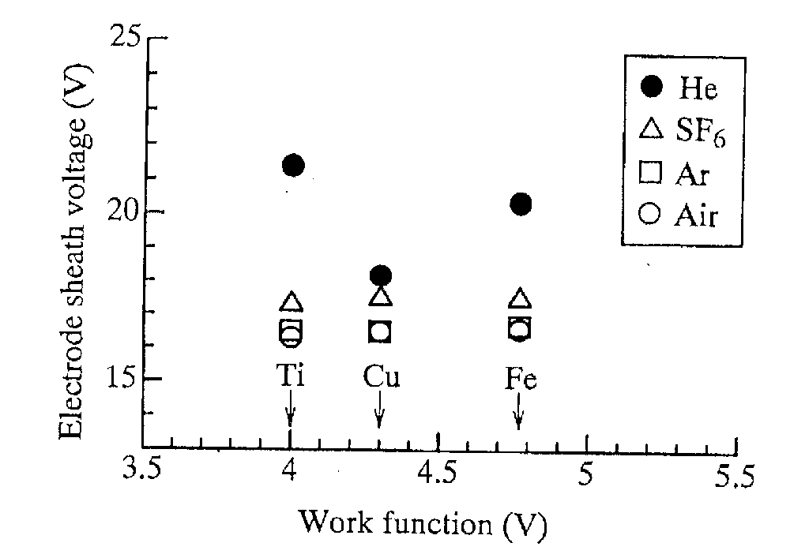
Sheath Voltage largely Independent of Electrodes!
Depends on Gas
Yokomizu et al, J Phys D 31, 880 (1998)

Slide 17
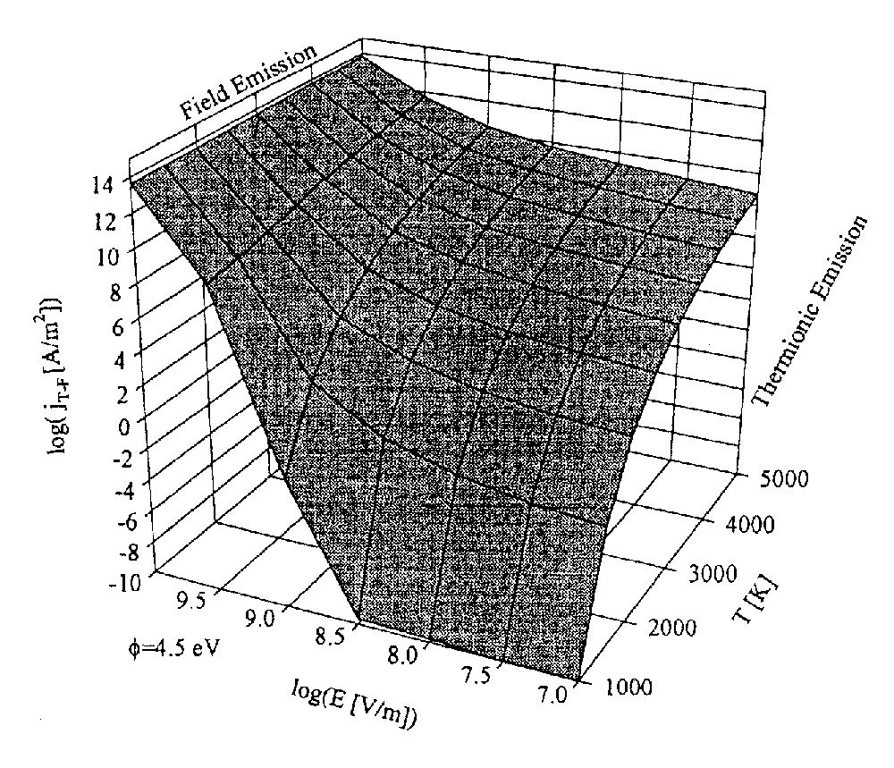
Field Emission
Coulombe and Meunier, J Phys D 30, 776 (1997).

Slide 18
Argon Energy Levels
Lowest excited states.
15.76 V
Ionization
¹P₁
11.82 V
³P₀
³P₁
³P₂
11.72 V Metastable
11.62 V
11.54 V Metastable
Radiative
¹S₀
Ground State

Slide 19
Non-Thermionic Cathode Sheath Model
Sheath
⋅
Plasma
Argon Arc Column
Cathode
Steel, Work Function 4.7 V
⋅
e
Ar*
e
Ar*
Arc Current
n₊ ~ 10¹¹/cc
V_{S} = 15 V
e(11.7 eV) + Ar → Ar* + e
Ar* + Cathode → Ar + e
~ 0.01 cm
³P Argon Metastables

Slide 20
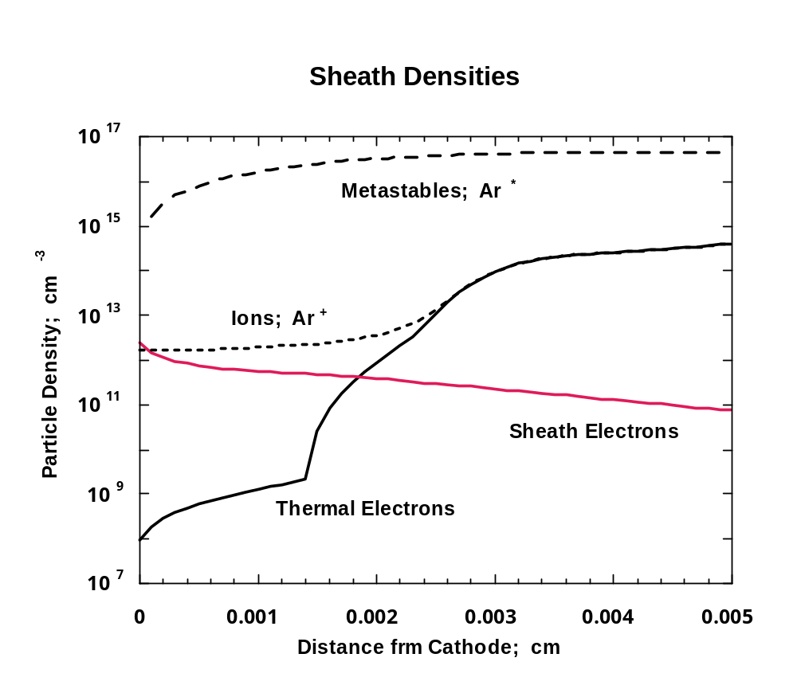

Slide 21
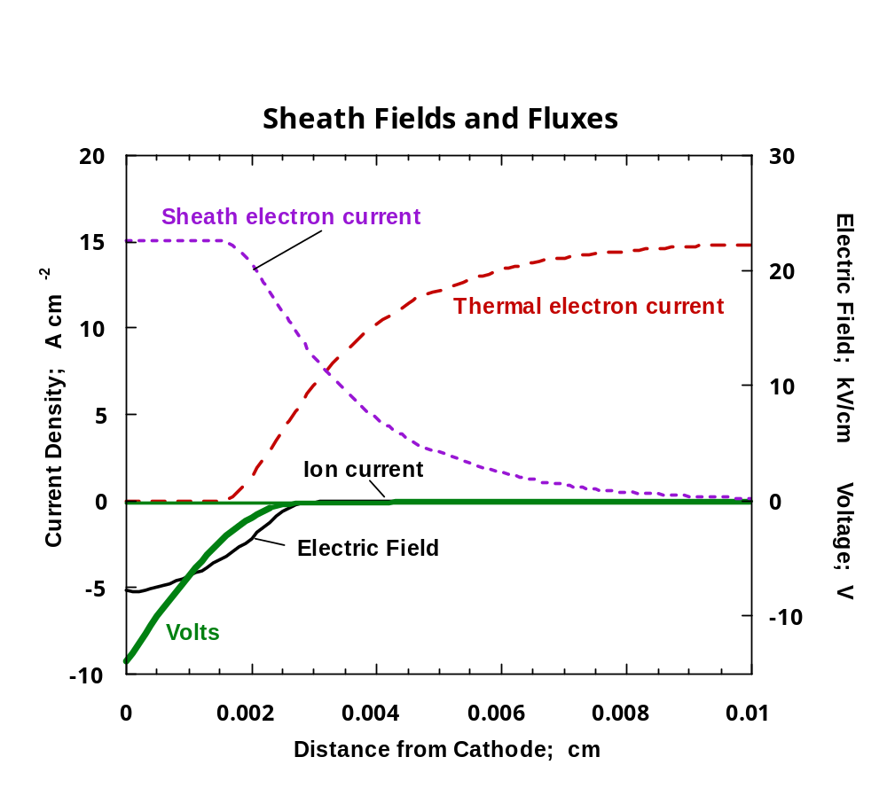

Slide 22
Boundary Conditions
Metal Anode
Electron Density
λ

Slide 23
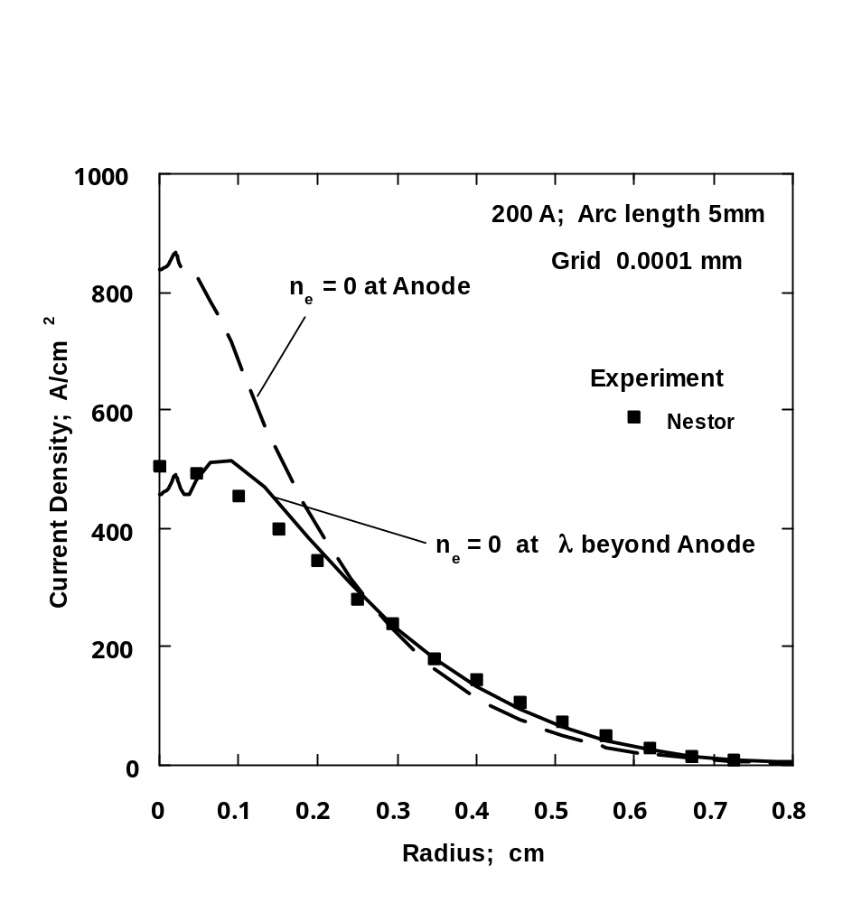
Current Density 200 A Arc

Slide 24
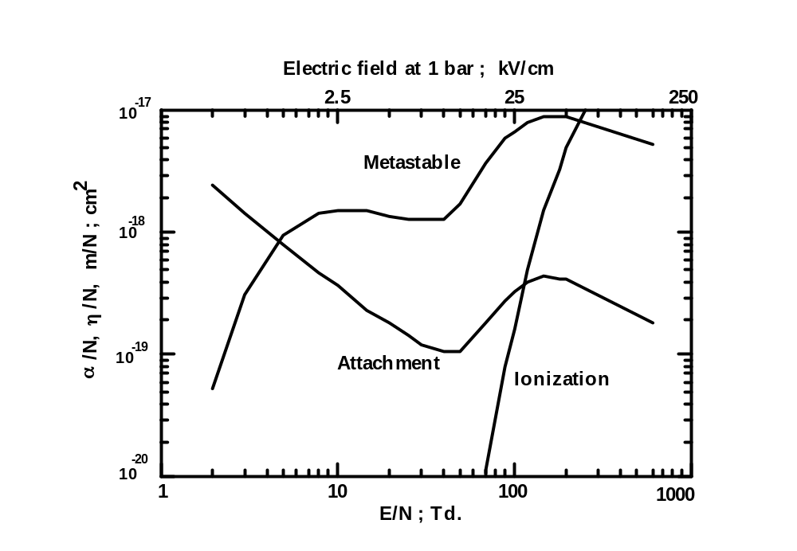
(3) Breakdown
Ionization - e + N₂ → 2e + N₂⁺
Attachment - e + O₂ → O₂⁻
High
Voltage

Slide 25
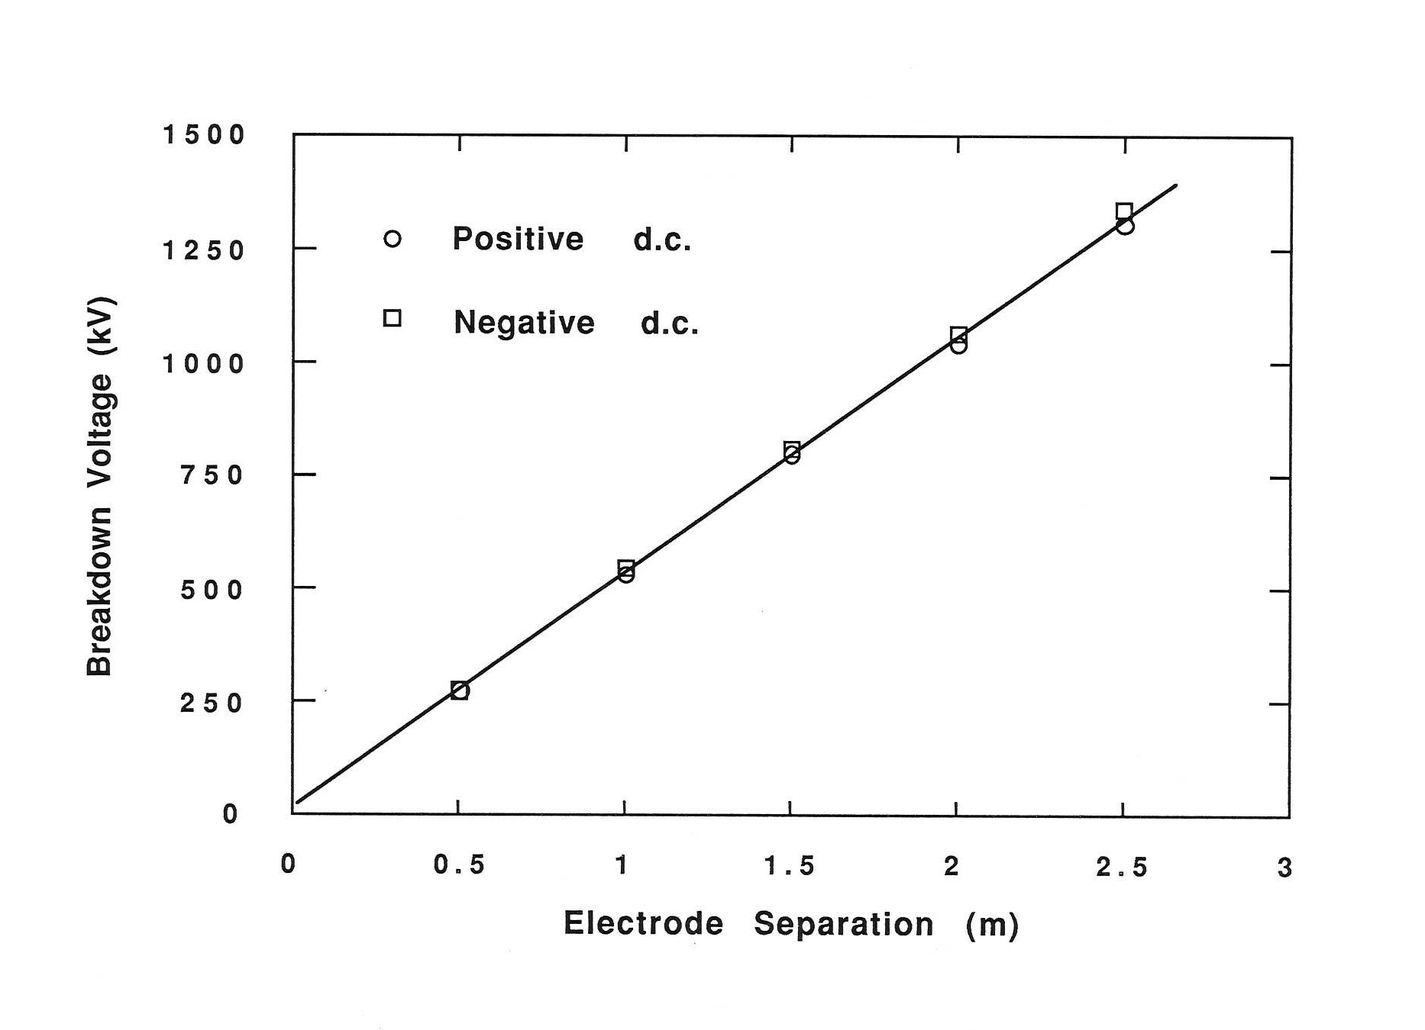
Breakdown in Air; 1 bar;
E ~ 5 kV/cm
High
Voltage

Slide 26
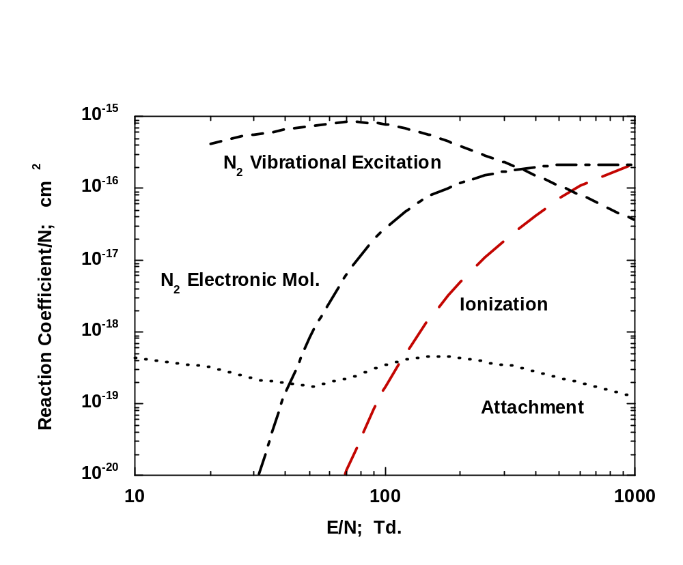
Excitation Coefficients Air

Slide 27
Nitrogen Molecule Energy Levels
Ionization
N₂⁺ + e
Ionization
N₂⁺ + e
Dissociation
N + N
Dissociation
N + N
15.6 V
15.6 V
Metastable
Vibration States
Metastable
Vibration States
13.0 V
13.0 V
Electronic States
Electronic States
a′ 9.72 V
B 8.04 V
A 7.56 V
a′ 9.72 V
B 8.04 V
A 7.56 V
~ 8 V
v = 60
~ 8 V
v = 60
v = 10
N₂(v) + N₂(v) → N₂(v-1) + N₂(v+1)
v = 10
N₂(v) + N₂(v) → N₂(v-1) + N₂(v+1)
0.29 V
0.29 V
v = 0
v = 0
Ground State
Ground State

Slide 28
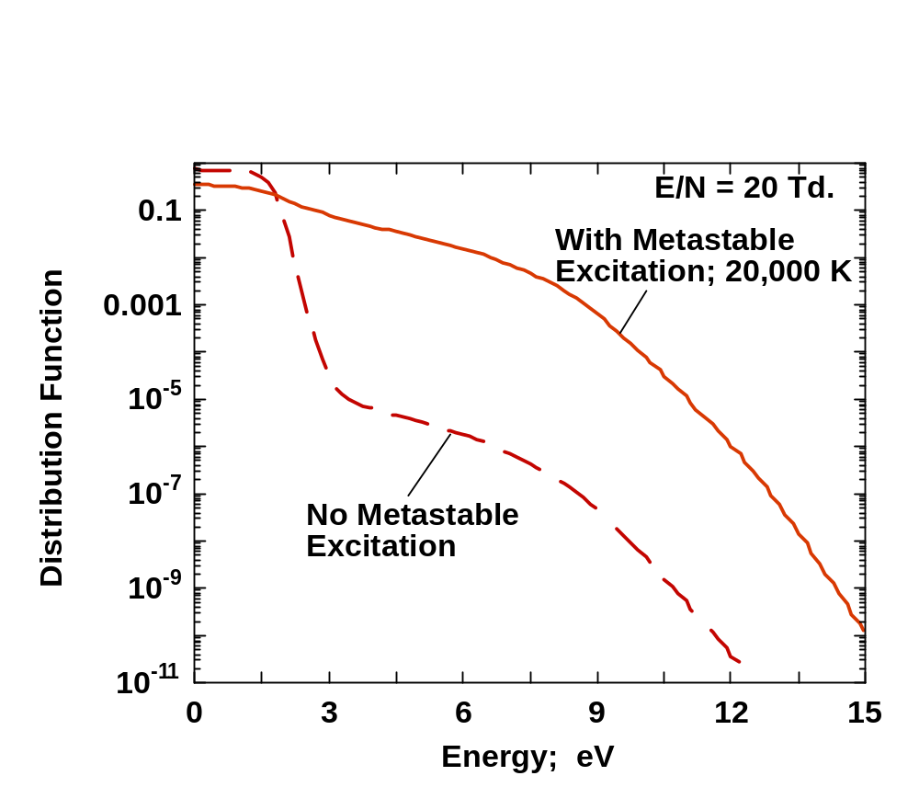
Effects of N₂(v) + e → N₂(v-x) + e
Distribution Function

Slide 29
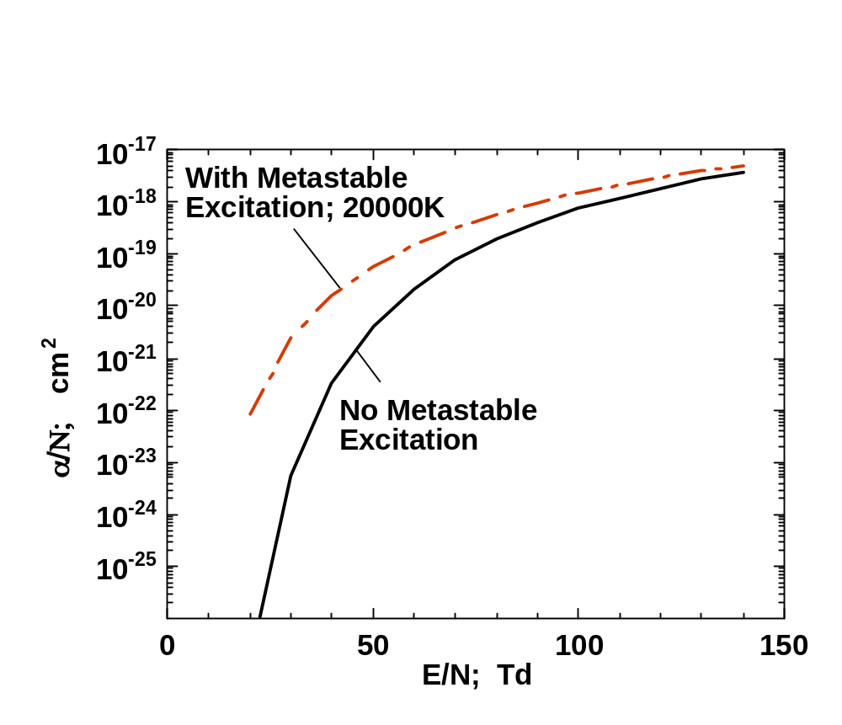
Effects of N₂(v) + e → N₂(v-x) + e
Ionization Coefficients

Slide 30
References
Radiation
“Predictions of arc temperature profiles using approximate emission coefficients for radiation losses.”
J. Quant. Spectrosc. Radiative Transfer 14, 111 (1974) J. J. Lowke.
“Radiation emission coefficients for sulphur hexafluoride arc plasmas”.
J. Quant. Spectrosc. Radiative Transfer 16, 253 (1976) R.W. Liebermann and J. J. Lowke.
“Calculation of temperature profiles of high pressure electric arcs using the diffusion coefficient for
radiation transfer”,
J. Quant. Spectrosc. Radiative Transfer 9, 207 (1969) J. J. Lowke, and E R Capriotti.
“Calculations of radiation transfer using the method of partial characteristics”
J. Phys. D: Appl. Phys. 27, 2066 (1994). V. Aubrecht and J. J. Lowke
Sheaths
“The physics of non-thermionic cathodes of electric arcs”
Int. Conf. Gas Discharges, Cardif 2008, pp137-140 J. J. Lowke and M. Tanaka.
“Plasma Predictions - Past Present and Future”
Plasma Sources Science and Technology 22, 023002, 2013. J. J. Lowke
Breakdown
“The plasma chemistry of electrical breakdown in air”,
Int. Symposium Plasma Chemistry, Cairns 2013. J. J. Lowke
“Plasma Predictions - Past Present and Future”
Plasma Sources Science and Technology 22, 023002, 2013. J. J. Lowke

