Slide 1

Predicting Credit Risk Defaulters
A data-driven approach to minimizing loan defaults.
H John Joshua

Slide 2
Problem Statement and Objectives
Problem Statement:
A mid-sized bank wants to:
Identify customers likely to default on loans within six months.
Segment customers for targeted marketing strategies.
Objectives:
Analyze customer demographics, transaction patterns, and behavioral insights.
Build a predictive model for loan default risks.
Provide actionable recommendations to reduce default rates.

Slide 3
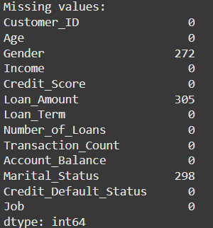
Data Overview
Dataset Summary:
Dataset contains 13 columns and 5000 rows.
Key Variables:
Demographics: Age, Gender, Income
Loan Info: Loan Amount, Loan Term, Credit Score
Account Info: Transaction Count, Account Balance
Key Challenges:
Missing values in Gender, Loan_Amount, Marital_Status.
Negative values in Income.

Slide 4
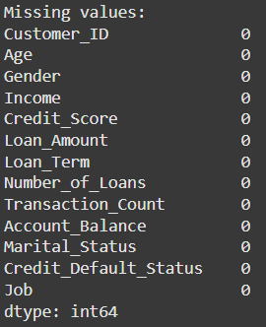
Data Cleaning
Approach:
Replaced missing values in Gender and Marital_Status with "Unknown" to retain data integrity for categorical analysis.
Imputed missing Loan_Amount values with the median.
Replaced negative values in Income with the median of positive income values to ensure logical consistency.
Outcome:
Clean dataset ready for analysis with no null values.

Slide 5
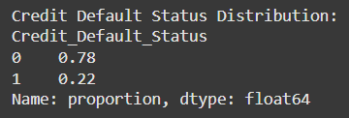
Data Exploration and Summary Statistics
Average Income
The average income is around $64,424, with a wide range from $0 to $139,870.
Default Rate
The Credit_Default_Status variable indicates a 22% default rate.

Slide 6

Customer Demographics Analysis

Slide 7
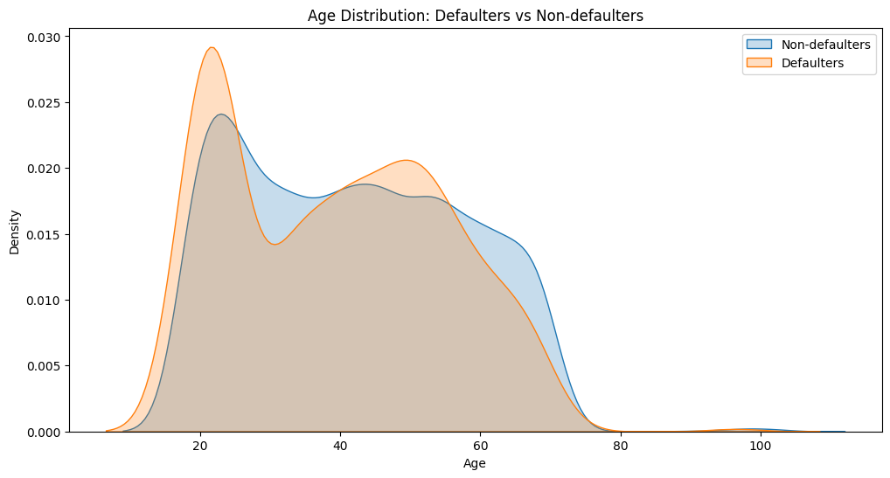
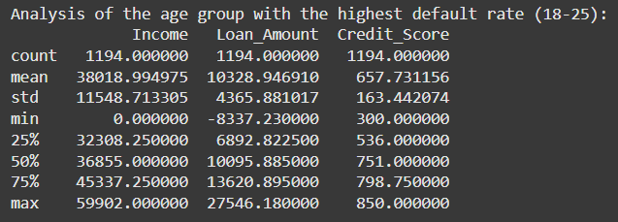
Age Distribution
Younger customers (18–25) have higher default probabilities, while older customers (above 50) tend to have fewer defaults.
Younger customers may lack financial stability or credit history, making them more prone to defaults.

Slide 8
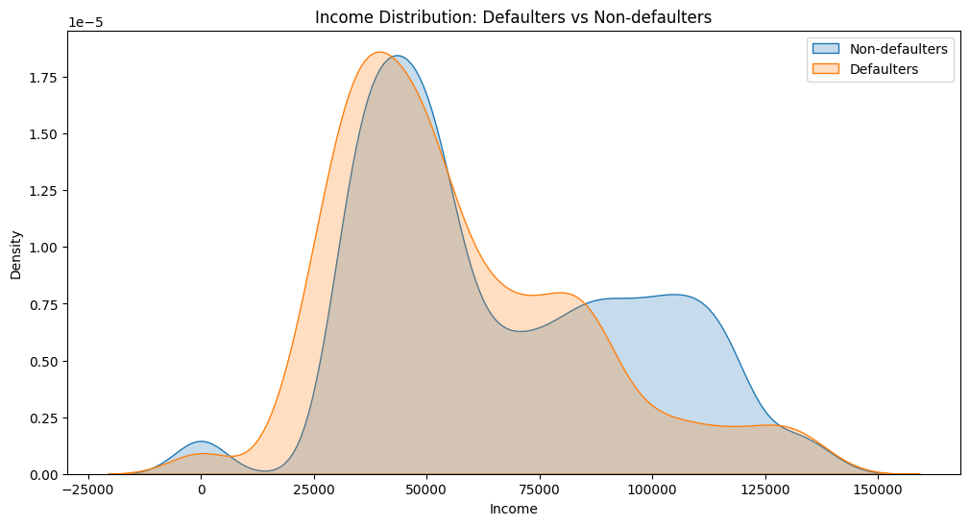
Income Distribution
Defaulters predominantly fall in the lower-income bracket, with a sharp drop-off in default rates at higher income levels.
Low income is a significant risk factor for defaults, indicating limited capacity to meet repayment obligations.

Slide 9
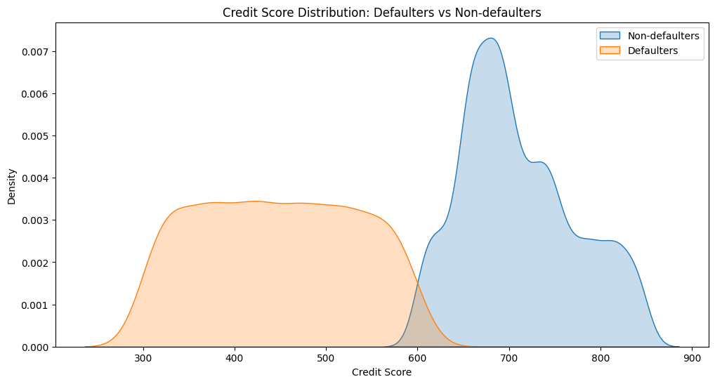
Credit Score Distribution
Defaulters have a lower average credit score, with most below 700, while non-defaulters typically have scores above 700.
Low credit scores strongly correlate with default risk, making it a key feature for prediction.

Slide 10
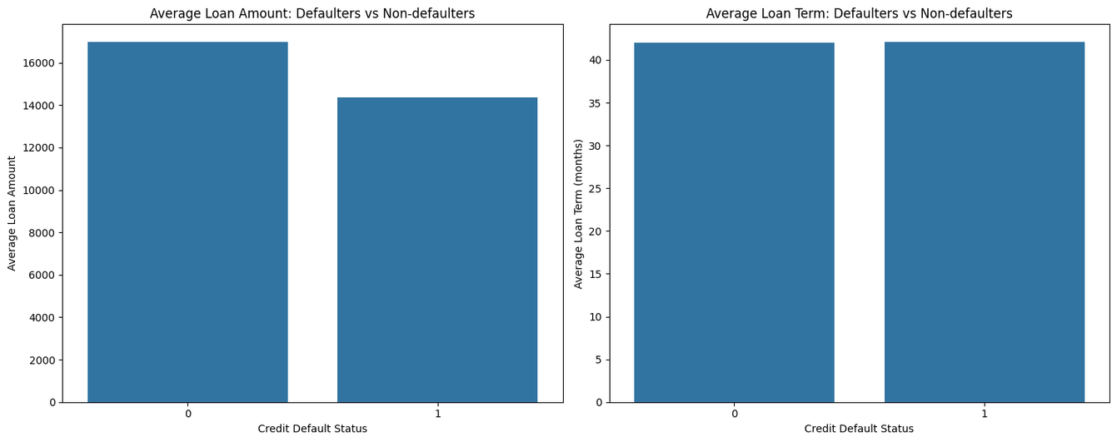
Loan Amount and Loan Term
Defaulters take slightly smaller loans ($14,356 vs. $16,965) but have similar loan terms (~42 months).
While loan size shows some influence on default risk, it is not as significant as income or credit score.

Slide 11
Transaction and Balance Analysis

Slide 12
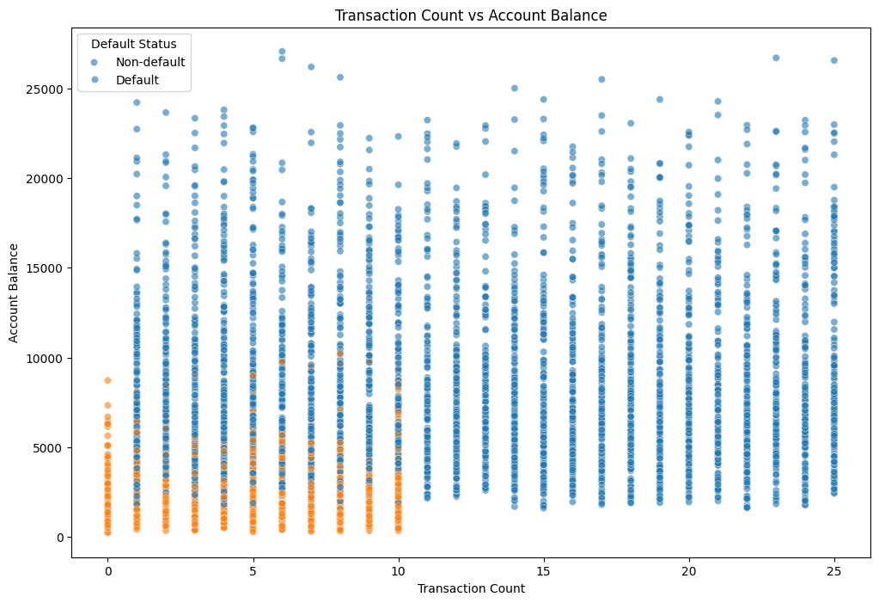
Transaction Count vs. Account Balance
Non-defaulters tend to have higher transaction counts and balances.
Defaulters cluster in the low-balance, low-transaction range.
Active account usage and higher balances reduce default risk.

Slide 13
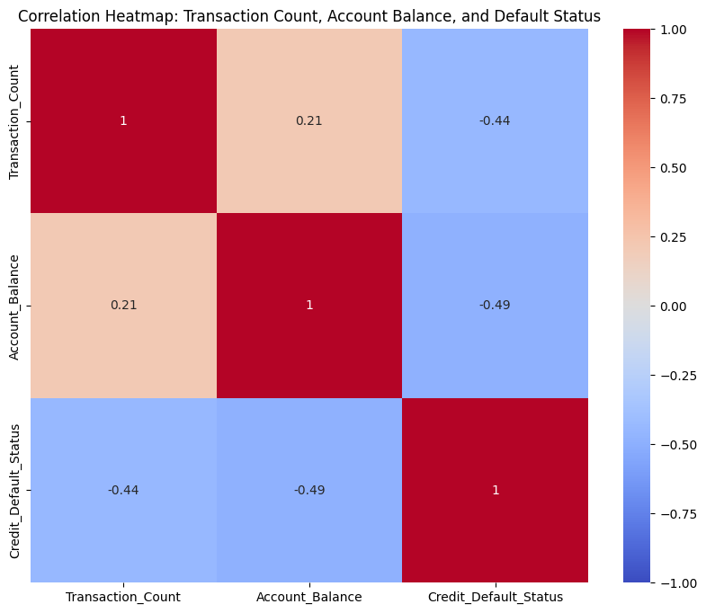
Correlation Heatmap
Default status negatively correlates with Account_Balance (-0.49) and Transaction_Count (-0.44).
Maintaining higher balances and frequent transactions lowers default likelihood.

Slide 14
Behavioral Insights

Slide 15
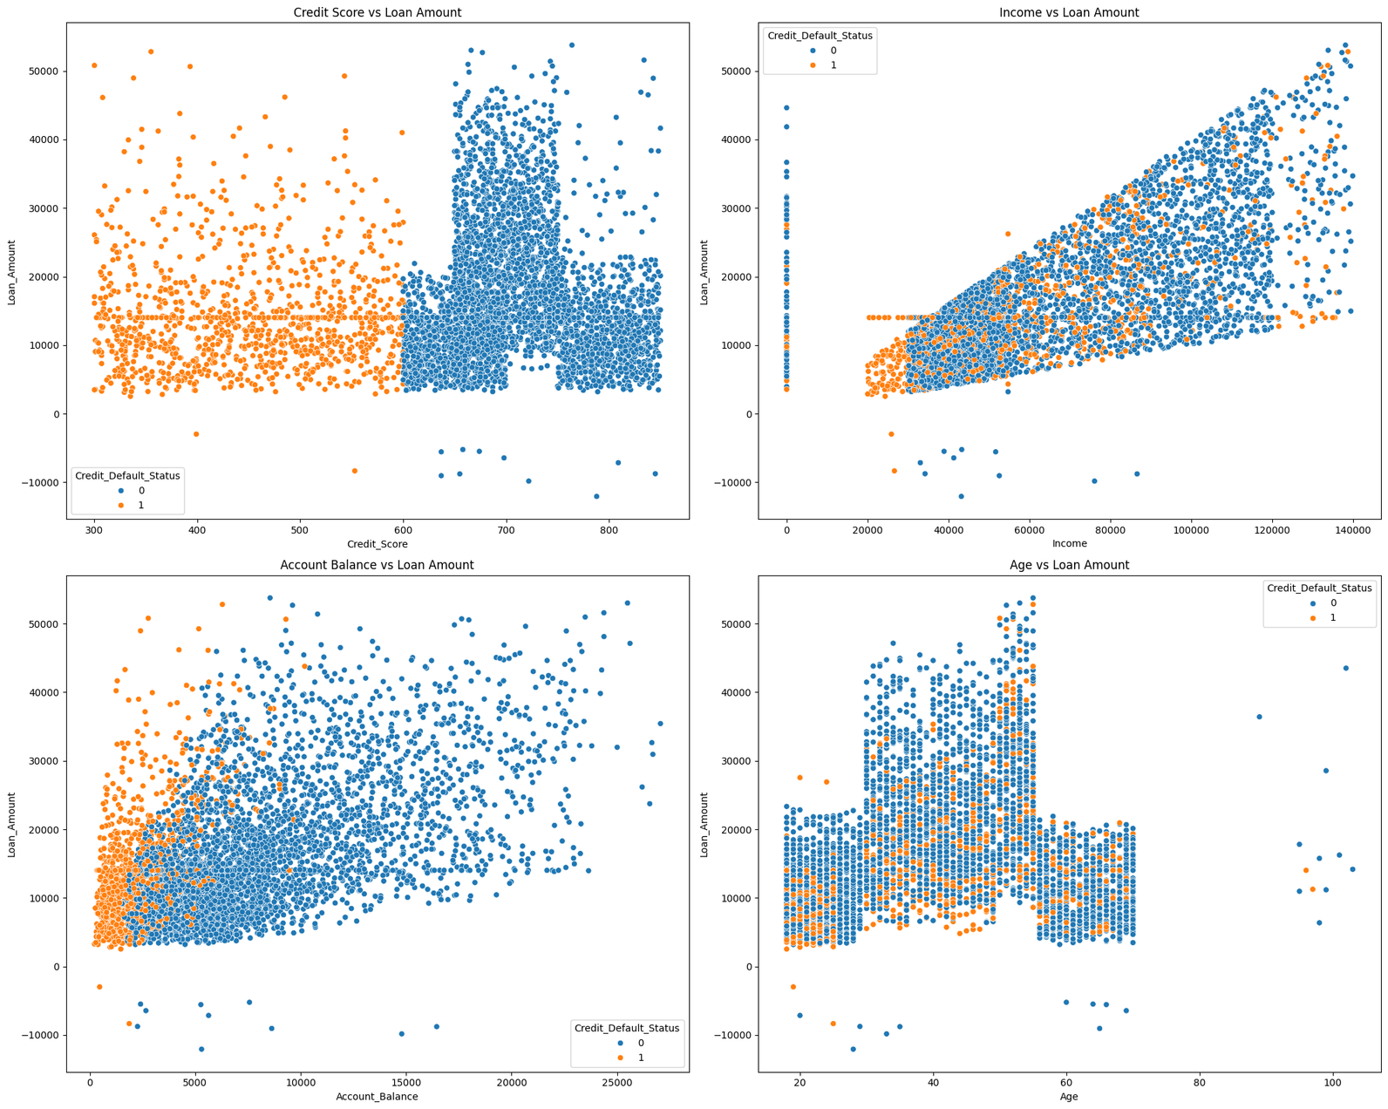
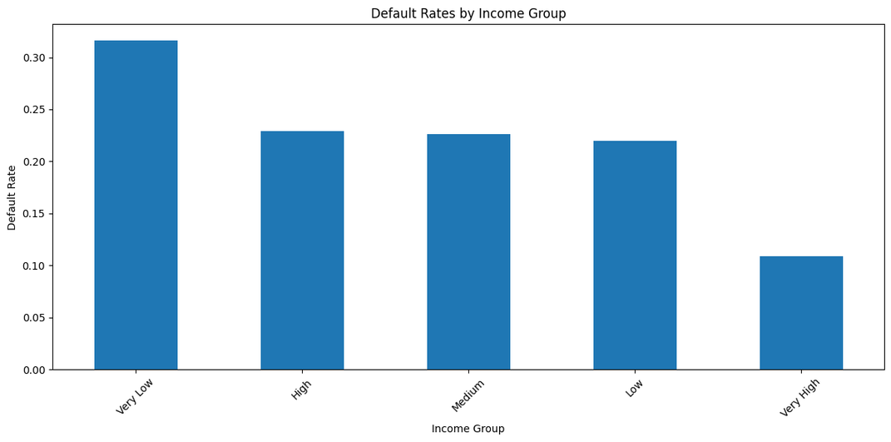
Default Rates by Income Group
Customers in the "Very Low" and "Low" income groups have the highest default rates.
Default risk decreases sharply in higher income groups.
Income is a strong indicator of repayment capacity.

Slide 16
Data Understanding and Customer Segmentation

Slide 17
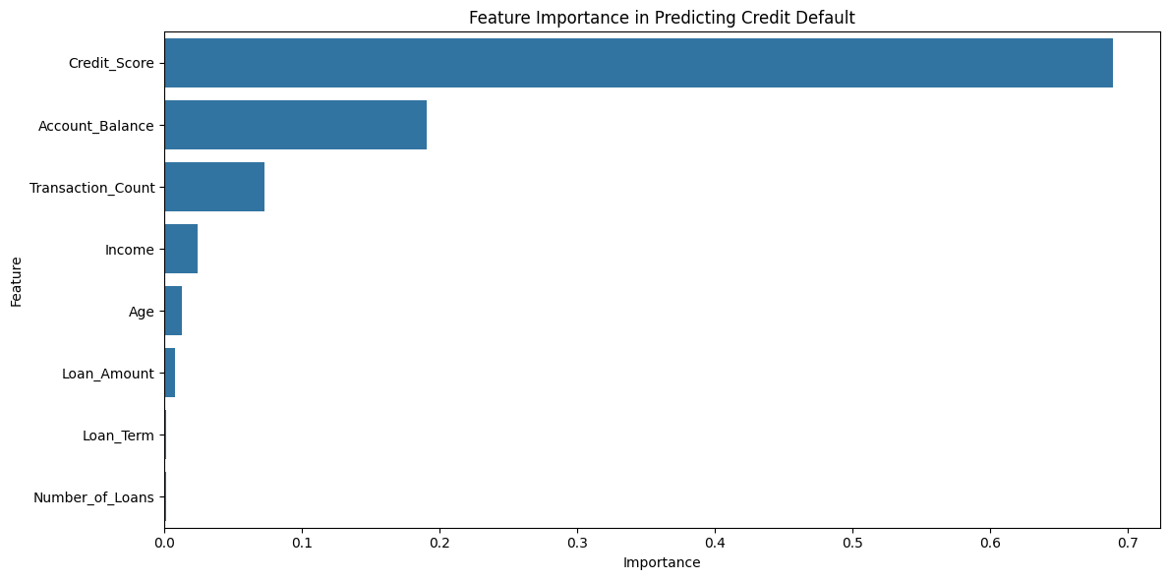
Feature Importance
Top Features: Account Balance, Credit Score, and Loan Amount.
Least Important: Gender, Marital Status.
The bank should focus on the most influential features to refine risk models and strategies.

Slide 18
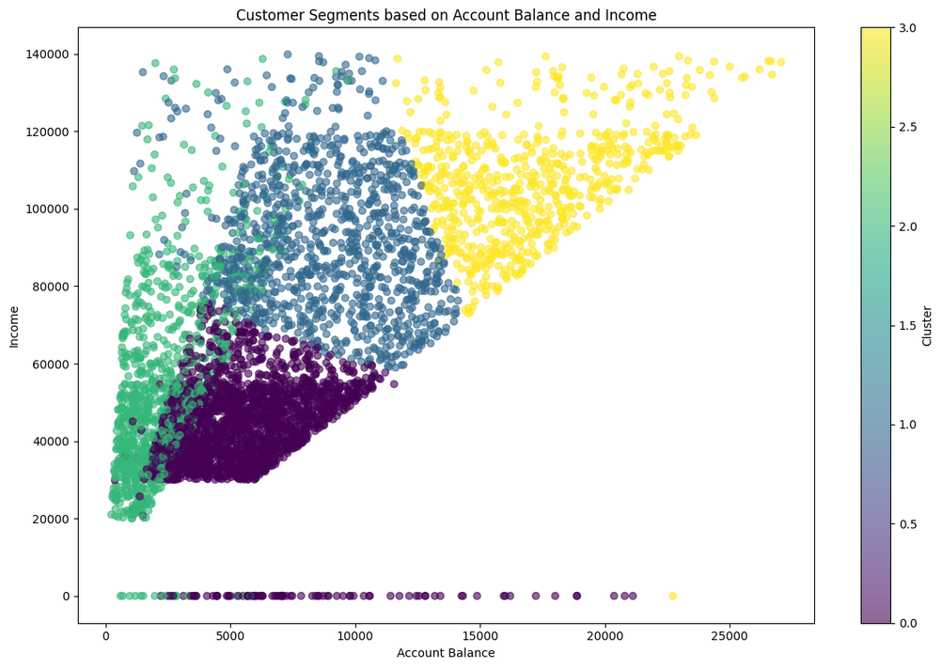
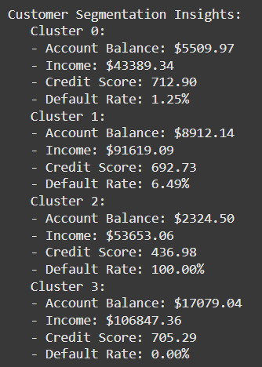
Account Balance and Income
Cluster 2: Low balance, moderate income, poor credit, and 100% default rate.
Cluster 3: High balance, high income, good credit, and 0% default rate.
This plot segments customers into four clusters based on account balance, income, and credit score.

Slide 19
Predictive Modeling

Slide 20
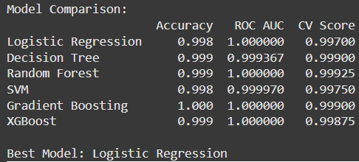
Model Performance and Evaluation
Various machine learning models, including Logistic Regression, Decision Tree, Random Forest, SVM, Gradient Boosting, and XGBoost, are trained and evaluated to predict credit default.
All models demonstrate exceptional performance, with near-perfect accuracy and ROC AUC scores.
Accuracy: All models achieved accuracy close to 99%.
ROC AUC: Near-perfect scores for all models, indicating excellent predictive power.
Logistic Regression selected for its simplicity, interpretability, and competitive performance.

Slide 21
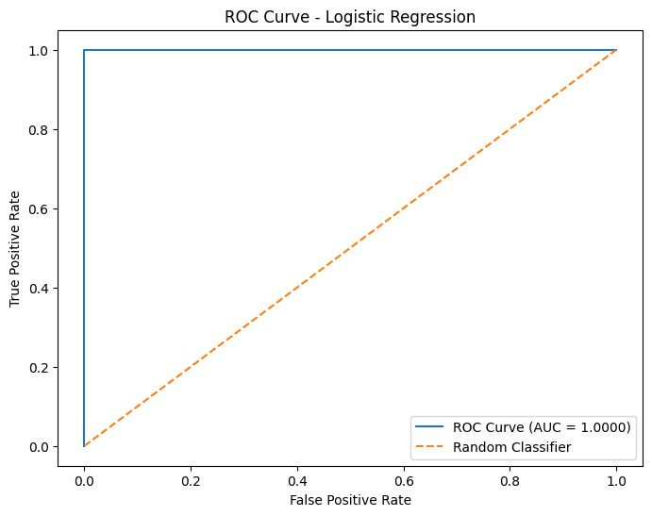
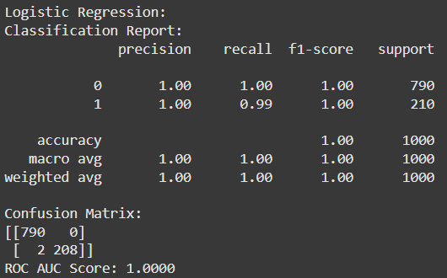
Model Insights
Logistic Regression was chosen as the best model due to:
Simplicity and ease of interpretation.
Comparable performance to complex models like Random Forest and XGBoost.

Slide 22
Conclusion

Slide 23
Insights
High Default Risk Segments:
Younger customers (18–25) and those with lower incomes have higher default rates.
Low credit scores and account balances correlate with higher default risks.
Segmentation Insights:
Cluster 2 (High Risk): Low balance, moderate income, low credit score; 100% default rate.
Cluster 3 (Low Risk): High balance, high income, high credit score; no defaults.
Loan and Transaction Patterns:
Defaults are more frequent with shorter loan terms and lower transaction counts.
Strong correlations observed between credit score, balance, and default status.
Predictive Model Success:
Logistic Regression achieves near-perfect accuracy, identifying key risk factors: Credit Score, Income, Loan Amount.

Slide 24
Actionable Insights
Stricter Loan Approvals:
Set minimum credit score (700) and balance thresholds to reduce default risk.
Targeted Customer Engagement:
High-Risk: Provide financial education, flexible loans, and small loan options.
Low-Risk: Upsell premium products to high-balance, high-income customers.
Automated Risk Management:
Use the predictive model for real-time loan approval and risk assessment.
Marketing & Portfolio Focus:
Target medium-risk segments (Clusters 0 & 1) for growth while managing risk effectively.

Slide 25

























Thank
You!
H John Joshua

