Slide 1

TRAFFIC VIOLATION DETECTION SYSTEM

Slide 2


PANIMALAR INSTITUTE OF TECHNOLOGY
DEPARTMENT OF COMPUTER SCIENCE & ENGINEERING
MINI PROJECT WORK
TRAFFIC VIOLATION DETECTION SYSTEM
BATCH NUMBER – B4
TEAM MEMBERS :
GUIDE :
Dr. A. ANBARASA PANDIAN,M.E.,PhD.,
Professor,
Department of CSE.
AKSHAY SREE KRISHNA M(211520104010) JOHN KELWIN JK (211520104069) MOHAMED YAZAR S (211520104093)

Slide 3
ABSTRACT
The increasing number of bikes and cars in cities can cause high volume of traffic, and implies that traffic violations become more critical nowadays in India and also around the world.
This causes severe destruction of property and more accidents that may endanger the lives of the people. To solve the alarming problem and prevent such unfathomable consequences, traffic violation detection systems are needed.
In this paper we are proposing a system to automatically detect violations like not wearing a helmet, speeding and traffic light violation for Indian road scenarios
This system will detect the violation and take a snapshot of violation vehicles.

Slide 4
INTRODUCTION
It is obvious that physical traffic police-based monitoring alone is insufficient to monitor such large traffic volumes and simultaneously track violations.
This has led to many violators going unnoticed. The violators, in turn, cause more serious mishaps on the road resulting in danger
We propose using a custom trained Yolo-v7 + DeepSORT for violation detection and tracking
This implementation obtained a mean average precision (mAP) of 98.09% for violation detection and an accuracy.
Thus, showing that the traffic violation system developed can be used to automate traffic violation ticketing

Slide 5
OBJECTIVES
The main objective of the traffic violation detection system is to automate traffic violation ticketing.
Some specific objectives of this system include:
Reducing traffic violation
Lowering the administrative cost
Reducing the work of traffic police

Slide 6
EXISTING SYSTEM
The previous system detect only the violation causes by two wheeler.
The previous system uses YOLO V4.
The previous system uses YOLO V4 + Tesseract for number plate detection.
The previous system can’t detect traffic light violation.

Slide 7
PROPOSED SYSTEM
The proposed system detect violation for two wheeler and other vehicle.
The proposed system uses YOLO V7.
The proposed system uses YOLO V7+ Tesseract for number plate detection.
The proposed system take snap shot of violating vehicles.

Slide 8
ADVANTAGES
The proposed system detect violation for two wheeler and other vehicle.
Increases performance as the proposed system uses YOLO v7.
The proposed system detect traffic light violation which is very important.

Slide 9
SOFTWARE SPECIFICATION
Operationg System :windows 10 & 11
Language : PYTHON
Libraries : Open CV
Package Manager : PIP

Slide 10
HARDWARE SPECIFICATION
CPU : Intel Core i5 @ 2.5GHz
RAM : 4GB OR above
Display : 720p Monitor or above

Slide 11
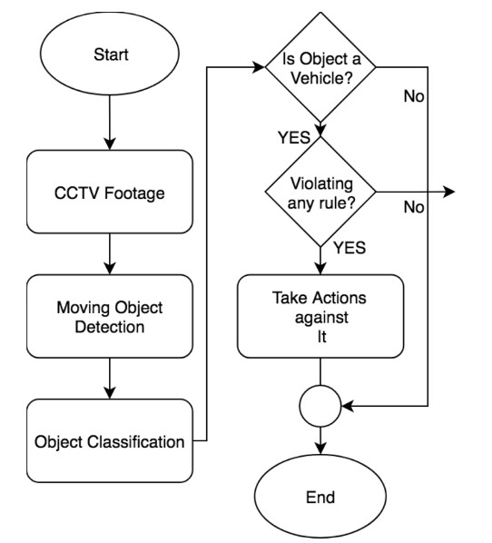
ARCHITECTURAL DESIGN
7
7

Slide 12
ALGORITHM USED
YOLO - YOLO (You Only Look Once) is an object detection Algorithm
DeepSort -DeepSORT is a tracking algorithm which tracks objects not only based on the velocity and motion of the object but also the appearance of the object.

Slide 13
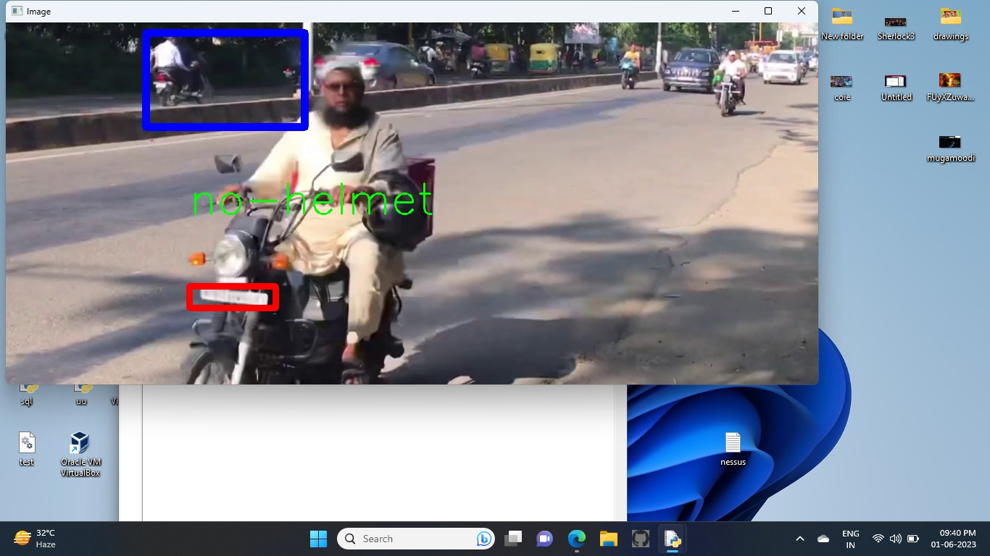
SCREENSHOTS
Snap shot of detecting helmet violation :

Slide 14
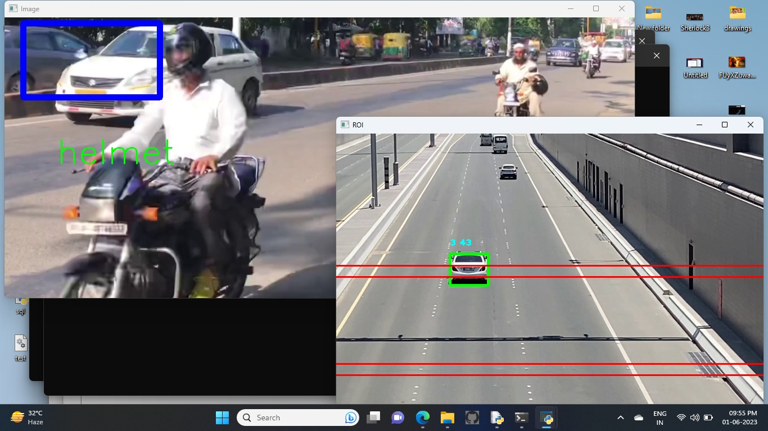

Slide 15
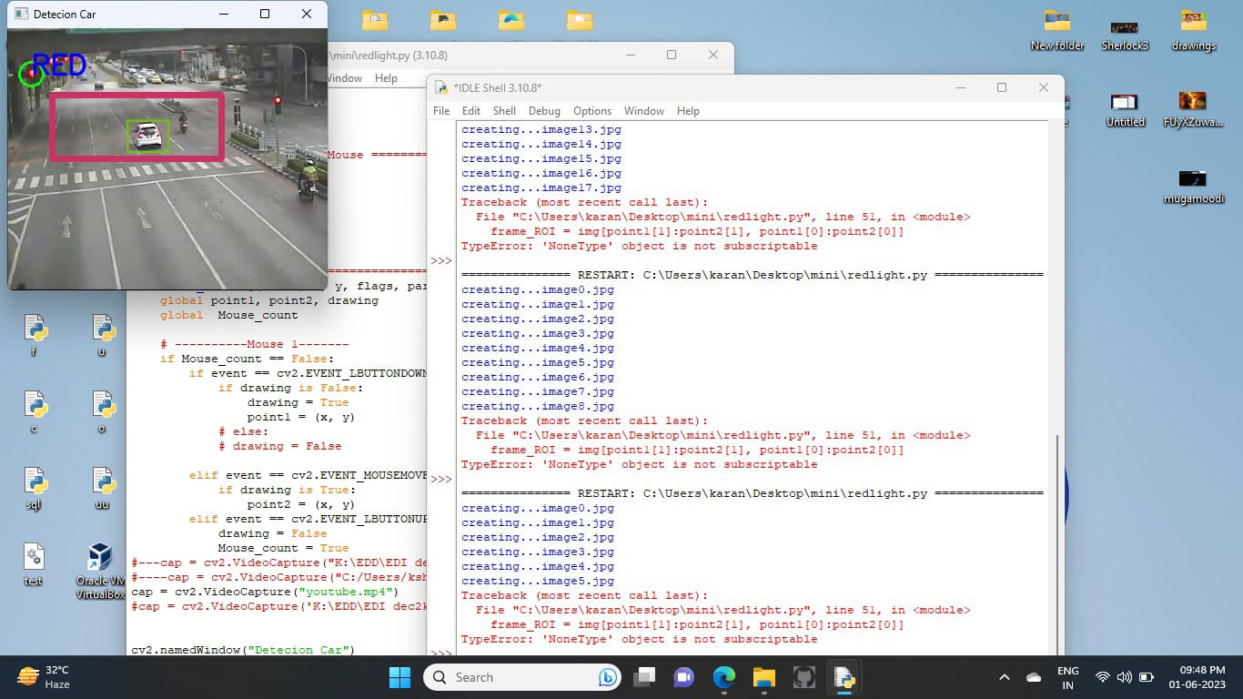
Snap shot of detecting traffic light violation :

Slide 16
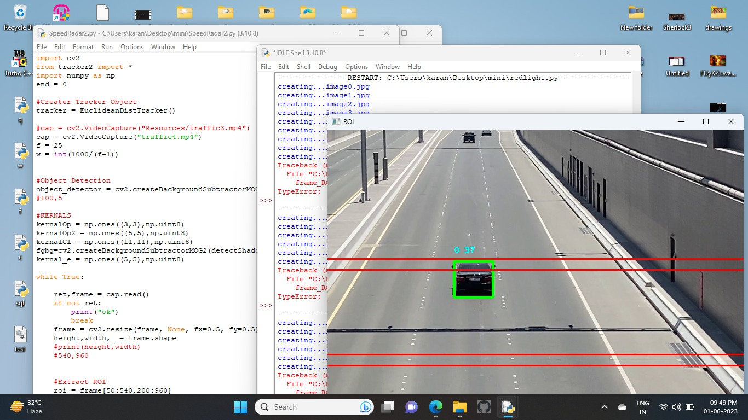
Snap shot of detecting speed violation :

Slide 17
CONCLUSION
The goal of the project is to automate the traffic signal violation detection system and make it easy for the traffic police department to monitor the traffic and take action against the violated vehicle owner in a fast and efficient way.
Detecting and tracking the vehicle and their activities accurately is the main priority of the system.
Our model detect violation traffic violation like not wearing helmet, violating traffic light and speeding.

Slide 18
REFRENCES
[1] G. Ou, Y. Gao and Y. Liu, "Real Time Vehicular Traffic Violation Detectionin Traffic Monitoring System, " I n 2012 IEEE / WIC/ ACM, Beijing , China , 2012.
[2] X. Wang, L.-M. Meng, B. Zhang, J. Lu and K.-L.Du, "A Video-based Traffic Violation Detection System," in MEC, Shenyang, China, 2013.
[3] Joseph Redmon and Ali Farhadi , "YOLOv3 : An Incremental Improvement"
[4] J. Chiverton, “Helmet presence classification with motorcycle detection and tracking,” IET Intell. Transp. Syst., vol. 6, no. 3, pp. 259–269, 2012.
[5] K. Dahiya, D. Singh, and C. K. Mohan, “Automatic detection of bikeriders without helmet using surveillance videos in real-time,” in Proc. Int. Joint Conf. Neural Netw. (IJCNN), Jul. 2016, pp. 3046–3051.

Slide 19
[6] X. Wang, L.-M. Meng, B. Zhang, J. Lu, and K.-L. Du, “A video-based traffic violation detection system,” in Proc. Int. Conf. Mech. Sci., Electr. Eng. Comput. (MEC), Dec. 2013, pp. 1191–1194.
[7] N. C. Mallela, R. Volety, R. P. Srinivasa, and R. K. Nadesh, “Detection of the triple riding and speed violation on two-wheelers using deep learning algorithms,” Multimedia Tools Appl., vol. 80, no. 6, pp. 8175–8187, Mar. 2021.
[8] B. Y. Reddy and M. Budka, “Detection of motor bicyclist violating traffic rules using computational neural networks,” Tech. Rep.
[9] V. Mandal and Y. Adu-Gyamfi, “Object detection and tracking algorithms for vehicle counting: A comparative analysis,” J. Big Data Anal.Transp., vol. 2, pp. 251–261, Nov. 2020

Slide 20
Thank You

