Slide 1
JSTL
JSP Standard Tag Library

Slide 2
Agenda
1)Introduction
2)Advantage
3)Classification
3.1)Core Tags
3.2)Formatting Tags
3.3)SQL Tags
3.4)XML Tags
3.5)JSTL Function

Slide 3
Introduction :
The JavaServer Pages Standard Tag Library (JSTL) is a collection of useful JSP tags which encapsulates the core functionality common to many JSP applications.
JSTL has support for common, structural tasks such as iteration and conditionals, tags for manipulating XML documents, internationalization tags, and SQL tags.

Slide 4
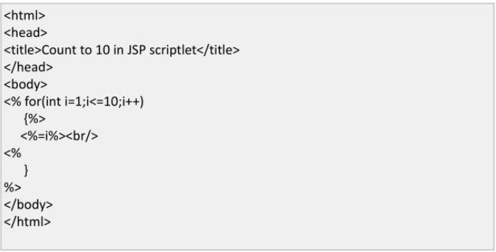
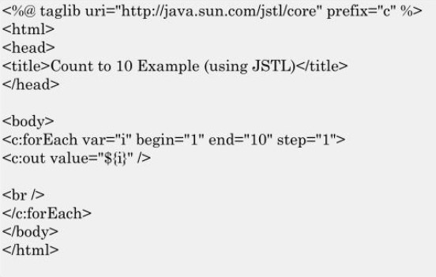
Advantages of using JSTL:
Usual JSP code to print 1 to 10
Using JSTL :

Slide 5
1)Fast Development 2)Code Reusability 3)No need to use scriptlet tag(<%....%>)

Slide 6
Classification:
JSTL tags are classified according to their functions
Core Tags
Formatting Tags
SQL Tags
XML Tags
JSTL Functions

Slide 7
Core Tags:
The core group of tags are the most commonly used JSTL tags .The JSTL core tags provide variable support, URL management,,flow control etc.
Syntax to include core tags:
<%@ taglib prefix = "c" uri = "http://java.sun.com/jsp/jstl/core" %>

Slide 8
Some Core Tags :
<c:out> – It display the result of an expression similar to the way
<%@ taglib uri=http://java.sun.com/jsp/jstl/core” prefix=“c” %>
<html>
<body>
<c:out value =“${Hello World…….!}”/>
</body>
OUTPUT:
Hello World…....!

Slide 9
More Core Tags :
<c:if> – conditional tag used to text condition.
<c:forEach>- for each statement.
Refer page 65 in notes for more core Tags

Slide 10
Formating Tags:
The JSTL formatting tags are used to format and display text, the date, the time, and numbers for internationalized Websites.
Following is the syntax to include Formatting library in your JSP
<%@ taglib prefix = "fmt" uri = "http://java.sun.com/jsp/jstl/fmt" %>

Slide 11
Some Formating Tags:
<fmt:timeZone> - It specifies a parsing action nested in its body . or the time zone for any time formatting.
<fmt:format Number> - It is used to format the numerical value . with specific format or precision.
<fmt:formatDate> - It formats the time or the date
<fmt:parseDate> - It parses the string representation of a time
. And date.

Slide 12
SQL Tags:
The JSTL SQL tag library provides tags for interacting with relational databases (RDBMSs) such as Oracle, mySQL, or Microsoft SQL Server.
The syntax to include SQL Tags:
<%@ taglib uri = "http://java.sun.com/jsp/jstl/xml" prefix = “sql" %>

Slide 13
Some SQL Tags:
<sql:query> - It is used for executing the sql query.
<sql:setDataSource> - It is used for creating a simple data source.
<%@ taglib uri = "http://java.sun.com/jsp/jstl/sql" prefix = “sql" %>
<sql:setDataSource var=“db” driver=“com.mysql.jdbc.Driver” url=“jdbc:mysql://localhost/test” urser=“root” password=“123”/>
<sql:query datasource=“${db}” var=“rs”>SELECT *from students;</sql:query>

Slide 14
XML Tags:
The JSTL XML tags provide a JSP-centric way of creating and manipulating the XML documents. Following is the syntax to include the JSTL XML library in your JSP.
The JSTL XML tag library has custom tags for interacting with the XML data. This includes parsing the XML, transforming the XML data, and the flow control based on the XPath expressions.
The syntax to include XML Tags:
<%@ taglib prefix = “sql" uri = "http://java.sun.com/jsp/jstl/xml" %>

Slide 15
Some XML Tags:
<x:out> - Similar to <%= > tag but for Xpath.
<x:parse> -It is used to parse the XML data specified.
<x:if > - It is used for evaluating the test Xpath expression and I is true it will processes its body . . content.
<x:transform>- Used in a XML document for providing the XSL tranformation

Slide 16
Function Tags:
JSTL includes a number of standard functions, most of which are common string manipulation functions. Following is the syntax to include JSTL Functions library in your JSP
The syntax to include Function Tags:
<%@ taglib uri = "http://java.sun.com/jsp/jstl/functions" prefix = “fn" %>

Slide 17
Some Function Tags:
fn:toLowerCase() – It converts all the characters to lower case.
fn:toUpperCase() – It converts all the characters to Upper Case.
fn:length() – return the number of charcter in the string
There are more function tag in JSTL refer pgNo: 66 in notes for more JSTL function tags

Slide 18
Thank You
By:
John Kelwin JK
Akshay Sree Krishna M

