Slide 1
REAL TIME VOICE CLONING USING NEURAL FUSION
final REVIEW
TEAM MEMBERS :
NAME | REGISTER NUMBER
AKSHAY SREE KRISHNA M | 211520104010
APPRAJIT VAIBHAV M | 211520104014
JOHN KELWIN JK | 211520104069
SRIRAM CM | 211520104156
GUIDE :
Mrs. TAMILSELVI,
Assistant Professor,
Department of CSE,
Panimalar Institute of Technology.

Slide 2
Real Time Voice Cloning Using Neural Fusion

Slide 3
OBJECTIVES
The main objective of the REAL TIME VOICE CLONNING USING NEURAL FUSION is to clone voice in real time
Some specific objectives of this system include:
Reduce the amount of input voice data,
Reduce the training time of the system.

Slide 4
BASE PAPER
TITLE : Unsupervised TTS Acoustic Modeling for TTS With
Conditional Disentangled Sequential VAE
AUTHOR : Jiachen Lian, Chunlei Zhang , Gopala K.
Anumanchipalli and Dong Yu
DOMAIN : NATURAL LANGUAGE PROCESSING
YEAR : 2023

Slide 5
ABSTRACT
In this paper, we propose a novel unsupervised text to-speech acoustic model training scheme, named UTTS, which does not require text-audio pairs. UTTS is a multi-speaker speech synthesizer that supports zero-shot voice cloning, it is developed from a perspective of disentangled speech representation learning. The framework offers a flexible choice of a speaker’s duration model, timbre feature (identity) and content for TTS inference. We leverage recent advancements in self-supervised speech representation learning as well as speech synthesis front-end techniques for system development. Specifically, we employ our recently formulated Conditional Disentangled Sequential Variational Auto-encoder (C-DSVAE) as the backbone UTTS AM, which of fers well-structured content representations given unsupervised alignment (UA) as condition during training. For UTTS inference, we utilize a lexicon to map input text to the phoneme sequence, which is expanded to the frame-level forced alignment (FA) with a speaker-dependent duration model .Then, we develop an alignment mapping module that converts FA to UA. Finally, the C-DSVAE, serving as the self-supervised TTS AM, takes the predicted UA and a target speaker embedding to generate the melspectrogram, which is ultimately converted to waveform with a neural vocoder. We show how our method enables speech synthesis without us ing a paired TTS corpus in AM development stage. Experiments demonstrate that UTTS can synthesize speech of high naturalness and intelligibility measured by human and objective evaluations. Audio samples are available at our demo page.

Slide 6
EXISTING METHOD
The Existing method do not clone voices in real time.
It takes more input data and time to clone voice.
It uses VAE(Variational Auto Encoder).

Slide 7
ADVANTAGE OF EXISTING METHOD
Suitable of Text To Speech (TTS) applications.
Pre-trained voices.
User no need to train the System.

Slide 8
DISADVANTAGE OF EXISTING METHOD
Take more time to train.
Voice break is unavoidable in VAE Encoder.
Need more input to train voice.

Slide 9
PROPOSED METHOD
The proposed system can clone voice in real time
The proposed system uses GE2E (Generalized End to End) Encoder.
The proposed system uses Tacotron (Synthesizer).

Slide 10
ADVANTAGES OF PROPOSED METHOD
The proposed system clone voice in real time.
It need less sample voice data as input than existing system.
Voice break is avoidable.

Slide 11
DISADVANTAGE OF PROPOSED METHOD
Can not change the Emotion in voice.
Can not be used in professional dubbing.

Slide 12
APPLICATION
This application can clone voice of any person in real time if the sample voice is given as input.
Once the application is trained with the input voice it can generate the cloned voice using Text To Speech (TTS) System.

Slide 13
SOFTWARE REQURIEMENT
Operating System :windows 10 & 11
Language : PYTHON
IDE : MICROSOFT ‘S VISUAL STUDIO CODE
Libraries : Tkinder(GUI)
Framework : PyTorch
Package Manager : PIP
Dependencies : FFmpeg

Slide 14
HARDWARE REQUIREMENT
CPU : Intel Core i5 @ 2.5GHz
RAM : 4GB OR above
GPU : 2GB OR above
Audio : Microphone
Display : 720p Monitor or above

Slide 15
BLOCK DIAGRAM
Speaker
Speaker
Encoder
Phoneme
sequence
Synthesizer
Vocoder
Wave form
Synthesizer :
Phoneme
sequence
Encoder
concat
Attention
Decoder
log- mel spectrogram

Slide 16
LITERATURE SURVEY
TITLE | ISSUED | ADVANTAGE | DISADVANTAGE
1) efficiency TTS 2: variational end to end text to speech synthesis and voice conversation | IEEE international conference on signal process., Oct 2018 | The modal outperform baseline models in both single speaker and multi speaker. High MOS scores | The text does not explicitly mention any disadvantages or limitations of EFTS2.
(2) Depressive Tendency Recognition by Fusing Speech and Text Features: A Comparative Analysis | IEEE Transaction on Information Forensics and Security, vol. 3, No. 4, DECEMBER 2021 | The multimodal that fuses speech and text features shows better prediction of depression tendency | Using speech or text features alone may not be through in prediction depression as understanding text content or speech information alone may not fully capture individuals.

Slide 17
TITLE | ISSUED | ADVANTAGE | DISADVANTAGE
3) SPEECH BERT EMBEDDING FOR IMPROVING PROSODY IN NEURAL TTS | IEEE international conference on signal process., Oct 2017 | Effectively improves prosody in speech synthesis by dynamically extracting and incorporation prosody attributes | This paper does not provide any disadvantage or limitation of the system.
4) a machine speech chain approach for dynamically adaptive lombard tts in static and dynamic noise environments | IEEE Transaction on Information Forensics and Security, vol. 3, No. 4, DECEMBER 2020 | Dynamically adaptive lombard text to speech system Short term objective intensity Machine speech chain approach | System performance in dynamic noise condition is not effective Non-incremental TTS performed better in clean and static noise conditons

Slide 18
TITLE | ISSUED | ADVANTAGE | DISADVANTAGE
5) TTS-BY-TTS: TTS-DRIVEN DATA AUGMENTATION FOR FAST AND HIGH-QUALITY SPEECH SYNTHESIS | IEEE international conference on signal process., Oct 2008 | Improves the quality of non-autoregressive text to speech system . Limited training data. | Generating large-scale synthetic corpora with phoneme durations using an auto regressive TTS system may require significant computational resources.
6) Neural Fusion for Voice Cloning | IEEE Transaction on Information Forensics and Security, vol. 3, No. 4, DECEMBER 2008 | Enhances speakers similarity. Maintains speech naturalness in voice cloning application. | The system may still face challenges with concatenation gaps despite the proposed refinement strategies.

Slide 19
TITLE | ISSUED | ADVANTAGE | DISADVANTAGE
7) Expressive tts training with frame and style reconstruction loss | IEEE international conference on signal process., Oct 2008 | Model with frame and structural reconstruction loss. Use of low deep style features is effective | Paper does not explicitly mention disadvantages of proposed training strategy or model.
8) A Semi-Automatic Method for Transcription Error Correction for Indian Language TTS Systems | IEEE Transaction on Information Forensics and Security, vol. 3, No. 4, DECEMBER 2008 | Improved network efficiency through optimized communication protocols | Increased complexity and potential errors in network architectures.

Slide 20
TITLE | ISSUED | ADVANTAGE | DISADVANTAGE
9) Decoding knowledge transfer for neural text to speech training | IEEE international conference on signal process., Oct 2014 | Effective knowledge transfer Neural TTS with naturalness and robustness | Complex Training process Limited run time efficiency Need for pre-trained models
10) Speech synthesis with mixed emotions | IEEE Transaction on Information Forensics and Security, vol. 3, No. 4, DECEMBER 2020 | This study allows for the mixed emotions in speech. Providing control and manipulation of emotion expression. | Conducting experiment with more emotional combinations are needed. Limitation in the enhancement of voice.

Slide 21
CONCLUSION
The goal of the project is to clone voice in real time and implement the voice in TTS(Text To Speech) System.
This project can clone voice of any person if the required sample voice is given as input
The another goal is to implement this project with user friendly GUI.

Slide 22
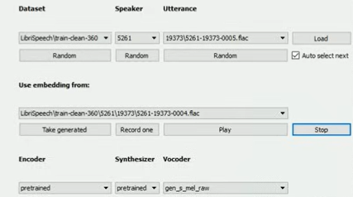
TRAINING MODULE

Slide 23
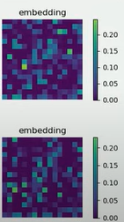
EMBEDDING MODULE

Slide 24
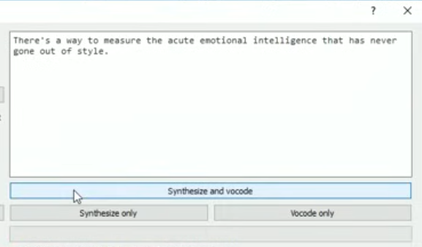
INPUT MODULE

Slide 25
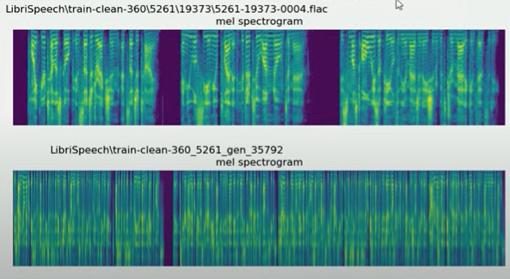
MEL SPECTRUM MODULE

Slide 26
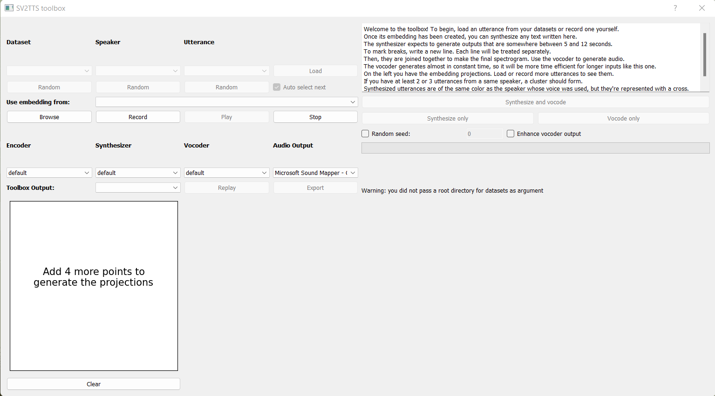
SCREENSHOT
Toolbox before cloning

Slide 27
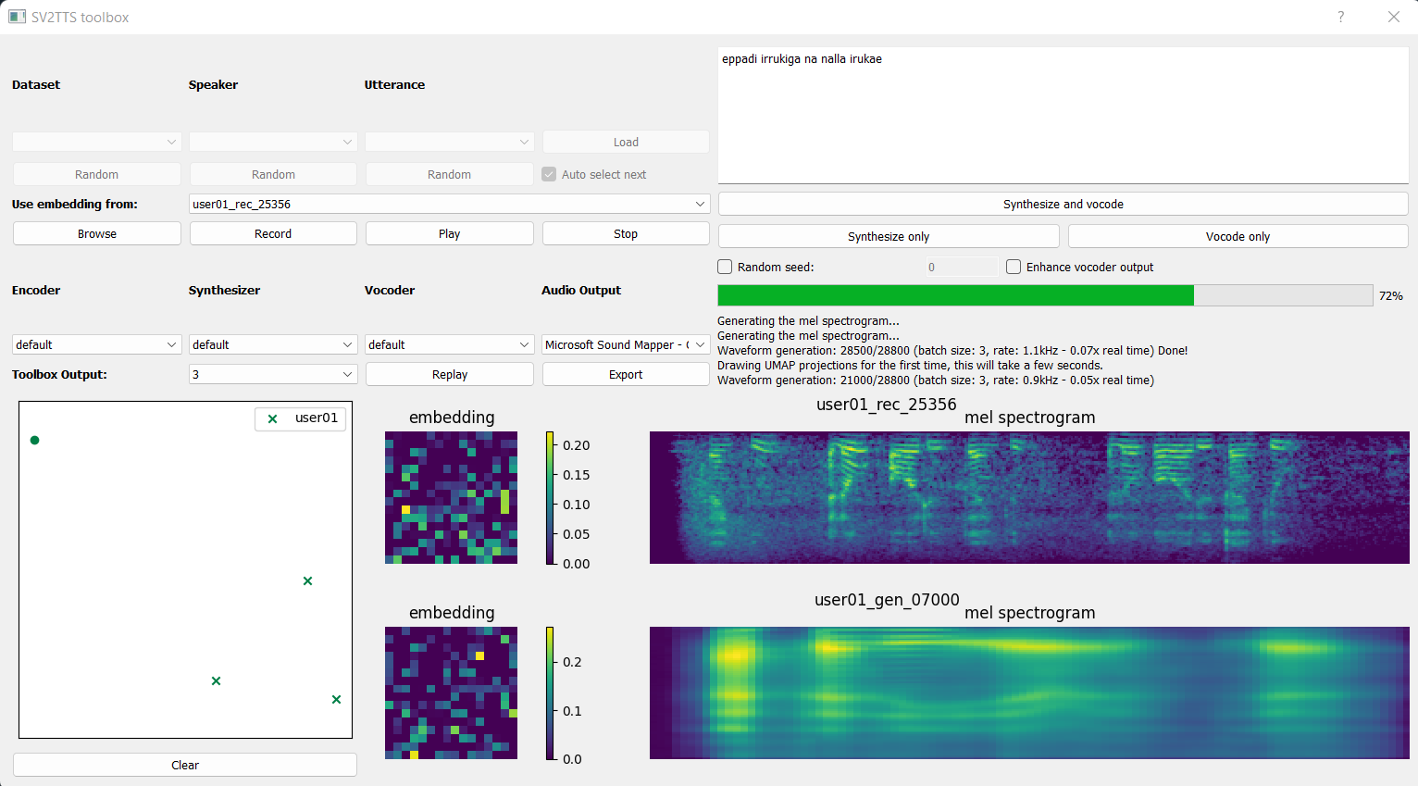
Toolbox after cloning

Slide 28
REFERENCES
[1] Artificial Intelligence at Google – Our Principles. https://ai.google/principles/, 2018.
[2] Sercan O Arik, Jitong Chen, Kainan Peng, Wei Ping, and Yanqi Zhou. Neural voice cloning with a few samples. arXiv preprint arXiv:1802.06006, 2018.
[3] Dzmitry Bahdanau, Kyunghyun Cho, and Yoshua Bengio. Neural machine translation by jointly learning to align and translate. In Proceedings of ICLR, 2015.
[4] Steven Boll. Suppression of acoustic noise in speech using spectral subtraction. IEEE Transactions on Acoustics, Speech, and Signal Processing, 27(2):113–120, 1979.
[5] Yutian Chen, Yannis Assael, Brendan Shillingford, David Budden, Scott Reed, Heiga Zen, Quan Wang, Luis C Cobo, Andrew Trask, Ben Laurie, et al. Sample efficient adaptive text-to-speech. arXiv preprint arXiv:1809.10460, 2018.

Slide 29
[6] Joon Son Chung, Arsha Nagrani, and Andrew Zisserman. VoxCeleb2: Deep speaker recognition. In Interspeech, pages 1086–1090, 2018.
[7] Rama Doddipatla, Norbert Braunschweiler, and Ranniery Maia. Speaker adaptation in dnnbased speech synthesis using d-vectors. In Proc. Interspeech, pages 3404–3408, 2017.
[8] Andrew Gibiansky, Sercan Arik, Gregory Diamos, John Miller, Kainan Peng, Wei Ping, Jonathan Raiman, and Yanqi Zhou. Deep Voice 2: Multi-speaker neural text-to-speech. In I. Guyon, U. V. Luxburg, S. Bengio, H. Wallach, R. Fergus, S. Vishwanathan, and R. Garnett, editors, Advances in Neural Information Processing Systems 30, pages 2962–2970. Curran Associates, Inc., 2017.
[9] Georg Heigold, Ignacio Moreno, Samy Bengio, and Noam Shazeer. End-to-end text-dependent speaker verification. In Acoustics, Speech and Signal Processing (ICASSP), 2016 IEEE International Conference on, pages 5115–5119. IEEE, 2016.
[10] Eliya Nachmani, Adam Polyak, Yaniv Taigman, and Lior Wolf. Fitting new speakers based on a short untranscribed sample. arXiv preprint arXiv:1802.06984, 2018.

