Slide 1





Digital Portfolio
Student Name:JEEVANANTHAM M
Register No:2422K2207
NM ID:DFB5A2BB8B20167B67D424AF23F75909
Department:B.Sc., Computer Science
College:Puratchi Thalaivi Amma Government Arts and
Science College
University:Bharathiar University

Slide 2




Project Title
Digital
Portfolio

Slide 3



Agenda
Problem Statement
Portfolio Design and Layout
Project Overview
Github Link
End Users
Features and Screenshots
Tools and Technologies
Results and Screenshots
Conclusion

Slide 4




Problem Statement
Students often struggle to present their academic
achievements, skills and projects in a structure and
professional manner. Traditional resumes fail to capture
creativity, practical skills and hands-on experiences
making it difficult for students to stand out in academic or
career opportunities. There is a need for a digital portfolio
solution that allows students to effectively showcase their
completed project and growth.

Slide 5


PROJECT OVERVIEW
By developing this portfolio system,student will have a
personalized digital identity that goes beyond a traditional
CV, enchancing their chances of securing opportunities in
competitive environments. It will also provide academic
institutions and recruiters with a reliable and holistic view
of a students’s potential.

Slide 6

End Users
Primary End Users :
Secondary End Users :
Students
Job Seekers
Freshers
Employers
Recruiters
Faculty
Mentors

Slide 7


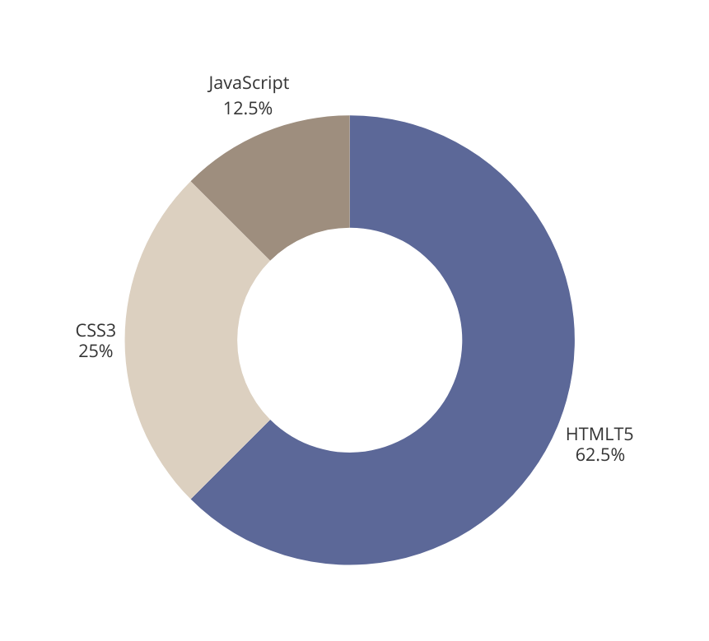

Tools and Techniques
Tools :
Trebedit
VS Code
Techniques :
HTML5
CSS3
JavaScript
Responsive Mobile Design

Slide 8


Portfolio Design and Layouts
A well-designedportfolio layout ensures clarity,
professionalism and impact while making it easy for
recruiters and mentors to quickly assess a student’s
strenghts.

Slide 9
Features and Functionality
Features = What‘s inside Profile, Skills, Projects, Achievements and etc.
Functionalities = What’s users can do create, edit, share ,export ,toggle menu bar and search.
About: Quick self-introduction & career goal
Certificates: Showcase of achievements
xperience: Past projects & work history
Education: Academic background timeline
Skills: Technical & soft skills highlight
Contact: Easy communication (Email, Phone, Social links)

Slide 10
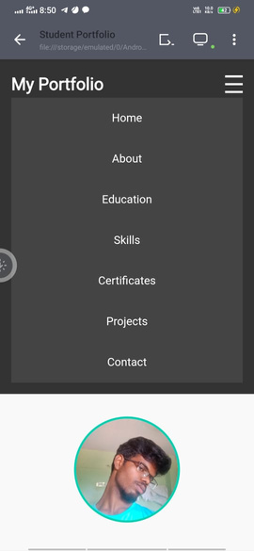
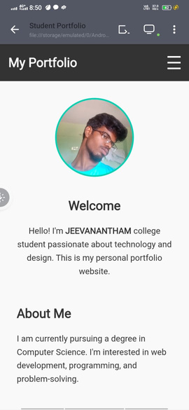
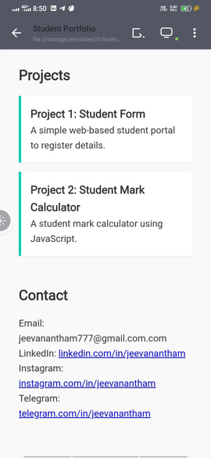
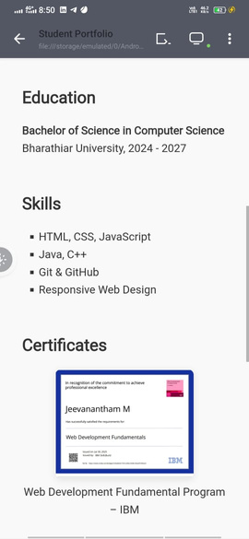
Results and Screenshots

Slide 11
Results and Screenshots
Working portfolio website hosted online
Successfully displays personal details, projects, and certificates
Easy navigation and user-friendly UI
Attracts recruiters by showcasing both skills and creativity

Slide 12



Conclusion
The development of the portfolio projects successfully
achieved its goal of creating a professional, user-friendly
and visually appearing platform to showcase skills,
projects and experiences. The responsive design ensure
accessability across various devices, while the integration
of multi-media elements and third-party links enchances
the portfolio’s effectiveness and reach

Slide 13


THANK YOU
For your attention

