Slide 1

POLARIS ACADEMIC AGENTS
Visual Identity System
Prepared for client review · June 2026

Slide 2
WHERE WE STARTED
The Problem
Polaris speaks to two audiences in the same room who need to hear different things. Students need the dream to feel real and achievable. Parents need to feel their child will be safe and the money well spent. Most brands pick one audience and hope the other follows.
Trust & expertise
Institutional stability for the parents footing the bill.
Aspiration & lift
The mark had to hold authority and warmth simultaneously — credible enough for an institutional letterhead, exciting enough to stop a student mid-scroll on Instagram.
The excitement of a bigger world opening up.
Rooted in education
Without leaning on the cliche of a book or mortarboard.
02

Slide 3
THE CONCEPT
Our Solution
The globe
Education means a bigger world, not a stack of textbooks. The globe speaks to every discipline a student might pursue, not just the classroom.
Africa - front and centre
The sphere is built from true geographic projection, not decoration. Africa dominates the visible face, exactly as it should for a Kenyan-founded agency serving African students.
The Polaris Star
A small guiding point sits beyond the globe's edge, present and watching. It is the one quiet nod to the brand name.
03

Slide 4
HOW IT WAS BUILT
How It Was Built
Every proportion in this mark is derived mathematically, not chosen by feel — the discipline that keeps it consistent as it scales from a favicon to a building fascia.
Swiss grid
Golden ratio
Optical compensation
International Style
phi = 1.618
Construction principle
Every element justified to a strict modular grid, the same discipline behind Lufthansa's identity system and the 1972 Munich Olympics.
The globe, the wordmark column, and the type hierarchy are all sized in golden-ratio proportion to one another, the same relationship found in the Apple logo's circles.
Mathematically equal elements don't look equal. Letterforms, the star's points, and the sphere's edge are all hand-adjusted so they read as balanced, not just measured as balanced.
04

Slide 5



THE SYSTEM
One Mark, Four Approved Lockups
Every application in this presentation draws from these four locked lockups. Nothing is improvised on the fly.
Primary Horizontal - Dark
Primary Horizontal - Light
Each lockup carries the same construction logic. The globe and star are always equal to the height of the wordmark beside or above it.
Icon Mark
Stacked
05

Slide 6
Seeing it in the world
A logo is only as good as its weakest application. The following pages show Polaris exactly as a student, a parent, or a partner institution would actually encounter it.

Slide 7
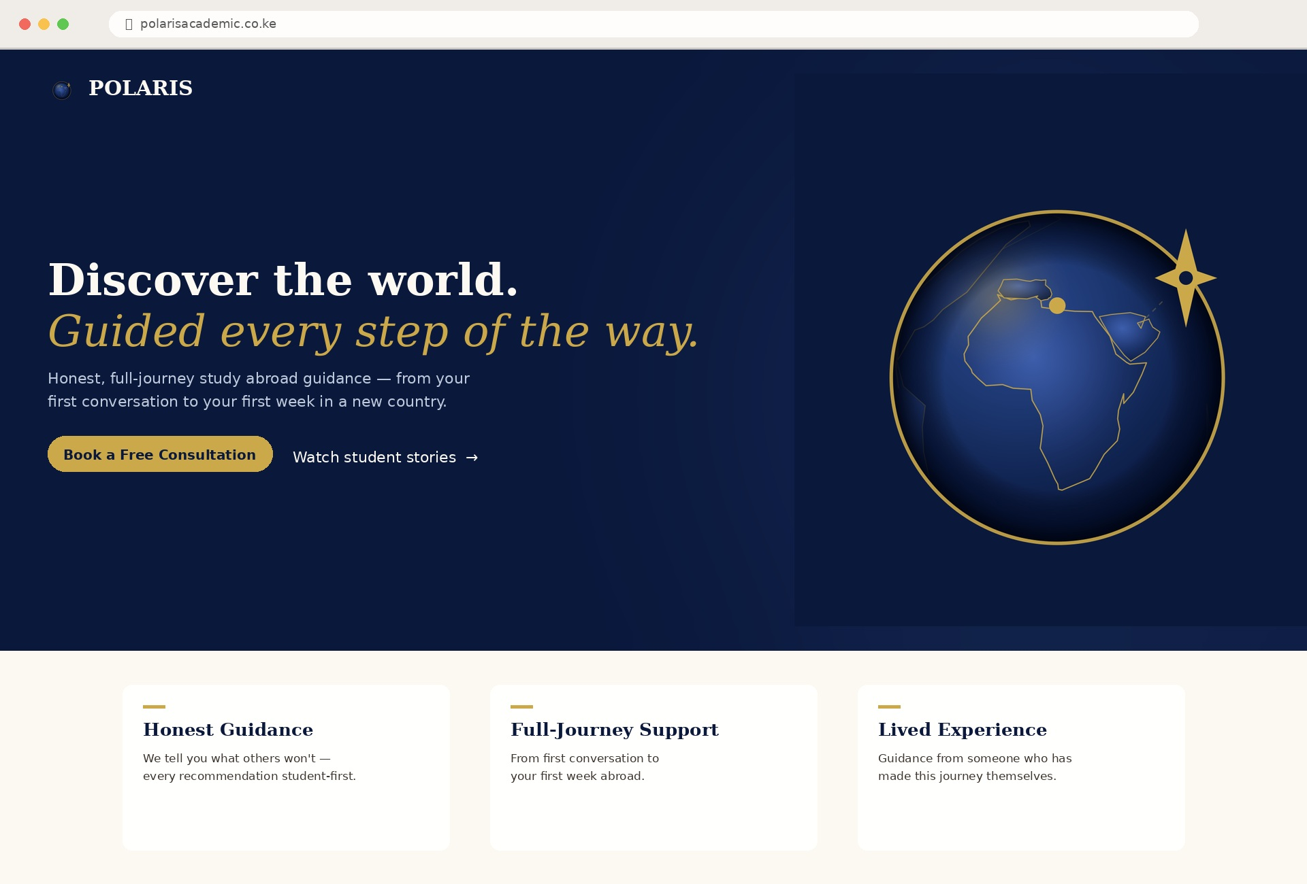
DIGITAL - THE FUNNEL STARTS HERE
Digital
Most students will meet Polaris online before anywhere else, through a search, a shared link, a social bio. The homepage has to make the brand's full promise legible in the first five seconds of a scroll.
WHY THIS WORKS
The hero pairs the tagline's exact wording, 'Discover the world.', with the large-format globe mark, while the three pillar cards beneath translate the brand's own messaging pillars directly into the page structure.
07

Slide 8
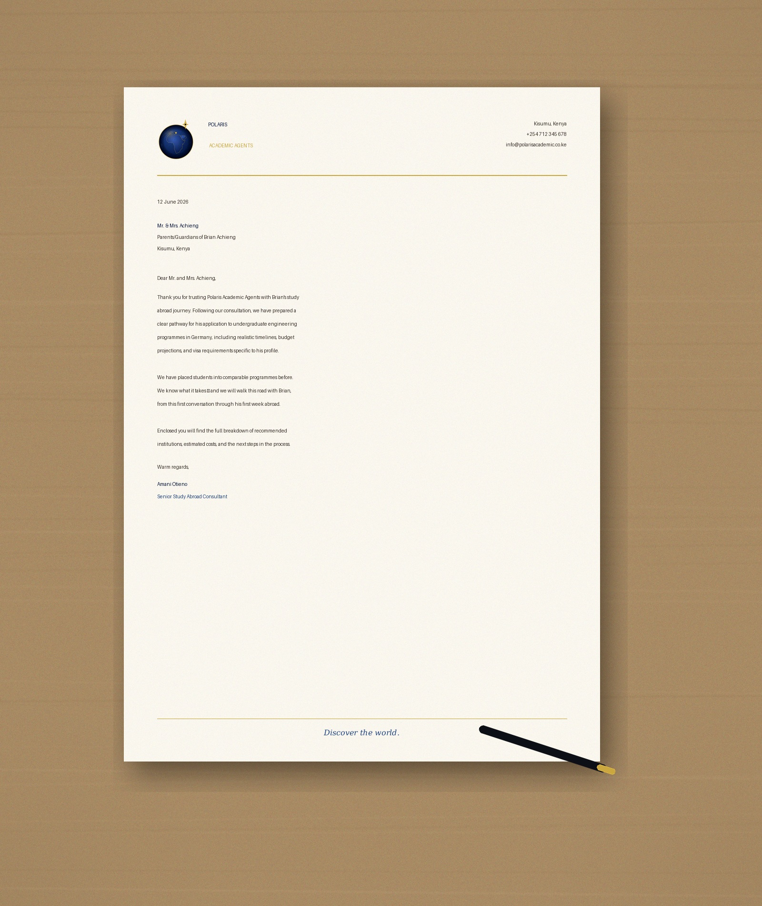
PRINT - INSTITUTIONAL TRUST
The Letterhead
A formal acceptance letter, a fee breakdown, a partnership agreement: these are the documents where Polaris has to look like an agency a university or a parent can trust with real money and a real future.
WHY THIS WORKS
Icon mark, address block, and a closing tagline rule frame a page that could sit beside any embassy or university's own letterhead, exactly the institutional register the brand voice calls for.
08

Slide 9
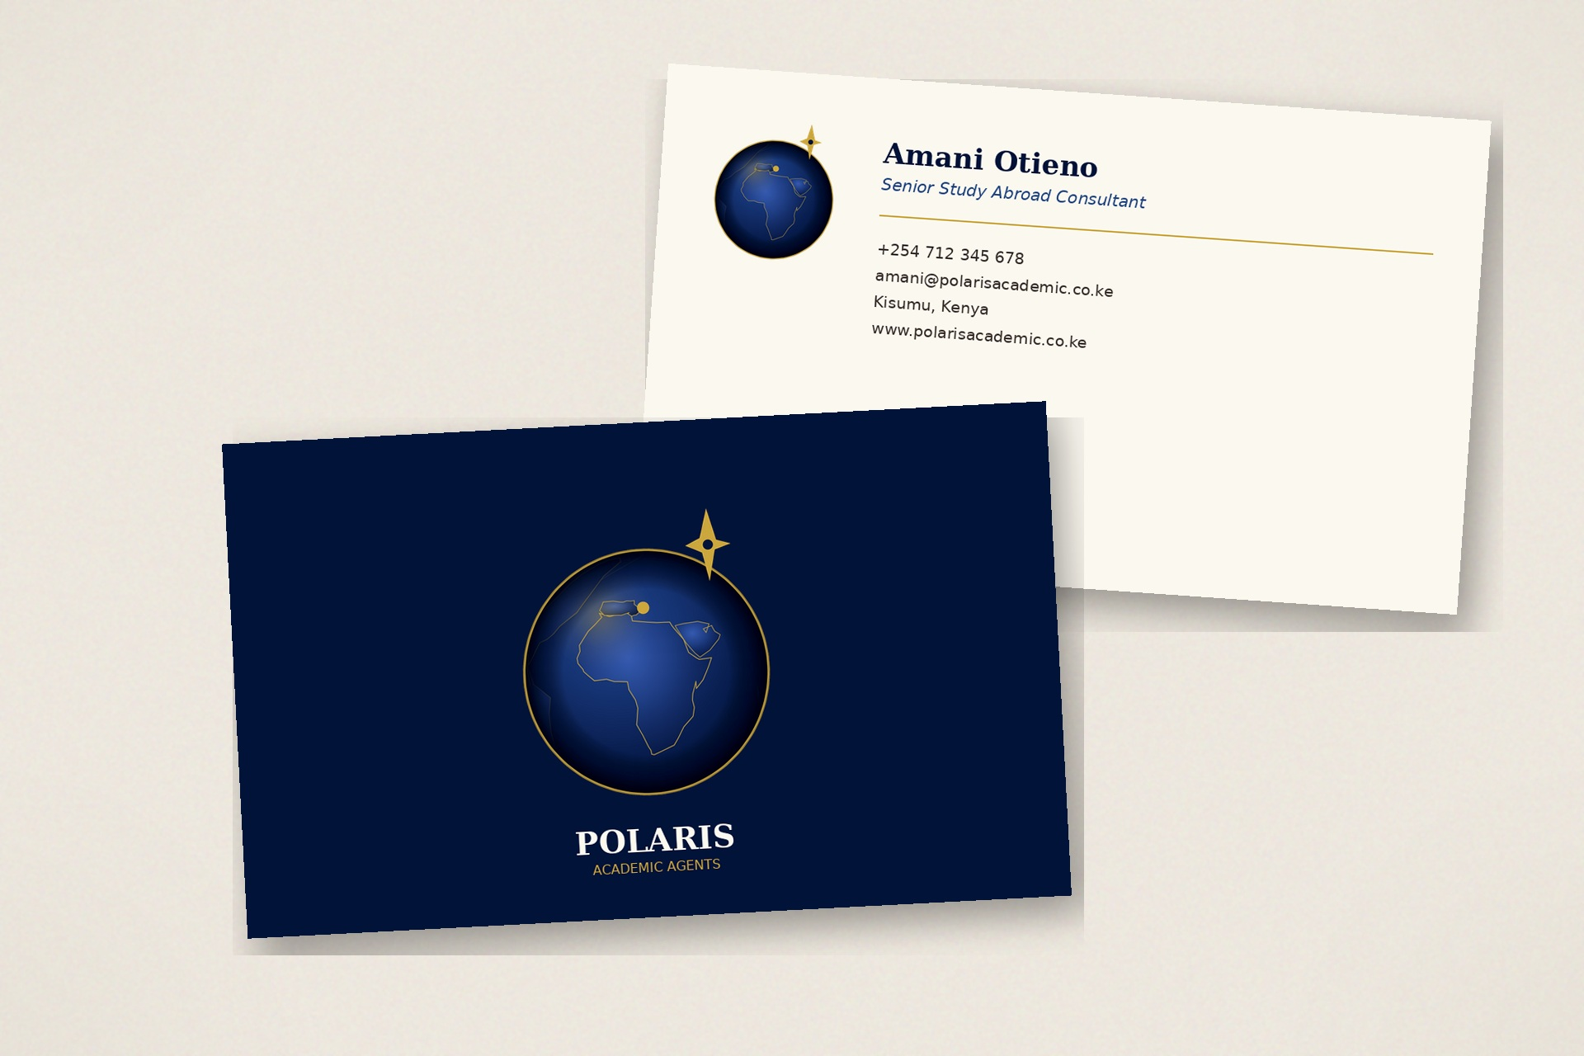
PRINT - FIRST IMPRESSION
The Business Card
After the first consultation, the business card is what stays behind on the kitchen table. It needs to feel as considered as the advice that was just given.
WHY THIS WORKS
Icon mark alone on the front signals confidence; the brand doesn't need to repeat its own name to be recognised. The back carries the full contact block in the same restrained, editorial type system the guidelines specify.
09

Slide 10
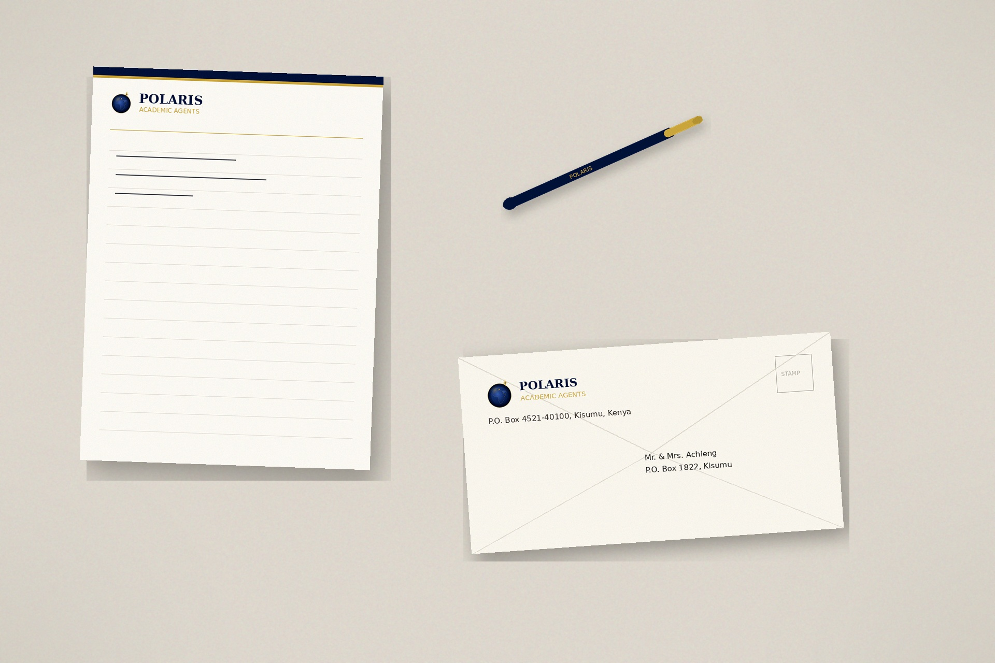
PRINT - THE QUIET DETAILS
Stationery Suite
10

Slide 11

ENVIRONMENT - PHYSICAL PRESENCE
Office Signage
11

Slide 12
Next Steps
1
Receive approval / feedback on direction
2
Receive balance of Ksh. 10,000
3
Make edits and prepare logo for delivery
Discover the world.

