Slide 1
HDInsight Spark Cluster Lab
John Kim

Slide 2
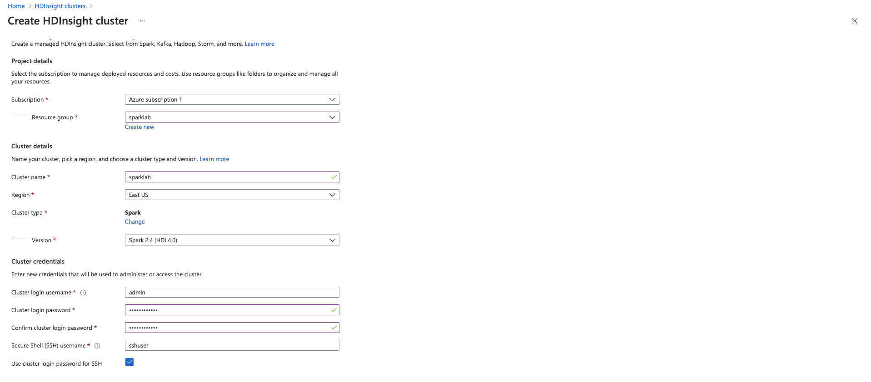
Creation of HDInsight Cluster

Slide 3
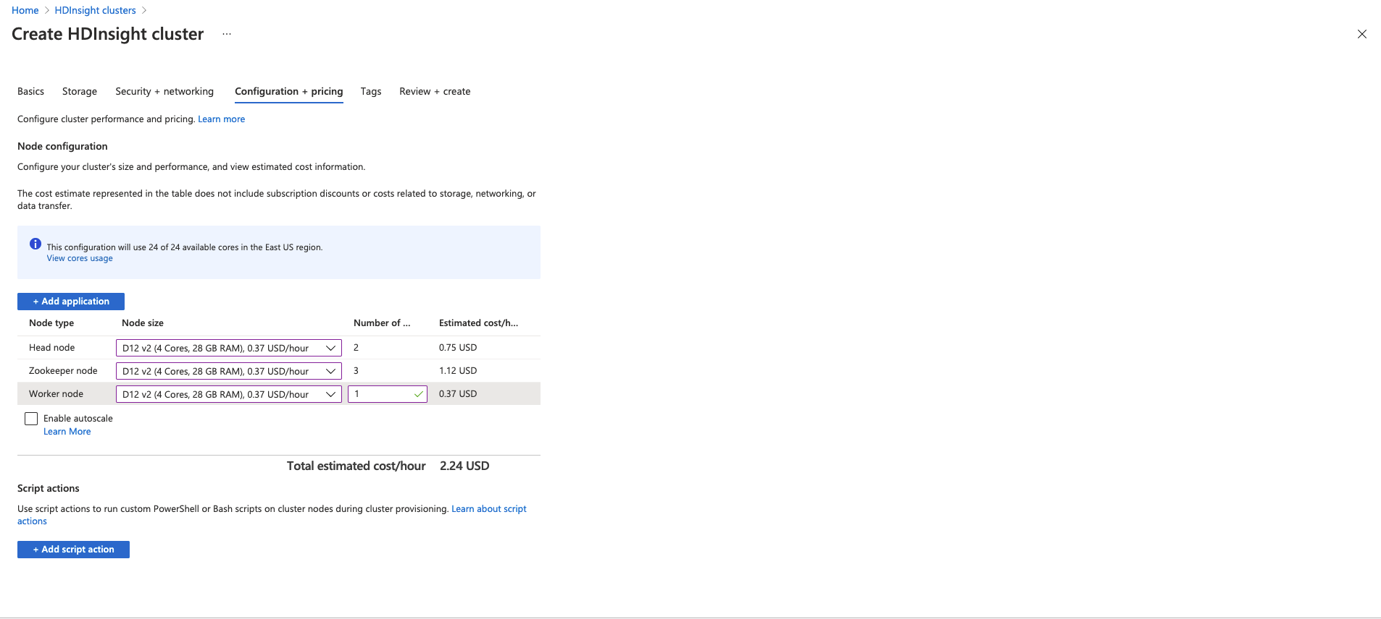
Configured cheapest recommended Node options.

Slide 4
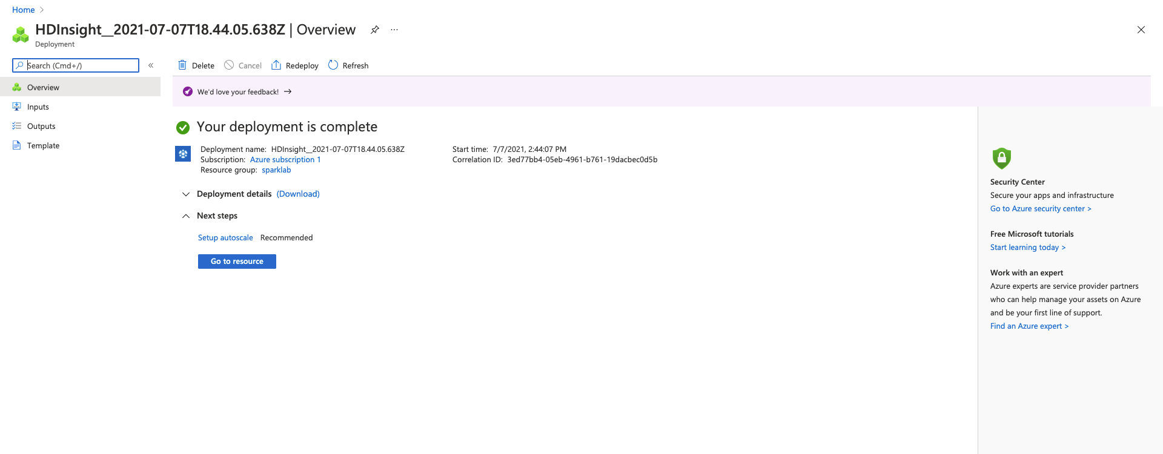
Successfully deployed Spark Cluster

