Slide 1


SMART INDIA HACKATHON 2026
• Problem Statement ID – SIH26100
• Problem Statement Title -
Project SATYAM
AI-Powered Integrated Bid Compliance Verification Platform for GeM
Procurement
• Theme - GovTech / Smart Procurement
• PS Category - Software / AI-Powered Decision Support
• Team ID -
• Team Name (Registered on portal) - Techy Pirates
1

Slide 2
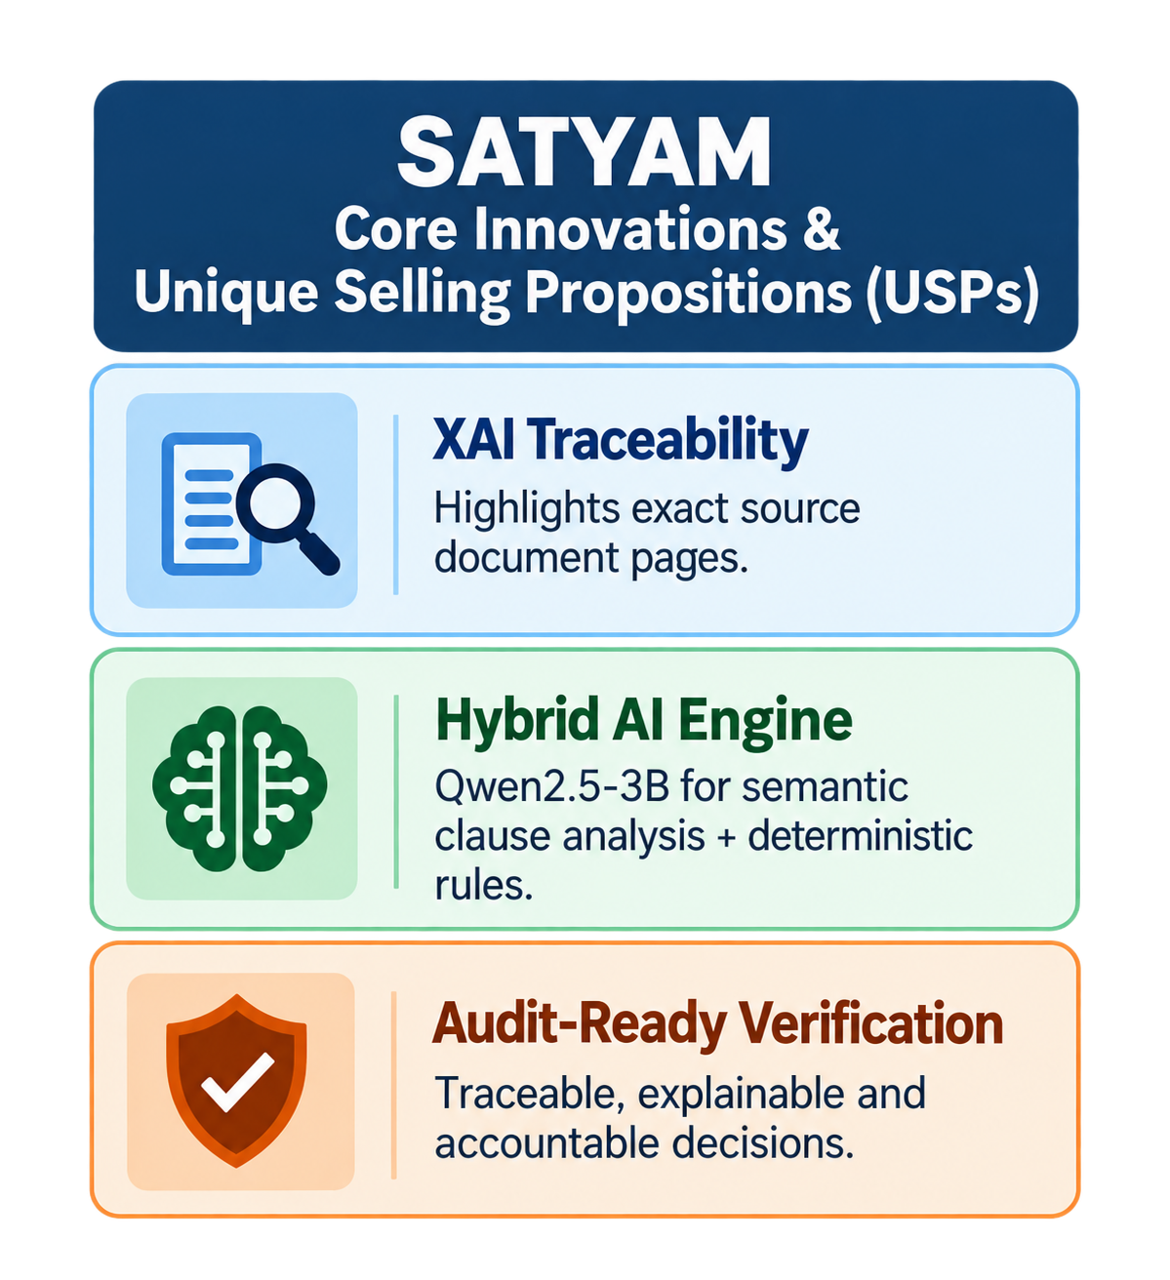
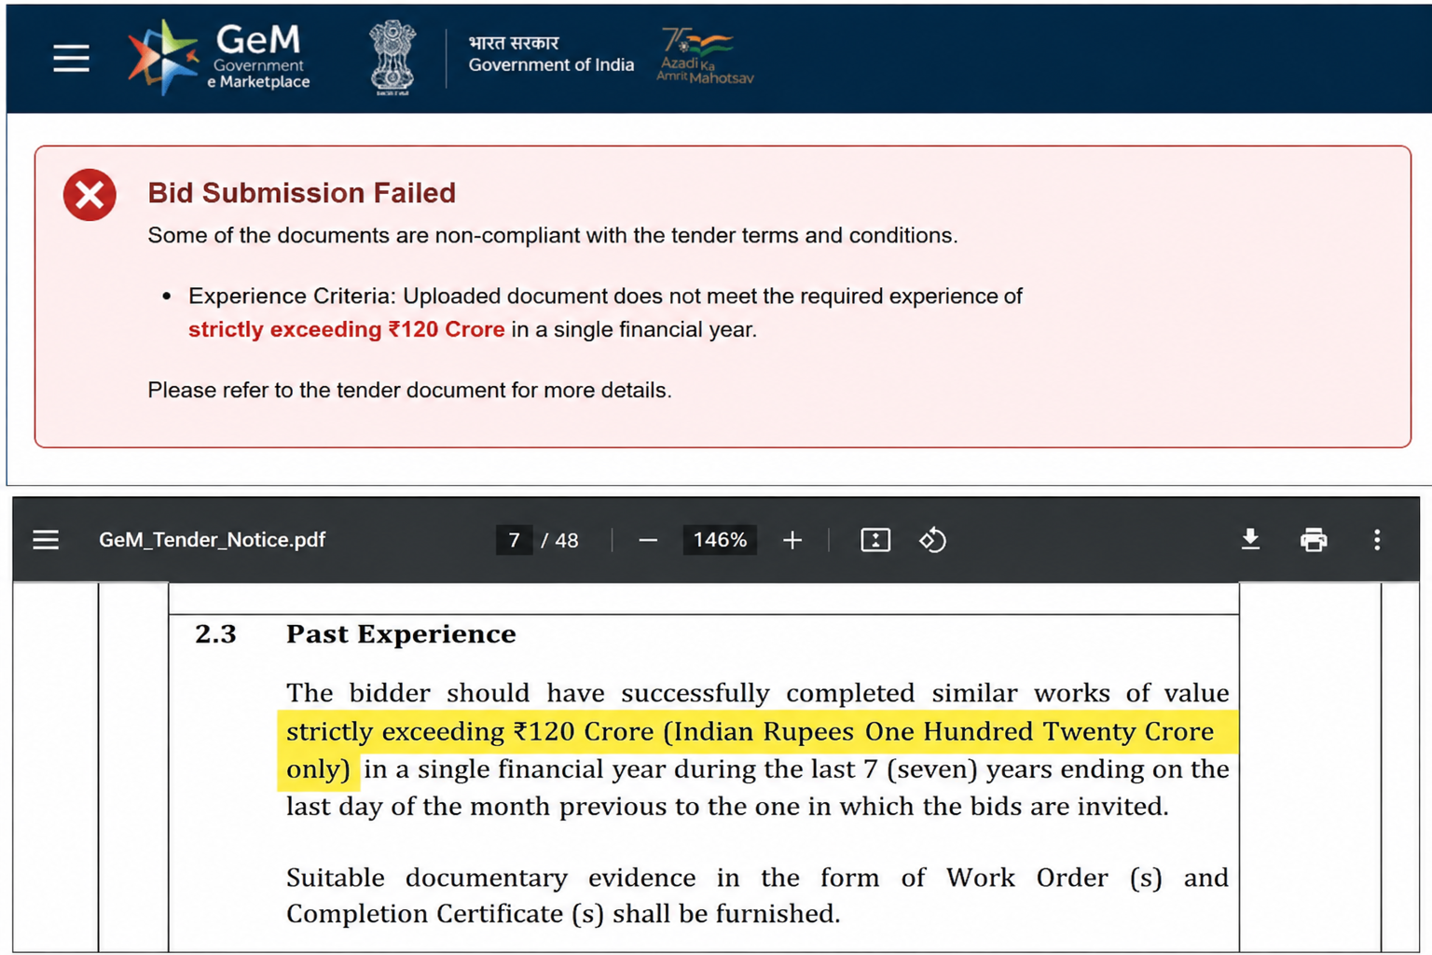
SATYAM : An intelligent compliance and verification layer built around the GeM procurement ecosystem
Real-world issue:
Manual verification of GeM bids requires officers to inspect multiple documents and tender clauses, causing delays, inconsistent decisions and missed compliance risks.
Why important: India risks ₹10,000+ crores annually in financial leakage from compliance errors, while evaluation bottlenecks severely stall critical national projects.
Solution:SATYAM automates document extraction and compliance checks, reducing verification time while providing explainable results for officer review.
@SIH Idea submission- Template
2

Slide 3
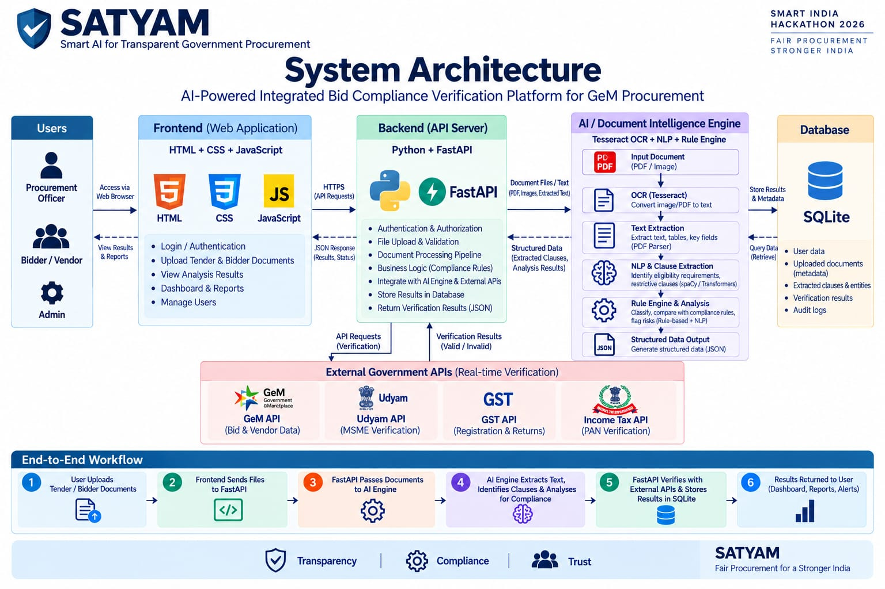
TECHNICAL APPROACH
Core System Advantages:
Zero-Latency Processing
Asynchronous FastAPI routing paired with a React SPA ensures instant, non-blocking UI updates for procurement officers.
Hybrid AI Pipeline
Fuses Tesseract OCR data extraction with deterministic rule engines to guarantee 100% explainable, audit-ready verdicts.
API-Ready GovTech Integration
DEsigned for secure integration with GeM,Udyam,GST and Income Tax veification API’s
@SIH Idea submission- Template
3

Slide 4
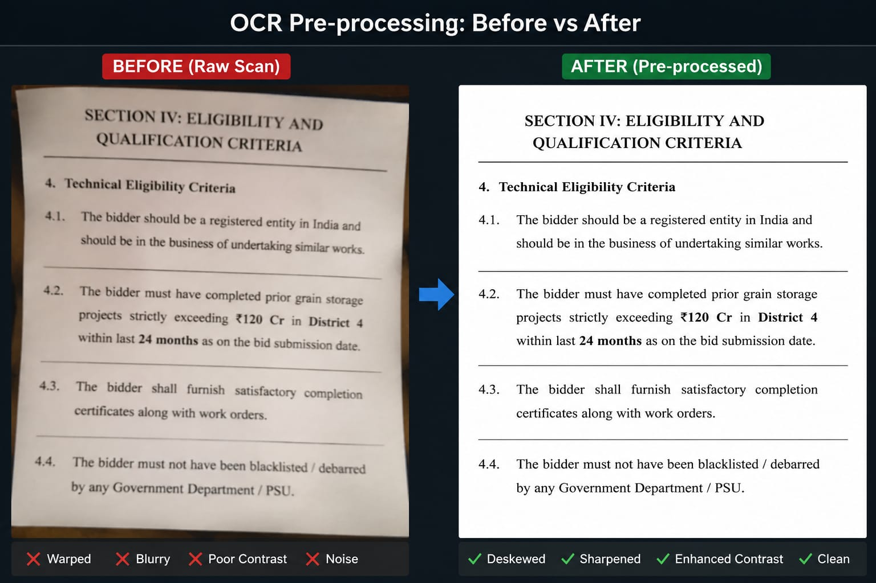
FEASIBILITY AND VIABILITY
TECHNICAL FEASIBILITY
Software-Only Architecture
No specialized hardware required.
Lightweight Processing
Modular document-processing pipeline designed for efficient deployment.
API-Ready Integration
Synthetic Mock API enables integration end-to-end testing without live GeM access.
CHALLENGES & MITIGATIONS
🔌 No Live GeM Access:Built a Synthetic Mock API Layer for testing.
📄 Scanned/Warped PDFs: Implemented Layout-Aware OCR Deskewing and binarization.
🧠 Ambiguous Clauses: Deployed Hybrid AI combining deterministic rules with NLP semantics.
🔐 Data Privacy: Secured via Localized RBAC (Role-Based Access Control) Encryption.
Document preprocessing improves OCR reliability on scanned tender PDFs
@SIH Idea submission- Template
4

Slide 5

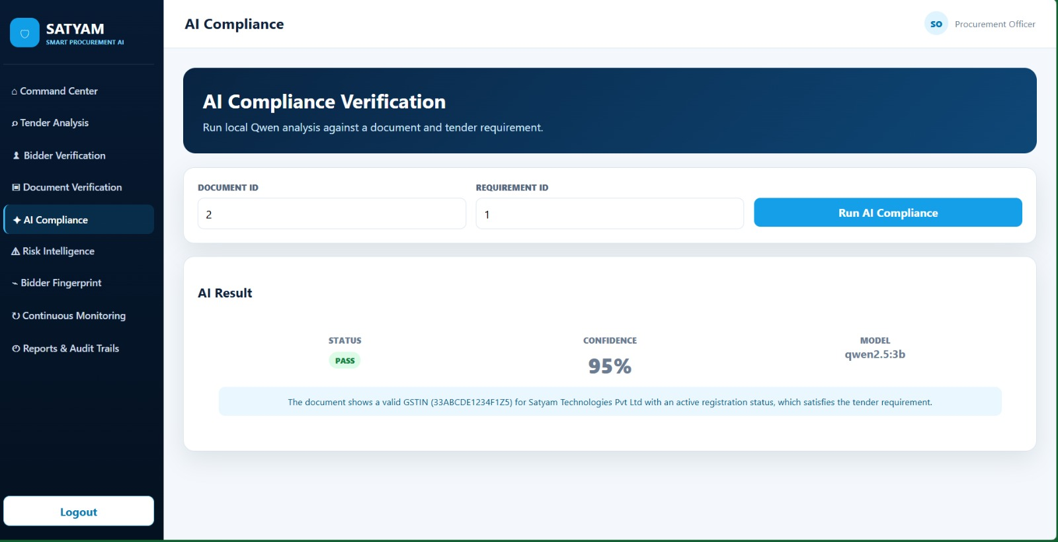



IMPACT AND BENEFITS
20-22% of GDP: Source: PIB, Ministry of Finance, 2022
₹5.03 Lakh Crore: GeM transaction volume processed in FY 2025-26.Source: GeM / Ministry of Commerce and Industry, April 2026
51+ lakh orders:
Source: GeM / Ministry of Commerce and Industry, via PIB, April 2026.
Core Value Pillars
83%
Processing Speedup (60 mins to 10 mins)
MSME Protection (Bias-free)
Audit-Ready Governance (Tamper-proof)
Bidder Digital Fingerprint (Cache history)
Post-Award Compliance (Continuous tracking)
"SATYAM doesn't just digitize documents—it transforms GeM procurement from a manual bottleneck into a transparent, high-speed national asset."
@SIH Idea submission- Template
5

Slide 6

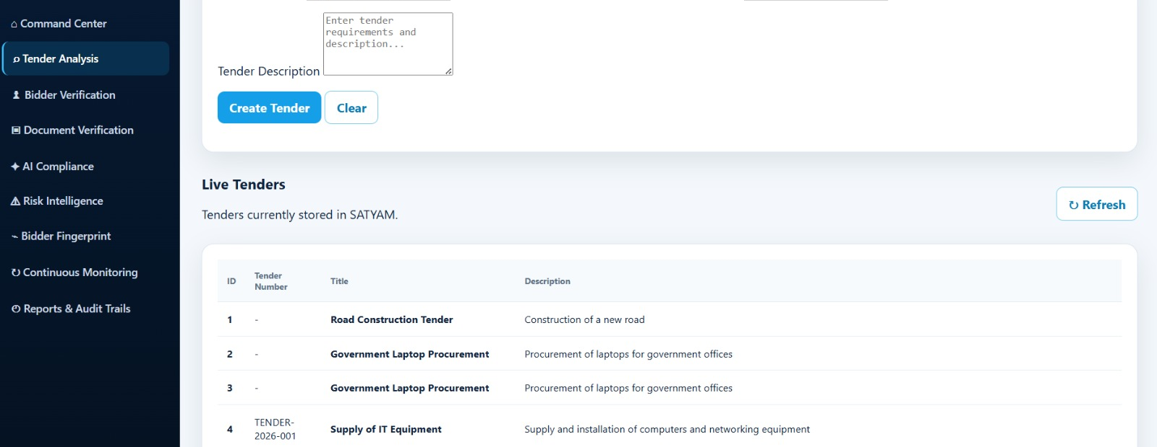
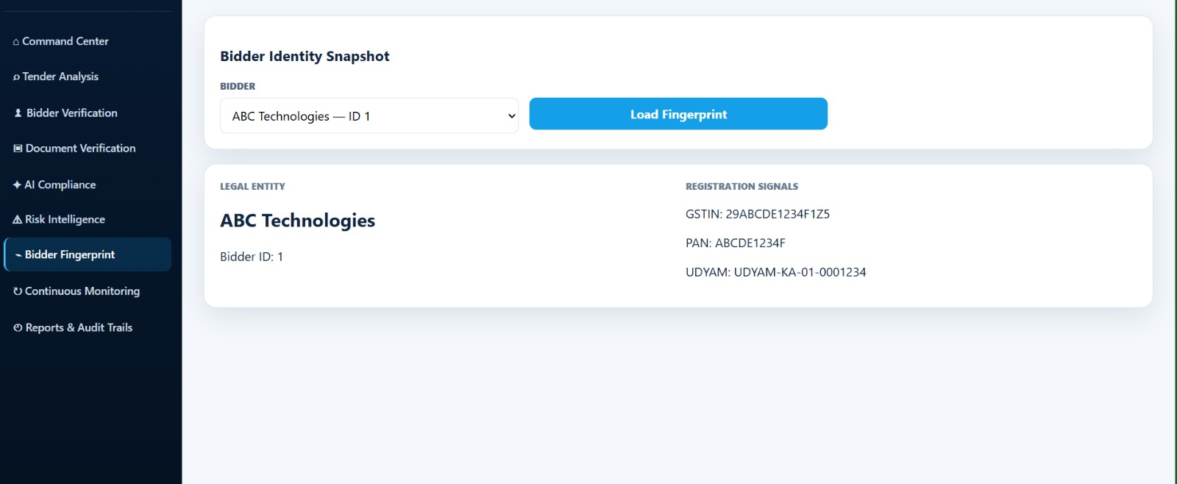
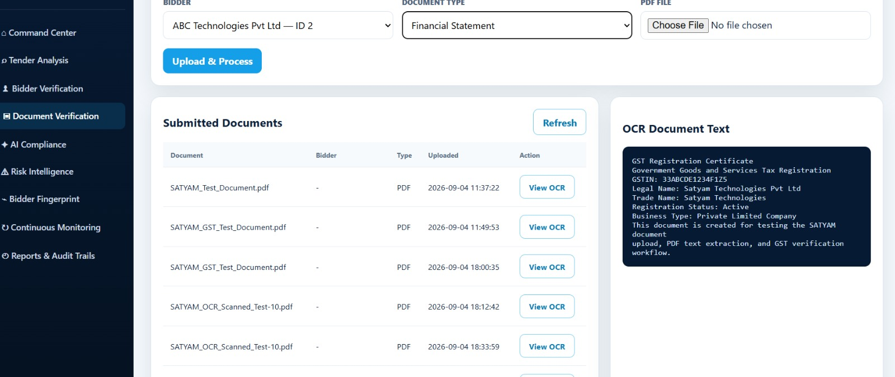
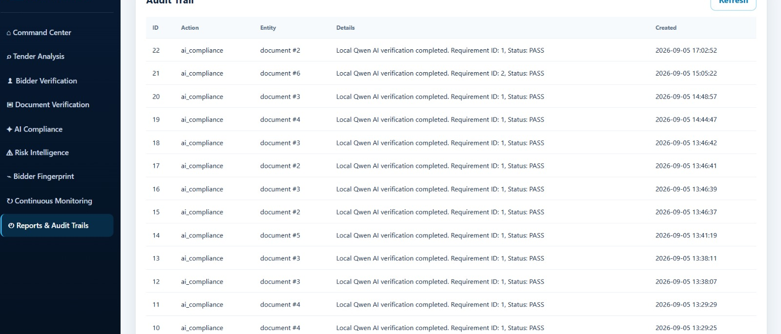
RESEARCH AND REFERENCES
Automated Clause Verification
Layout-Aware PDF Parsing
Zero Black-Box Auditability
Standardized API Alignment
Working Platform Deployment
GFR 2017:Manual for Procurement of Goods
[LINK]
Tesseract OCR & LayoutLM Architecture
[LINK]
NITI Aayog: Responsible AI for GovTech
[LINK]
GeM Portal v4.0 Data Schemas & API Specs
Restricted-access model — public APIs via API Setu (apisetu.gov.in)
Project SATYAM GitHub & Interactive Portal
[LINK]
LIVE PROTOTYPE UI
@SIH Idea submission- Template
6

