Slide 1
Wrapper of libsvm (klibsvm)
John K Lee

Slide 2
Klibsvm : Training process
All related class for libsvm process can be found under packages :
ksvm.run.*
For the training process, check below flow :
Prepare your training data. (ex. heart_scale)
Prepare your own record iterator to implement ksvm.data.IRecordIter.
You can refer to ksvm.data.BasicRDIter which support default libsvm training format:
<Label> <item1>:<value1> <item2>:<value2> …
Label : The class to predict. Ex. 1, 2…
item_{N}: The feature number. Ex. 1, 2… (Start from 1 not 0!)
value_{N}: The value of feature_{N}
Initial ksvm.run.SVMTrain object and pass your implemented IRecordIter into the constructor.
Call SVMTrain.start() to start training.
Call SVMTrain.saveModel() to save the training model for future usage without re-training.

Slide 3
Klibsvm : Predicting process
Once you have trained the model successfully, it is very easy for you to predict the class based on it. Please check below flow
Make sure you have ksvm.run.SVMTrain object which has already completed training or the external file as model being saved.
Create ksvm.run.SVMPredict object using below supported constructors:
public SVMPredict(SVMTrain train) // Using trained ksvm.run.SVMTrain object
public SVMPredict(svm_model model) // Using libsvm.svm_model object
public SVMPredict(String modelPath) // Using external file as saved model.
Then you can call SVMPredict.start(IRecordIter rdIter, File outputRst) to start predicting.

Slide 4
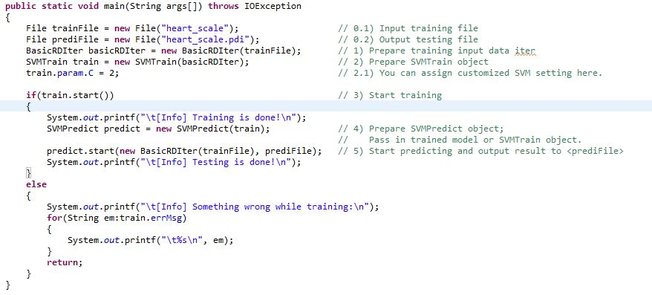
Klibsvm : Sample code

Slide 5
Klibsvm : Appendix
LIBSVM -- A Library for Support Vector Machines
[ klibsvm ] libsvm 的 Java wrapper
[ libsvm ] piaip 的 (lib)SVM 簡易入門

