Slide 1
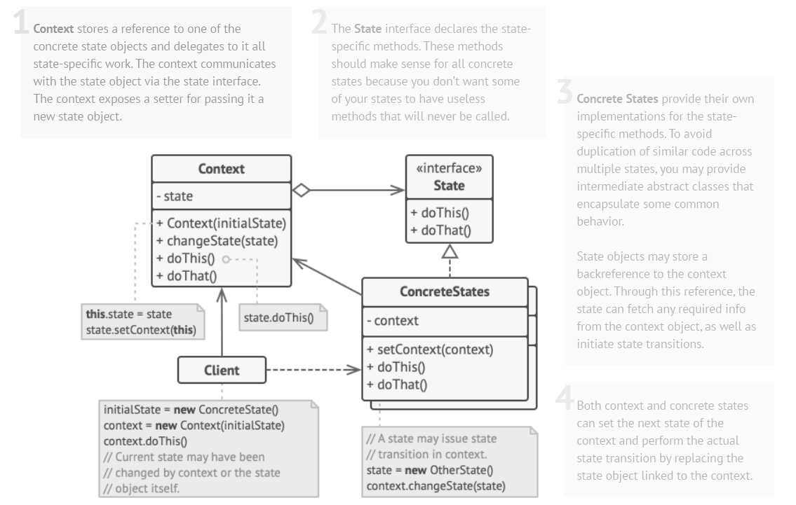
State is a behavioral design pattern that lets an object alter its behavior when its internal state changes. It appears as if the object changed its class. (source)

Slide 2
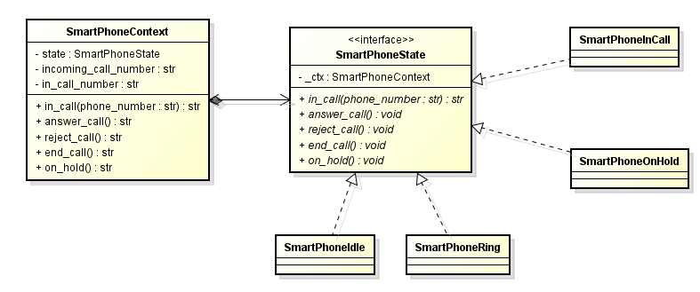
Regarding our smartphone refactoring (#2):

Slide 3
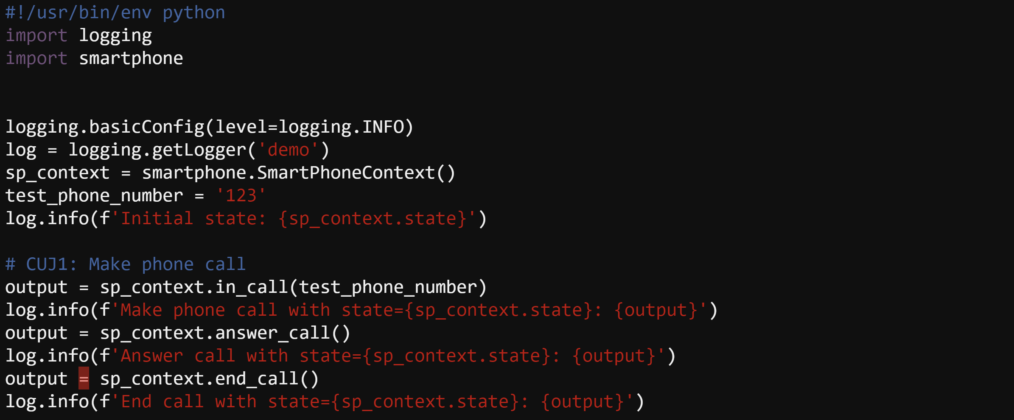
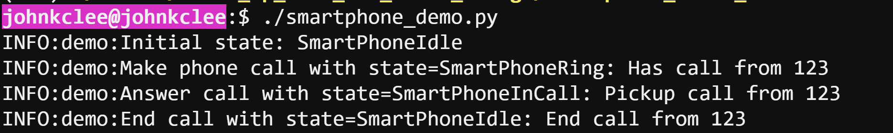
Regarding our smartphone refactoring (#2):

