Slide 1
Factory series
SimpleFactory
Factory method

Slide 2
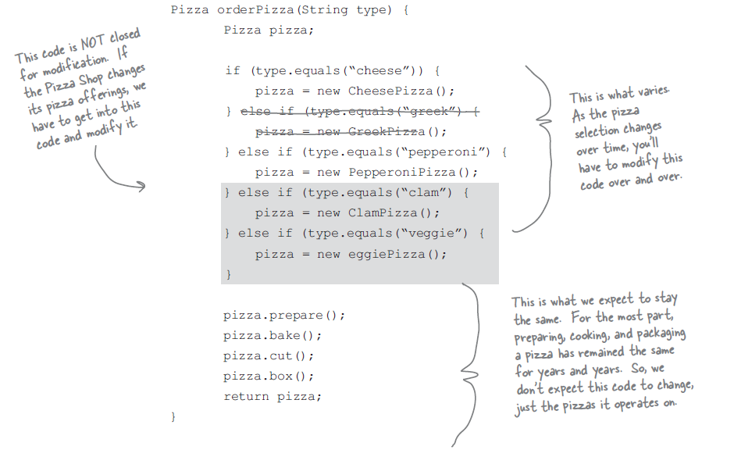
SimpleFactory

Slide 3
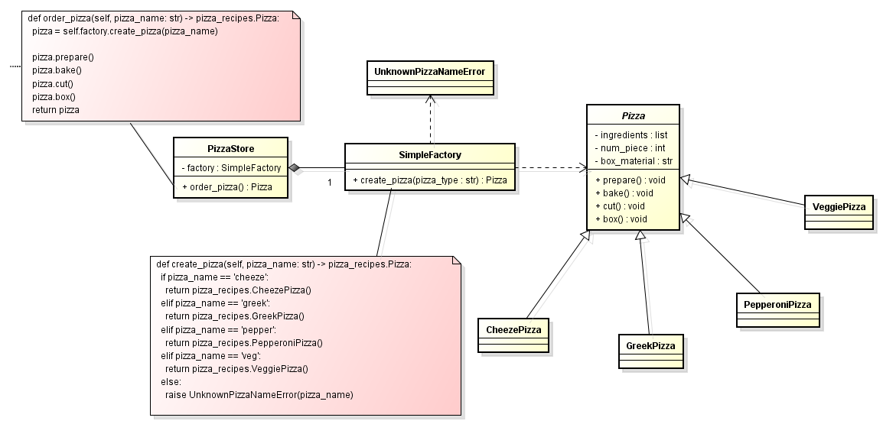
SimpleFactory

Slide 4
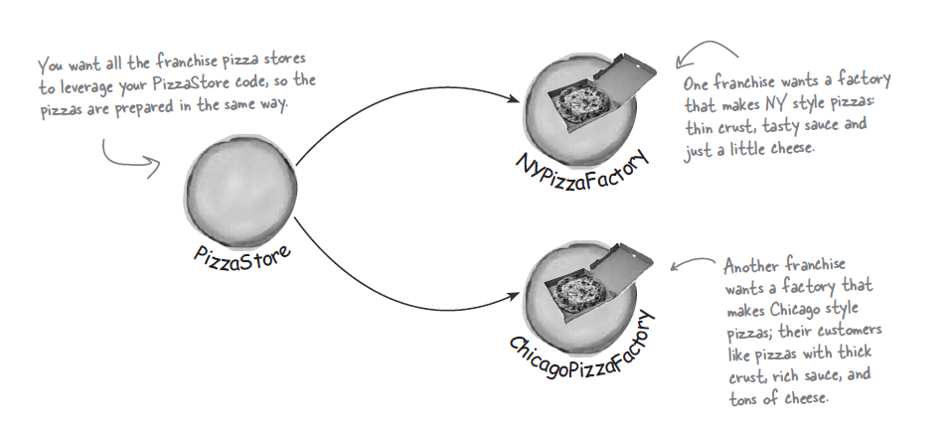
Franchise pizza stores

Slide 5
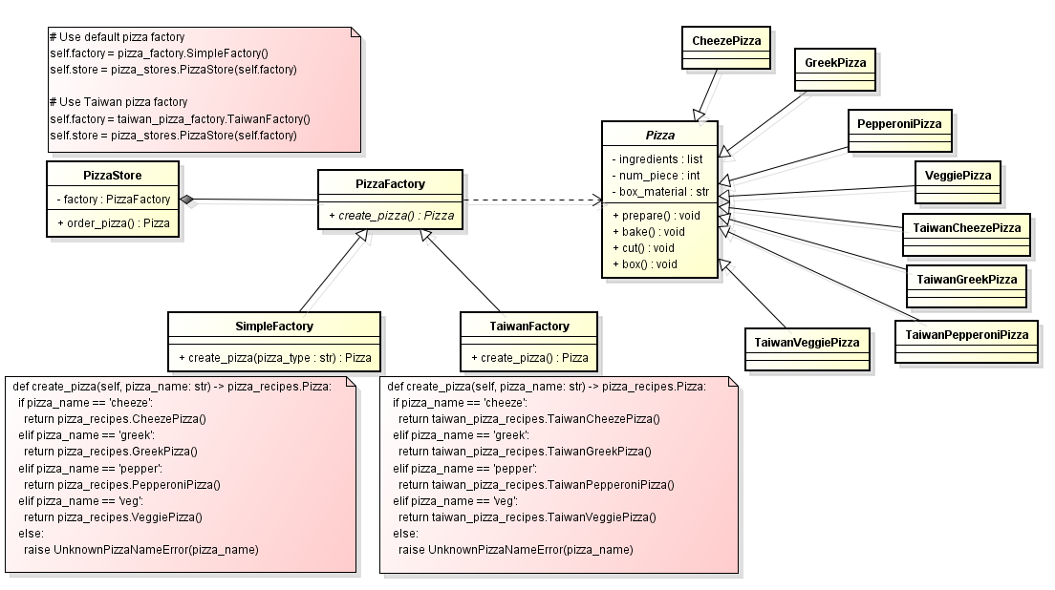
Franchise pizza stores (simple factory)

Slide 6
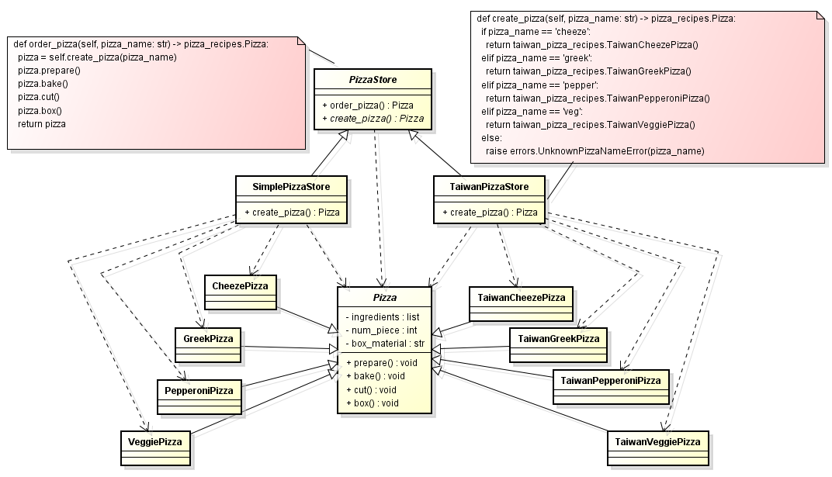
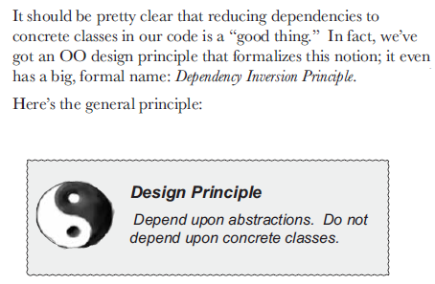
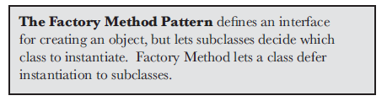
Franchise pizza stores (factory method)

Slide 7
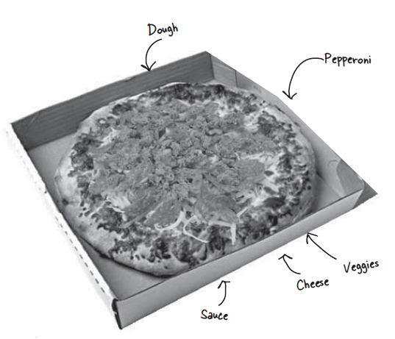
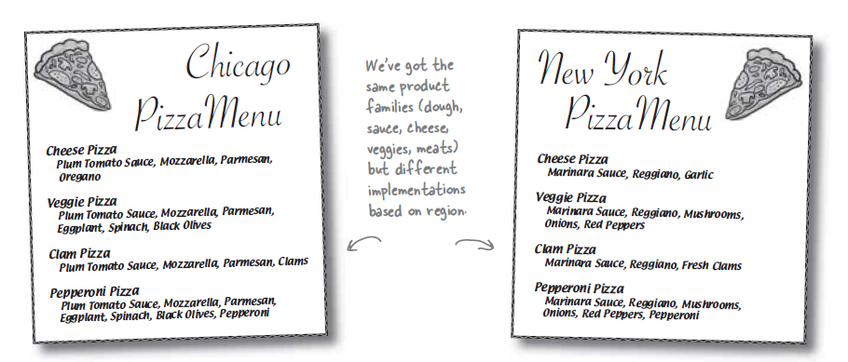
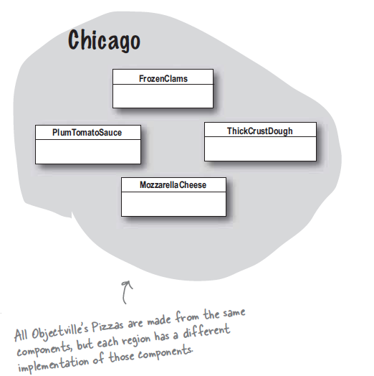
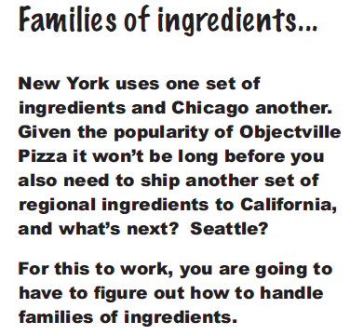
Franchise pizza stores with customized ingredients
PizzaIngredientFactory

Slide 8
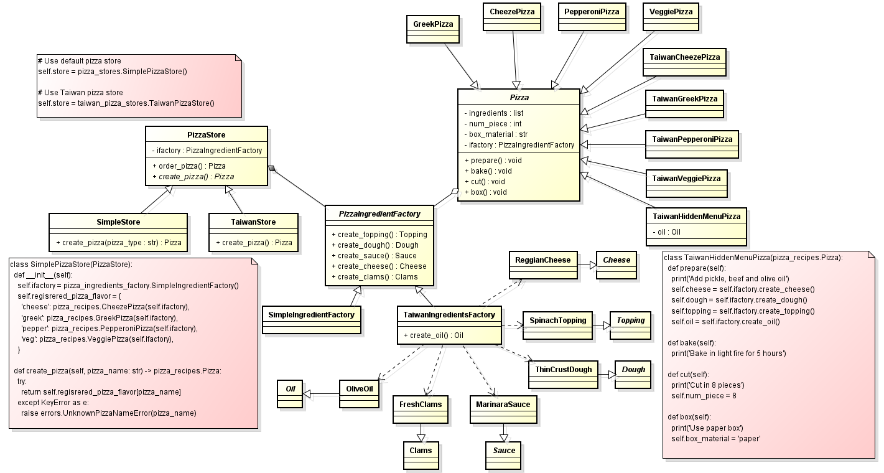
Franchise pizza stores with customized ingredients

Slide 9
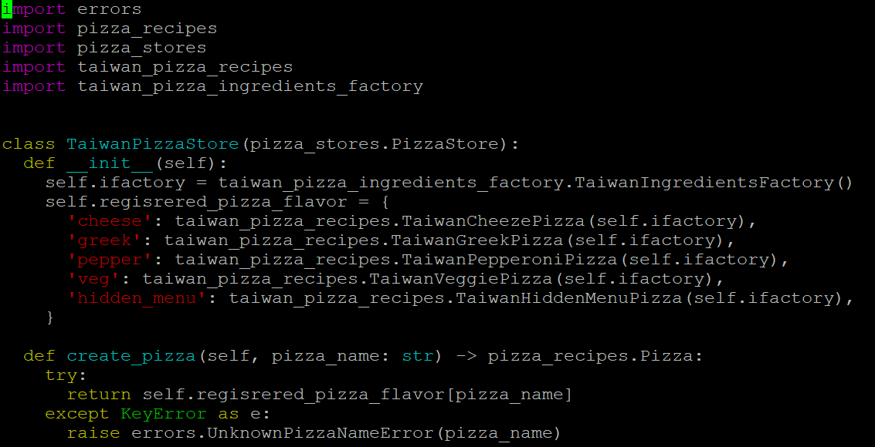
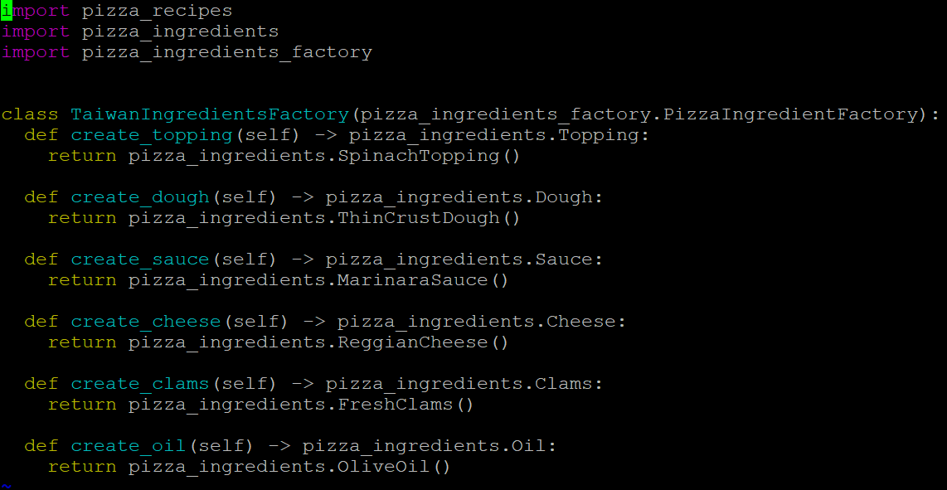
Taiwan pizza stores with customized ingredients

Slide 10
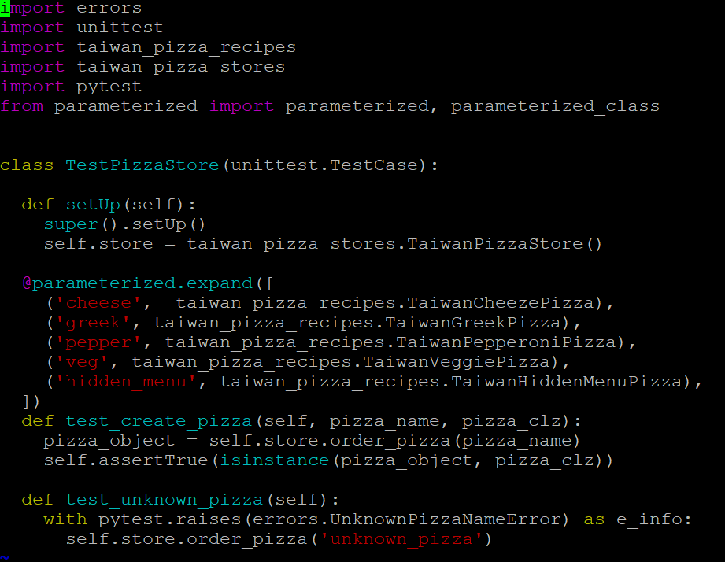
Taiwan pizza stores unit test
test_taiwan_pizza_store.py

Slide 11
Appendix
Refactoring Guru – Factory method
iT 邦幫忙 – Factory method
RealPython - The Factory Method Pattern and Its Implementation in Python

