Slide 1
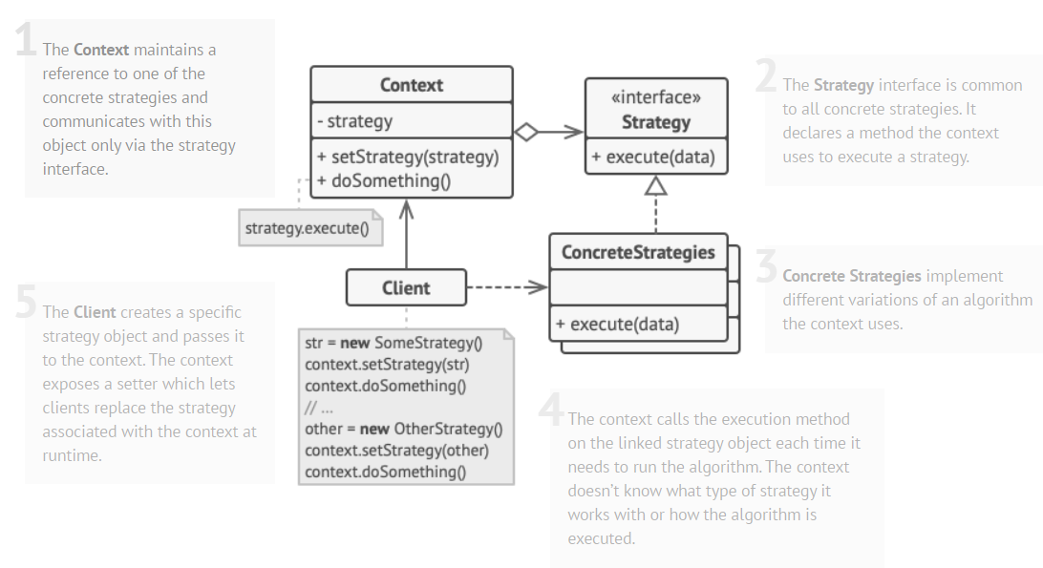
Strategy is a behavioral design pattern that lets you define a family of algorithms, put each of them into a separate class, and make their objects interchangeable. (source)

Slide 2
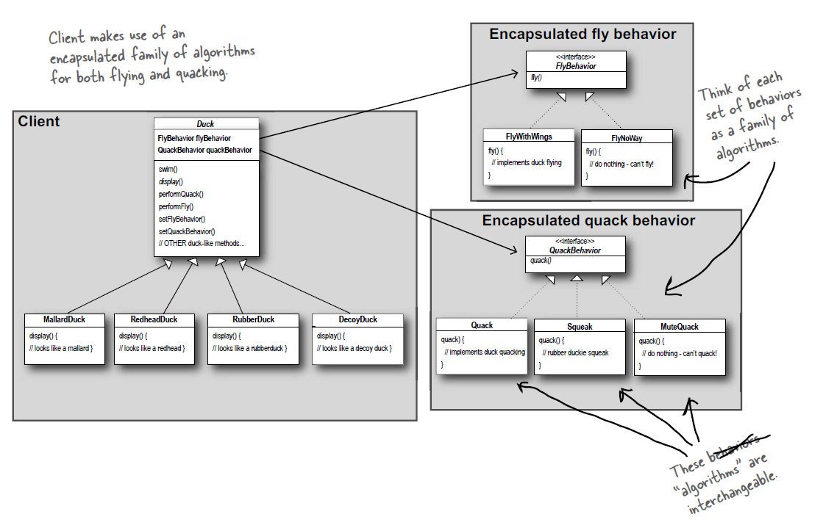
Regarding our smartphone refactoring (#3 & #4):
Image source
Headfirst Design Pattern

Slide 3
