Slide 1
Exploratory of techniques to deal with imbalanced dataset
Date: 2020/08/25
Reporter: John Lee

Slide 2

Goal
Imbalanced classification are those classification tasks where the distribution of examples across the classes is not equal. Many dataset example including Spam/Ham classification, Credit card fraud detection, Cancer prediction etc. the positive or abnormal case.
From this sharing, I plan to explore some well know techniques such as “Undersampling”, “Oversampling” and “Class weight” on the imbalanced dataset “Credit Card Fraud Detection” to see the impact on the performance of linear model LogisticRegression.
Next, I will use grid search to look for optimal hyperparameters and try on other popular models such as SVM and XGBoost.
Finally, I will list my viewpoint based on the experiment conducted here.

Slide 3
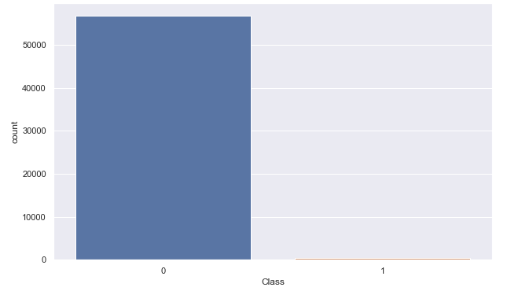
Data Set
The original dataset contains 284,315 rows for majority class (Class=0) and 492 rows for minority class (Class=1). In order to save my training time, I did uniform sampling to select 20% data from majority class and keep all data from minority class which leads to our target dataset with total 57,355 rows (majority class has 56,863 rows)
minority percentage=0.84%; majority percentage=99.16%
minority size is 0.85% of majority size
56,863
492
A classic imbalanced data set

Slide 4
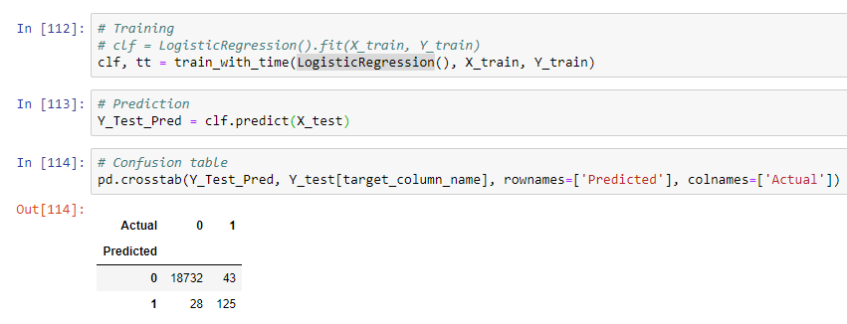
Baseline performance
With LogisticRegression, we can obtain our baseline performance (“lr_baseline”) as below:
56,863
Accuracy = 0.996248943364328
Precision = 0.8169934640522876
Recall = 0.7440476190476191
F1 Score = 0.778816199376947

Slide 5
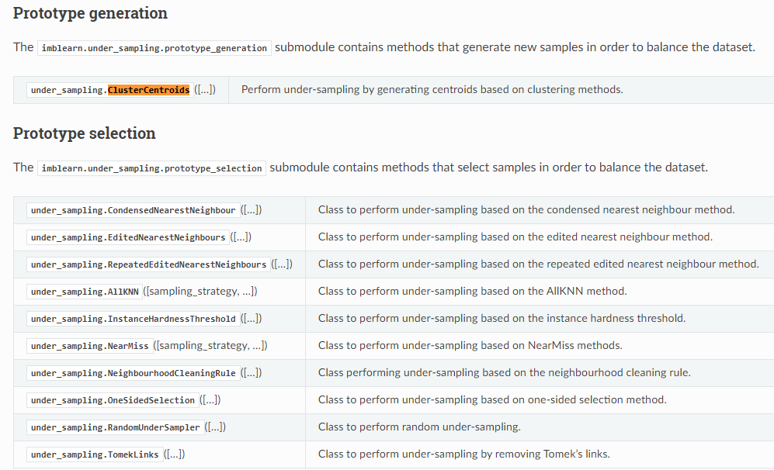
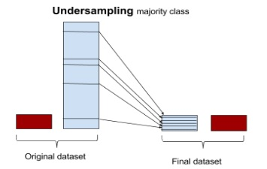
Part 1 – Undersampling
I take advantage of exist python package imblearn (imbalanced-learn API) to do undersampling/oversampling on our dataset. So far this package support below undersampling algorithms:
ClusterCentroids
TomekLinks

Slide 6
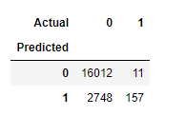
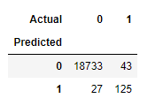
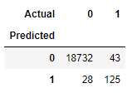
Part 1 – Undersampling
The performance doesn’t look so promising:
ClusterCentroids (lr_us_cc)
TomekLinks (lr_us_tl)
Baseline (lr_baseline)
Accuracy = 0.8542371090448013
Precision = 0.054044750430292596
Recall = 0.9345238095238095
F1 Score = 0.10218027985681744
Accuracy = 0.996301775147929
Precision = 0.8223684210526315
Recall = 0.7440476190476191
F1 Score = 0.78125
Accuracy = 0.996248943364328
Precision = 0.8169934640522876
Recall = 0.7440476190476191
F1 Score = 0.778816199376947
The “TomekLinks” hardly has any impact here. For “ClusterCentroids”, TP is improved from 125 to 157 (Recall 0.74->0.93); however, the FP is deteriorated from 28 to 2748 (0.81->0.05)!

Slide 7
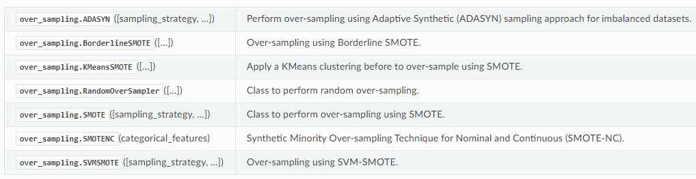
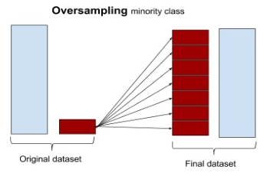
Part 1 – Oversampling
For oversampling, package support below overdersampling algorithms:
SMOTE
SVMSMOTE

Slide 8
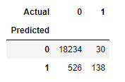
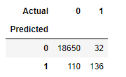
Part 1 – Oversampling
The performance doesn’t look so promising too:
SMOTE
(lr_smote)
SVMSMOTE
(lr_svmsmote)
Baseline
(lr_baseline)
Accuracy = 0.970625528317836
Precision = 0.20783132530120482
Recall = 0.8214285714285714
F1 Score = 0.3317307692307693
Accuracy = 0.9924978867286559
Precision = 0.5528455284552846
Recall = 0.8095238095238095
F1 Score = 0.6570048309178743
Accuracy = 0.996248943364328
Precision = 0.8169934640522876
Recall = 0.7440476190476191
F1 Score = 0.778816199376947
The oversampling will increase the total size of dataset (by enlarging the size of minority class to be the same as majority class) which may cause problem in training time. All in all, the recall can be improved by oversampling. However, precision metrics will be sacrificed.

Slide 9
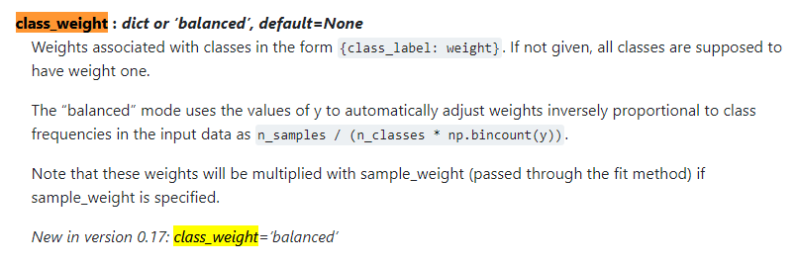
Part 1 – Class weight
Some model will support argument “class_weight” to adjust the relevant importance of each class during training. Take scikit-learn “LogisticRegression” for example:
The weight of minority class will be larger than majority class‘s weight

Slide 10
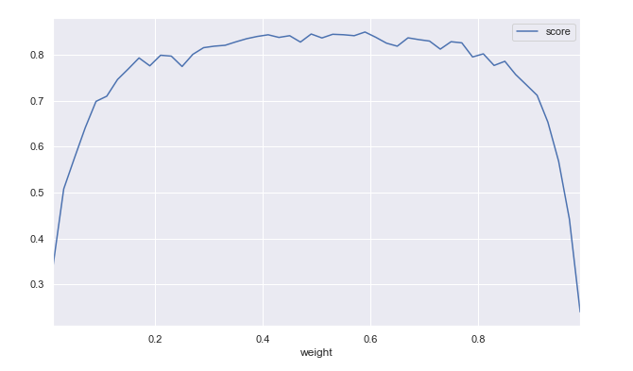
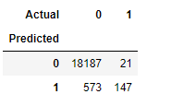
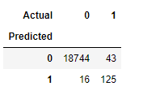
Part 1 – Class weight
The performance looks ok now:
Class weight
(lr_cw)
Grid search Class weight
(lr_cw_grid)
Baseline
(lr_baseline)
Accuracy = 0.9686179205409975
Precision = 0.20416666666666666
Recall = 0.875
F1 Score = 0.3310810810810811
Accuracy = 0.9968829247675401
Precision = 0.8865248226950354
Recall = 0.7440476190476191
F1 Score = 0.8090614886731392
Accuracy = 0.996248943364328
Precision = 0.8169934640522876
Recall = 0.7440476190476191
F1 Score = 0.778816199376947
We apply scikit-learn grid search to find the optimal setting of class_weight={0: 0.59, 1: 0.41} which can improve FP from 28 to 16 (Precision 0.81->0.88)

Slide 11
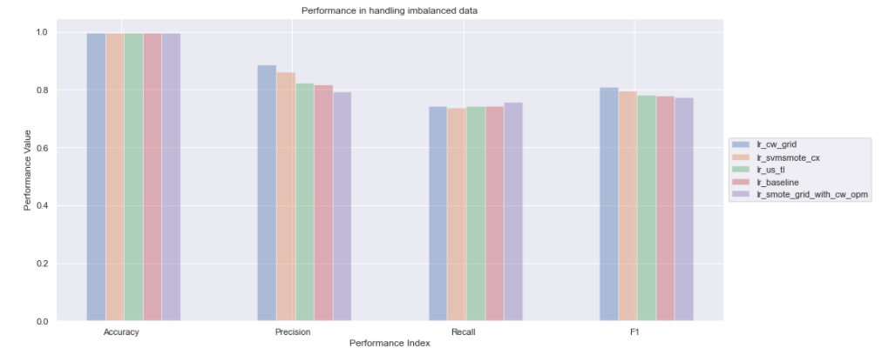
Part 1 – Class weight
Overall performance:
SMOTE (oversampling) + grid search to find best class weight has best recall.
Optimal class weight has best F1 score

Slide 12
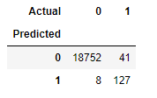
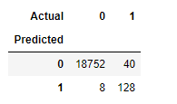
Part 2 – SVM
Every machine learning model has its’ limitation. Let’s try another two popular models “SVM” and “XGBoost” to see how they perform here. Firstly, let’s check SVM:
SVM
(svm)
SVM + SVMSMOTE + Class weight
(svm_cx)
Baseline
(lr_baseline)
Accuracy = 0.9974112426035503
Precision = 0.9407407407407408
Recall = 0.7559523809523809
F1 Score = 0.8382838283828383
Accuracy = 0.9974640743871513
Precision = 0.9411764705882353
Recall = 0.7619047619047619
F1 Score = 0.8421052631578947
Accuracy = 0.996248943364328
Precision = 0.8169934640522876
Recall = 0.7440476190476191
F1 Score = 0.778816199376947
SVM can increase both Recall and Precision metrics and improve F1 score.

Slide 13
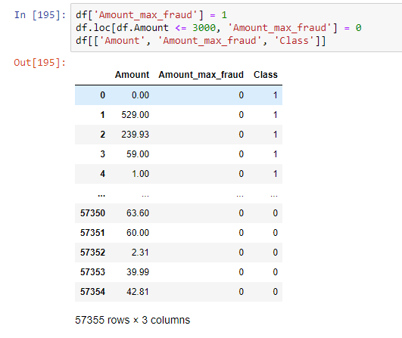
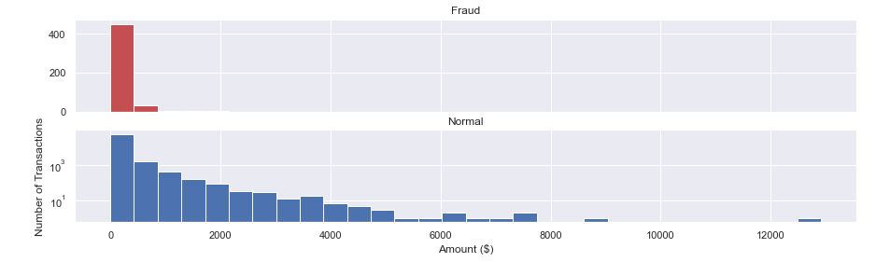
Part 2 – SVM (feature engineering)
Before moving to XGBoost model, let’s do one more thing to analyze our dataset to see if we can extract more features along the way. For number of traction on specific amount (source link):
Most fraudulent transactions are small amounts and less than 3000 roughly. So let's add one more feature here.

Slide 14
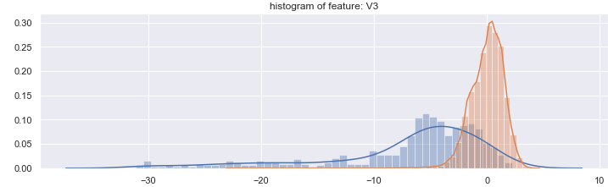
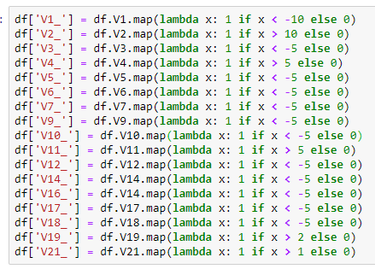
Part 2 – SVM (feature engineering)
More features
Most of data are normal
Most of the data are fraud
x=-5

Slide 15
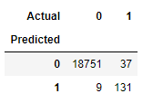
Part 2 – SVM (feature engineering)
Performance
SVM + SVMSMOTE + Class weight
(svm_cx)
SVM + SVMSMOTE + Class weight +FE
(svm_cx_fe)
Baseline
(lr_baseline)
Accuracy = 0.9974640743871513
Precision = 0.9411764705882353
Recall = 0.7619047619047619
F1 Score = 0.8421052631578947
Accuracy = 0.9975697379543533
Precision = 0.9357142857142857
Recall = 0.7797619047619048
F1 Score = 0.8506493506493507
Accuracy = 0.996248943364328
Precision = 0.8169934640522876
Recall = 0.7440476190476191
F1 Score = 0.778816199376947
The feature engineering features enhance Recall slightly.

Slide 16
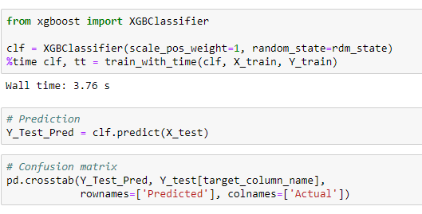
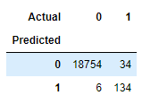
Part 2 – XGBoost
“XGBoost” will be our next and last model to check:
XGBoost
(xgb)
Baseline
(lr_baseline)
Accuracy = 0.9978867286559594
Precision = 0.9571428571428572
Recall = 0.7976190476190477
F1 Score = 0.8701298701298702
Accuracy = 0.996248943364328
Precision = 0.8169934640522876
Recall = 0.7440476190476191
F1 Score = 0.778816199376947
XGBoost can surpass other models without any grid search or feature engineering which is quite impressive!

Slide 17
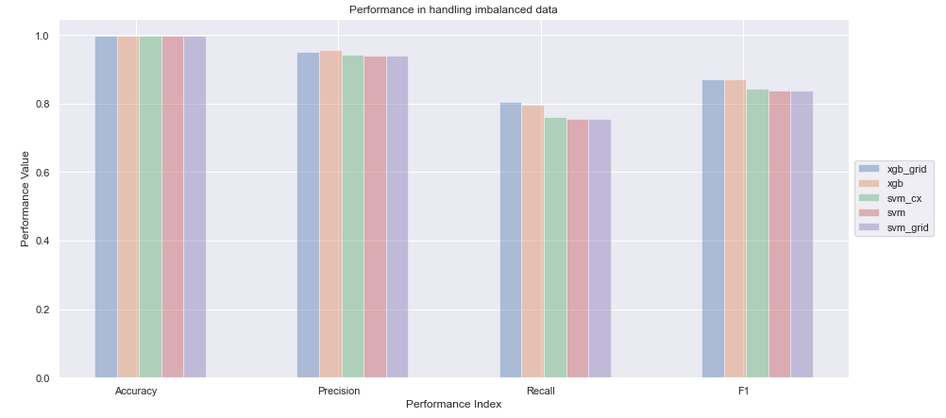
Part 2 – Top5 models based on F1 score
XGB is the best model we got so far.

Slide 18
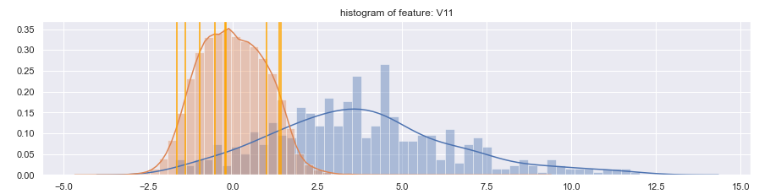
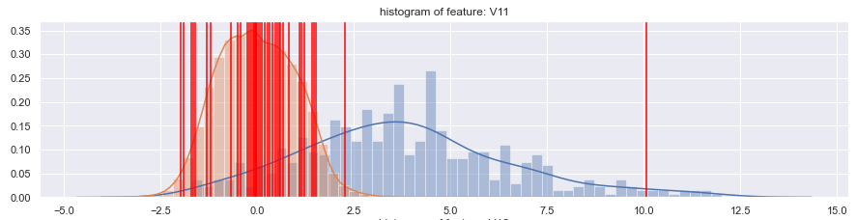
Error Analysis
FP distribution on Feature V11
FN distribution on Feature V11

Slide 19
Lesson Learned
Undersampling/Oversampling can help us to improve recall. But it also may deteriorate precision too.
Grid search is helpful. But it will increase the cost of training time.
Feature engineering is one kind of art and you need plenty of time to explore to data in order to find useful feature(s).
Error analysis can be helpful too to know the propensity of FP and FN and find out some possible random/system errors (wrong labeling)
A powerful model can some how more have more impact on the performance significantly and efficiently.

